Slide 1

Team Spirit
Team Leader Name: Bharani Kumar
Team Leader Mobile Number: 9705639722
Team Leader Email: bharanipasupuleti123@gmail.com
No. of Team Members: 3
Mentor Name: S Srinivas Reddy
Team Members Details : Prudvi Sai - 8309114910 , Prashanth - 9951060164
College Name: Vardhaman College of Engineering
1

Slide 2




  Climate & Ocean Intelligence: Conversational AI for Weather Forecasting, Alerts & Climate Information.
  THE PROBLEM
  Scattered Information: Weather and climate data is spread across PDFs, maps, portals and technical reports, making it difficult to access quickly.
  Accessibility Gap: English-heavy and technical information creates barriers for rural and non-literate users.
  Delayed Action: When warnings are difficult to understand or arrive too late, agriculture, coastal activities and disaster preparedness can be affected.
  Affected Sectors: Agriculture · Marine & Coastal · Disaster Management · Aviation · Urban Planning
Domain and Problem Statement
2

Slide 3
Idea/Solution
Voice-first platform turning weather data into plain-language advisories
Text / Voice
Query
Dual-Path
Router
Live Data
+ RAG
Domain Action
Engine
Voice Advisory
/ Alert
User
Core capabilities powering every step
Voice-First
Multilingual (BHASHINI)
Grounded RAG
Persona Actions
Live Weather APIs
Low-Connectivity Ready
3

Slide 4
Existing Vs Proposed System
Aspect | Existing Related Systems — IMD MAUSAM / Meghdoot | VayuVani — Proposed Solution
Example | Meghdoot: crop advisories. MAUSAM: location-based forecasts & warnings. | Farmer asks: “Will it rain tomorrow?” VayuVani gives one simple, combined answer.
User Interaction | App screens, forecasts, maps, warnings and advisories. | Ask by text or voice; get a conversational reply.
Information | Weather forecasts, warnings and agricultural advisories. | Combines live weather data with verified advisories for the question asked.
User Focus | MAUSAM: general users. Meghdoot: agriculture. | One interface for farmers, fishermen and disaster-response users.
Output | Forecasts, warnings and advisories. | Persona-specific guidance: crop advice, sea-safety info, risk alerts.
Key Difference | Established government weather and advisory services. | Conversational layer that retrieves and presents relevant information for the situation.
Example Output | Weather-based agricultural advisory. | “Rain expected tomorrow — you may delay irrigation.”
VayuVani Adds | — | Voice interaction + contextual Q&A + persona-specific guidance.
4

Slide 5
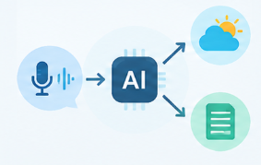
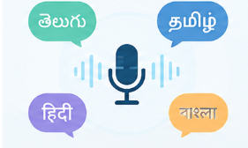


Innovation & USP
G
M
D
L
Grounded Query
Routing
Multilingual
Voice
Domain Action
Engine
Low-Connectivity
Access
Structured values + verified retrieval
Indian-language voice interaction
Weather context → actionable advisory
Built for limited connectivity
5

Slide 6
Objective & Scope of Solution
Objectives
Scope
Speed , Historical Weather & Climate Trends
Dual-Path Router
1
✓
Timely Alert Dissemination
BHASHINI Voice Pipeline
✓
Accessibility
2
3 Persona Workflows
✓
Voice, in local languages
Decision Support
IMD / INCOIS Integration
3
✓
Multi-sector, actionable guidance
6

Slide 7
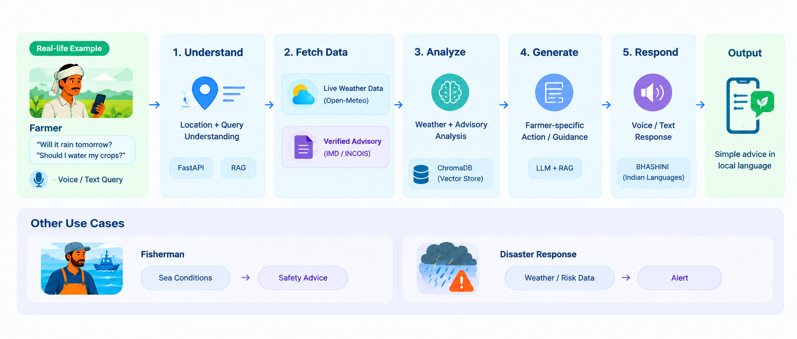
System Architecture
RAG
7

Slide 8

Resources Required
• Python
• FastAPI
• LLM + RAG
• ChromaDB
• Streamlit
• VS Code
• Git / GitHub
• Open-Meteo — weather data
• IMD — weather bulletins
• INCOIS — ocean/coastal information
• BHASHINI — Indian-language speech services
TECHNOLOGIES
TOOLS
DATA & RESOURCES
8

Slide 9
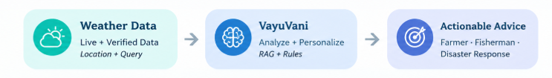
User Flow
1
2
3
4
5
6
Location + Query
Understand
Retrieve
Analyze
Respond
Alert
9

Slide 10
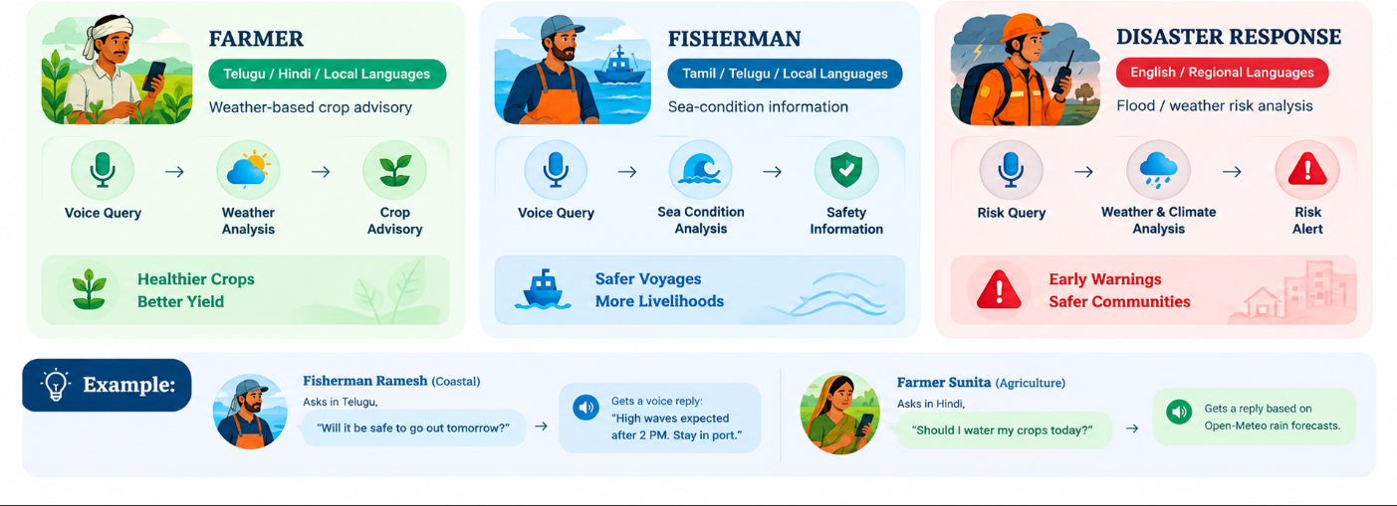
Persona Workflows & Impact
10

Slide 11
References
1. India Meteorological Department (IMD)
4. BHASHINI
Weather forecasts, warnings and MAUSAM services
Indian-language speech and language services
https://mausam.imd.gov.in/
https://bhashini.gov.in/
2. INCOIS
5. MAUSAM / Meghdoot
Ocean forecasts, marine information and advisories
Existing weather and agricultural advisory services
https://incois.gov.in/
https://mausam.imd.gov.in/
3. Open-Meteo
Weather Forecast API and historical weather data
https://open-meteo.com/en/docs
11

Slide 12

Thank You!
🌐 LIVE PROTOTYPE
Basic Streamlit Prototype — Core Features
vayuvani.app
Demonstrates selected core features of the proposed solution.
12

