Slide 1
Digital Portfolio
STUDENT NAME: BHARANITHARAN VA
REGISTER NO AND NMID:2428B0302
DEPARTMENT:B.SC COUMPUTER SCIENCE WITH DATA ANALYTICS
COLLEGE:KPR COLLAGE OF ARTS SECIENCE AND RESEARCH
UNIVERSITY:BHARATHIYAR UNIVERSITY

Slide 2
PROJECT TITLE
Peer Leader and Peer Learning Experience

Slide 3


AGENDA
Problem Statement
Project Overview
End Users
Tools and Technologies
Portfolio design and Layout
Features and Functionality
Results and Screenshots
Conclusion
Github Link
3/21/2024 Annual Review

Slide 4

PROBLEM STATEMENT
Many students find it difficult to present their skills, projects, and certifications in a structured manner.
Traditional resumes often fail to highlight practical knowledge and technical expertise.
Recruiters face challenges in evaluating the true potential of candidates without a detailed showcase.
A digital portfolio is needed to create a clear, accessible, and professional representation of student achievements.

Slide 5

PROJECT OVERVIEW
This project aims to develop a digital portfolio platform that displays a student’s skills, academic details, certifications, and projects.
It will act as a bridge between students and recruiters, improving placement opportunities.
The portfolio highlights creativity, technical skills, and problem-solving abilities through a professional design.
The system is simple, responsive, and customizable for different user needs.

Slide 6

WHO ARE THE END USERS?
Students: To showcase skills, projects, and achievements in an organized manner.
Recruiters/Companies: To evaluate candidate profiles efficiently during placement or hiring.
Educational Institutions: To track student growth and enhance placement support.
Peers & Mentors: To collaborate, provide feedback, and inspire skill development.

Slide 7

TOOLS AND TECHNIQUES
Frontend: HTML, CSS, JavaScript, Bootstrap/React for UI.
Backend (if applicable): Node.js / Python Flask / Django.
Database: MySQL / MongoDB for storing student data.
Design Tools: Canva, Figma for portfolio layout design.
Version Control: Git & GitHub for code collaboration.
Hosting: GitHub Pages / Netlify / Vercel for deployment.

Slide 8
POTFOLIO DESIGN AND LAYOUT
Homepage: Introduction, photo, and contact details.
About Section: Education, skills, and career objectives.
Projects Section: Detailed description with screenshots and GitHub links.
Certifications: Industry-recognized achievements (TNSDC, Coursera, etc.).
Resume Integration: Downloadable CV in PDF format.
Responsive Design: Works on mobile, tablet, and desktop devices.
8

Slide 9
FEATURES AND FUNCTIONALITY
Easy-to-update sections for student achievements.
Searchable and filterable project showcase.
Interactive and user-friendly interface.
Responsive design with cross-browser compatibility.
Social media and GitHub integration.
Option for recruiters to contact students directly.

Slide 10
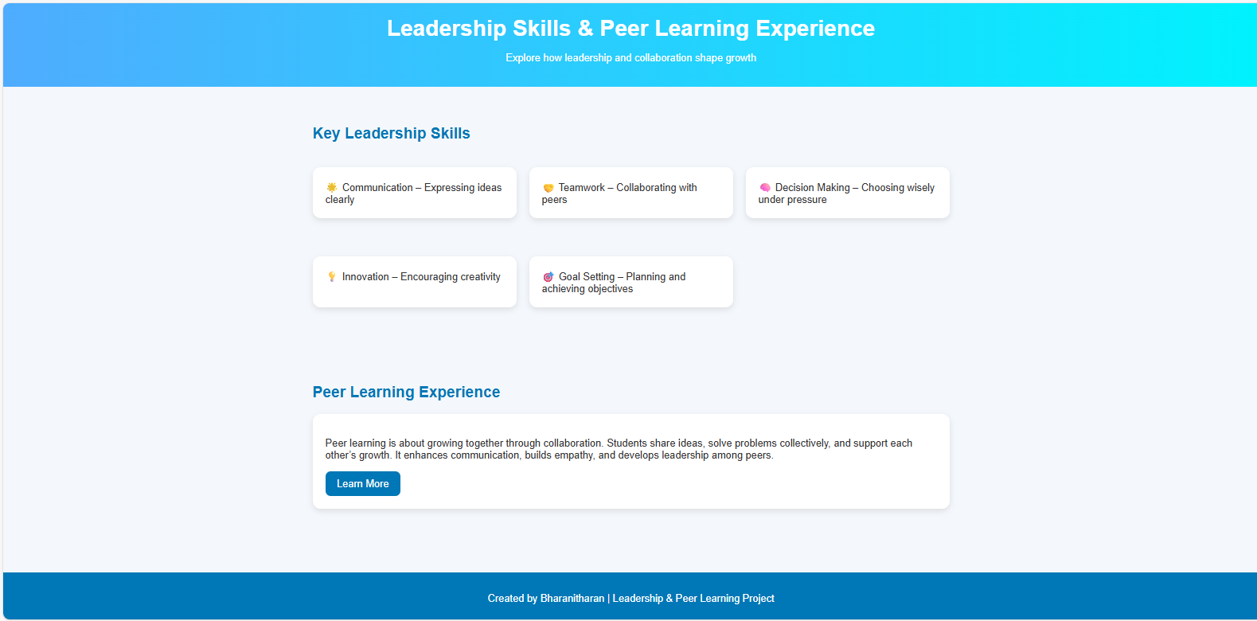

RESULTS AND SCREENSHOTS
Successfully created a live digital portfolio accessible online.
Integrated project showcase with code repositories.
Certificates and achievements displayed professionally.
Screenshots include:
Homepage with introduction
Projects page with details and GitHub links
Certificates and skills section
3/21/2024 Annual Review
10

Slide 11
CONCLUSION
The digital portfolio project enhances visibility, accessibility, and professionalism for students.
It provides recruiters with a comprehensive evaluation tool beyond resumes.
The platform builds confidence among students and supports career growth.
Future scope: Adding AI-based profile recommendations, resume analyzers, and recruiter dashboards.
11

Slide 12
GITHUB LINK
https://bharanitharan1107.github.io/bharanitharan/

