Slide 1

What is NETRA?
NETRA is a small USB device that you plug into a personal systems.
It sits between your device and the internet and watches all the network traffic going in and out.
If something looks suspicious — like a hacking attempt — it blocks it and shows you an alert.
NETRA
Network Security Device for
Public Wi-Fi
Plug-and-Play. No setup needed.
1 / 13

Slide 2


The Problem
Think about what happens when you connect to free Wi-Fi at a café or airport...
User on Public Wi-Fi
Someone is watching
Malicious — a fake hotspot
You connect to 'Free WiFi' without thinking twice.
An attacker on the same network can see your unencrypted data.
The hotspot itself is created by the attacker to trap users.
2 / 13

Slide 3
Why Public Wi-Fi is Risky
When you connect to public Wi-Fi, your device trusts the network.
But the network may not be trustworthy.
What MITM looks like
Your Device
Attacker
(in the middle)
Internet
Man-in-the-Middle (MITM) attack: attacker reads your messages and passwords
Fake hotspot: you connect to attacker's device thinking it's the real WiFi
Packet sniffing: all your unencrypted traffic is readable by others
Session hijacking: attacker steals your login session cookie
Attacker sees
everything you send
You don't get any warning that this is happening.
Most users don't even know these attacks exist.
3 / 13

Slide 4


What Do People Use Right Now?
There are some tools people already use for security. Let's quickly look at them.
VPN
Antivirus
Firewall
Encrypts your internet traffic by routing it through another server.
Scans files on your device to detect and remove malware.
Blocks or allows connections based on rules you set.
These are useful tools. But they have some important limitations when it comes to public Wi-Fi...
4 / 13

Slide 5
Why These Solutions Are Not Enough
Each of them has gaps — especially for a normal person on public Wi-Fi.
Solution
What it misses
Problem for normal users
VPN
Doesn't detect rogue hotspots or MITM in real time
Hard to set up, slows connection, paid plans needed
Antivirus
Only scans files, not live network packets
Won't help if you're on a fake hotspot
Firewall
Device-level only, no IDS, no alerts to user
Needs manual configuration, not plug-and-play
None of them give a real-time alert to a non-technical user in a simple, understandable way.
5 / 13

Slide 6

Our Solution — NETRA
We wanted something that works for everyone — not just tech-savvy people.
In short...
The idea is simple:
Public Wi-Fi
Plug NETRA into the router or use it as a hotspot
It monitors all network traffic automatically
Detects attacks like MITM or fake hotspots
Blocks the bad traffic using firewall rules
Shows alerts on a simple webpage — no app needed
NETRA (USB Device)
Your device (safe)
NETRA works in the middle —
watching, filtering, protecting.
6 / 13

Slide 7



How NETRA Works — Step by Step
Once you plug NETRA in, it does everything on its own. Here's the flow:
1. Plug In
2. Connect
3. Monitor
4. Detect
5. Alert
Connect NETRA to the router via USB
Your device connects through NETRA
NETRA watches all traffic in real time
Suricata IDS finds suspicious activity
You get a clear warning on the dashboard
No manual configuration. NETRA handles everything after the initial plug-in.
7 / 13

Slide 8

Hardware — What's Inside NETRA?
The device is built using a Raspberry Pi Zero 2 W — it's small, cheap, and powerful enough for this job.
Components used:
Why Raspberry Pi Zero 2 W?
Raspberry Pi Zero 2 W
Very small — fits in a pocket
Costs around ₹ 1800 only
Has built-in Wi-Fi
Can run Linux (Raspbian OS)
Enough CPU for Suricata IDS
Main processing unit. Handles all monitoring and detection.
USB OTG Adapter
Connects NETRA to the router or laptop USB port.
Wi-Fi Chip (built-in)
Used to create a protected hotspot for your device.
MicroSD Card
Stores the OS, software, and traffic logs.
Total estimated device cost: ~₹3200
8 / 13

Slide 9
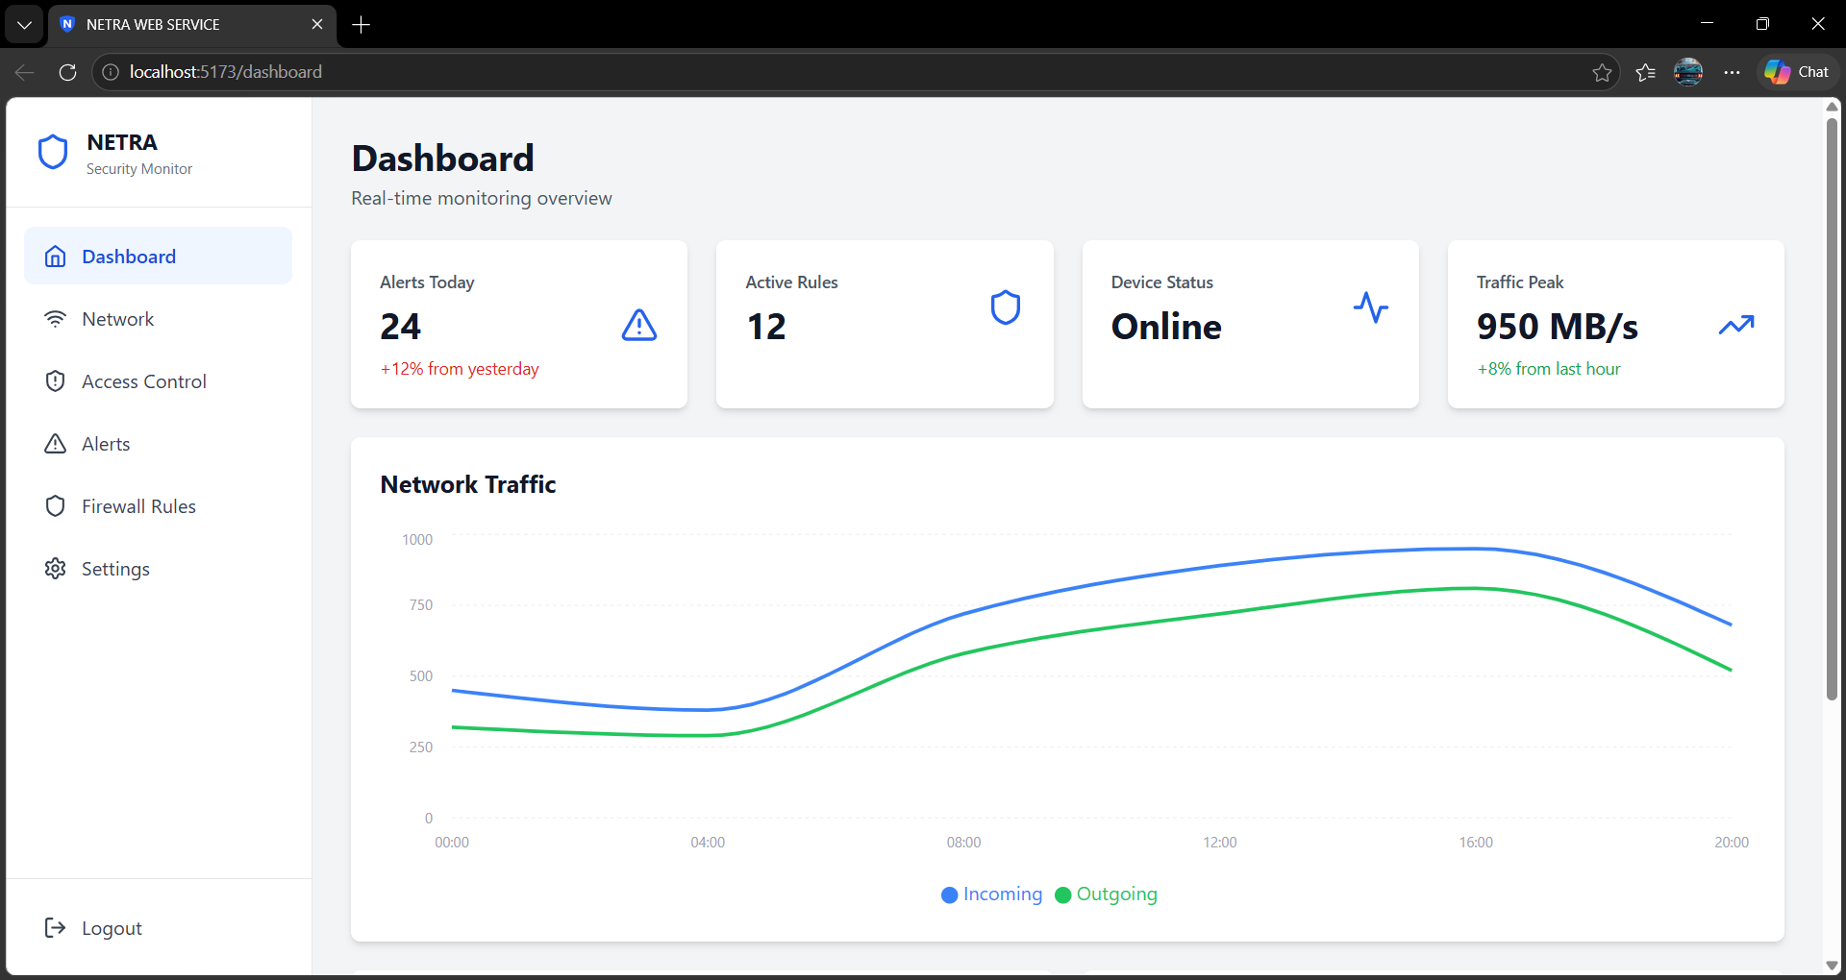
Software — The Dashboard
We built a simple local web dashboard. You just open a browser and go to 192.168.4.1 — that's it.
What you can see on the dashboard:
NETRA Dashboard
Live status — protected or not
List of all detected threats
Traffic logs with timestamps
Block/allow controls
Tech stack used:
Python Flask (web server)
HTML + CSS (front end)
SQLite (log storage)
9 / 13

Slide 10
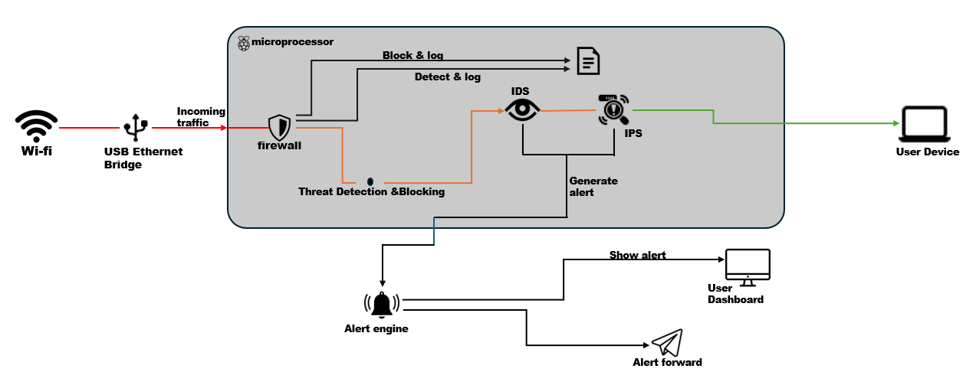
System Architecture
This is how all the parts of NETRA are connected and how data flows through the system.
10 / 13

Slide 11
BUSINESS MODEL CANVAS
Key Partners
Key Activities
Value Propositions
Customer Relationship
Customer Segments
Hardware suppliers
Manufacturers
Online marketplaces
Tech communities
Internet service providers
Cybersecurity firms
Electronics retailers
Product development
Security updates
Marketing & user acquisition
Prevents data theft on public Wi-Fi
Alerts before connecting to unsafe networks
Simple, no setup required
Affordable personal security
Easy plug-and-use experience
Regular updates for security
Freelancers using public Wi-Fi
Students working in cafes
Travelers using airport/public networks
Laptop users handling personal data
Key Resources
Channel
Hardware device
Security detection system
Development team
Online sales via Amazon, Flipkart
Tech communities & college demos
Cost Structure
Revenue Stream
Hardware production
Development & R&D
Marketing & distribution
One-time product sales
Future premium features
Bundled offers (student packs, etc.)
11 / 13

Slide 12

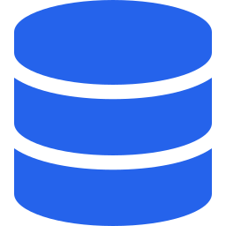
Key Features of NETRA
To summarise what NETRA can do:
Plug and Play
Real-Time Detection
Works for Normal Users
No software to install, no account to create. Just plug it in.
Suricata IDS catches attacks as they happen, not after the fact.
Plain English alerts. Simple dashboard. No technical knowledge needed.
Blocks Malicious Traffic
Traffic Logging
Portable & Affordable
iptables firewall drops bad packets before they reach your device.
Keeps a log of all activity. You can review it anytime.
Small as a pen drive. Total cost under ₹3200.
12 / 13

Slide 13
Why NETRA is Useful
A quick summary of what we built and why it matters:
Public Wi-Fi is used by millions of people every day — and most of them are not protected.
Existing solutions like VPN need technical knowledge and are not always affordable.
NETRA is a simple, plug-and-play device that anyone can use without any setup.
It detects and blocks real attacks in real time — not just scans for files.
NETRA
13 / 13

