Slide 1

My Scrap Kart An Android App
Team Members:
Bharat Banavalikar : 2BV14IS032
Anvita Bhat : 2BV14IS021
Apoorva Joshi : 2BV14IS022
Akshay Rao : 2BV13IS013
Guide:
Mr . Amit Gundad

Slide 2

Theme
Digitally transformed services in real time from online & mobile platforms

Slide 3

Problem Statement
To develop an Android Application for MyScrapKart company

Slide 4
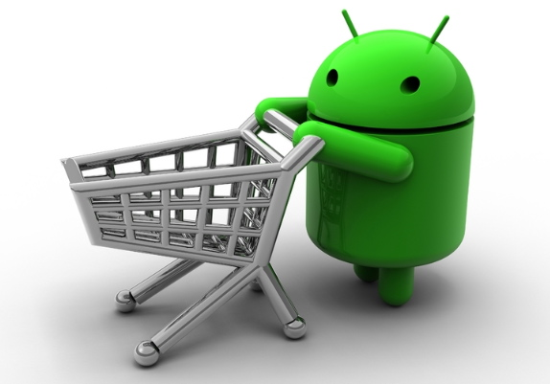
Industry Details
Industry name: MyScrapKart
Owner: Naveen Ullikashi
Description : MyScrapKart is the first online platform to sell scrap. They provide professional and reliable services. They use EMW (Accurate Weight) to provide right value for the scrap.

Slide 5
Introduction
Purpose
The purpose of this document is to present a detailed description of the MyScrapKart an android application. It will explain the purpose and features of the system, the interfaces of the system, what the system will do, the constraints under which it must operate and how the system will react to external stimuli. This document is intended for both the stakeholders and the developers of the system

Slide 6


Scope
The App shall be used in metropolitan cities to make a good use of scrap.
To make clean environment and the world a better place to live in.

Slide 7

Objectives
To sell the scrap materials that are produced at their locality.
To provide a transparent platform for selling the scrap.

Slide 8


Knowledge Required
Android
Mobile Business Intelligence

Slide 9
Overall Description
Product Perspective
The MyScrapKart application project is a product intended for use on the Android platform. While the MyScrapKart mobile application is the main focus of the project, there is also a server-side application to help the client company. The scope of the project encompasses both server- and client-side application functionalities, so both aspects are covered in detail within this document. Product Functions. The server side application refers to another android app which is used by the employee of MyScrapKart company who collects scrap,to ensure that the transaction has been completed.

Slide 10
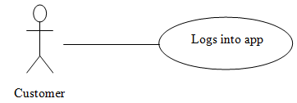
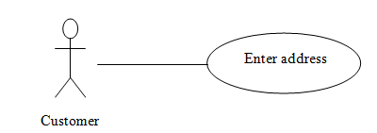
User Classes and Characteristics
Step 1: User logs on to the app.
Step 2: User selects or enters his/her address through map.

Slide 11
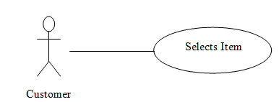
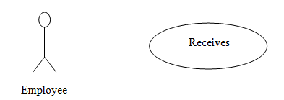
Step 3: User selects item from the app and press submit.
Step 4: Employee collects scrap materials from the users.

Slide 12
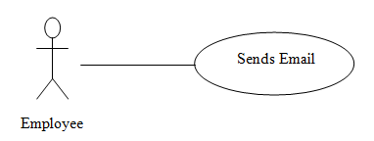
Step 5: Employee sends an email to the user giving details of the transactions.

Slide 13
Operating Environment
The main component of the MyScrapKart project is the software application, which will be limited to the Android operating system (specifically Android 4.3 and above). The application is not resource- or graphics-intensive, so there are no practical hardware constraints.
The app will rely on several functionalities built into Android’s Application Programming Interface (API), so ensuring appropriate usage of the API will be a major concern.
Beyond that, the application is a self-contained unit and will not rely on any other Android-related software components.
The database for the MyScrapKart application is hosted by the company using MySQL and is interfaced with a wrapper written in PHP 5.

Slide 14
Design and Implementation Constraints
The primary design constraint is the mobile platform. Since the application is designated for mobile handsets, limited screen size and resolution will be a major design consideration.
Creating a user interface which is both effective and easily navigable will pose a difficult challenge.
Constraints such as limited memory and processing power are also worth considering.
MyScrapKart is meant to be quick and responsive, so each feature must be designed and implemented with efficiency in mind.

Slide 15
User Documentation
The primary goal of MyScrapKart is to facilitate MyscrapKart company’s customers to sell their scrap.
Consequently, the application will be designed to be as simple to use as possible. Nonetheless, users may still require some supplementary information about each component of the MyScrapKart application.
So we are providing with the readme manual which will guide the user with our app.

Slide 16

User Interface
Page 1: Splash screen
Logo should appear in at center. Duration 3 seconds

Slide 17
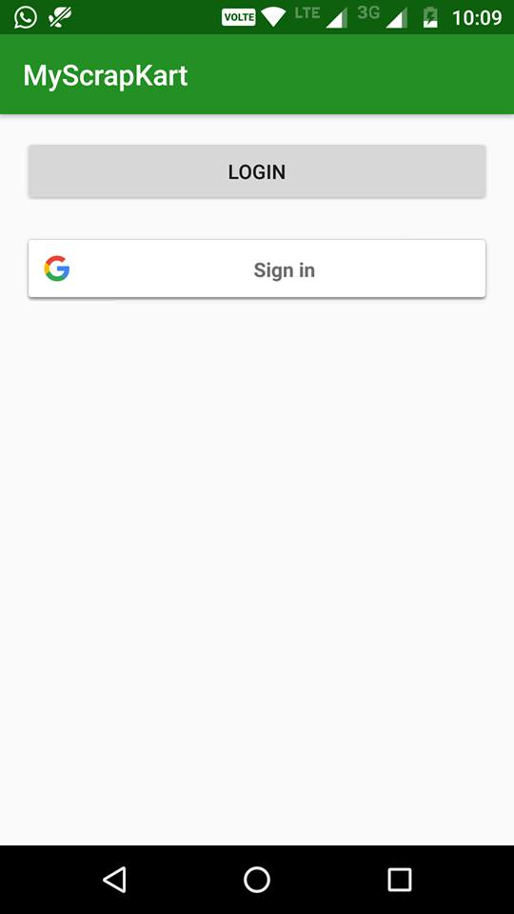
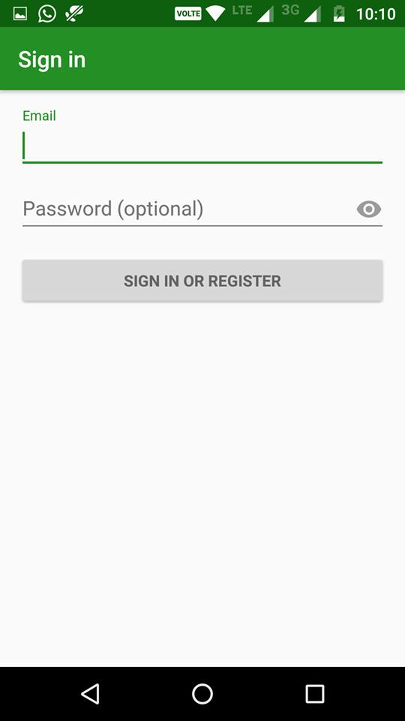
Sign up/LogIn

Slide 18
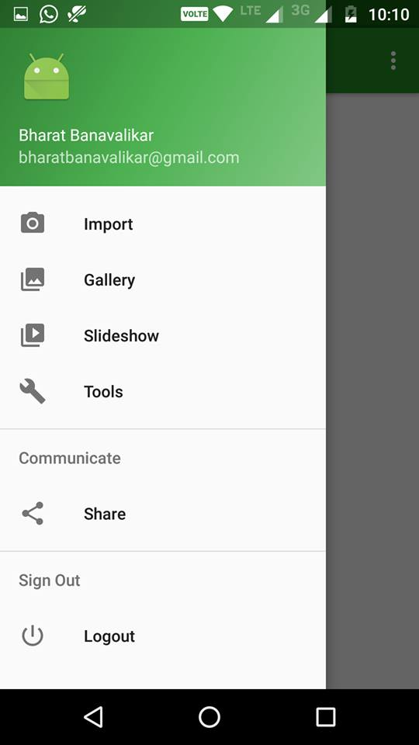
Menu bar

Slide 19
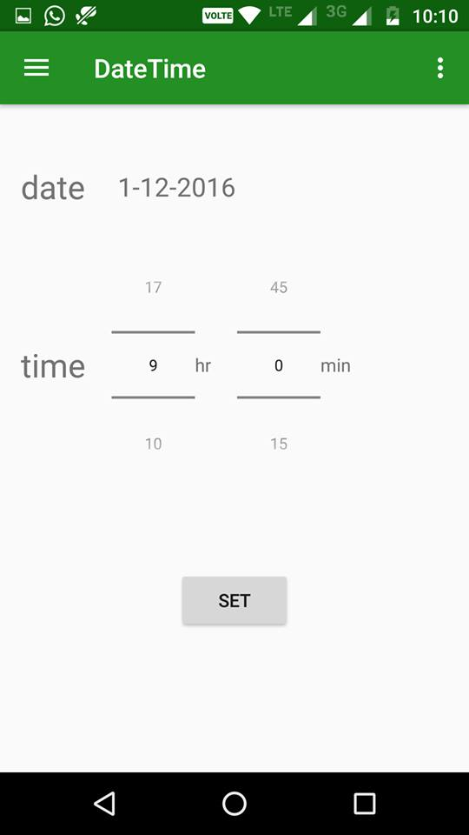
Date and time of pickup

Slide 20
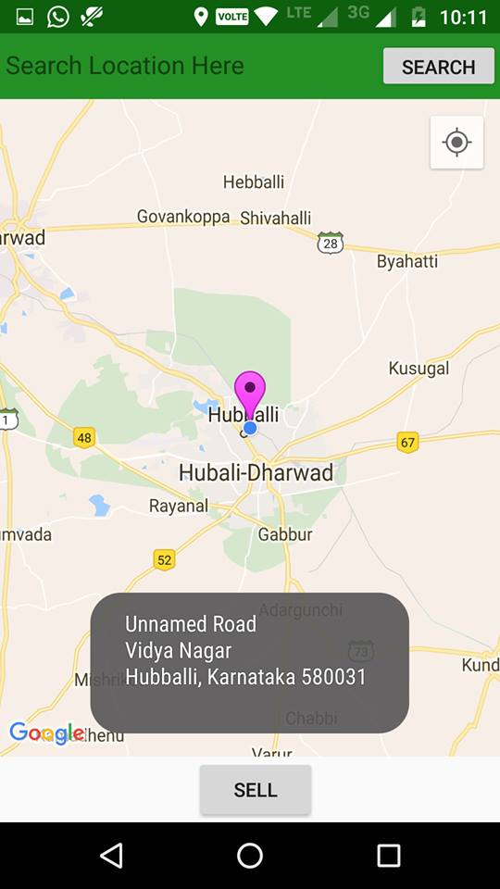
Update location for pickup

Slide 21
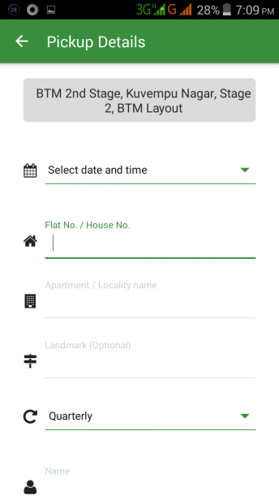
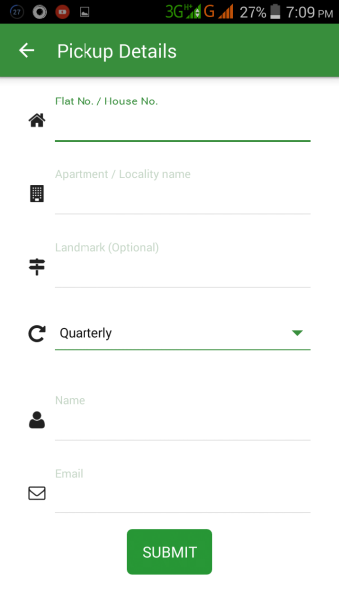
Submit button details

Slide 22
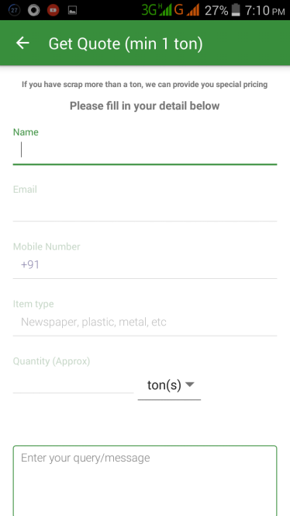
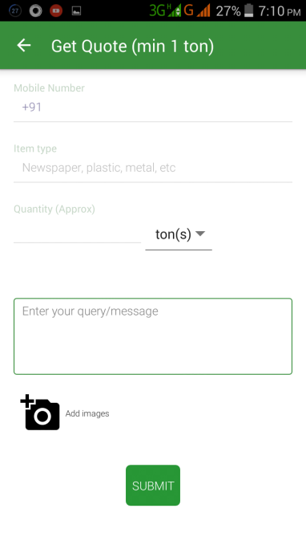
Quotation page

Slide 23
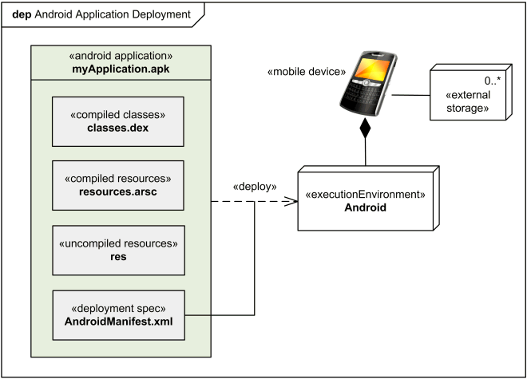
Hardware Interfaces

Slide 24
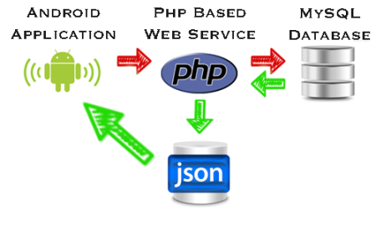
Database

Slide 25

Software Interfaces
Database: Company’s database hosted online.
API details hostname - mysql.hostinger.in database-u114678071_uat user- u114678071_uat password - root123

Slide 26
Software’s used | For Android Application Development we have chosen Android Studio(x64)
Operating system | Ubuntu(x64), Linux Mint(x64), Windows 7(x64)
Database | To save the Admin details, Patient details, remainders and family member details we have chosen Firebase Database.
XML | To implement the project we have chosen XML language for its more interactive support.

Slide 27
Nonfunctional Requirements
Performance Requirements
Performance should not be an issue because all of our server queries involve small pieces of data.
Changing screens will require very little computation and thus will occur very quickly. Updates to the database can be reflected quickly.
The user has very less interfaces so computation of changing screens will be very less too.

Slide 28
Safety Requirements
MyScrapKart will not affect data stored outside the company database nor will it affect any other applications installed on the user’s phone.
It cannot cause any damage to the phone or its internal components.
The only potential safety concern associated with this application applies to virtually all handset apps: MyScrapKart should not be used while operating a vehicle or in any other situation where the user’s attention must be focused elsewhere.

Slide 29

Requirements:
Android application with features as Google location, materials to sell and contact details of customer as well as an attractive UI.
Market competitors :
EnCashea
www.encashea.com
Communication summary:
We have contacted them through Emails and telephonic conversation.

Slide 30
Security Requirements
The user get access to app through signing up by providing necessary information or by logging in through gmail or facebook. Hence the application is secure. In users App the employee uses their Id for logging into the app.

Slide 31
Software Quality Attributes
The graphical user interface of Myscrapkart is to be designed with usability as the first priority. The app will be presented and organized in a manner that is both visually appealing and easy for the user to navigate.
There will be feedbacks and visual cues such as notifications to inform users of updates and pop-ups to provide users with instructions.

Slide 32
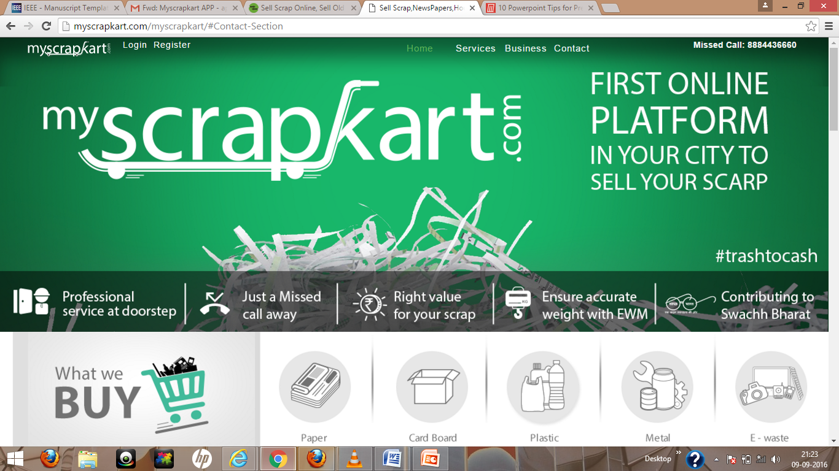
Website: www.myscrapkart.com

Slide 33


Additional features
Mobile Business Intelligence
The company will be given recommendations based on how much and what kind of scrap will be generated on what days.
Security There should not be any involvement of third party in buying and selling scrap. Therefore we will be providing Aadhaar authentication in that way only the owner can sell scrap.

Slide 34
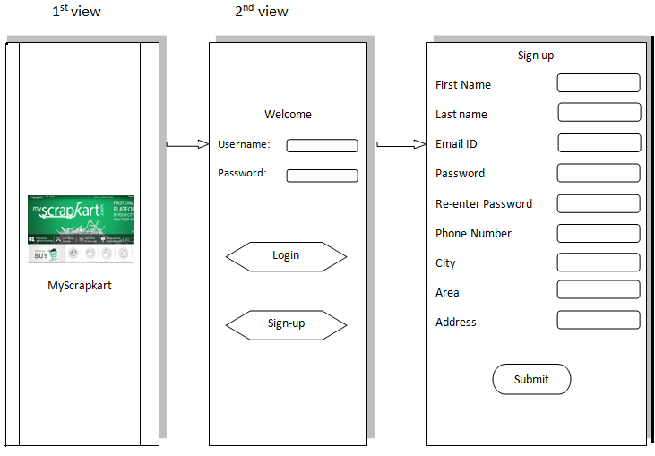
Wire Frame

Slide 35
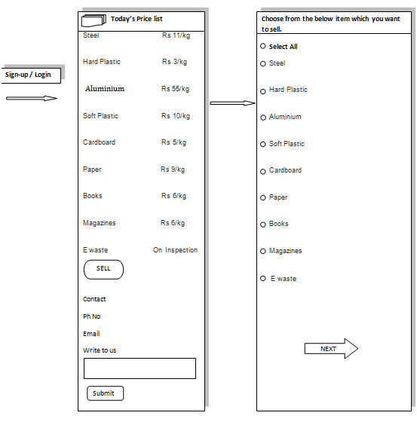

Slide 36
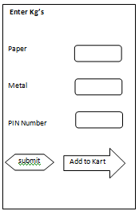

Slide 37
Course relevance
Sl no | Course Code | Course Name | Credits | Semester | Concepts
1 | Object oriented programming (Java and J2EE) | ISC316 | 3 | 5 | Classes & Objects, Inheritance, Static variables and methods
2 | Data structures and Algorithms | ISC229 | 6 | 3 | Concept of nodes and sorting algorithms.
3 | Applied Statistics | MAC221 | 4 | 4 | Data analysis and understanding through graphs and parameters such as mean,median,mode.
4 | Data Mining | ISC326 | 4 | 5 | Data visualization through charts and plots, similarity and dissimilarity of data.

Slide 38
References
Stodder, David. Mobile Business Intelligence and Analytics. 1st quarter. 2012.
Udacity; June 2011; www.udacity.com

Slide 39


