Slide 1
Insurance Premium PREDICTION
Bharat Gogineni

Slide 2
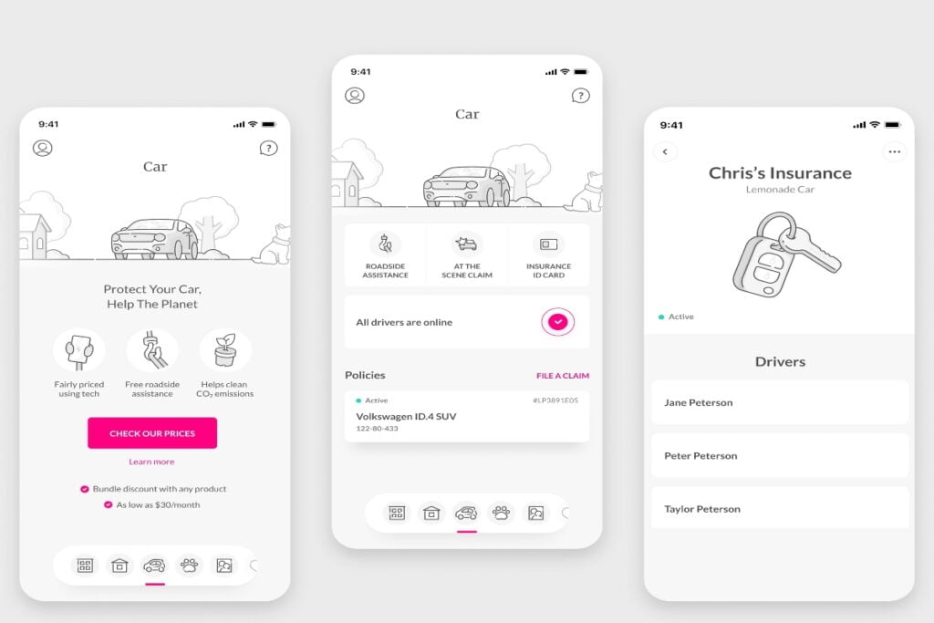

Slide 3

Introduction
In this Project, We try to predict cost of insurance for a user based off criteria such as gender,age,height,weight,bmi, whether the person smokes and region of person

Slide 4
Architecture
CSV Dump
Model Predictor
Flask API Application
HTML Front end

Slide 5
Dataset
The dataset was taken from the Kaggle competition page.
Data type of columns – Validating the data type of the columns if wrong, then it was corrected.
Null values in columns – Validating the column in the dataset have null values or missing information.

Slide 6
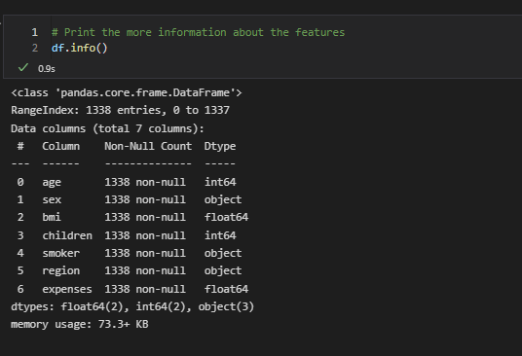
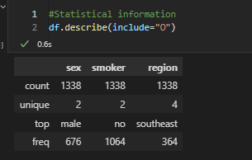
Dataset

Slide 7
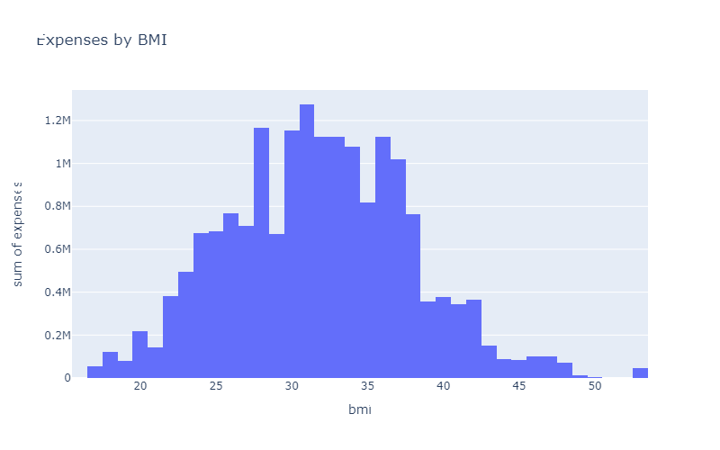
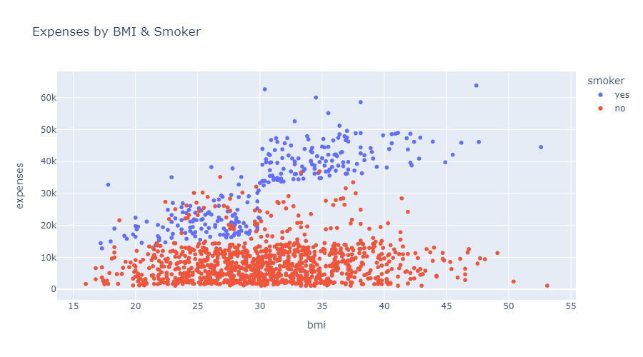
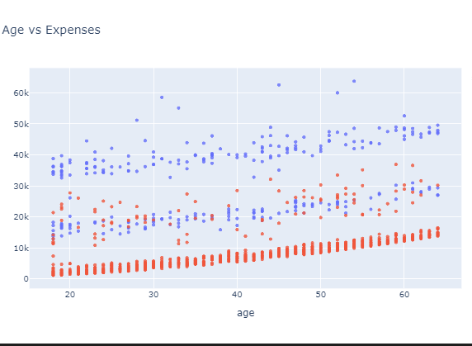
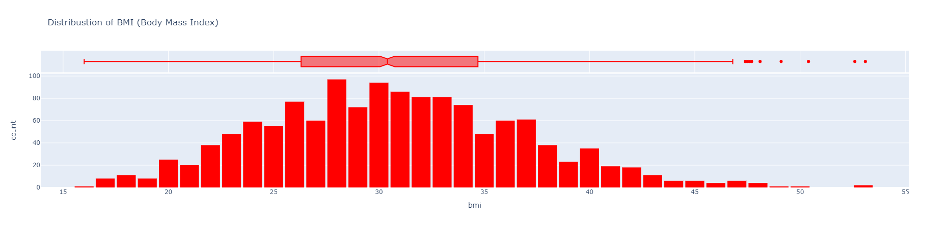

Slide 8
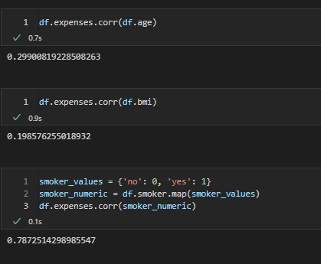
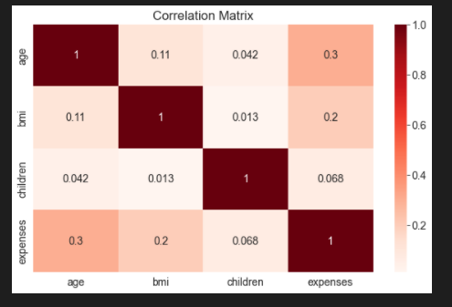
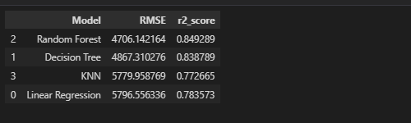

Slide 9




Things to DO

