Slide 1
Final 701Project Personal Dashboard
Bharat Gogineni

Slide 2
Technologies
Additional tools
JWT – Authentication
Mongoose
RXJS
Angular animations
Mongodb
Express
Angular
Nodejs

Slide 3
Functionalities
Login /Sign Up
Add a List
Remove list
Add tasks to List
Remove Tasks from list
Add Notes
Remove Notes
Add Bookmarks
Remove bookmarks
Add quick Todos
Delete/Mark as completed
Clock
Quote of the day – Motivate User
Store Data to Database

Slide 4
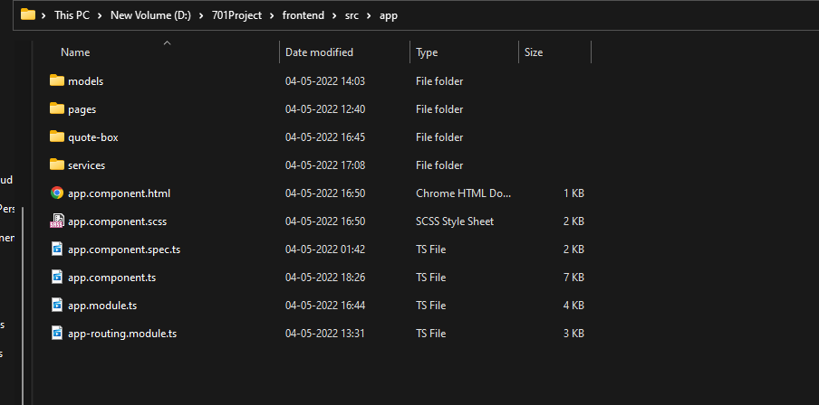
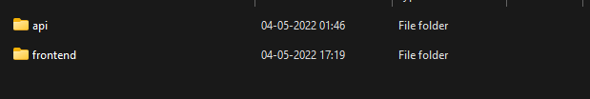
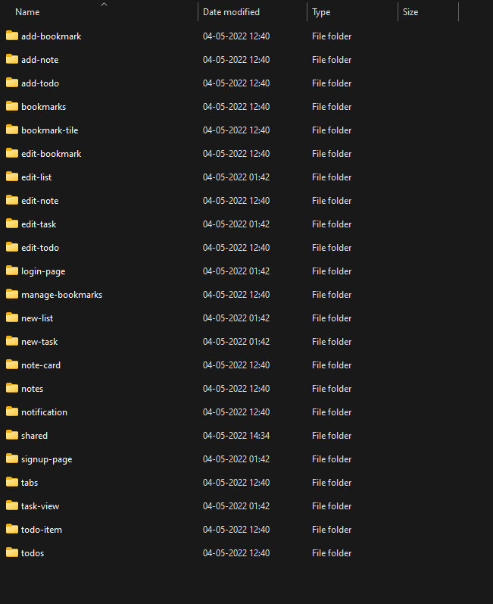
Folder Structure

Slide 5
Issues faced
Storing user session
Prepopulating Data
Router issues
Animations debugging

Slide 6
Todo
Add Music player
Alarms for Todo
Timer
Weather

Slide 7




Thank you

