Slide 1
Balance of Power
DDDM project (TEAM 2) by
Sachin Ahuja (sahuja)
Bharat Mukheja (bkmukhej)
Sneha Shah (smshah4)
Pranav Firake (ppfirake)
Alex Harrell (atharrel)

Slide 2
Problem Statement
To understand and define the context of our work, the first task was to understand the meaning of two terms given to us:
Balance
Power

Slide 3
Power
The capacity or ability to direct or influence the behavior of others or the course of events.

Slide 4
Balance
Formally : Compare the value of one thing with another.
Our Vision: Do all the countries in middle east have the same influence on others or some have greater dominance over others.

Slide 5
What have we learned? How did we start?
Given the meaning of balance and power we now needed the paradigms to somehow calculate the power a nation possesses and to somehow compare these scores relatively.
As our entity of context is a country, it is not possible to represent a country by a number.
So we divided the power figuratively into the economical, demographic, social, military strengths
The next step was to calculate these strengths or indirectly to frame some attributes which together can represent these strengths for a given country.
Now that we had an subjective idea of what to do, we needed to convert the problem to numbers. We prepared a mind-map showing our problem statement in abstract.

Slide 6
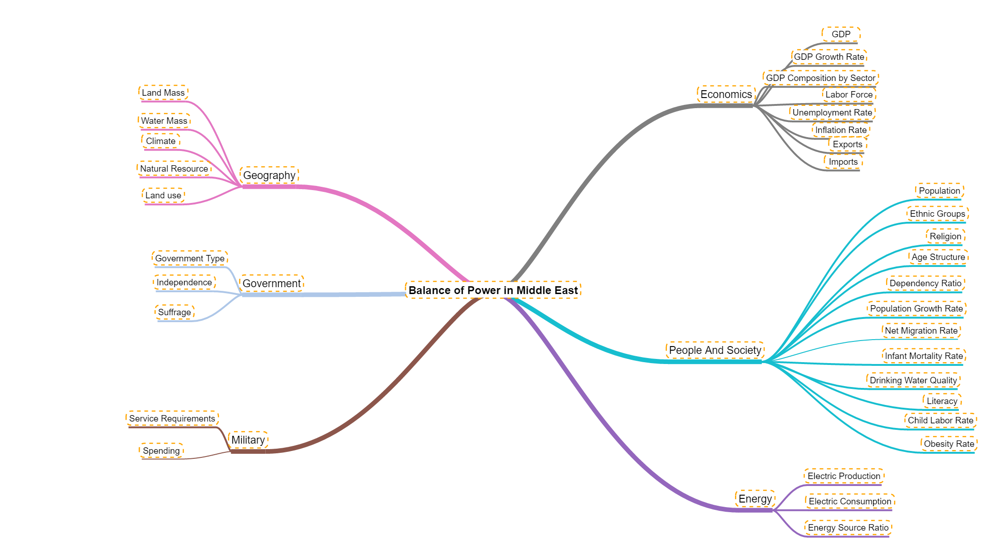
Mind Map
Notes:
Infrastructure :Military Expenditure, Health Expenditure ,Industrial growth, electricity prod,
Economy: Exports ,Imports(,-ve) GDP, GDP per capita ,oil production, refined petroleum production
Society: Net Migration(-ve) , poulation,obesity(-ve) , life expectancy , fertility,internet,infant mortality (-ve)
Geography: area , water area
Demographics : Population, literacy ,[ poverty ,population growth, dependancy ratio, unemployment ] --negative

Slide 7
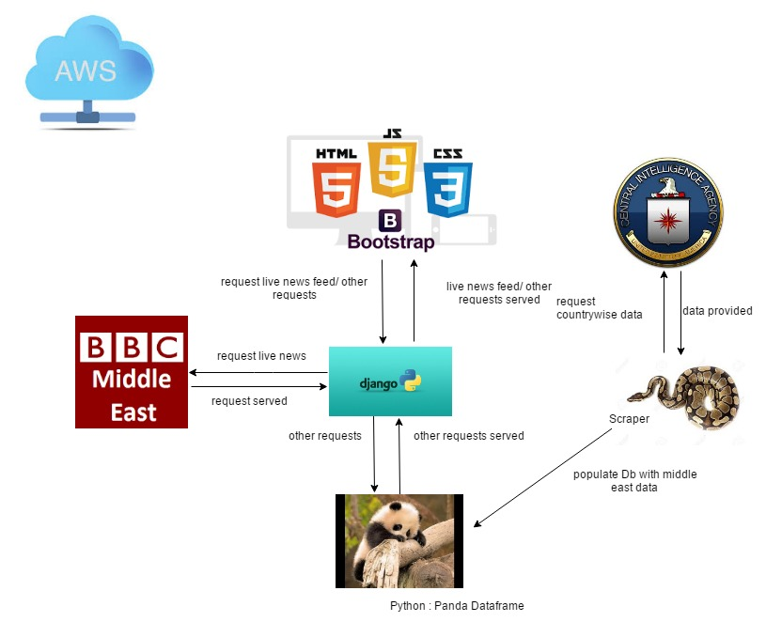
Architecture

Slide 8
App Development
Web application is developed in Django framework and we deployed using Amazon EC2 instance by AWS
For UI, 4 pages we chose are
- Welcome Screen
- Latest News Screen
- Form filling for power evaluation
- Results and display of scores

Slide 9
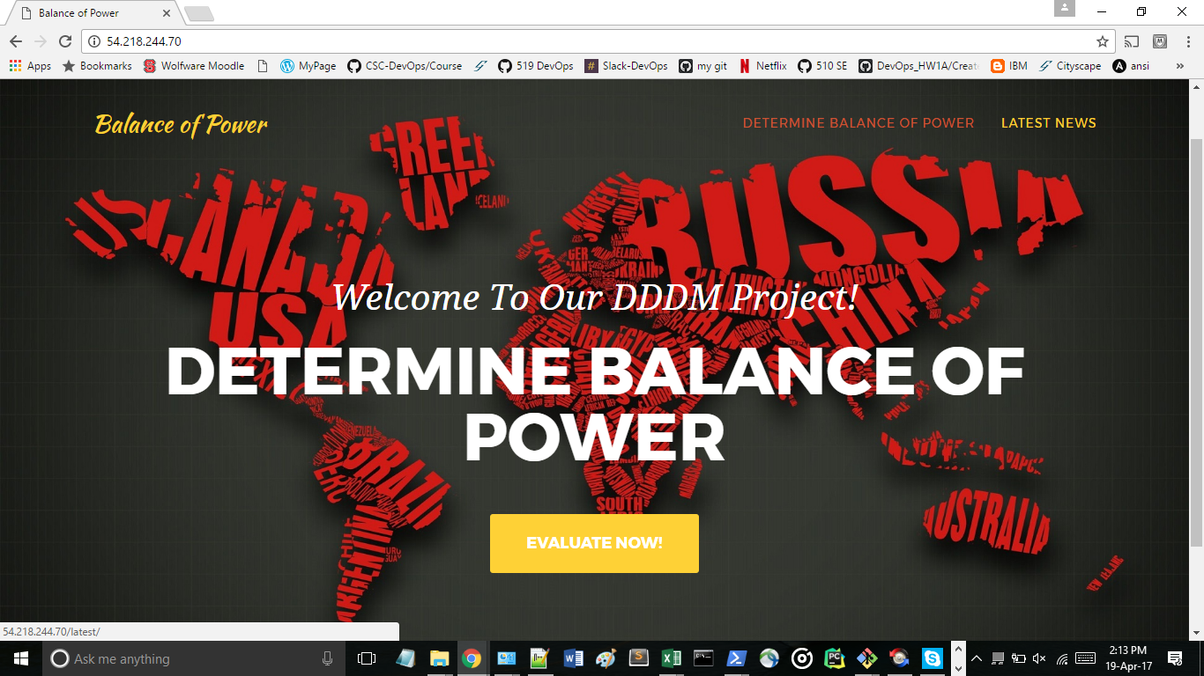
Page 1 : Navigation and link to latest news

Slide 10
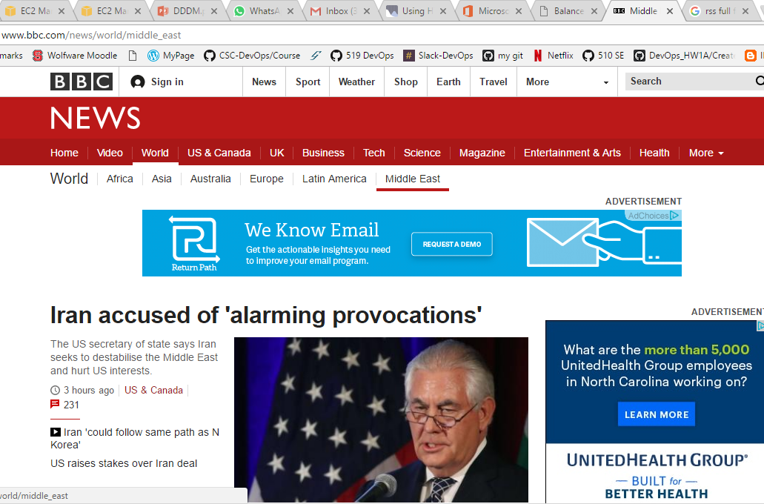
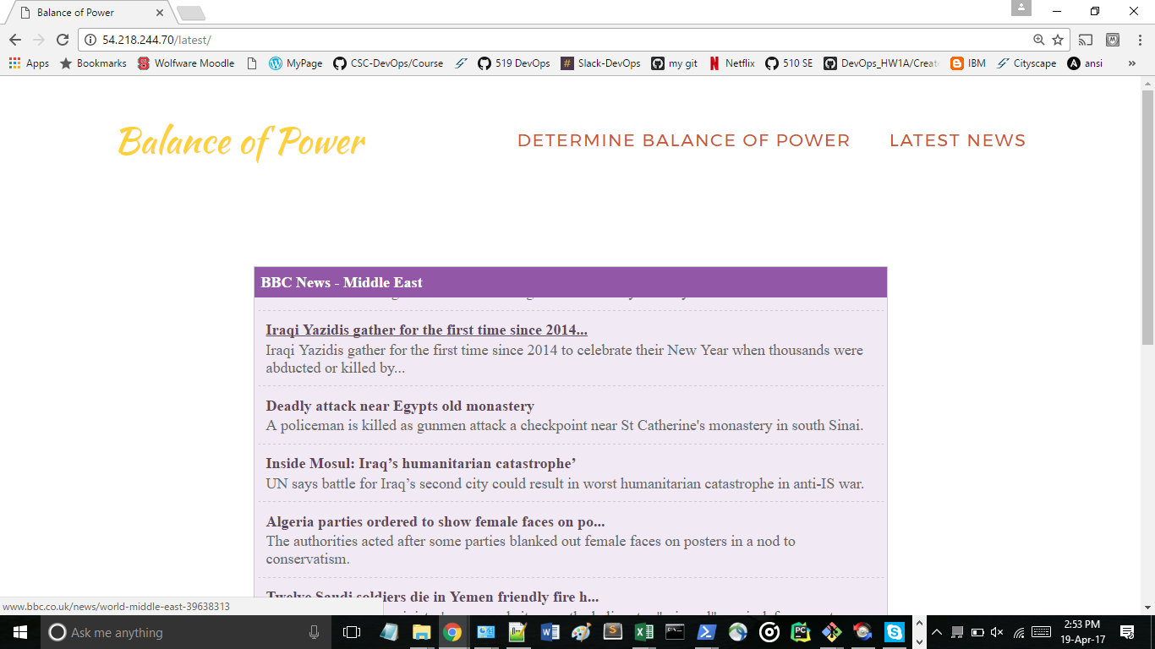
Page 2: Latest news for middle east populating from live BBC site in xml-html
Presented on live site using Javascript
RSS in XML format

Slide 11
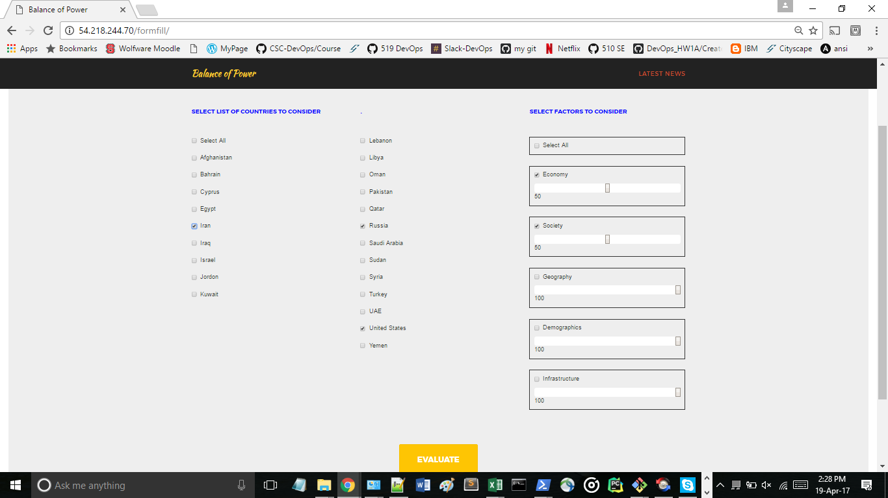
Page 3: Form filling for choosing countries and parameters

Slide 12
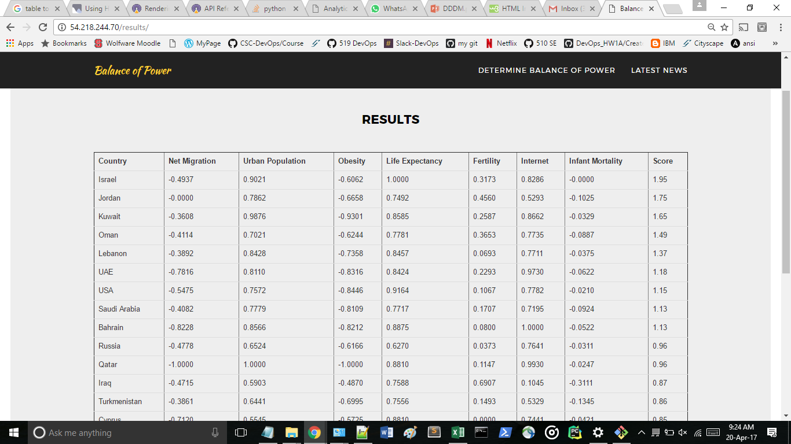
Page 4: Results & Score for each country

Slide 13
Data Sources and Scraping
Sources
CIA World Factbook
Lexis Nexus Documents
World News Sites (BBC, CNN, and Reuters)
Scraping
All Scraping is done in Python 3
Static baseline tables are generated using the CIA data
Several aggregate scores are given to countries based on documents scraped as unstructured text (In Progress)

Slide 14
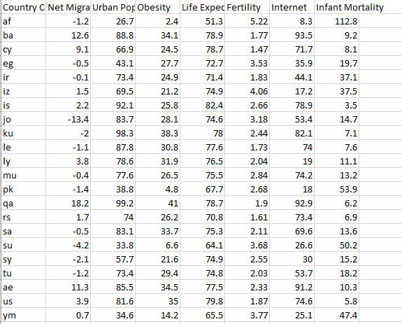
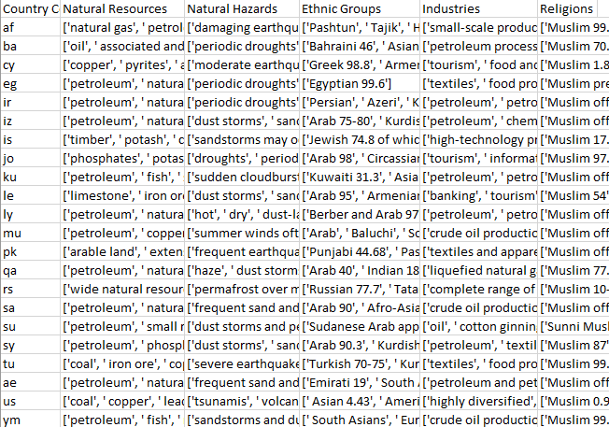
Data Tables

Slide 15
<demo> </demo>

Slide 16
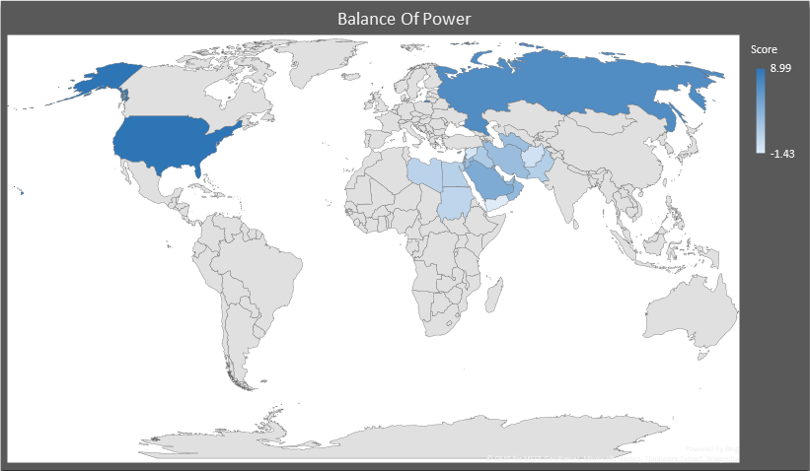

Slide 17
Conclusion Results page showing the scores of countries
Defining the power of a country in terms of its economic, demographic or military strengths give promising results.
The critical thinking process is a well defined approach to solve real world problems.
Critical thinking is not only required to solve the problem. But the steps of critical thinking can also be used to understand the problem.
That understanding can further be used to establish approach to solve the problem and gain results that are promising.

Slide 18
Experience and Future Work
We haven’t used the news feed up to its 100%. But we can use the news feed or use other unstructured data such as tweets to do sentiment analysis and use the results of sentiment analysis to further optimize/fine-tune the results
This can be done using Apache Kafka and Apache Spark.
However, the tweets should be promising. Here, the truth and fiction people can help. Their application can serve as a driver for our application to optimize our results.

