Slide 1
Sales Management

Slide 2
Sales Culture
How would you define a sales culture?
Who is responsible for establishing a successful sales culture within an organization?
Athletic Director/General Manager/Team President
Marketing & Advertising
Sales
Development/Fund-Raising
Ticket Operations
Public/Media Relations
Event Management
Technology/Web Design
Compliance

Slide 3
Organizational Theory
Organizational (or Management) theory can be grouped into four eras:
Classic era (1880’s – 1930’s Industrial Revolution)
- Focus on _______________
Behavioral era (1930’s – 1940’s)
- Focus on ___________________________
Human relations era (1950’s – 1980’s)
- Focus on ___________________________
Modern era (1980’s to present)
- Focus on ___________________________

Slide 4
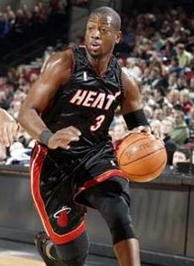
Decentralization & Autonomy
The Miami Heat have developed a program called “Show Me the Way” in which each account executive is given the authority to resolve conflicts without consulting upper management.
In fact, each rep receives a set a dollar value to spend at their discretion throughout the season to deal with ticket holder issues.

Slide 5
Effective Sport Sales Teams
Vic Gregovits, former VP of Sales for Eagles, Pirates, and Indians, asks the following questions to evaluate a sport sales team:
Has the sales staff been properly trained?
Does the sales staff have resources to meet goals?
What are the strengths & weaknesses of the sales team?
How can staff personalities be used to complement one another?
Is there an effective incentive structure?
(Mullin, Hardy, Sutton, 2007)

Slide 6
Strategic Planning
Appropriate Planning
____________ cycle
____________ cycle: Link
Season ticket sales
Group sales
Renewals
After-marketing & Eduselling
Pricing

Slide 7
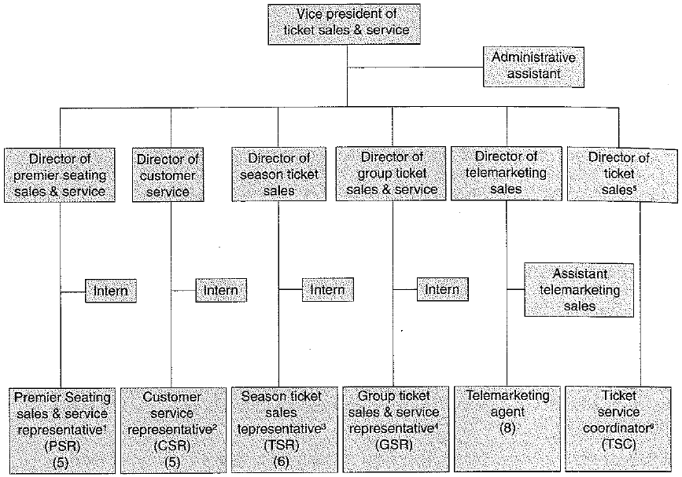
Organizational Structure

Slide 8
How Large Should Staff Be?
“2. Hire salespeople dedicated to only selling tickets. Many sports teams are guilty of understaffing their ticket sales staff. This error is, of course, a self-inflicted wound. I recommended that each team have one dedicated salesperson per 1,000 companies in their marketing area. If there were 5,000 companies in the marketing area, then easy math: The team would need five salespeople dedicated to only selling tickets. The profile of these companies would be 10 to 50 employees, non-retail, non-government. These salespeople would make appointments to visit, eyeball-to-eyeball, each one of these companies. The salesperson’s goal would be to sell the company something, whether it be season tickets, group tickets or a small ticket package. This sales staff would, of course, have to be trained thoroughly. If they are trained, they cost about 20 percent of the sale; if they are not trained, they could cost up to 50 percent of the sale. With either a trained or untrained salesperson, there are expenses. The trained salesperson will be far more efficient because he or she will sell a lot more tickets. That 20 percent first-year cost isn’t very appealing, and the 50 percent makes me cringe, but even 50 percent of something is a lot better than 100 percent of nothing if salespeople aren’t hired.” (Jon Spoelstra – SBJ, 2010)
Notes:
1 person for every 300 accounts

Slide 9
Hiring Question
How would you recruit to fill a sales team?
What would you look for?
Where would you recruit?
Would you invest on the front-end or back-end?

