Slide 1
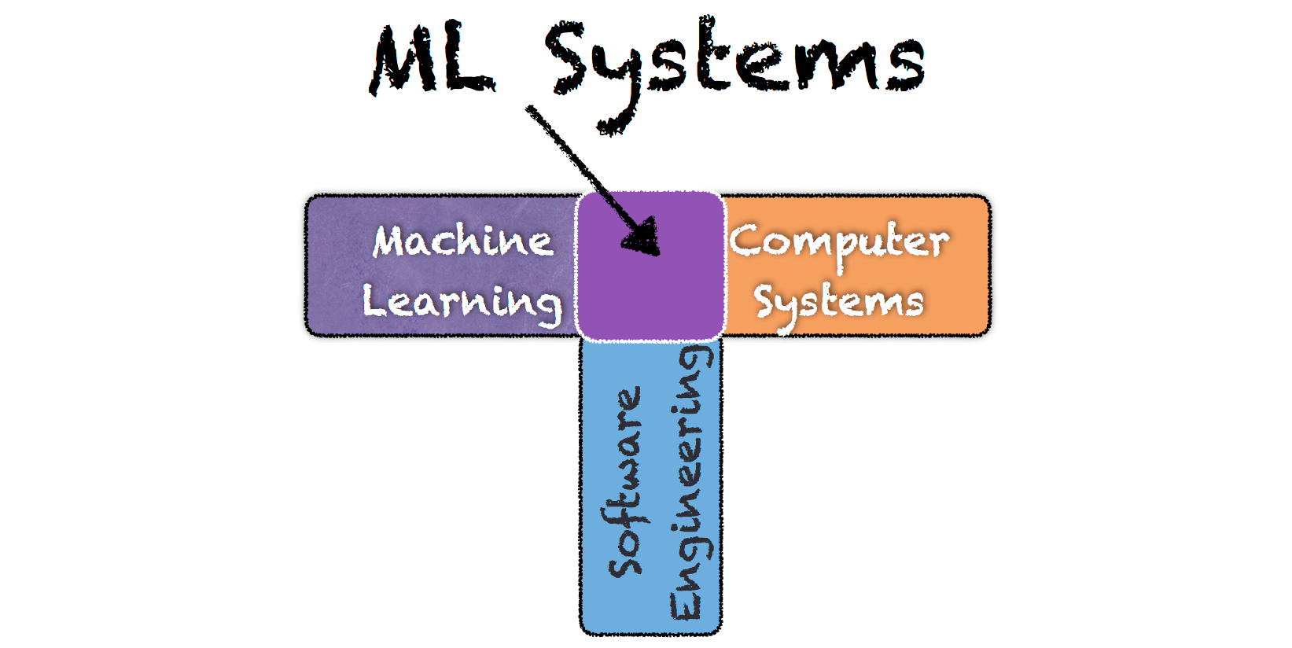

P3 – Design Space Exploration of Model Serving
Mid-Term Progress Report
Jianhai Su, Harrison Howell and Bharat Joshi

Slide 2
Outline
Problem to Investigate
Configuration Space
Experimental Infrastructure
DNN Models
Investigation Plan
Current Experimental Progress
Following Steps

Slide 3


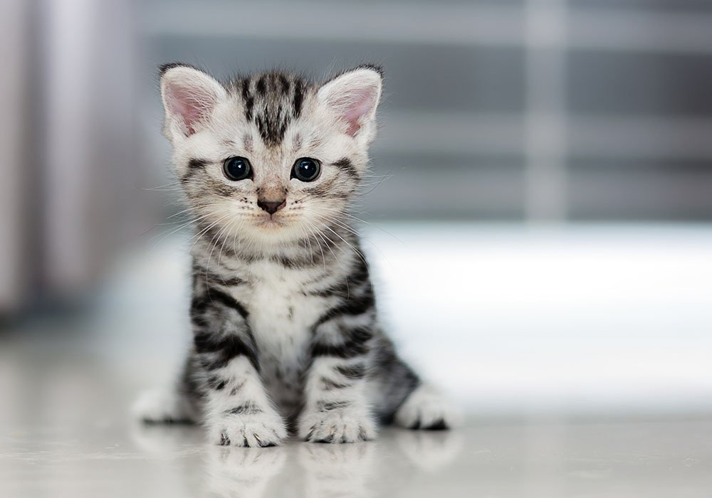
Problem to Investigate
Latency of a request
Energy Consumption of a serving model
Configuration Space
Response
Server
DNN model
Request

Slide 4
Problem to Investigate
Latency of a request: average response time (ART)
Energy Consumption: average CPU usage (ACU)
  Event Trigger vs Window Cut
  psutil python lib: running processes and system utilization
Response
Server
DNN model
Request

Slide 5
Configuration Space
Client Side
  # of threads
  Size of a file to be inquired
Server Side
  # of servers
  CPU capacity
  Memory capacity
Network reliability:?

Slide 6

Experimental Infrastructure
Serving Center
TSB
Master Node
M1
Items
to be
inquired
Load Generator
Client Script
Load
Balancer
TSB
M2
TSB
M3
TSB: TensorFlow Serving Box

Slide 7
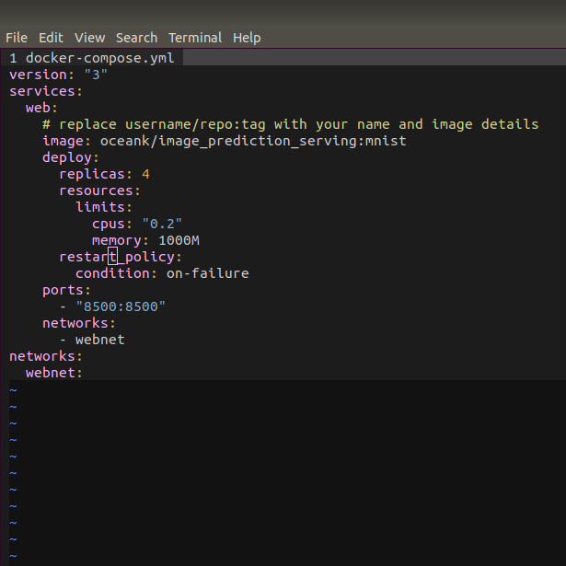
Experimental Infrastructure
Serving Center
TSB
Master Node
M1
Load
Balancer
TSB
M2
TSB
M3

Slide 8
DNN Models
Image: Inception V3 (CNN), Simple Softwmax Regression
Text Translation: Neural Machine Translation (RNN)
Speech-To-Text: DeepSpeech V0.1.0 (RNN)

Slide 9
Investigation Plan
Impact of single configurable parameter
  # of threads, size of file to be inquired
  # of servers, CPU capacity, Memory capacity
Correlation of 5 parameters on the impact of ART and ACU

Slide 10
Current Experimental Progress
Servable Model: simple softmax regression model
  Trained on MNIST dataset
MNIST dataset
  handwritten digits
  Black-white
  size 28X28
  Testing samples: 10k
Another servable model: Neural Machine Translation Model

Slide 11
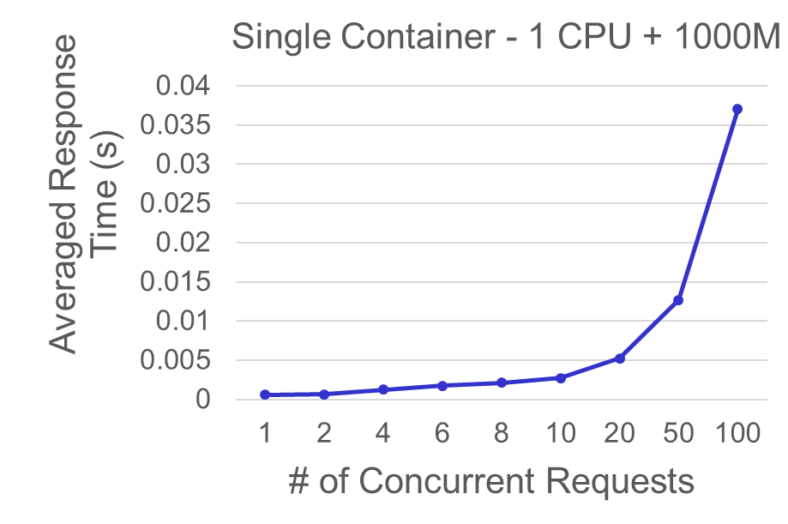
Current Experimental Progress
Impact of
# of concurrent requests
ART increases when # of concurrent requests increases
# of Tests: 1000
# of Containers: 1
For each container:
CPU: 1.0 core
Memory: 1000M

Slide 12
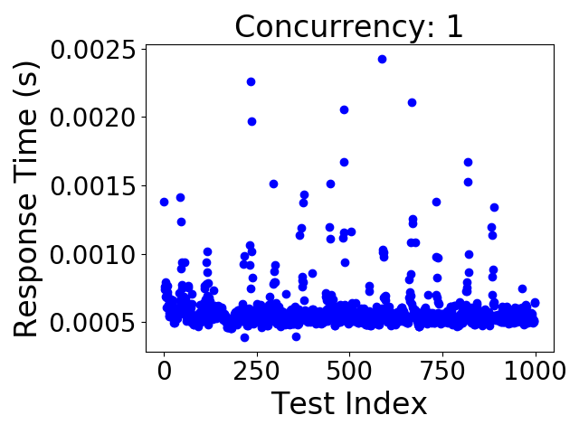
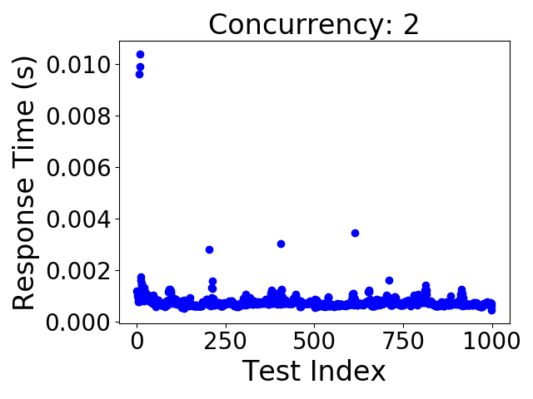
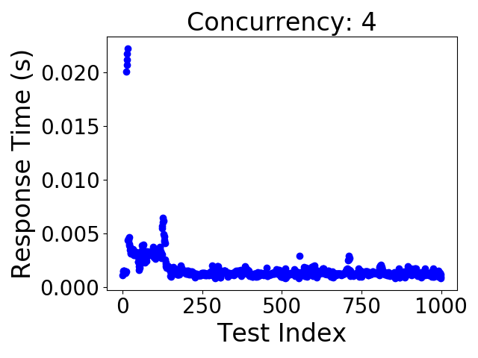
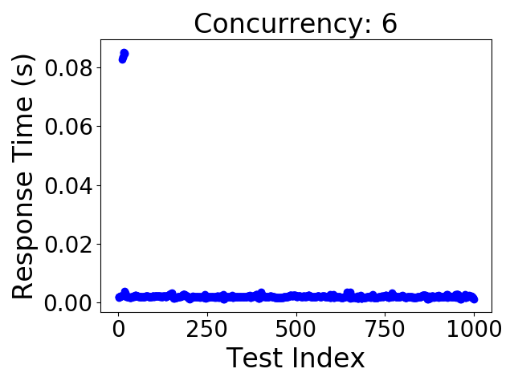
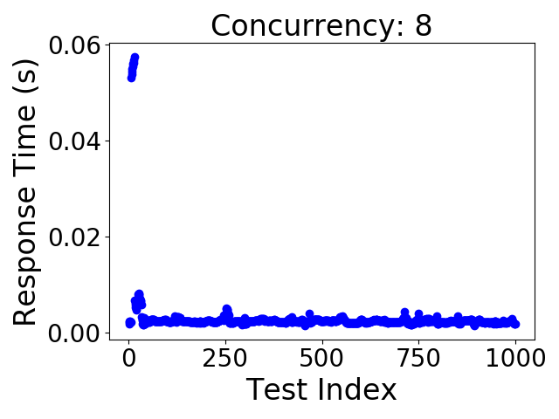
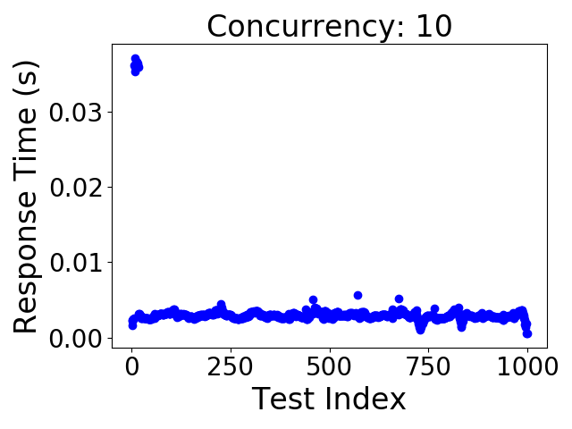
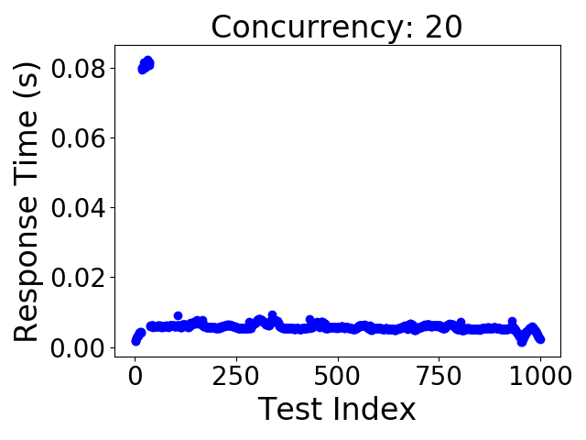
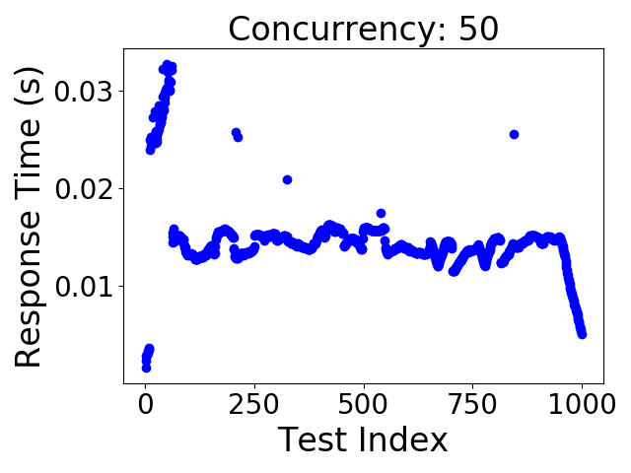
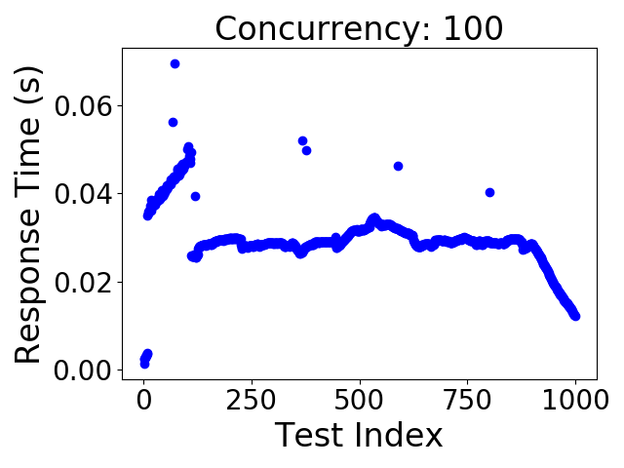
Current Experimental Progress
Model:
warm up &
Cool down
When the # of concurrent requests increases, windows of model warm-up and model cool-down appear.

Slide 13
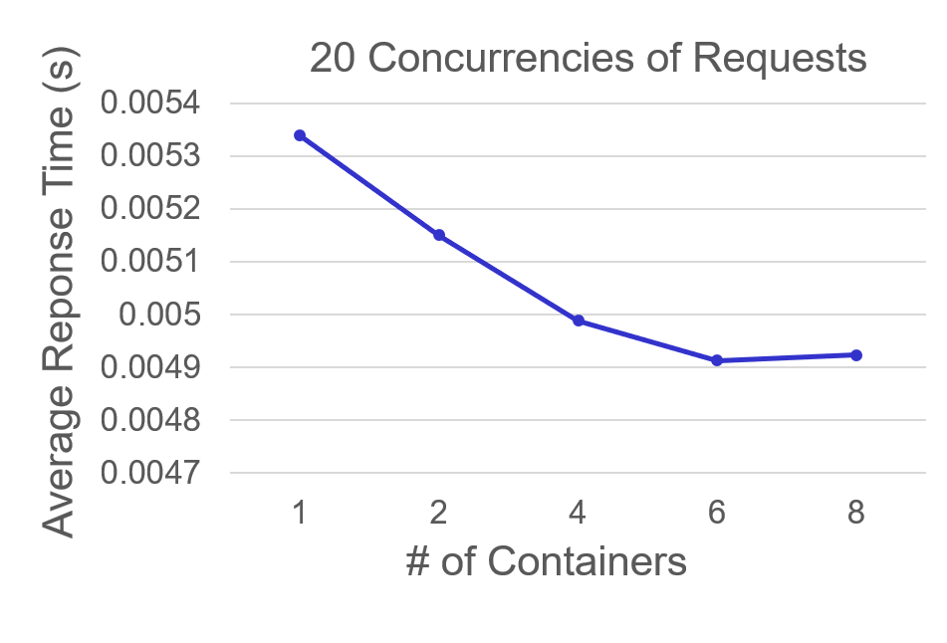
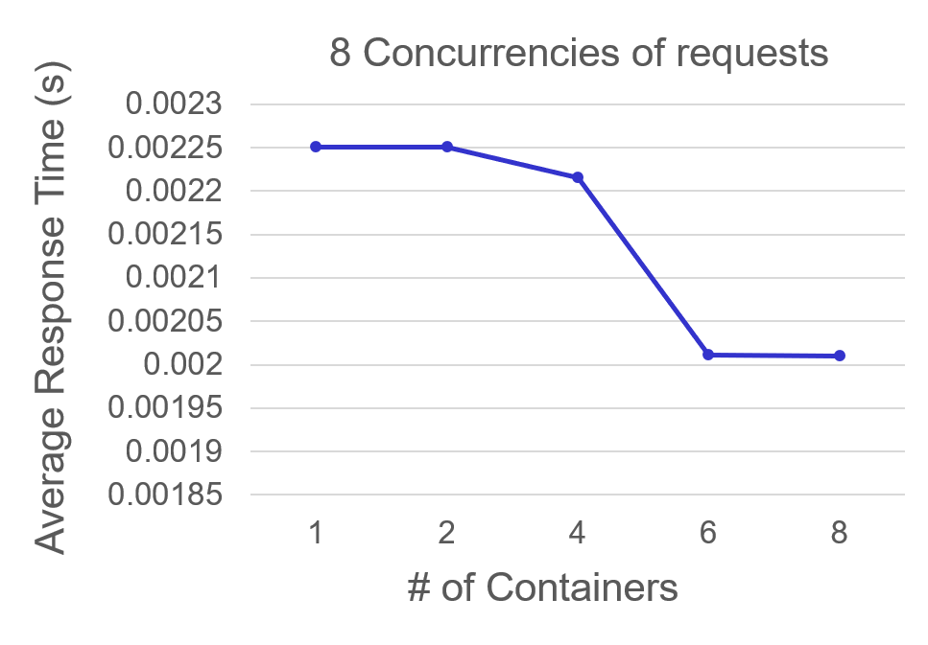
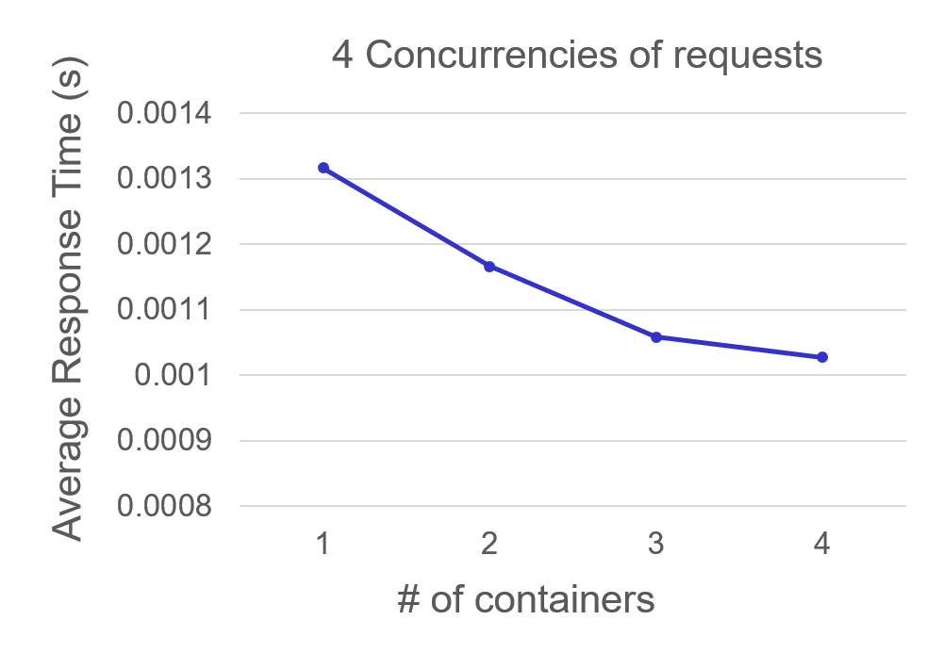
Current Experimental Progress
Impact of
# of Containers
ART drops in general when # of servers increases
4%
# of Tests: 1000
For each container:
CPU: 1.0 core
Memory: 1000M
Desktop:
8 cores
2 threads per core
About 10 %
>10%

Slide 14
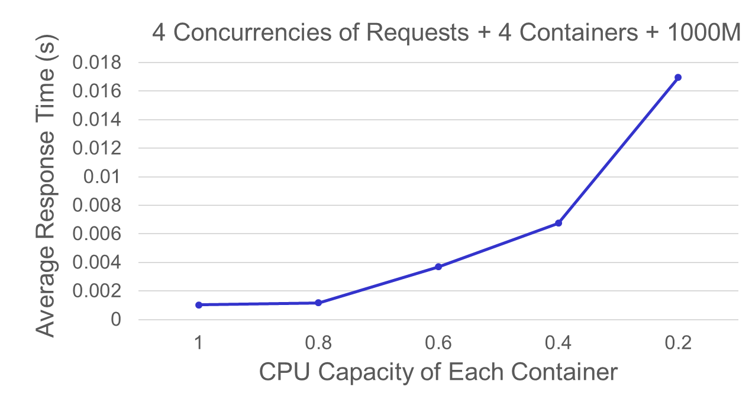
Current Experimental Progress
Impact of
CPU Capacity
ART
Increases
when CPU
Capacity
drops

Slide 15
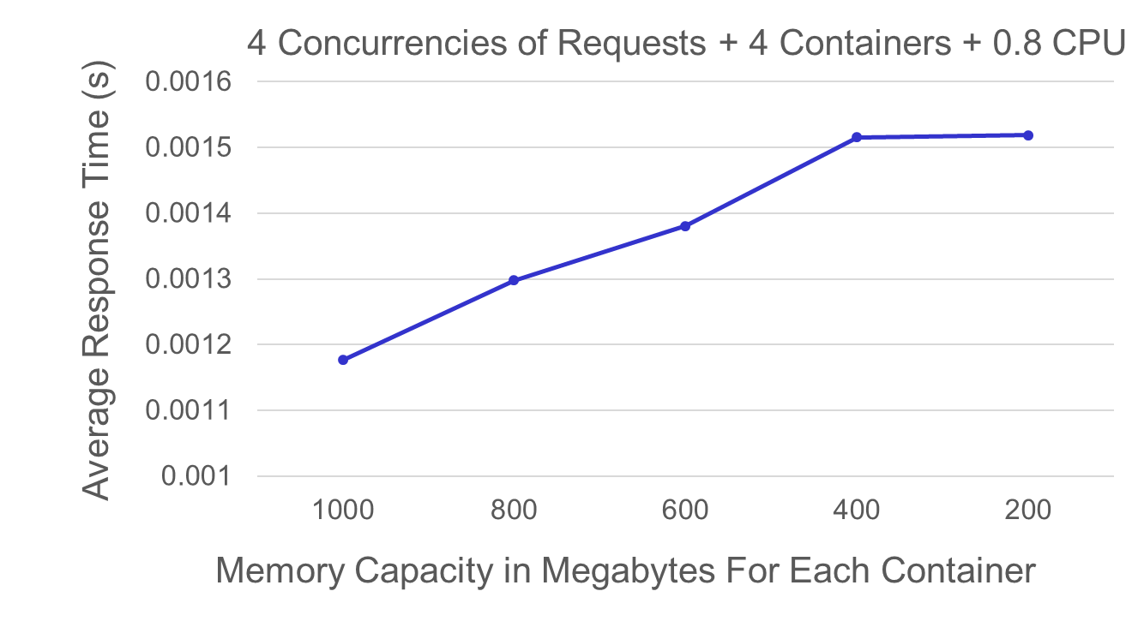
Current Experimental Progress
Impact of
Memory Capacity
ART
increases
when Memory
Capacity
drops

Slide 16
Current Experimental Progress
Neural Machine Translation Model
Uses RNN architecture with attention
Translate English to Vietnamese
Inference time: the length of the sentence
The input : tokenized words
Varied the length of tokenized words and figure out how response time changes

Slide 17
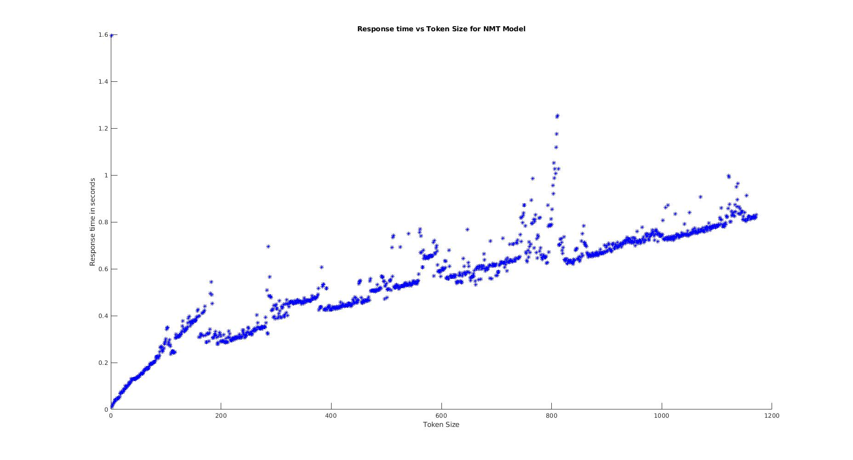
Current Experimental Progress
Impact of
# of token Size
RT increase when token size increases
#token size from 1 to 1171
# of Containers: 1
Response time in secs

Slide 18
Following Steps
Enable Three DNN models serviceable
Write scripts for client request and combine with load generator
Do planned investigation by using TensorFlow serving and Docker
Implement the way to estimate the energy consumption

