Slide 1

UE24CS352A MACHINE LEARNING · MINI-PROJECT · PROBLEM #71
Predicting Airbnb prices
across cities
Can a model price a city with no local training labels?
New York City
Paris
Berlin
Bharat V Bhat
Bharath Hegde
Re-implementing Luo, Zhou & Zhou (Stanford CS229, 2019)
on September 2026 Inside Airbnb data
PES1UG24CS113
PES1UG24CS114
Notes:
Introduce the team and the question. We re-implement a 2019 Stanford CS229 project end-to-end on fresh September 2026 Inside Airbnb data for New York, Paris and Berlin, then add a calibrated transfer extension that uses the mean log price estimated from 571 labelled Berlin training listings; it is not zero-shot.

Slide 2
THE PROBLEM
A new host has to pick a price.
A new market has no price history.
01
02
In-city prediction
Unseen-city transfer
How well can a listing's nightly price be predicted from its attributes in New York City, Paris and Berlin?
Can a model trained on NYC + Paris price listings in Berlin, a city it has never seen?
NYC
Paris
Berlin
NYC
+
Paris
Berlin ?
We re-implement Luo, Zhou & Zhou (Stanford CS229, 2019) end-to-end on fresh 2026 data, check whether their findings still hold, and propose an extension for question 02.
Predicting Airbnb prices across cities · UE24CS352A · Problem #71
02
Notes:
Two tasks. First, regression inside each city. Second, transfer to a city the model has never seen, which is the interesting one: a platform entering a new market has no price history to learn from.

Slide 3



DATASET · INSIDE AIRBNB DETAILED LISTINGS · SEPTEMBER 2026
Three cities, 71,047 priced listings
New York City
Paris
Berlin
19,396
$182
43,495
$251
8,156
$149
listings used
median / night
listings used
median / night
listings used
median / night
14 Sep 2026 · 29,918 raw rows
16 Sep 2026 · 77,149 raw rows
19 Sep 2026 · 12,376 raw rows
90 columns
≈ 40% excluded
1 EUR = 1.15 USD
70 / 20 / 10
per listing · CC BY 4.0
missing/unusable prices
Paris and Berlin converted
train / val / test per city, seed 42
Predicting Airbnb prices across cities · UE24CS352A · Problem #71
03
Notes:
Inside Airbnb detailed listings, September 2026 snapshots, CC BY 4.0. Around 40% of raw rows lack a usable price; missing price does not prove inactivity, so we exclude those rows without attributing a cause. We keep prices between 10 and 10,000 dollars. EUR converted at 1.15. Each city is split 70/20/10 with seed 42, as in the paper.

Slide 4
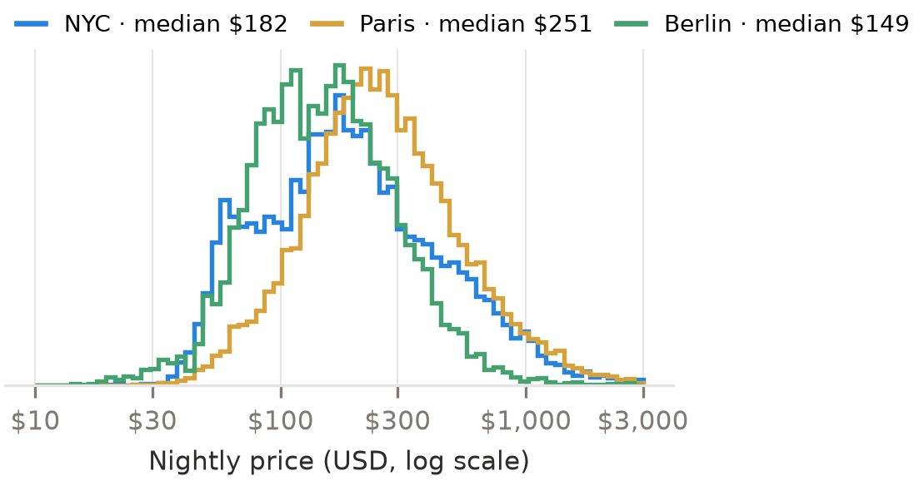
WHAT THE DATA LOOKS LIKE
Prices are right-skewed and close to lognormal
01
Kept $10 – $10,000
About 40% of raw rows have no usable price; this does not prove inactivity.
02
Leakage guard
price_quote_* and estimated_revenue_l365d are computed from the price, so they are excluded.
03
Schema drift since 2019
Cleaning fee, security deposit and 9 of the paper's 12 text fields are gone. We use title, description and host bio.
Nightly price in USD, log scale. Each city sits at a clearly different price level, which matters for transfer later.
Predicting Airbnb prices across cities · UE24CS352A · Problem #71
04
Notes:
Prices are heavily right-skewed in every city and roughly lognormal, which motivates the log label. Nearly 40.5% of raw rows lack a usable price; we cannot conclude all are inactive. Two data-hygiene points: the new price_quote and estimated_revenue columns leak the label, so we drop them, and the 2026 schema lost several of the paper's features.

Slide 5
APPROACH
One pipeline, fitted on training data only
01
02
03
04
Features
Labels
Models
Metrics
C
Continuous · 33
Raw price
Ridge
R²
size, nights, availability, reviews, location
baseline
as in the paper
I
Interactions
TH
KNN
MSE
degree-2 terms of the continuous features
only prices ≤ $1000
baseline
on the label scale
O
Categorical
Square root
Random forest
MAE in $
room, property, area, licence, top-100 amenities
compares labels fairly
T
Text
Log price
XGBoost
TF-IDF uni + bigrams → 50-dim SVD per field
best label
early stopping
D
Dates
Neural net
review recency and host tenure
64 → 32 ReLU
One scikit-learn ColumnTransformer · mean imputation · standardisation · drop one of each pair with |r| > 0.9
Predicting Airbnb prices across cities · UE24CS352A · Problem #71
05
Notes:
All preprocessing lives in one scikit-learn ColumnTransformer fitted on the training split only: mean imputation, standardisation, correlation pruning, multi-hot top-100 amenities, and TF-IDF reduced to 50 dimensions per text field. TH uses a 1000 dollar cap because 2026 prices are about twice the 2019 level; the paper used 500. XGBoost uses early stopping on validation. The neural net follows the paper: SGD with Nesterov momentum 0.9, learning rate 0.005, L2 0.005, batch 64.

Slide 6
TABLE 1 · NYC · CONTINUOUS FEATURES · TH LABEL
XGBoost wins the controlled comparison
0.787
0.778
0.787
0.712
0.659
XGBoost · test R²
0.466
+0.32
0.778
R² over the ridge baseline
random forest
Trees learn non-linear effects of size, stay length and location without scaling.
Paper (2019 data): XGBoost and the neural net tied at 0.665.
Ridge
KNN
Neural net
Random forest
XGBoost
Predicting Airbnb prices across cities · UE24CS352A · Problem #71
06
Notes:
Controlled comparison: NYC, continuous features only, prices capped at 1000 dollars. XGBoost beats the linear baseline by 0.32 R², with random forest close behind. Tree ensembles capture non-linear interactions among continuous features without scaling; the neural net is second-tier on tabular data of this size.

Slide 7
TABLE 2 · XGBOOST · NYC · CONTINUOUS FEATURES
Log price is the biggest single gain
Raw price
Square root
Log price
0.654
0.809
0.865
test R² on the label scale
test R² on the label scale
test R² on the label scale
MAE $103
MAE $84
MAE $80
Why it works
A fair comparison in dollars
Prices are heavily right-skewed. On raw price, squared error is dominated by a few luxury listings; log turns it into a relative error. Same direction as the paper (0.195 → 0.669).
R² on different label scales is not comparable, so we convert back: dollar R² 0.654 → 0.721 and MAE $103 → $80. Interaction terms add almost nothing (0.866).
Predicting Airbnb prices across cities · UE24CS352A · Problem #71
07
Notes:
Prices are right-skewed, so squared error on raw price is dominated by a few luxury listings. The log label makes it a relative error. Because R² on different label scales is not directly comparable, we also report dollar R² and MAE: 0.654 to 0.721, and 103 to 80 dollars.

Slide 8
TABLES 3–4 · XGBOOST · NYC
Categories help; text and dates don't
Each group on its own · TH label
Stacking groups · log label
Dates only
C
Continuous
0.865
0.154
Text only (best variant)
O
+ Categorical
0.888
+0.023
0.587
Categorical only
T
+ Text
0.888
−0.001
0.718
D
+ Dates
0.887
−0.001
Text variants: unigram TF-IDF 0.587 · uni + bigram 0.574 · raw counts 0.558
Room type, neighbourhood, licence and amenities carry the signal. Only 3 text fields survive in 2026 (the paper had 12) and they repeat what the categories already say. Dates add little in this dataset, as in the paper.
Predicting Airbnb prices across cities · UE24CS352A · Problem #71
08
Notes:
Each feature group alone, then stacked. Categorical features are strong on their own and lift the log-price model to 0.888. Text and dates add nothing on top. Unlike the paper, bigrams did not beat unigram TF-IDF, likely because only three text fields survive in the 2026 schema.

Slide 9
WHAT DRIVES PRICE · XGBOOST GAIN SHARE (%) · NYC, ALL FEATURES
NYC's rental rules show up in the model
Shared bathroom
15.4
73%
Licence: exempt
12.1
Entire home / apt
10.7
Licence: registered
6.8
of priced NYC listings require stays of 30+ nights
In Manhattan
4.8
Minimum nights
4.8
NYC
73%
Avg. minimum nights
4.7
Berlin
19%
Building staff (amenity)
4.4
Short stays in NYC need registration (Local Law 18), so many hosts moved to 30-night stays. Licence status and minimum nights split the two markets.
Private room
4.1
Short-term rental rules
Listing attributes
Predicting Airbnb prices across cities · UE24CS352A · Problem #71
09
Notes:
Shared bathroom, entire home versus private room and Manhattan are the intuitive drivers. Licence status and minimum nights are NYC-specific: since Local Law 18, most stays under 30 nights need registration, so many listings moved to monthly stays, and those price differently. 73 percent of priced NYC listings need 30+ nights, against 19 percent in Berlin.

Slide 10
TABLES 5 & 9 · XGBOOST · ALL FEATURES · LOG PRICE
The model works in every city
New York City
Paris
Berlin
.888
.818
.763
test R², log price
test R², log price
test R², log price
Test MAE
$72
Test MAE
$99
Test MAE
$48
Host-grouped split
.847
Host-grouped split
.779
Host-grouped split
.752
Paper, 2019 data
.740
Paper, 2019 data
.704
Paper, 2019 data
–
Host-grouped split: no host appears in both train and test. Near-identical listings make the random split slightly optimistic. Different data, so this is not a like-for-like comparison with the paper.
Predicting Airbnb prices across cities · UE24CS352A · Problem #71
10
Notes:
Higher R² than the paper in both cities, but the data changed: cleaner 2026 data with inactive listings removed, and our XGBoost uses early stopping. The host-grouped split is a robustness check: hosts with several near-identical listings make the random split optimistic. Neural net with C+O features: NYC 0.835, Paris 0.774, versus 0.741 and 0.716 in the paper. Pooled NYC plus Paris net: 0.804, paper 0.773.

Slide 11
TABLE 7 · NEURAL NETWORK · TESTED ON ALL OF BERLIN, NEVER SEEN IN TRAINING
Single-city models collapse on Berlin
TRAINED ON
TEST R² ON BERLIN
MAE
PAPER
−44,916
n/a
−3.5
NYC
Berlin
−36,389
n/a
−17.4
Paris
Berlin
.237
$106
.514
NYC
+
Paris
Berlin
n/a: single-city predictions overflow, so dollar errors are meaningless. Same story as the paper, only far more extreme. Why?
Predicting Airbnb prices across cities · UE24CS352A · Problem #71
11
Notes:
Train on one city, test on all of Berlin. Single-city networks fail catastrophically; training on NYC plus Paris gives a positive R² of 0.237, versus 0.514 in the paper. Same qualitative story as the paper, which reported minus 3.5, minus 17.4 and 0.514. The next slide explains why ours is so extreme.

Slide 12
WHY IT COLLAPSES
Berlin latitude is ~200 NYC standard deviations away
New York City
40.7°N · sd ≈ 0.06°
Paris 48.9°N
Berlin 52.5°N
40°N
44°N
48°N
52°N
≈ 197 standard deviations in NYC-scaled units
01
02
03
Scaled with NYC's statistics
ReLU extrapolates linearly
Two cities widen the range
Standardisation uses the training city's mean and sd, so Berlin's coordinates land far outside anything seen.
Far outside the training range the network's output keeps growing, so its predictions explode.
NYC + Paris covers far more latitude, which is largely why combined training seems to generalise (0.237).
Predicting Airbnb prices across cities · UE24CS352A · Problem #71
12
Notes:
This is a plausible explanatory mechanism for our extreme numbers, not a verified causal attribution to any one feature or to the original paper. Berlin's latitude is 52.5, NYC's is 40.7 with a standard deviation of about 0.06 degrees, so Berlin is about 197 standard deviations away after scaling. Out-of-distribution coordinates and city-specific categories motivate the extension.

Slide 13
OUR EXTENSION
Strip out the city, then add back its price level
01
02
City-agnostic features
Price-level calibration
−
Latitude and longitude
train y − μ(city)
predict f(x) + μ(Berlin)
−
Neighbourhood
+
Distance to the city centre
μ is a city's mean log price. The model learns only how a listing differs from its city's average.
Less dependence on city-specific location encodings.
Where μ(Berlin) comes from
A labelled 10% sample of Berlin's training split: 571 listings. Few-shot baselines train on the same sample, so every method sees the same Berlin labels. Zero-shot results are reported separately.
Predicting Airbnb prices across cities · UE24CS352A · Problem #71
13
Notes:
Two changes. One: city-agnostic features, dropping latitude, longitude and neighbourhood and adding distance to the city centre. Two: price-level calibration, where the model learns log price minus the city's mean log price and we add Berlin's mean back. That mean comes from 571 labelled Berlin training rows (10 percent sample), so this is aggregate target supervision, not strict zero-shot. Few-shot baselines use the same sample, so the comparison is fair.

Slide 14
TABLE 8 · BERLIN TEST SPLIT · R² ON LOG PRICE
Berlin mean from 571 labels: R² 0.111 → 0.526
NO BERLIN LABELS
0.526
NN · paper features
0.189
XGB · city-agnostic
0.111
ONE NUMBER: μ(BERLIN)
city-agnostic XGBoost + μ(Berlin) from 571 labelled rows
XGB · paper features + level
0.410
XGB · city-agnostic + level
0.526
Features alone don't fix it
571 BERLIN ROWS (10% SAMPLE)
City-agnostic NN: .189 → .171. The main error is a price-level bias.
XGB · NYC + Paris + Berlin rows
0.489
XGB · 10% rows + level
0.632
Local labels catch up fast
XGB · Berlin sample only
0.641
XGBoost trained on the same 571 Berlin listings alone reaches .641.
FULL BERLIN TRAINING SPLIT
Evidence for a gain
XGB · trained on Berlin
0.777
Separate 95% CIs do not overlap; a paired test would be stronger.
Predicting Airbnb prices across cities · UE24CS352A · Problem #71
14
Notes:
Grouped by how many Berlin labels each method uses. With none, everything is poor. A mean log price estimated using 571 Berlin training labels lifts XGBoost to 0.526. The separate bootstrap CIs for paper features plus level and city-agnostic features plus level do not overlap, suggestive but not a paired test. With 571 local labels, a local model is as good, so transfer stops paying off. NYC alone still fails even with the level, at minus 0.41. Full Berlin training gives 0.777 as an in-city reference.

Slide 15
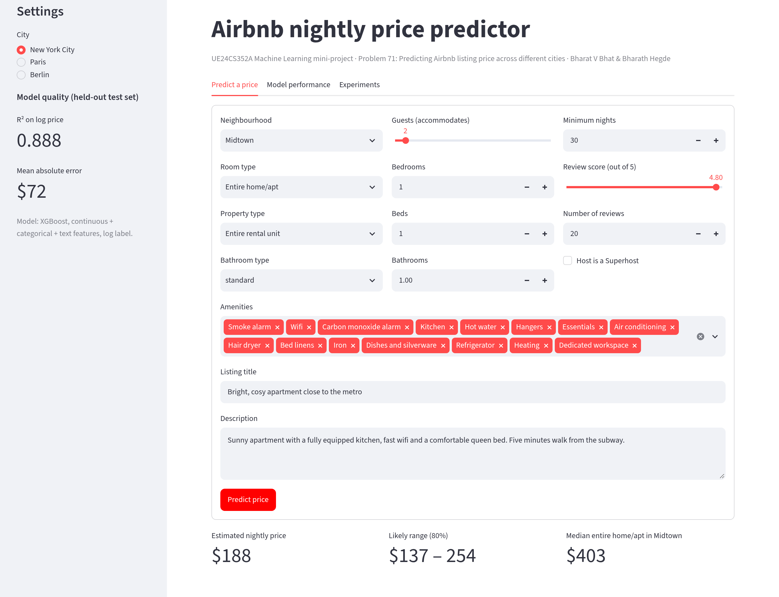
LIVE DEMO · streamlit run app.py
A price predictor anyone can use
01
Predict a price
Predict a price, view an indicative range and local median. Berlin transfer range is not 80% calibrated.
02
Unseen-city mode
For Berlin, switch to the NYC + Paris transfer model calibrated with μ(Berlin).
03
Show the evidence
Predicted vs actual, feature importance and every experiment table in the other tabs.
Trained models ship in models/, so the demo runs without retraining.
Predicting Airbnb prices across cities · UE24CS352A · Problem #71
15
Notes:
Demo script: NYC, Midtown, entire home, 2 guests gives about 188 dollars with a range of 137 to 254. Switch to a private room and the price drops sharply. Then Berlin with and without the calibrated transfer model. Its source-city residual band covered only 61.4% of held-out Berlin prices despite a nominal 80% target; point that out explicitly. Then the model performance tab.

Slide 16
IMPLEMENTATION · PYTHON 3 · SCIKIT-LEARN 1.9 · XGBOOST 3.4 · STREAMLIT
Reproducible from five commands
airbnb-price-prediction/
src/
config.py every constant
data.py load, clean, split
features.py C / I / O / T / D
models.py the five models
evaluate.py labels, metrics
experiments.py 9 tables + figures
train_final.py .joblib bundles
predict.py command line
tests/ 18 pytest tests
results/ tables, figures
app.py Streamlit demo
01
pip install -r requirements.txt
pinned versions
02
python -m pytest -q
18 tests, including loading the saved models
03
python -m src.experiments
all 9 tables + figures, ~15 min on a 2-core CPU
04
python -m src.train_final
preprocessor + model saved as one .joblib
05
streamlit run app.py
data and trained models included
Seed 42 · pinned requirements · fitted on training data only
Predicting Airbnb prices across cities · UE24CS352A · Problem #71
16
Notes:
config.py holds every constant; data.py loads, cleans and splits; features.py builds the five feature groups as one ColumnTransformer with custom transformers for correlation pruning and amenities. experiments.py regenerates all nine tables, the figures and RESULTS.md in one command. Tests cover price parsing, label round-trips, correlation pruning, amenity encoding, an end-to-end feature check and loading the saved models.

Slide 17
INDIVIDUAL CONTRIBUTION
Who built what
Bharat V Bhat
Bharath Hegde
PES1UG24CS113 · PES1202403301
PES1UG24CS114 · PES1202400374
DATA PIPELINE AND FEATURES
MODELS, TRANSFER AND DEMO
Cleaning, label transforms and EDA
Text and amenity encoding, correlation pruning
Ridge and KNN baselines
Tables 2–4 and the test suite
Random forest, XGBoost and neural net
Cross-city and transfer experiments (Tables 1, 5–9)
The calibration extension
Saved models and the Streamlit demo
OWNED FILES
OWNED FILES
data.py · features.py · config.py
scripts/download_data.py · tests/
models.py · experiments.py · train_final.py
predict.py · app.py
Both of us wrote the report and the slides.
Predicting Airbnb prices across cities · UE24CS352A · Problem #71
17
Notes:
Bharat: data pipeline and features, EDA, baselines, Tables 2 to 4, tests. Bharath: random forest, XGBoost and the neural net, cross-city and transfer experiments, the calibration extension, saved models and the demo.

Slide 18
CONCLUSIONS
What we learned
01
The paper's findings hold on 2026 data
Log price + XGBoost performs best (R² 0.76–0.89); dates add little here, and multi-city transfer beats single-city transfer.
02
Why cross-city transfer fails
Out-of-range coordinates and different city price levels plausibly contribute to failure.
03
One number about the new city is worth the most
Its mean log price lifts Berlin R² from 0.111 to 0.526. With 571 local labels, a local model (0.641) is as good.
LIMITATIONS
FUTURE WORK
Hosts shared across random splits · one seed · one snapshot per city (no seasonality) · listed, not booked, prices · fixed exchange rate · light tuning
More source cities · hierarchical or city-embedding models · listing photos
Predicting Airbnb prices across cities · UE24CS352A · Problem #71
18
Notes:
Three takeaways, then limitations and future work. Emphasize that city-level calibration is not zero-shot (571 Berlin training labels), source-city prediction bands cover only 61.4% of Berlin test prices, and scaling is a plausible rather than proven cause.

Slide 19
THANK YOU
Questions?
Bharat V Bhat · Bharath Hegde
REFERENCES
1 Luo, Zhou & Zhou. Predicting Airbnb Listing Price Across Different Cities. Stanford CS229, 2019.
2 Inside Airbnb, listings data, September 2026 (CC BY 4.0).
3 Chen & Guestrin. XGBoost: A Scalable Tree Boosting System. KDD 2016.
4 Pedregosa et al. Scikit-learn: Machine Learning in Python. JMLR 2011.
Notes:
Thank the panel and take questions.

