Slide 1
Predicting Theatre Seat Occupancy using ML
Machine Learning Model for Forecasting/Predicting Theatre Seat Bookings
Prepared By – Bharat B Singh
Date – 06/03/2025

Slide 2
Problem Statement
Goal: Predict the number of occupied seats for a movie showtime based on historical data and external factors.
Use Cases:
✅ Optimize ticket pricing
✅ Improve theatre capacity planning
✅ Recommend optimal showtimes
Worked on this - Improved theatre capacity planning - by predicting ticket_sold based on relevant features.
ML Model (ticket_sold<- no_of_seats+type+no_screens)

Slide 3
Data Collection
Sources:
- Theatre booking data (ticket sales, occupancy rates)
- Movie metadata (IMDb API, genre, ratings)
- Showtime details (weekday/weekend, time)
- External factors (holidays, weather, competition)

Slide 4
Data Preprocessing & Feature Engineering
Key Features:
- Movie-specific: Genre, rating, IMDb score
- Theatre-specific: Location, screen type
- Time-based: Show time, holidays
- External: Weather, competing movie releases
Data Cleaning:
- Handle missing values
- Encode categorical data
- Normalize numerical variables

Slide 5
Model Selection
Models Used:
✅ Linear Regression (Baseline)
✅ Random Forest Regressor (Feature Importance)
✅ Gradient Boost
✅ XGBoost/LightGBM (Performance Boost)
✅ SARIMA (If time-series trends exist)
✅ LSTM (For deep learning-based sequential modeling)

Slide 6
Model Evaluation & Tuning
Metrics:
- R² Score: Measures variance explanation
- MAE: Average prediction error
- RMSE: Penalizes large errors more
Hyperparameter Tuning:
- Use GridSearchCV or Optuna
- Tune learning rate, max depth, estimators

Slide 7
Deployment & Business Integration
Deployment Options:
🚀 Flask/FastAPI-based API
📊 Dashboard with Streamlit or Power BI
🔄 Regular model updates with real-time data

Slide 8
Conclusion & Next Steps
Data –
Movie and theatre data with strong correlation not publicly available
Time/Event-specific recording not available
Data quality and data sufficiency to support ML Model
ML-Models -
✅ Start with Simple Linear Regression to baseline model to predict ticket_sold.
✅Random Forest/ Gradient Boost to compare similar models and metrics
✅ Explore LSTM for sequential trends
✅ Deploy as an API for real-world integration

Slide 9
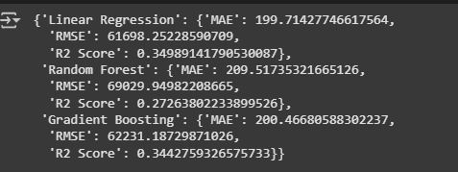
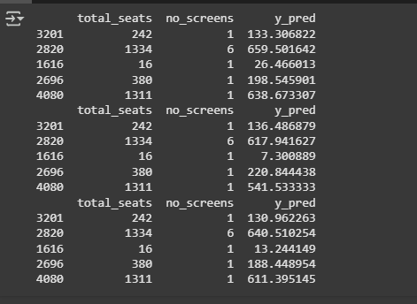
Conclusion & Next Steps
ML-Model – Metrics

Slide 10
Conclusion & Next Steps
Bias vs. variance
Underfitting issue – Training + Test (Metrics not good)
ML Model (ticket_sold<- no_of_seats+type+no_screens)
Next Steps:
- Enhance feature set with real-time ticket sales
- Test model on new datasets
- Optimize deployment for scalability

