Slide 1
What is C++?
C++ is an object-oriented programming (OOP) language that is viewed by many as the best language for creating large-scale applications. C++ is a superset of the C language.
C++ is a general-purpose, object-oriented programming language that was designed by Bjarne Stroustrup in 1979 to be an extension of the C language.
It has the features of imperative, object-oriented as well as generic programming models

Slide 2
C++
C++ is a statically typed, compiled, general-purpose, case-sensitive, free-form programming language that supports procedural, object-oriented, and generic programming.
C++ is regarded as a middle-level language, as it comprises a combination of both high-level and low-level language features.
C++ was developed by Bjarne Stroustrup starting in 1979 at Bell Labs in Murray Hill, New Jersey, as an enhancement to the C language and originally named C with Classes but later it was renamed C++ in 1983.
C++ is a superset of C, and that virtually any legal C program is a legal C++ program.

Slide 3
Features of C++
1:Object-Oriented Programming
2:Rich library support:(STL)
3:Speed
4:Compiled
5:Pointer Suopport
6:Memory Management

Slide 4
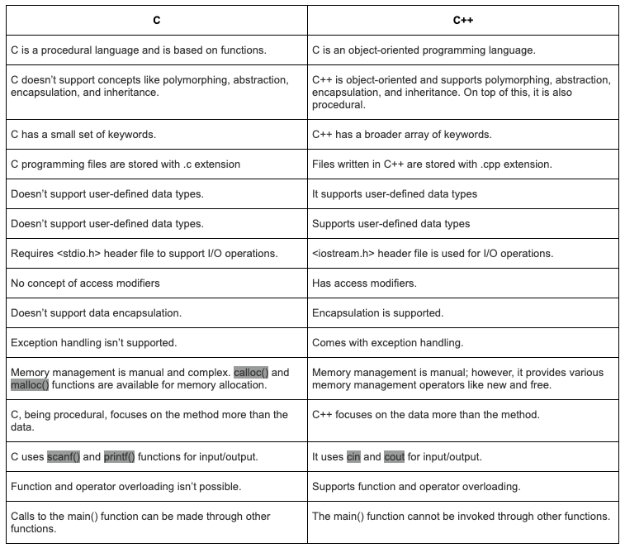

Slide 5
// C++ program to display "Hello World"
// Header file for input output functions
#include <iostream>
using namespace std;
// Main() function: where the execution of
// program begins
int main(){
// Prints hello world
cout << "Hello World";
return 0;
}

Slide 6
“using namespace std” means we use the namespace named std.
“std” is an abbreviation for standard.
So that means we use all the things with in “std” namespace.
If we don’t want to use this line of code, we can use the things in this namespace like this. std::cout, std::endl.
// Code written in the iostream.h file
namespace std {
ostream cout;
iOstream cin;
// and some more code
}

Slide 7
cin and cout
To use cin/cout,
#include <iostream>
Using namespace std;
cin
cin
>>
num
Object of
istream class
Extraction
operator
Variable
keyboard
cin >> num ;
cout
cout
<<
num
Object of
ostream class
Insertion
operator
Variable
screen
cout << “Number = ” << num << endl;

Slide 8
cin and cout
cin is an object of the input stream and is used to take input from input streams like files, console, etc.
cout is an object of the output stream that is used to show output.
Basically, cin is an input statement while cout is an output statement.

Slide 9
What is a token?
A C++ program is composed of tokens which are the smallest individual unit. Tokens can be one of several things, including keywords, identifiers, constants, operators, or punctuation marks.
There are 6 types of tokens in c++:
Keyword
Identifiers
Constants
Strings
Special symbols
Operators

Slide 10
Variable initialization in C++
Variables are the names given by the user. A datatype is also used to declare and initialize a variable which allocates memory to that variable. There are several datatypes like int, char, float etc. to allocate the memory to that variable
There are two ways to initialize the variable.
One is static initialization in which the variable is assigned a value in the program and another is dynamic initialization in which the variables is assigned a value at the run time

Slide 11
The following is the syntax of variable initialization.
datatype variable_name = value;
Here,
datatype − The datatype of variable like int, char, float etc.
variable_name − This is the name of variable given by user.

Slide 12
Data Types
All variables use data type during declaration to restrict the type of data to be stored. Therefore, we can say that data types are used to tell the variables the type of data they can store. Whenever a variable is defined in C++, the compiler allocates some memory for that variable based on the data type with which it is declared. Every data type requires a different amount of memory.
C++ supports a wide variety of data types and the programmer can select the data type appropriate to the needs of the application. Data types specify the size and types of values to be stored. However, storage representation and machine instructions to manipulate each data type differ from machine to machine, although C++ instructions are identical on all machines.

Slide 13
Data Types
There are 4 types of data types in C++ language.
1:Basic Data Type:int, char, float, double, etc
2:Derived Data Type:array ,pointer etc.
3:Enumeration Data Type:enum
4:User Defined Data Type:struct,class .

Slide 14
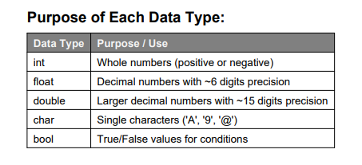
Data Types

Slide 15
int: Represents integer values. Typically, it occupies 4 bytes of memory and can store values ranging from -2,147,483,648 to 2,147,483,647.
char: Represents a single character. It typically occupies 1 byte of memory and can store any character, including special characters.
float: Represents single-precision floating-point numbers. It occupies 4 bytes of memory and is used for numbers with fractional parts.
double: Represents double-precision floating-point numbers. It occupies 8 bytes of memory and is used for more precise numbers with fractional parts.
bool: Represents boolean values, i.e., true or false. It occupies 1 byte of memory.
void: Represents the absence of type. It is primarily used in functions to indicate that they do not return a value.

Slide 16
Type Modifiers
These modify the size or range of the data types:
signed: Allows both negative and positive values (default for int).
unsigned: Allows only non-negative values, thus doubling the maximum value.
short: Reduces the size of an integer.
long: Increases the size of an integer.

Slide 17
Demo
The size of variables might be different , depending on the compiler and the computer you are using.
Following is the example, which will produce correct size of various data types on your computer.
use sizeof() operator to get size of various data types.
cout << "Size of char : " << sizeof(char) << endl;
cout << "Size of int : " << sizeof(int) << endl;
cout << "Size of short int : " << sizeof(short int) << endl;
cout << "Size of long int : " << sizeof(long int) << endl;
cout << "Size of float : " << sizeof(float) << endl;
cout << "Size of double : " << sizeof(double) << endl;

Slide 18
auto
Before C++ 11, each data type needed to be explicitly declared at compile-time, limiting the values of an expression at runtime but after the new version of C++, many keywords are included which allows a programmer to leave the type deduction to the compiler itself.
auto keyword: The auto keyword specifies that the type of the variable that is being declared will be automatically deducted from its initializer. In the case of functions, if their return type is auto then that will be evaluated by return type expression at runtime. Good use of auto is to avoid long initializations when creating iterators for containers.
auto x = 4;
auto y = 3.37;
auto z = 3.37f;
auto c = 'a';
The auto keyword tells the compiler to automatically deduce the type of the variable from its initializer.

Slide 19
Operators
*Arithmetic Operator
• Relational Operator
• Logical Operator
• Unary Operator
• Ternary Operator
• Assignment Operator

Slide 20
1) Arithmetic Operators
These operators are used to perform arithmetic or mathematical operations on the operands. For example, ‘+’ is used for addition, ‘-‘ is used for subtraction ‘*’ is used for multiplication, etc.
Arithmetic Operators can be classified into 2 Types:
A) Unary Operators: These operators operate or work with a single operand. For example: Increment(++) and Decrement(--) Operators.
(Note: ++a and a++, both are increment operators, however, both are slightly different.
In ++a, the value of the variable is incremented first and then It is used in the program. In a++, the value of the variable is assigned first and then It is incremented. Similarly happens for the decrement operator.)
B)Binary Operators: These operators operate or work with two operands. For example: Addition(+), Subtraction(-), etc.

Slide 21
2) Relational Operators
These operators are used for the comparison of the values of two operands. For example, ‘>’ checks if one operand is greater than the other operand or not, etc. The result returns a Boolean value, i.e., true or false.
3) Logical Operators
These operators are used to combine two or more conditions or constraints or to complement the evaluation of the original condition in consideration. The result returns a Boolean value, i.e., true or false.
4)Assignment Operators:
These operators are used to assign value to a variable. The left side operand of the assignment operator is a variable and the right side operand of the assignment operator is a value. The value on the right side must be of the same data type as the variable on the left side otherwise the compiler will raise an error.

Slide 22
5)Ternary or Conditional Operators(?:)
This operator returns the value based on the condition.
Expression1? Expression2: Expression3
The ternary operator ? determines the answer on the basis of the evaluation of Expression1. If it is true, then Expression2 gets evaluated and is used as the answer for the expression. If Expression1 is false, then Expression3 gets evaluated and is used as the answer for the expression.
This operator takes three operands, therefore it is known as a Ternary Operator.
6)Unary operators are the operators that perform operations on a single operand to produce a new value.

Slide 23
Types of unary operators
Types of unary operators are mentioned below:
Unary minus ( – )
Increment ( ++ )
Decrement ( — )
NOT ( ! )
Addressof operator ( & )
sizeof()

