Slide 1
OOP Concepts

Slide 2
C++ What is OOP?
OOP stands for Object-Oriented Programming.
Procedural programming is about writing procedures or functions that perform operations on the data, while object-oriented programming is about creating objects that contain both data and functions.
Object-oriented programming has several advantages over procedural programming:
OOP is faster and easier to execute
OOP provides a clear structure for the programs
OOP helps to keep the C++ code DRY "Don't Repeat Yourself", and makes the code easier to maintain, modify and debug
OOP makes it possible to create full reusable applications with less code and shorter development time

Slide 3
Basic Object-Oriented Programming (OOPS) Concept in C++
There are some basic concepts that act as the building blocks of OOPs.
Classes & Objects
Abstraction
Encapsulation
Inheritance
Polymorphism

Slide 4
Class
Class in C++ is the building block that leads to Object-Oriented programming. It is a user-defined data type, which holds its own data members and member functions, which can be accessed and used by creating an instance of that class. A C++ class is like a blueprint for an object.
A Class is a user-defined data type that has data members and member functions.
Data members are the data variables and member functions are the functions used to manipulate these variables together, these data members and member functions define the properties and behavior of the objects in a Class.

Slide 5
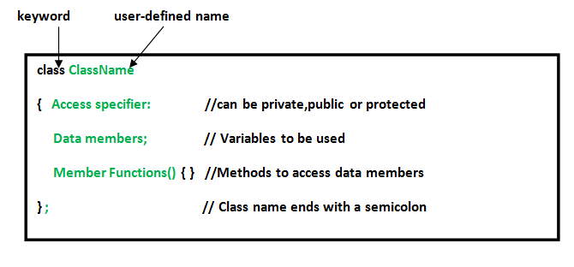

Slide 6
Classes allow you to model complex real-world entities and provide a way to organize and manage code. They support principles of object-oriented programming (OOP) such as encapsulation, inheritance, and polymorphism, which help in creating more organized, maintainable, and reusable code
Syntax To Create a Class
class MyClass { // The class
public: // Access specifier
int myNum; // Attribute (int variable)
string myString; // Attribute (string variable)
};

Slide 7
Access Modifiers
In C++ classes, we can control the access to the members of the class using Access Specifiers.
In C++, there are 3 access specifiers that are as follows:
Private: Members declared as private can only be accessed within the class itself.
Protected: Members declared as protected can be accessed within the class and by derived classes.
Public: Members declared as public can be accessed from outside the class.
If we do not specify the access specifier, the private specifier is applied to every member by default.

Slide 8
What is an Object in C++?
When a class is defined, only the specification for the object is defined; no memory or storage is allocated. To use the data and access functions defined in the class, you need to create objects.
Syntax to Create an Object
We can create an object of the given class in the same way we declare the variables of any other inbuilt data type.
ClassName ObjectName;
An Object is an instance of a Class. When a class is defined, no memory is allocated but when it is instantiated (i.e. an object is created) memory is allocated.

Slide 9
Object
An Object is an instance of a Class. When a class is defined, no memory is allocated but when it is instantiated (i.e. an object is created) memory is allocated.
When a class is defined, only the specification for the object is defined; no memory or storage is allocated. To use the data and access functions defined in the class, you need to create objects.
Syntax
ClassName ObjectName;

Slide 10
Example:
Think about a "Car". There are many cars in the world (Maruti, BMW, Audi) — but the general concept of a car remains the same: it has wheels, an engine, a steering wheel, etc.
"Car" is a class
"Your Honda City" is an object
👉 The class defines what a car has and what it can do
👉 The object is a real-world instance of that class

Slide 11
Accessing data members and member functions:
The data members and member functions of the class can be accessed using the dot(‘.’) operator with the object.
For example, if the name of the object is obj and you want to access the member function with the name printName() then you will have to write obj.printName().

Slide 12
Class Methods
Methods are functions that belongs to the class.
There are two ways to define functions that belongs to a class:
Inside class definition
Outside class definition

Slide 13
Constructors
A constructor in C++ is a special method that is automatically called when an object of a class is created.
To create a constructor, use the same name as the class, followed by parentheses ():
class MyClass { // The class
public: // Access specifier
MyClass() { // Constructor
cout << "Hello World!";
}
};
The constructor has the same name as the class, it is always public, and it does not have any return value.

Slide 14
Constructor
Special member function of the class with same name as its class name.
Used to initialize attributes of an object
Implicitly called when objects are created.
Without any input parameter is no-argument constructor.
Rules for implementing constructor:
No return type for constructor. Not even void.
Multiple constructors can be written - different number, types and order of parameters.
Must have same name as that of the class.
s

Slide 15
There are 3 types of constructors:
Default Constructors
Parameterized Constructors
Copy Constructors:
A copy constructor is a member function that initializes an object using another object of the same class. In simple terms, a constructor which creates an object by initializing it with an object of the same class, which has been created previously is known as a copy constructor.

Slide 16
Creating Instance Of Class
// Client Code
int main()
{
cDate d1;
...
return 0;
}
d1 is an object of class cDate
Steps in creation of object
Memory is allocated.
Constructor is called.
Memory gets initialized.

Slide 17
this Keyword
this is a keyword in C++.
this always holds a reference of an object which invokes the member function.
this points to an individual object.
It is a hidden parameter that is passed to every class member function.

Slide 18
Creating an Object on Heap
int main()
{
cDate* ptr = new cDate (5,7,9);
...
delete ptr ;
return 0;
}
Heap
Stack
Date object on heap
5 7
ptr
7 9

Slide 19
Static Variable
Some characteristics or behaviors belong to the class rather than a specific instance
interestRate, CalculateInterest method for a SavingsAccount class
count variable in Employee to automatically generate employee id
Such data members are static for all instances
Change in static variable value affects all instances
Also known as class variable.
Applications
Static variable may be a pointer to an error-handling routine for that class.
It can be a pointer to the heap memory.
Also can be used to keep a track of how many objects of that class are created.

Slide 20
Data to be shared by all objects is stored in static data members.
Only a single copy exists.
Class scope and lifetime is for entire program.
Class variable
Data to be shared by all objects is stored in static data members.
Only single copy exists.
Scope: entire class and lifetime: entire program.

Slide 21
Static Member Functions
Can access static data members only.
Invoked using class name as:
class name :: functionName();
this pointer is never passed to a static member function.
public class cEmployee
{
. . .
static int count;
static int showCount()
{
return count;
}
}
main()
{
int number = Employee.showCount();
cout<< “Number employees are:” << number;
}

