Slide 1
Inheritance

Slide 2
Inheritance is a feature or a process in which, new classes are created from the existing classes. The new class created is called “derived class” or “child class” and the existing class is known as the “base class” or “parent class”. The derived class now is said to be inherited from the base class
Sub Class: The class that inherits properties from another class is called Subclass or Derived Class.
Super Class: The class whose properties are inherited by a subclass is called Base Class or Superclass

Slide 3
Base and Derived Class
Derived class inherits all data members and methods of its base class.
cVehicle
Base Class
Generalization
cTwoWheeler
cThreeWheeler
Derived Class
Specialization

Slide 4
This is ‘is a’ kind of hierarchy.
More than one class can inherit attributes from a single base class.
A derived class can be a base class to another class.
Employee
Sales Person
Manager

Slide 5
Inheritance Syntax
Access can be public or private or protected.
class baseClassName
{
// body of base class
};
class derivedClassName:access baseClassName
{
// body of derived class
};

Slide 6
Public, Protected, and Private inheritance in C++
public inheritance makes public members of the base class public in the derived class, and the protected members of the base class remain protected in the derived class.
protected inheritance makes the public and protected members of the base class protected in the derived class.
private inheritance makes the public and protected members of the base class private in the derived class.

Slide 7
Derived Class Constructors/Destructors
Constructors are called in the sequence of
Base 🡪 Derived
Destructors are called in the sequence of
Derived 🡪 Base

Slide 8
Polymorphism (Late Binding)
Ability of different related objects to respond to the same message in different ways is called polymorphism.
Compile-time Binding and Run-time Binding
Compile-time binding
The binding of a member function call with an object at compile-time.
Also called static type or early binding.
Run-time binding:
The binding of the function call to an object at run time.
Also called dynamic binding or late binding.
Achieved using virtual functions and inheritance.

Slide 9
Virtual Function
To implement late binding, the function is declared with the keyword virtual in the base class.
Points to note:
Virtual function is a member function of a class.
Virtual functions can be redefined in the derived class as per the design of the class.
Also considered virtual by the compiler

Slide 10
Base Class Pointer in Inheritance
A base class pointer is a pointer that is declared as a pointer to a base class but can point to an object of any derived class.
This is a powerful feature of C++ that allows for polymorphism, where a base class pointer can be used to invoke methods that are overridden in derived classes.

Slide 11
Key Points:
1:Base Class Pointer:
A pointer of the base class type can hold the address of any derived class object.
This enables polymorphism, allowing for dynamic binding of functions at runtime when the function is declared virtual in the base class.
2:Virtual Functions:To achieve polymorphism, the base class function should be declared as virtual. This tells the compiler to look for an override in the derived class.
3:Upcasting:The process of assigning a derived class object to a base class pointer is called upcasting. It's safe and implicit in C++.
4:Downcasting:Conversely, casting a base class pointer back to a derived class pointer (if needed) is called downcasting. This usually requires an explicit cast and should be done with caution.

Slide 12
Generic Pointers
Base* basePtr; // Base class pointer
Derived derivedObj;
basePtr = &derivedObj;// Pointing to derived class object
basePtr->show(); // Calls the derived class version of show()

Slide 13
Generic Pointers
int main ()
{
cEmployee e1(…), *pemp;
cSalesPerson sp1(…);
pemp = &e1;
pemp = &sp1;
pemp 🡪computeSalary();
return 0;
}
pemp is a pointer to base class
Base class or generic pointer can point to objects of derived class.
Can compiler resolve this call?

Slide 14
Need of Type-casting
Calls cSalesPerson’s computeSalary()
cEmployee* pemp;
...
switch(type_of_emp)
{
case 1: ( (cSalesPerson*) pemp )🡪computeSalary()
. . .
break;
case 2: ( (cManager*) pemp )🡪computeSalary();
. . .
break;
}
Calls cManager’s computeSalary()
Based on which computeSalary() should be called, cEmployee pointer has to be typecast to a particular data type.
Compiler checks for static data type of the pointer.

Slide 15
Method Overloading Vs Overriding
 | Overloading | Overriding
Scope | In the same class | In the inherited classes
Purpose | Handy for program design as different method names need not be remembered | Message is same but its implementation needs to be specific to the derived class
Signature of methods | Different for each method overloaded | Has to be same in derived class as in base class
Return Type | Can be same or different as it is not considered | Return type also needs to be same

Slide 16
Virtual Function
Some points to note:
Should be non-static member function of the base class
Cannot be used as a friend function
Generally functions that are overridden in the derived class are declared as virtual functions in the base class.
Constructors cannot be declared as virtual but destructors can be.
If a function is declared as virtual in the base class then, it will be treated as virtual in the derived class even if the keyword virtual is not used.

Slide 17
Pure Virtual Function
A virtual function without any executable code
A pure virtual function is a function that does nothing, which means that you can declare a pure virtual function in the base class that does not have a description in the base class.
Declared by using a pure specifier (= 0) in the declaration of a virtual member function in the class declaration.
For example, in class cEmployee
A class containing at least one pure virtual function is termed as abstract class.
virtual float computeSalary() = 0;

Slide 18
Types of Classes
Concrete class
A class which describes the functionality of the objects
Abstract class
A class which contains generic or common features that multiple derived classes can share.
Cannot be instantiated
Pure abstract class
All the member functions of a class are pure virtual functions.
It is just an interface and cannot be instantiated.
Polymorphic class
A class that contains at least one virtual function

Slide 19
Abstract Class
An object of an abstract class cannot be created.
However, pointer or reference to abstract class can be created.
Therefore, abstract classes support run-time polymorphism.
Pure virtual functions must be overridden in derived classes; otherwise derived classes are treated as also abstract.
shape
virtual void area()=0;
rectangle
circle
triangle
void area();
void area();
void area();

Slide 20
Interfaces in C++ (Abstract Classes)
An interface describes the behavior or capabilities of a C++ class without committing to a particular implementation of that class.
The C++ interfaces are implemented using abstract classes.

Slide 21
Importance of Interfaces
Any class derived from the pure abstract class (Interface) must implement all of the methods of the base class i.e. Interface.
Interface pointers can be passed to functions and classes thereby we can call the functions of the derived class from there itself.
Rules While Using Interfaces
Declare only pure virtual functions. (No definition)
For pure virtual functions assign only 0.
Cannot create an instance of the class.
We can create a pointer to the instance of the derived class with a reference of a base abstract class.

Slide 22
Types of Inheritance
A
A
A
C
A
B
B
B
B
C
C
D
Single
Inheritance
Multi-level
Inheritance
Multiple
Inheritance
Diamond
Inheritance

Slide 23
Problems of Multiple Inheritance
class B : public A, public C { … }
If multiple base classes contain a function with same name.
Resolve by any of the following ways:
Use scope resultion operator - bobj.A::func() or bobj.C::func()
Override func() in B class.
Leads to serious problem of diamond inheritance.
Resolve using virtual base class.
B bobj;
bobj.func();
A
C
func()
func()
B

Slide 24
Diamond Inheritance: Derive Sales Manager
When a class inherits from two classes, each of which inherits from a single base class, it leads to a diamond shaped inheritance pattern.
cEmployee
cSalesPerson
cManager
cSalesManager

Slide 25
Virtual Base Class
When a class is specified as a virtual base class, it prevents duplication of its data members. Only one copy of its data members is shared by all the base classes that use the virtual base class.
If a virtual base class is not used, all the derived classes will get duplicated data members. In this case, the compiler cannot decide which one to execute.

Slide 26
Operator Overloading
Operator overloading is a compile-time polymorphism.
It is an idea of giving special meaning to an existing operator in C++ without changing its original meaning.
In C++, we can make operators work for user-defined classes. This means C++ has the ability to provide the operators with a special meaning for a data type, this ability is known as operator overloading.
So the main idea behind “Operator overloading” is to use C++ operators with class variables or class objects. Redefining the meaning of operators really does not change their original meaning; instead, they have been given additional meaning along with their existing ones.

Slide 27
Rules for Operator Overloading
Existing operators can only be overloaded, but the new operators cannot be overloaded.
The overloaded operator contains atleast one operand of the user-defined data type.
We cannot use friend function to overload certain operators. However, the member function can be used to overload those operators.
When unary operators are overloaded through a member function take no explicit arguments, but, if they are overloaded by a friend function, takes one argument.
When binary operators are overloaded through a member function takes one explicit argument, and if they are overloaded through a friend function takes two explicit arguments.

Slide 28
We can overload
Unary operators
Binary operators
Special operators ( [ ], (), etc)
We can not overload
Conditional or Ternary Operator (?:) cannot be overloaded.
Size of Operator (sizeof) cannot be overloaded.
Scope Resolution Operator (::) cannot be overloaded.
Class member selector Operator (.) cannot be overloaded.
Member pointer selector Operator (.*) cannot be overloaded.
Object type Operator (typeid) cannot be overloaded.

Slide 29
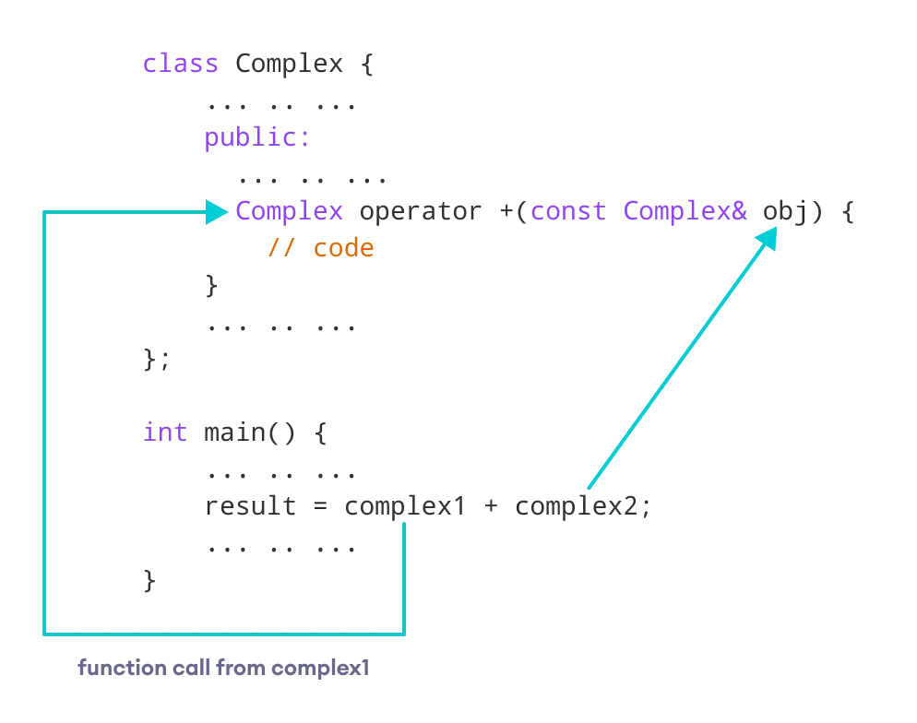

Slide 30
Friend Function
If a function is defined as a friend function in C++, then the protected and private data of a class can be accessed using the function.
By using the keyword friend compiler knows the given function is a friend function.
For accessing the data, the declaration of a friend function should be done inside the body of a class starting with the keyword friend.

Slide 31
Declaration of friend function in C++
class class_name
{
friend data_type function_name(argument/s); // syntax of friend function.
};

Slide 32
class Box {
private:
int length;
public:
Box(): length(0) { }
friend int printLength(Box); //friend function
};
int printLength(Box b)
{
b.length += 10;
return b.length;
}

Slide 33
Characteristics of a Friend function:
The function is not in the scope of the class to which it has been declared as a friend.
It cannot be called using the object as it is not in the scope of that class.
It can be invoked like a normal function without using the object.
It cannot access the member names directly and has to use an object name and dot membership operator with the member name.

Slide 34
Constant functions
The const member functions are the functions which are declared as constant in the program. The object called by these functions cannot be modified. It is recommended to use const keyword so that accidental changes to object are avoided.
Syntax:
return_type function_name() const
{
// function logic
}

Slide 35
Type Casting operators
C++ supports following 4 types of casting operators:
1. const_cast
2. static_cast
3. dynamic_cast
4. reinterpret_cast

Slide 36
1. const_cast
const_cast is used to cast away the constness of variables. Following are some interesting facts about const_cast.
2:Static Cast:
This is the simplest type of cast that can be used. It is a compile-time cast. It does things like implicit conversions between types (such as int to float, or pointer to void*), and it can also call explicit conversion functions.
3:Dynamic Cast: A cast is an operator that converts data from one type to another type. In C++, dynamic casting is mainly used for safe downcasting at run time. To work on dynamic_cast there must be one virtual function in the base class. A dynamic_cast works only polymorphic base class because it uses this information to decide safe downcasting.

Slide 37
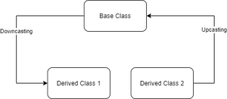
Downcasting: Casting a base class pointer (or reference) to a derived class pointer (or reference) is known as downcasting. In figure 1 casting from the Base class pointer/reference to the “derived class 1” pointer/reference showing downcasting (Base ->Derived class).
Upcasting: Casting a derived class pointer (or reference) to a base class pointer (or reference) is known as upcasting. In figure 1 Casting from Derived class 2 pointer/reference to the “Base class” pointer/reference showing Upcasting (Derived class 2 -> Base Class).

Slide 38
reinterpret_cast
reinterpret_cast is a type of casting operator used in C++.
It is used to convert a pointer of some data type into a pointer of another data type, even if the data types before and after conversion are different.
It does not check if the pointer type and data pointed by the pointer is same or not.
int* p = new int(65);
char* ch = reinterpret_cast<char*>(p);

Slide 39
Purpose for using reinterpret_cast
reinterpret_cast is a very special and dangerous type of casting operator. And is suggested to use it using proper data type i.e., (pointer data type should be same as original data type).
It can typecast any pointer to any other data type.
It is used when we want to work with bits.
If we use this type of cast then it becomes a non-portable product. So, it is suggested not to use this concept unless required.
It is only used to typecast any pointer to its original type.
Boolean value will be converted into integer value i.e., 0 for false and 1 for true.

Slide 40
Streams
In C++, a stream refers to a sequence of characters that are transferred between the program and input/output (I/O) devices.
Stream classes in C++ facilitate input and output operations on files and other I/O devices. These classes have specific features to handle program input and output, making it easier to write portable code that can be used across multiple platforms.
To use streams in C++, you need to include the appropriate header file. For instance, to use input/output streams, you would include the iostream header file. This library provides the necessary functions and classes to work with streams, enabling you to read and write data to and from files and other I/O devices.

Slide 41
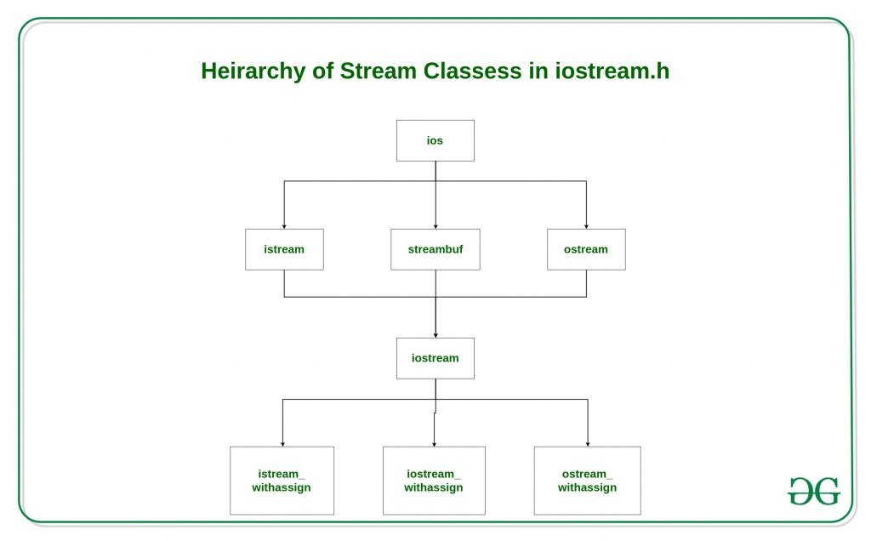

Slide 42
ios class is topmost class in the stream classes hierarchy. It is the base class for istream, ostream, and streambuf class.
istream and ostream serves the base classes for iostream class. The class istream is used for input and ostream for the output.
Class ios is indirectly inherited to iostream class using istream and ostream. To avoid the duplicity of data and member functions of ios class, it is declared as virtual base class when inheriting in istream and ostream as
class istream: virtual public ios{};
class ostream: virtual public ios{};

Slide 43
The istream class: This class is responsible for handling input stream. It provides number of function for handling chars, strings and objects such as get, getline, read, ignore, putback etc..
char x;
// used to scan a single char
cin.get(x);
cout << x;

Slide 44
The ostream class:
The ostream class: This class is responsible for handling output stream. It provides number of function for handling chars, strings and objects such as write, put etc..
char x;
// used to scan a single char
cin.get(x);
// used to put a single char onto the screen.
cout.put(x);

Slide 45
Unformatted input/output operations In C++
In C++, the function getline() and write() provide a more efficient way to handle line-oriented inputs and outputs. getline() function reads the complete line of text that ends with the new line character. This function can be invoked using the cin object.
char line[100];
// Get the input
cin.getline(line, 10);
// Print the data
cout.write(line, 5);
cout << endl;
// Print the data
cout.write(line, 20);

Slide 46
Formatted console input/output functions
In C++, the formatted console input/output functions are used for performing input/output operations at the console by formatting the data in a particular format.
Some of the most important formatted console input/output functions in C++ are
width(int width)
Using this function, we can specify the width of a value to be displayed in the output at the console.
fill(char ch) Using this function, we can fill the unused white spaces in a value(to be printed at the console), with a character of our choice.
peek() The function returns the next character from the input stream, without removing it from the stream.

