Slide 1
File Handling

Slide 2
C++ I/O Features
C++ defines its own object-oriented I/O system.
C++ I/O system supplies consistent interface to the programmer independent of actual device.
A stream is a logical device that produces or consumes information.
Two types of streams:
Text stream which is a sequence of characters.
Binary stream which is a sequence of bytes, no character translation.

Slide 3
Streams in C++ :-
We give input to the executing program and the execution program gives back the output. The sequence of bytes given as input to the executing program and the sequence of bytes that comes as output from the executing program are called stream. In other words, streams are nothing but the flow of data in a sequence.
The input and output operation between the executing program and the devices like keyboard and monitor are known as “console I/O operation”. The input and output operation between the executing program and files are known as “disk I/O operation”.

Slide 4
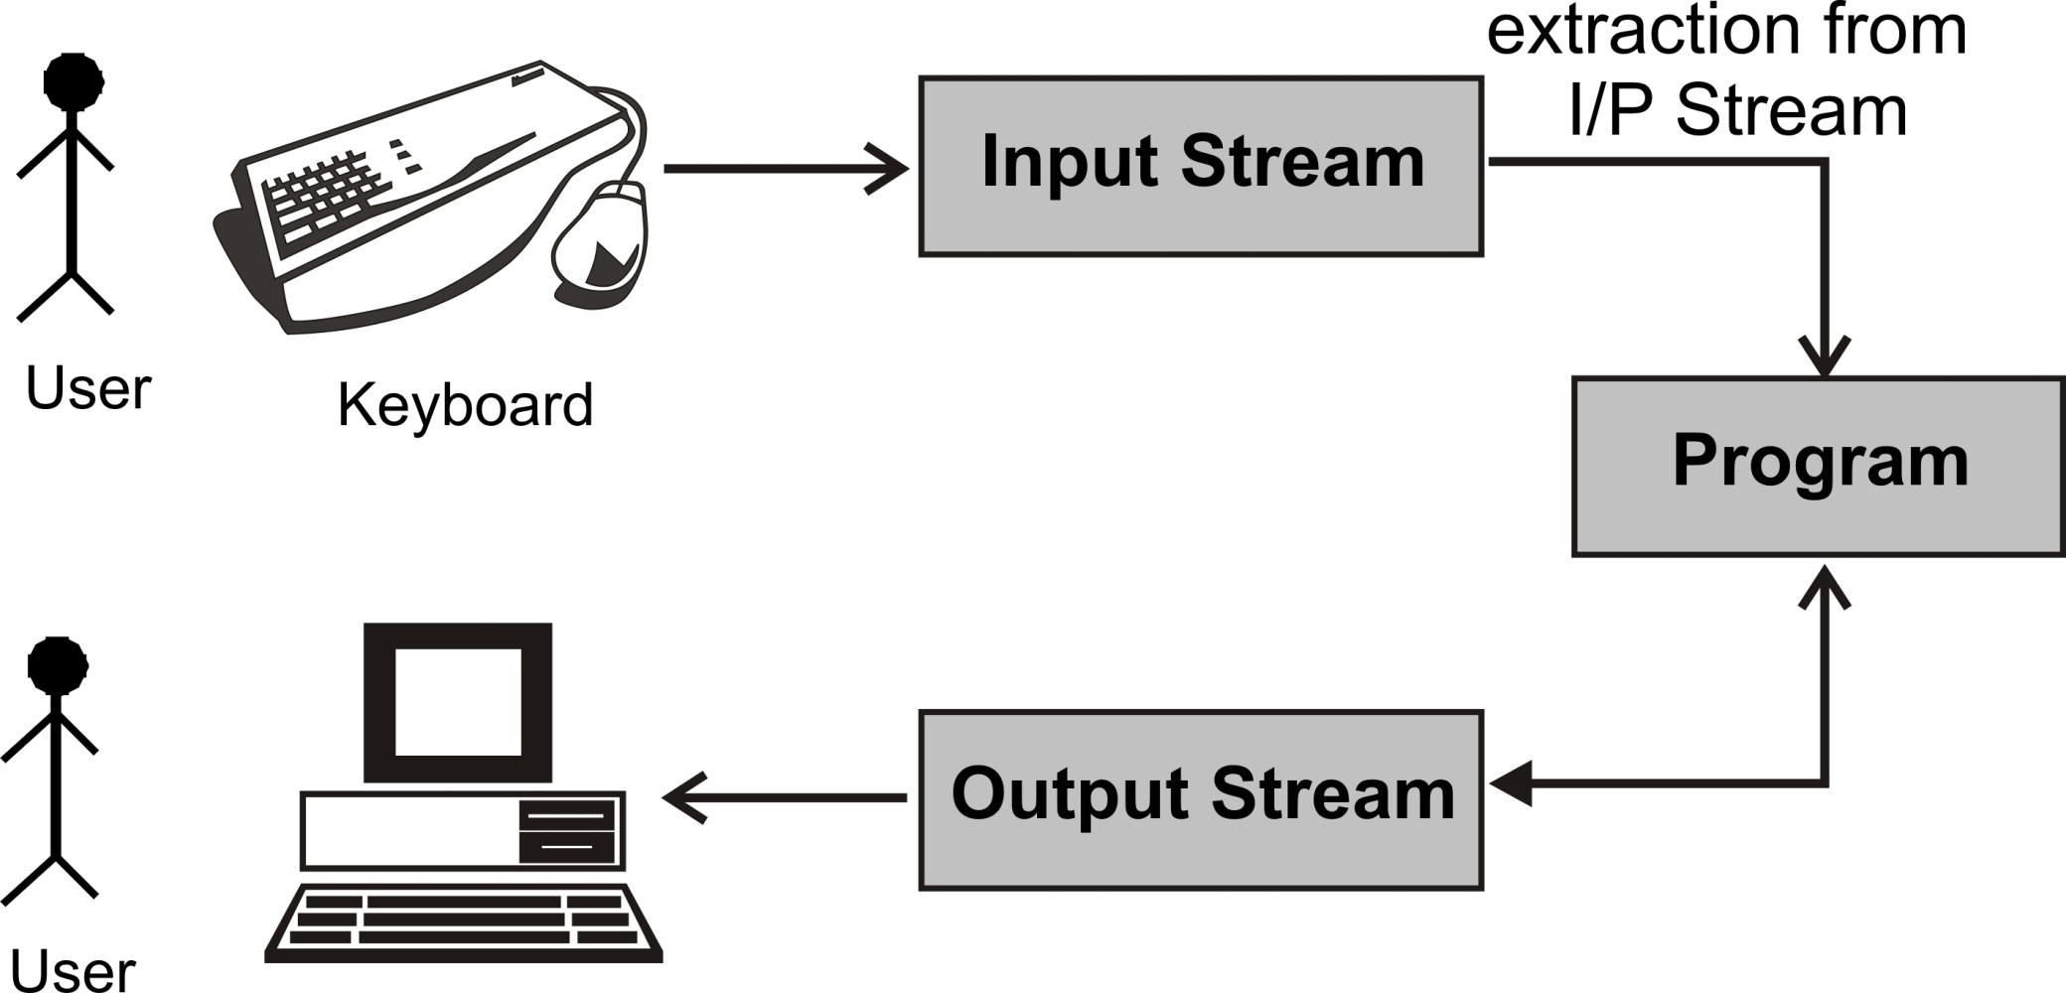
Data Stream

Slide 5
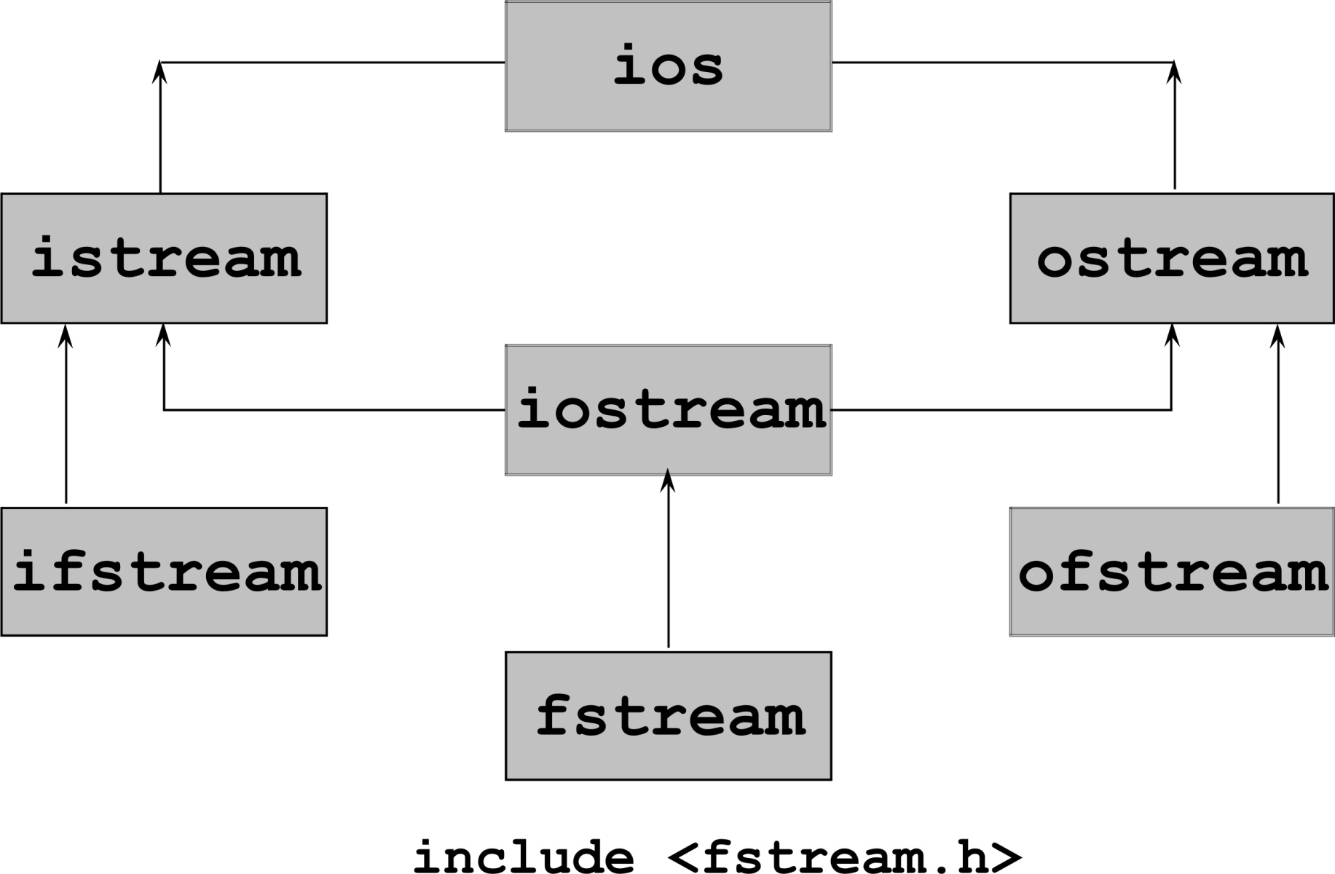
Stream Class for File I/O

Slide 6
IOS
1. ios:-
ios stands for input output stream.
This class is the base class for other classes in this class hierarchy.
This class contains the necessary facilities that are used by all the other derived classes for input and output operations.

Slide 7
1: ifstream:-
This class provides input operations.
It contains open() function with default input mode.
Inherits the functions get(), getline(), read(), seekg() and tellg() functions from the istream.
2:. ofstream:-
This class provides output operations.
It contains open() function with default output mode.
Inherits the functions put(), write(), seekp() and tellp() functions from the ostream.
3: fstream:-
This class provides support for simultaneous input and output operations.
Inherits all the functions from istream and ostream classes through iostream.

Slide 8
file handling
file handling we need to follow the following steps:-
STEP 1-Naming a file
STEP 2-Opening a file
STEP 3-Writing data into the file
STEP 4-Reading data from the file
STEP 5-Closing a file.

Slide 9
Open File
We can open file by
1. passing file name in constructor at the time of object creation
2. using the open method
Open File by using constructor
ifstream (const char* filename, ios_base::openmode mode = ios_base::in);
ifstream fin(filename, openmode) by default openmode = ios::in
ifstream fin(“filename”);
Open File by using open method
Calling of default constructor
ifstream fin;
fin.open(filename, openmode)
fin.open(“filename”);

Slide 10
Opening a File
File can be opened in two ways
Using constructor function of a class
Using function open()
ofstream outfile(“result”);
outfile.open(“result”);

Slide 11
Using Constructor to Open a File
Facilitates file operations
#include<fstream>
using namespace std;
int main()
{
ofstream outfile(“result”);
...
outfile.close();
return 0;
}
outfile is an object of class ofstream
Constructor will open file in write mode
Closes file
When file object goes out of scope, corresponding destructor is called which closes the file.

Slide 12
Using open() to Open File
open() associates the file stream with the file.
open() is a member function of ofstream, ifstream and fstream classes.
void ifstream::open(char* filename,mode=ios::in);
void ofstream::open(char* filename,mode=ios::out|
ios::trunc );
void fstream::open(char* filename,mode=ios::in |
ios::out);

Slide 13
ofstream outFile("demo.txt"); // open file for writing
if (!outFile) {
cout << "File could not be opened!" << endl;
}else{
outFile << "Hello, this is a demo file.\n";
outFile << "C++ File Handling is easy!" << endl;
outFile.close(); // close the file
cout << "Data written successfully!" << endl;
}

Slide 14
#include <iostream>
#include <fstream> // for file handling
using namespace std;
int main() {
#include <iostream>
#include <fstream>
using namespace std;
int main() {
ifstream inFile("demo.txt"); // open file for reading
string line;
if (!inFile) {
cout << "File not found!" << endl;
return 1;
}
cout << "Reading from file:" << endl;
while (getline(inFile, line)) { // read line by line
cout << line << endl;
}
inFile.close();
return 0;
}
return 0;
}

Slide 15
Types of File Opening Modes
Parameter | Meaning
ios::app | Append to end of file
ios::binary | Binary file.
ios::in | Open file for reading only (default arg).
ios::nocreate | Open fails if the file does not exist.
ios::noreplace | Open fails if the file already exists.
ios::out | Open file for writing only (default arg).
ios::trunc | Causes contents of pre-existing with same file name to be destroyed.

Slide 16
Binary File Storage:Writing class object into file
A pair of functions write() and read() are used to access the file in binary mode.
istream &read(char *buf, long num);
ostream &write(const char *buf, long num);
class CStudent {
int roll_no;
char name[30];
char grade;
public:
void accept();
void display();
};
CStudent S1,S2;
S1.accept();
out.write((char*)&S1,sizeof(CStudent);
...
in.read((char*)&S2,sizeof(CStudent));
S2.display();
...

Slide 17
In C++, random access is achieved using:
seekg(pos) → move the read pointer (get).
seekp(pos) → move the write pointer (put).
tellg() → current read position.
tellp() → current write position.

Slide 19
Random Access in Files
Random access is achieved using seekg() and seekp() functions.
seekg()/seekp() moves get/put pointer offset number of characters from the specified origin.
origin must be one of the three values:
ios::beg Beginning-of-file
ios::cur Current location
ios::end End-of-file
istream::seekg(offset,origin)
ostream::seekp(offset,origin)

