Slide 1

Project Presentation of CO-OP Project at Industry (Module-2) (22CS421)
On
Managing Complex Campus Networks Using Secure Software Defined Networking (SDN)
Names: Nikhil, Bharat, Nampreet Singh, Jatin Sharma
Roll No.: 2210990609, 2210990212, 2210990596, 22109911714
Supervised By
Dr. Preeti Saini
Department of Computer Science and Engineering,
Chitkara University, Punjab

Slide 2
Introduction
What Is Secure SDN?
Secure SDN combines the speed and flexibility of Software Defined Networking with the authentication rigor of a Public Key Infrastructure — delivering a unified, centralized platform for configuration, monitoring, and policy enforcement.
Control Plane
Data Plane
Management Plane
A central controller executes all management functions — RADIUS, NTP, load balancing — independent of the data plane
OpenFlow-compliant switches handle packet forwarding based on rules pushed down from the controller
Provides automated device configuration, BYOD support, and strong authentication and authorization policies

Slide 3


Problem Statement
Campus Networks Are Under Pressure
Today's university networks face mounting complexity: an explosion of connected devices, rising user expectations for speed and security, and infrastructure built on heterogeneous hardware from competing vendors.
Traditional network management offers insufficient centralized control, leaving administrators reactive rather than proactive — and unable to keep pace with the dynamic demands of modern academic environments.
Existing management frameworks lack the flexibility and security depth required for modern higher education campuses.

Slide 4

History
2006 — Stanford
Clean Slate research initiative introduces the foundational concept of Software Defined Networking
2009 — Decoupling
Separation of control plane from data plane lays the groundwork for centralized network management
2012 — Google
Google successfully deploys SDN across its global backbone network, proving enterprise-scale viability
Today
SDN is a primary architectural focus across technology companies and higher education institutions worldwide

Slide 5
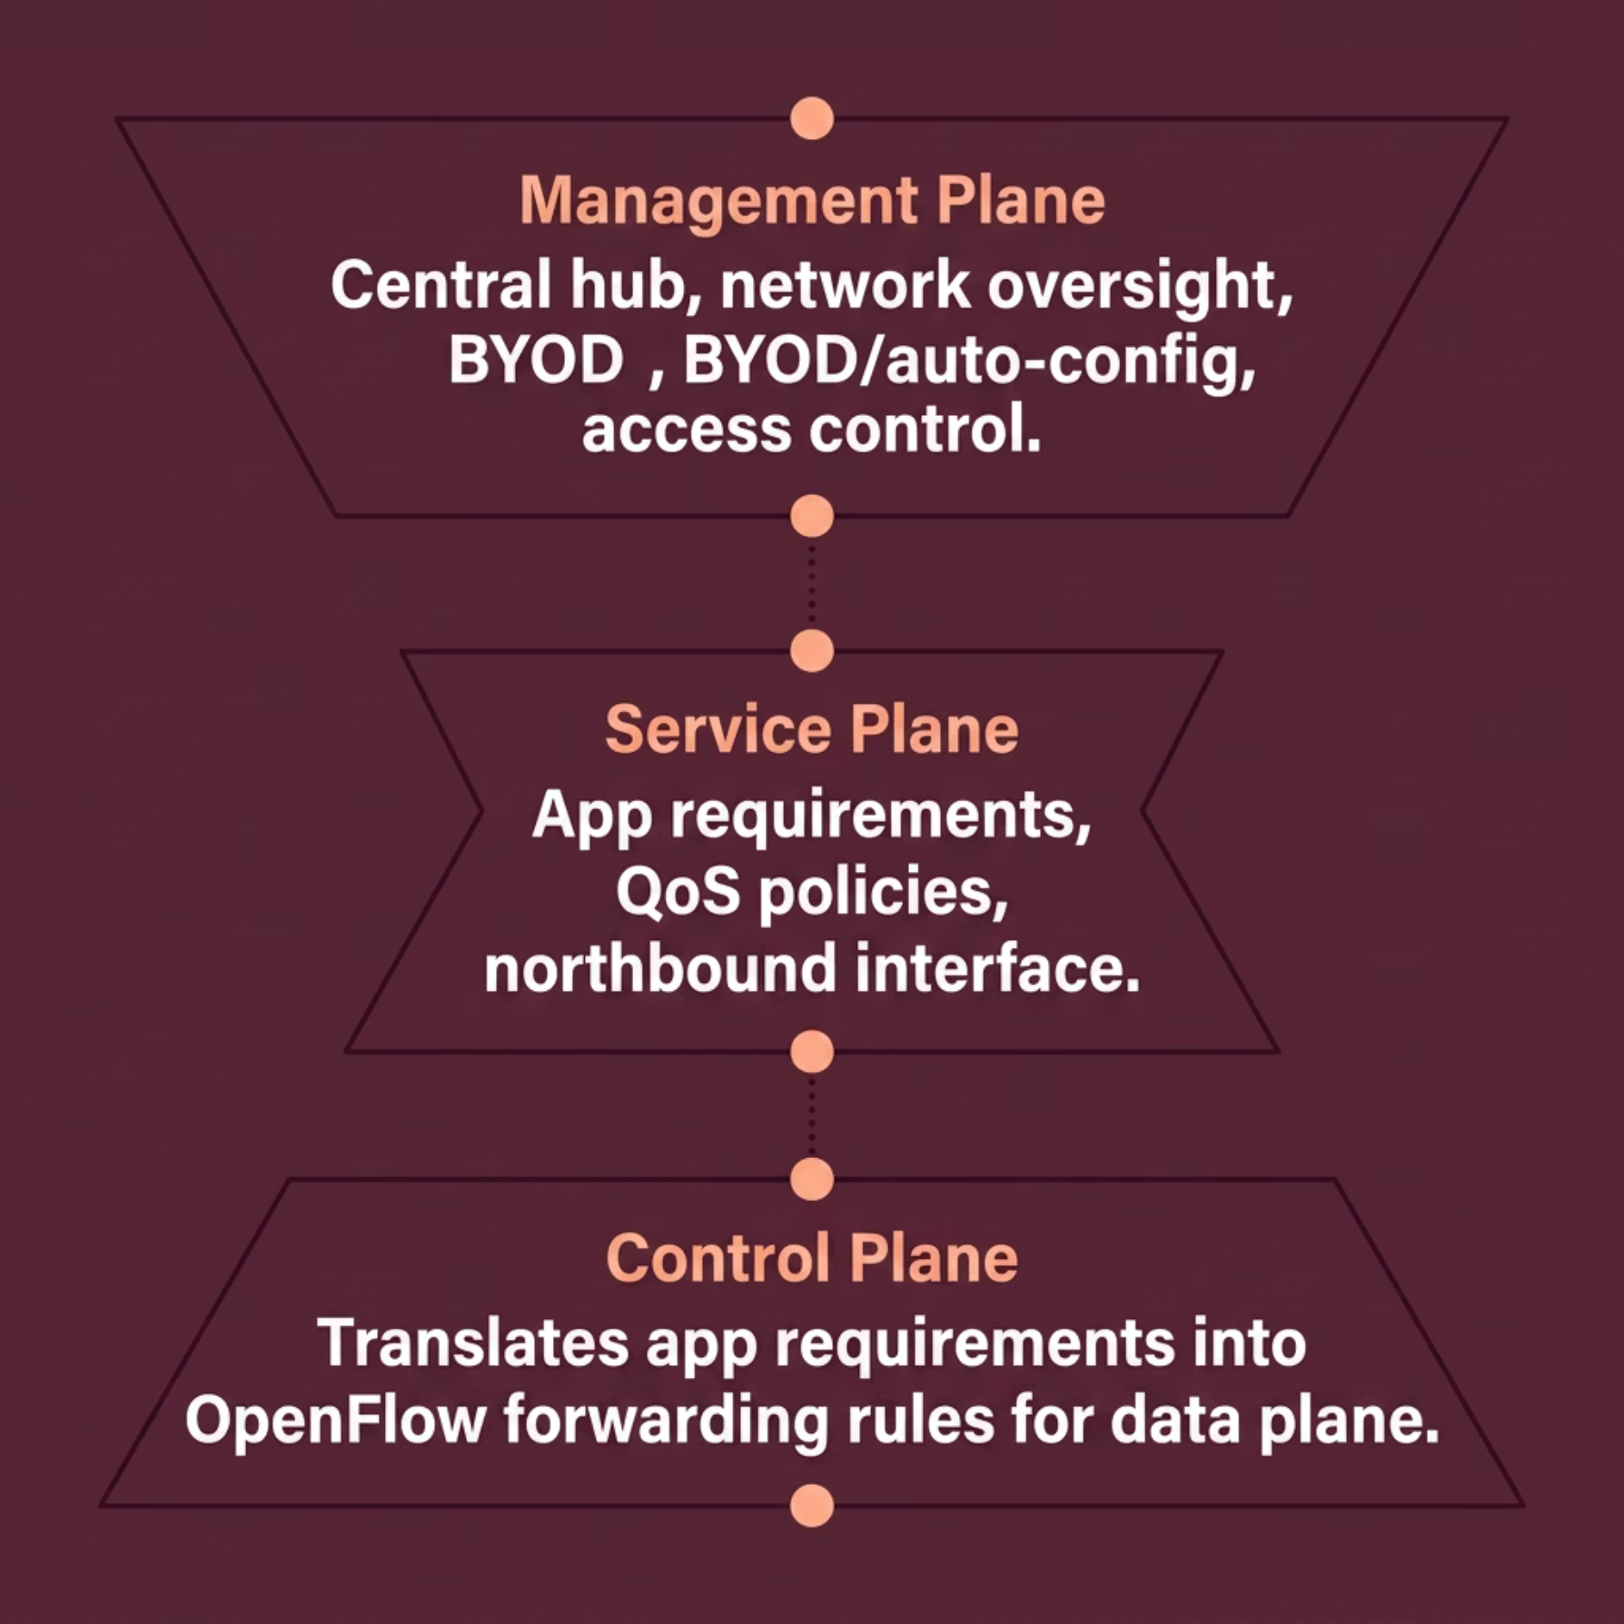

Objective : Three-Plane System Architecture
The proposed campus network management system is organized into three coordinated planes, each with a distinct operational role:
Management Plane
Control Plane
Data Plane
Central hub for orchestration, device configuration, and policy enforcement
Translates application requirements into OpenFlow forwarding rules via the northbound interface
OpenFlow-compliant switches execute forwarding decisions and collect real-time network status

Slide 6
Algorithm 1: Dynamic Access Control
The Dynamic Access Control Algorithm (DACA) evaluates each user's role and device type at connection time to assign granular access privileges — automatically and in real time.
Enhanced Security
User Role
Laptop
Mobile
IoT / Other
Unauthorized access is restricted based on role and device policies
Faculty
Full Access
Limited Access
No Access
Student
Limited Access
Internet Only
No Access
Adaptive Control
Staff
Limited Access
Limited Access
No Access
Access levels adjust automatically as roles or device types change
Resource Efficiency
Users access only what they need, optimizing network utilization

Slide 7

Algorithm 2: Anomaly Detection & Mitigation
Monitor in Real-Time
Detect Deviation
Continuously collect live traffic metrics.
Use ML to compare traffic to baseline.
This algorithm continuously monitors network traffic and uses machine learning and behavioral analysis to establish a baseline of normal operations. Any significant deviation triggers an automated mitigation response.
Establish Baseline
Trigger Mitigation
Build baseline from historical traffic data.
Isolate, rate-limit, and notify admin.
Proactive Security
Automated Response
Adaptive Learning
Threats are identified before they escalate into breaches
Isolates affected devices, applies rate limiting, and alerts administrators
Models improve accuracy over time by adapting to evolving traffic patterns

Slide 8

Algorithm 3: Traffic Engineering & QoS Optimization
The Traffic Engineering and QoS Optimization Algorithm dynamically reroutes traffic to eliminate congestion and enforces application-specific quality-of-service policies — ensuring a seamless experience for every user on the network.
Congestion Detection
QoS Policy Enforcement
Analyzes real-time traffic to identify bottlenecks and reroute flows dynamically
Applies bandwidth reservation, rate limiting, and packet prioritization per application
Dynamic Adaptation
Continuously re-evaluates traffic patterns and adjusts routing paths in real time

Slide 9
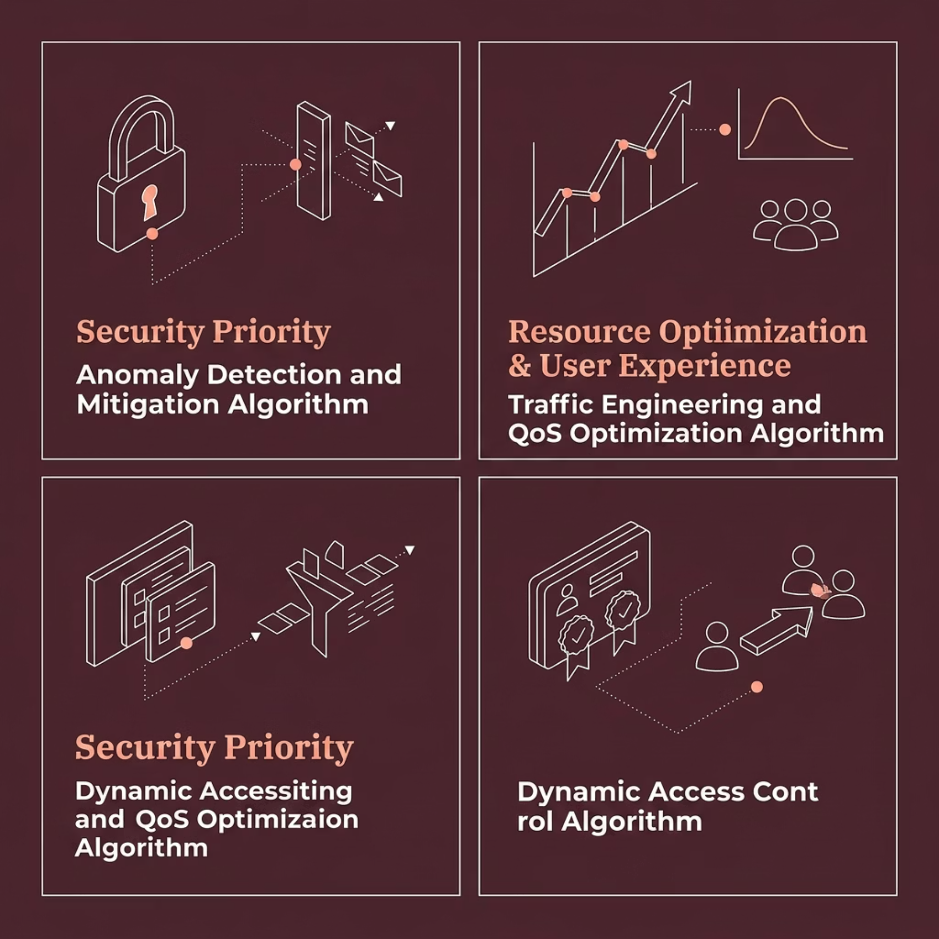

Methodology
In practice, all three algorithms operate together. But when prioritization is needed, the following guidance applies:
No single algorithm is universally optimal. The right choice depends on the institution's primary network management goals. When deployed together within a well-integrated SDN architecture, the three algorithms address security, performance, and access control as complementary, interdependent concerns.
Regular monitoring and fine-tuning are essential to sustaining algorithmic efficiency across changing network conditions.

Slide 10




Conclusion
Optimized Performance
Enhanced Security
Better User Experience
Scalable & Adaptable
SDN architecture reduces congestion and improves bandwidth utilization across all campus network segments
DACA and Anomaly Detection algorithms dynamically manage access and proactively neutralize threats before escalation
QoS optimization guarantees reliable, prioritized access to critical applications for all campus users
The system accommodates evolving device types, user roles, and traffic demands — built for the future of higher education
Institutions that adopt Secure SDN architectures gain a measurable operational advantage — reducing administrative complexity while elevating network quality for every stakeholder.

Slide 11
Thank You

