Slide 1
MPI programming

Slide 2
Presentation Outline
Parallel Programming models
Introduction to MPI
Structure of MPI and Simple MPI program
Point to point communication calls
Collective Communication calls
Collective Computation
Demonstration of Sample MPI programs
Conclusion

Slide 3
Sample Parallel Programming Models
Shared Memory Programming
Processes share memory address space (threads model)
Transparent Parallelization
Compiler works magic on sequential programs
Directive-based Parallelization
Compiler needs help (e.g., OpenMP)
Message Passing
Explicit communication between processes (like sending and receiving emails)

Slide 4
Introduction to MPI
A message passing library specification
Message passing among processes in parallel computing
Meant for clusters and network of workstations
Message Passing Standard for Parallel Programs
MPI Implementation left to individual vendors.
Most commonly supports C, Fortran, C++ programs
Inter-process communication consists of
Synchronization
movement of data from one process’s address space to another’s.
Process
MPI
Process
MPI

Slide 5
Requisites for MPI Implementations
The Following features are needed in MPI Implementations
Allow efficient Communication between processes.
Allow overlap of computation and communication
Important considerations while using MPI
All parallelism is explicit: the programmer is responsible for correctly identifying parallelism and implementing parallel algorithms using MPI constructs
Notes:
13

Slide 6
Why Parallelization of codes?
Sequential code
Input
Sum(1..1000)
Output
Time taken = T
Parallel code
Sum(1..250)
Sum(251..500)
Output
Input
Sum(501..750)
Sum(751..1000)
Time = T/4 (Approx.)

Slide 7
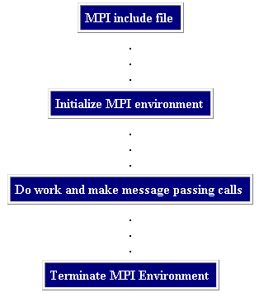
Structure of MPI Program

Slide 8
BaSIC MPI CAlls
Many parallel programs can be written using just these six mpi calls,
MPI_INIT – initialize the MPI library
MPI_COMM_SIZE - get the size of a communicator
MPI_COMM_RANK – get the rank of the calling process in the communicator
MPI_SEND – send a message to another process
MPI_RECV – receive a message to another process
MPI_FINALIZE – clean up all MPI state (must be the last MPI function called by a process)

Slide 9
Simple MPI Program
#include <stdio.h>
#include <mpi.h>
void main(int argc, char *argv[]) {
int rank, size;
MPI_Init(&argc, &argv); MPI_Comm_rank(MPI_COMM_WORLD, &rank); MPI_Comm_size(MPI_COMM_WORLD, &size);
printf("Process:%d out of %d\n", rank, size); MPI_Finalize();
}

Slide 10
Compiling and Running MPI Programs
C program compilation
$ mpicc filename.c
Fortran program compilation
$ mpiifort filename.f90 (Fortran)
Running C and Fortran mpi applications
$ mpirun –np <np> <exe-name>
$ mpirun –np <np> –machinefile <hostfilesname> <exe-name>
Where
-np: No. of processes to run on
-machinefile : List of possible machines to run the executable

Slide 11
Only 5 things to know before learning MPI function calls
Communications
Point to point communication
Collective communication
MPI Data types
Format of MPI Calls
Communicator
Rank

Slide 12
MPI Communications
Point-to-Point Communication
Blocking
Non Blocking
Collective Communication
Synchronization
Collective computation
Data Movement

Slide 13
MPI Basic Data types- C Programs
MPI Basic Data types - C
MPI Datatype
C Datatype
MPI_CHAR
Signed char
MPI_SHORT
Signed short int
MPI_INT
Signed int
MPI_LONG
Signed long int
MPI_UNSIGNED_CHAR
Unsigned char
MPI_UNSIGNED_SHORT
Unsigned short int
MPI_UNSIGNED
Unsigned int
MPI_UNSIGNED_LONG
Unsigned long int
MPI_FLOAT
Float
MPI_DOUBLE
Double
MPI_LONG_DOUBLE
Long double
MPI_BYTE

Slide 14
MPI Basic Data types – Fortran programs
MPI Datatype
Fortran Datatype
MPI_INTEGER
INTEGER
MPI_REAL
REAL
MPI_DOUBLE_PRECISION
DOUBLE PRECISION
MPI_COMPLEX
COMPLEX
MPI_LOGICAL
LOGICAL
MPI_CHARACTER
CHARACTER(1)
MPI_BYTE

Slide 15
Format of MPI Calls - C Language
Format | Rc = MPI_Xxxxx(parameter, ... )
Ex | Rc = MPI_Send(&buf,count,type,dest,tag,comm)
All MPI Functions are case sensitive.
All MPI calls begin with MPI_ followed by actual function name.
C programs should include the file mpi.h
Return_integer Rc is of type integer. It is set to MPI_SUCCESS upon success.

Slide 16
Format of MPI Calls- Fortran
(Contd…)
 | CALL MPI_XXXXX(parameter,..., ierr)
Ex | CALL MPI_SEND(buf,count,type,dest,tag,comm,ierr)
Case insensitive.
Fortran programs should include the file mpif.h
Additional parameter ierr to take care of the function status

Slide 17
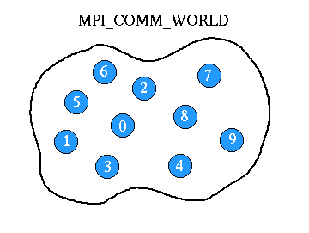
Communicator
The communicator is Communication Universe.
Processes that are allowed to communicate
Messages are sent / received within a given Universe.
MPI_COMM_WORLD is the default communicator.

Slide 18
What is ‘Rank’ in Communicator?
Rank:
Unique integer identifier for every process.
Assigned by the system during initialization.
Ranks are contiguous & begin at zero.
Used to specify the source and destination of messages.
Often used to control program execution (if rank=0 do this / if rank=1 do that).

Slide 19
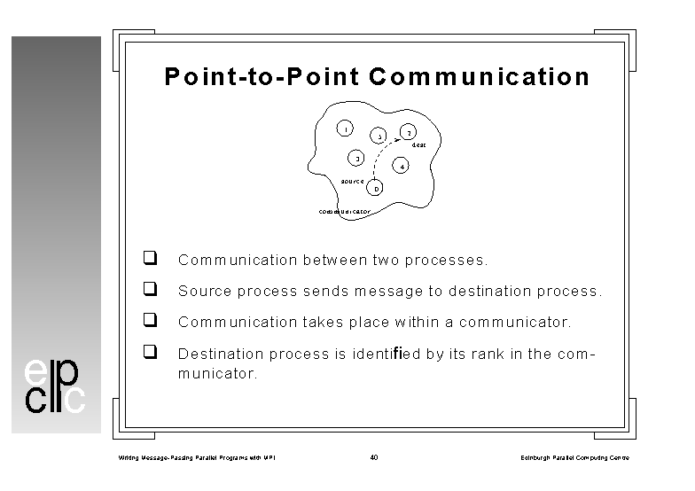
MPI Point-to-Point Communication
Communication between two processes.
Source process sends message to destination process.
Communication takes place within a communicator.
Destination process identified by its rank in the communicator.

Slide 20
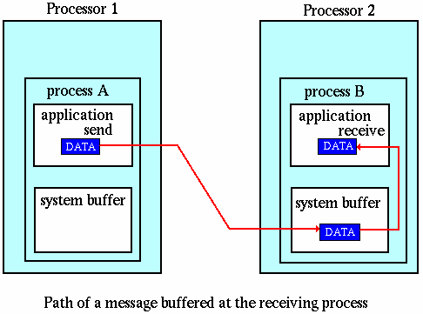
MPI Point-to-Point Communication
(Contd…)

Slide 21
MPI Send and Receive: Syntax
int MPI_Send(void *buf, int count, MPI_Datatype dtype, int dest, int tag, MPI_Comm comm);
int MPI_Recv(void *buf, int count, MPI_Datatype dtype, int source, int tag, MPI_Comm comm, MPI_Status *status);
When MPI_Recv routine returns, the received message data have been copied into the buffer; and the tag, source, and actual count of data received are available via the status argument

Slide 22
MPI Send and Receive: Blocking
strcpy(Message, "Hello India");
Destination = 0; source= 1; BUFFER_SIZE = 32;
MPI_Send (Message, BUFFER_SIZE, MPI_CHAR, Destination, tag,MPI_COMM_WORLD);
MPI_Recv(Message, BUFFER_SIZE, MPI_CHAR, source, tag,MPI_COMM_WORLD, &status);
Arguments of MPI_send & Receive:
Message: Address where the data starts.
BUFFER_SIZE: Number of elements (items) of data in the message.
MPI_CHAR: Datatype of the message passed / received.
Destination/source: Rank of Receiving or Sending processes
tag: Integer to distinguish messages
MPI_COMM_WORLD: Communicator, status: contains status

Slide 23
MPI Send and Receive: Fortran Syntax
MPI_SEND(buf,count,datatype,dest,tag,comm,ierr)
MPI_RECV(buf,count,datatype,source,tag,comm,status,ierr )
When MPI_RECV routine returns, the received message data have been copied into the buffer; and the tag, source, and actual count of data received are available via the status argument

Slide 24
MPI Send and Receive- Fortran
….
data Message/'Hello India'/
Destination = 0
MPI_SEND (Message, BUFFER_SIZE, MPI_CHAR, Destination, tag,MPI_COMM_WORLD,ierr)
do iproc=1 ,numprocs-1
MPI_RECV(Message, BUFFER_SIZE, MPI_CHAR, iproc, tag,MPI_COMM_WORLD, &status,ierr)
enddo
Arguments of MPI_SEND & RECV:
Message: Address where the data starts.
BUFFER_SIZE: Number of elements (items) of data in the message.
MPI_CHAR: Datatype of the message passed / received.
Destination/iproc: Sending or Receiving processes
tag: Integer to distinguish messages
MPI_COMM_WORLD: Communicator

Slide 25
Example MPI Program with Send/Receive – Fortran. Contd…
print *, 'Machine name ',processor_name
Root = 0
iproc=2
tag = 0
MessageSize = 11
if(MyRank .ne. Root) then
Destination = Root
call MPI_SEND(Message, MessageSize, MPI_CHARACTER, Destination,
$ tag, MPI_COMM_WORLD, ierror)
else
do iproc = 1, Numprocs-1
call MPI_RECV(Message, MessageSize, MPI_CHARACTER, iproc, tag,
$ MPI_COMM_WORLD, status, ierror)
print *, Message,' from Process with Rank ', iproc
enddo
endif
call MPI_FINALIZE( ierror )
stop
end

Slide 26
Non blocking Communication
It is an enhancement to blocking communication
The non-blocking operations return (immediately) ‘‘request handles” that can be waited on and queried
It allows overlapping computation and communication
One can also test without waiting using MPI_Test
Anywhere you use MPI_Send or MPI_Recv, you can use the pair of MPI_Isend/MPI_Wait or MPI_Irecv/MPI_Wait
MPI_ISEND(buf, count, datatype, dest, tag, comm, request)
MPI_IRECV(buf, count, datatype, src, tag, comm, request)
MPI_WAIT(request, status)
MPI_Test(request, flag, status)

Slide 27
Blocking vs. Nonblocking Communication
MPI_SEND/MPI_RECV are blocking communication calls
Return of the routine implies completion
When these calls return the memory locations used in the message transfer can be safely accessed for reuse
For “send” completion implies variable sent can be reused/modified
Modifications will not affect data intended for the receiver
For “receive” variable received can be read
MPI_ISEND/MPI_IRECV are nonblocking variants
Routine returns immediately – completion has to be separately tested for
These are primarily used to overlap computation and communication to improve performance

Slide 28
Collective Communication - Introduction
Involves the sending and receiving of data among processes
All processes need to participate in the communication.
Usage of Point-to-point communication routines
Customized communicator
No message tags used

Slide 29
Collective Communications – Characteristics
Communications are locally blocking
Some routines use a root process to originate or receive all data
Synchronization is not guaranteed (implementation dependent)
Data amounts must exactly match
Different types
One-to-All
All-to-One
All-to-All

Slide 30
Collective Communications – Patterns
Data movement (Ex: Broadcast, Scatter, Gather)
Collective computation (Ex: SUM, MAX, MIN, etc)
Synchronization (Ex: Barrier synchronization)

Slide 31
MPI Collective Communication - Calls
Broadcast from one member to all other members
Gather data from an array spread across processors into one
array
Scatter data from one member to all members
All-to-all exchange of data
Global reduction (e.g., sum, min of "common" data elements)
Scan across all members of a communicator
Barrier synchronization

Slide 32
Data Movement – Calls
Broadcast
Gather and Gatherv
Scatter and Scatterv
Allgather and Allgatherv
Alltoall and Alltoallv

Slide 33
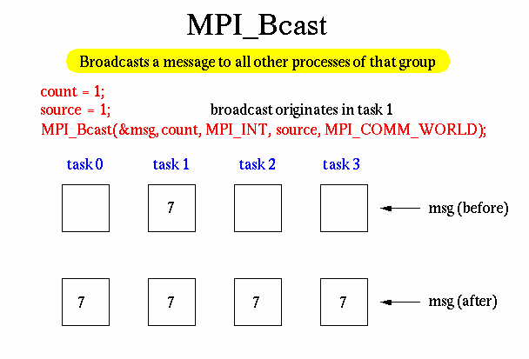
MPI Collective Communication - Broadcast
Send a message from the root process to all processes in the group, including the root process

Slide 34
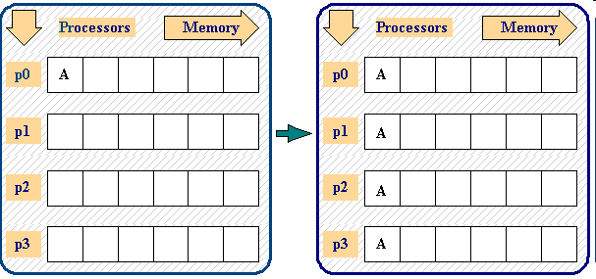
MPI Collective Communication – Broadcast…

Slide 35
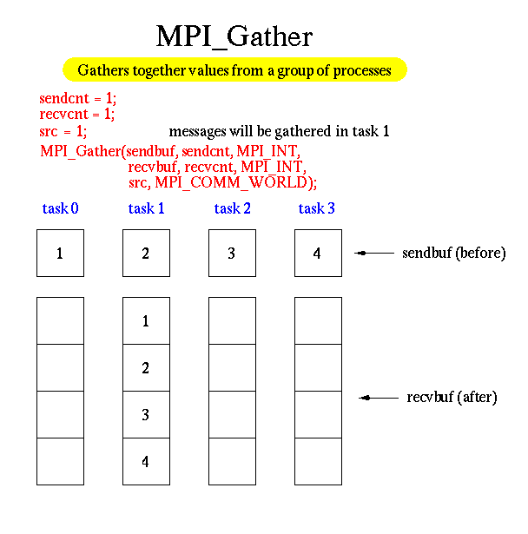
MPI Collective Communications- Gather
Each process sends the contents of its send buffer to the root process.
The root process receives the messages and stores them in rank order.

Slide 36
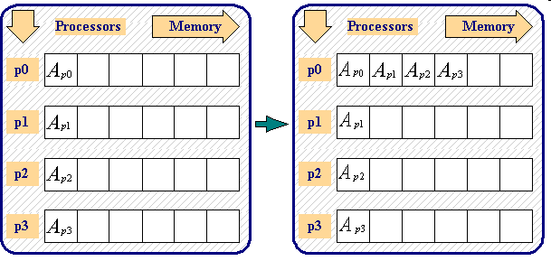
MPI_Gather…

Slide 37
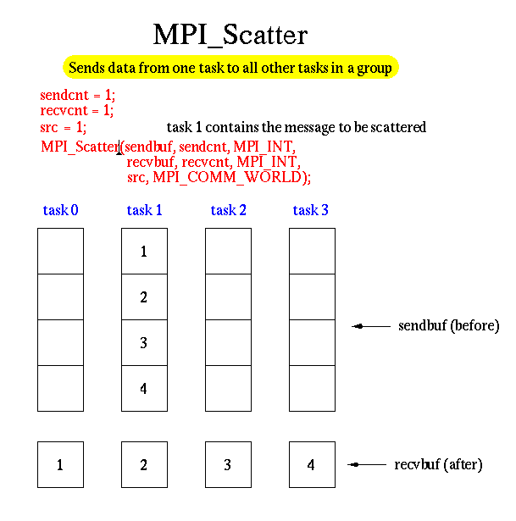
MPI Collective Communications – Scatter
The root process splits a buffer of data into chunks, then sends
each process in the group 1 chunk.
Reverse of GATHER operation

Slide 38
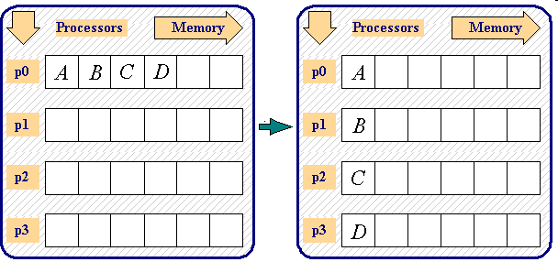
MPI _Scatter…

Slide 39
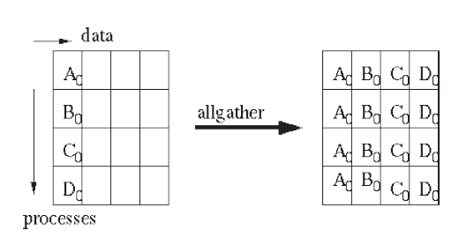
MPI Collective Communications –MPI_AllGather
Same as GATHER, except that all processes, not just root, receive the result
Data stored in rank order

Slide 40
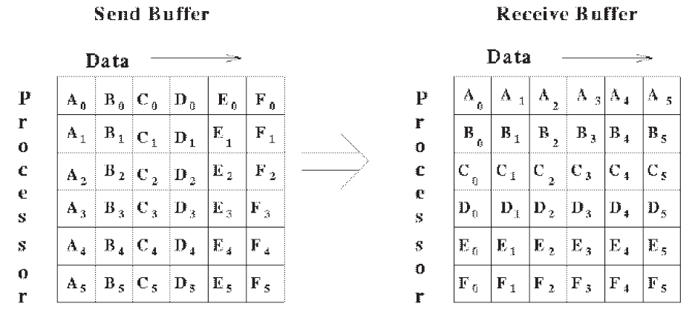
MPI Collective Communications – MPI_Alltoall
Extension to ALLGATHER
Each process sends distinct data to each receiver
Process i sends its jth block of data to process j
Process j stores data from process i in ith block

Slide 41
Data Movement – More info
All routines provided so far require equal chunk sizes.
There are so-called varying data size versions (with the exception of MPI_Bcast, of course) available.
The varying data size versions have a letter v appended to its names, e.g. MPI_Gather becomes MPI_Gatherv.

Slide 42
Collective Computation calls
Communication routines that include a computation
Computation function included in routine call may be either
An MPI predefined routine or
A user-supplied function
Two types of global computation routines:
Reduce
Scan

Slide 43
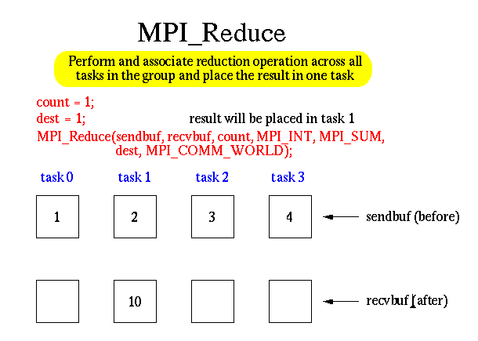
MPI_Reduce
Combine the elements of the input buffer of each process using a specified operation
Return result to root process

Slide 44
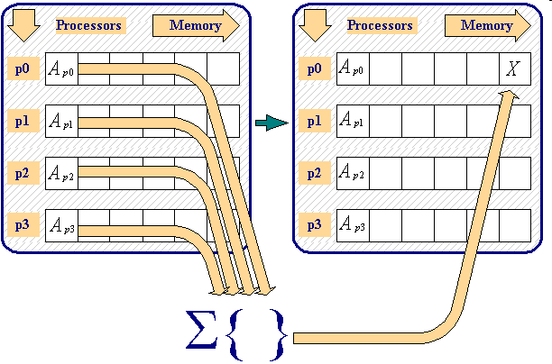
MPI _Reduce…

Slide 45
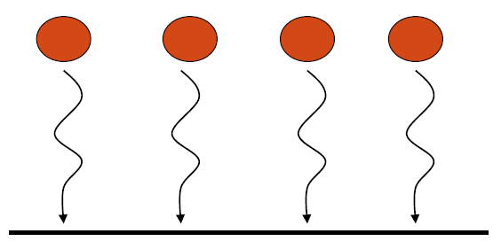
MPI Collective Communication - Barrier
Blocks the calling process until all group members have called the routine
C
int MPI_Barrier (comm);
Fortran
MPI_barrier (comm, ierror)

Slide 46
Predefined Operators:
Each of these operations makes sense for only certain data types
The MPI Standard lists the types accepted for each operation.
MPI Name
Operation
MPI_MAX
Maximum
MPI_MIN
Minimum
MPI_PROD
Product
MPI_SUM
Sum
MPI_MAXLOC
Maximum value and location

Slide 47
Performance Analysis of MPI Programs
Why Performance Analysis of MPI Applications
To get the benefit of parallelization
Tuning the Parallel algorithm
Tuning the application
Communication Vs Computation Time
Function Profiling

Slide 48
Debugging Parallel Applications
Through Command Line Interface
GDB
Valgrind
Through Graphical User Interface (GUI)
TotalView debugger
Valgrind

Slide 49
Conclusion
MPI helps for Portable parallel Program Development
Rich set of collective functions
MPI helps for developing Scalable Parallel Programs
Simplified sending & receiving of messages
No language binding issues

Slide 50
References
Books
Parallel Programming in C with MPI and OpenMP, by Michael J. Quinn, Tata McGraw Hill
Approx. Rs. 200/-
Using MPI, 2nd Edition, by William Gropp, Ewing Lusk, Anthony Skjellum
MPI: The Complete Reference, by Marc Snir, Steve Otto, Steven Huss-Lederman, David Walker, Jack Dongarra
MPICH Org https://www.mpich.org/

Slide 51
Web Pointers
MPI Standard : http://www.mpi-forum.org/docs/docs.html
MPI Forum : http://www.mpi-forum.org/
MPI implementations:
MPICH : http://www.mpich.org
MVAPICH : http://mvapich.cse.ohio-state.edu/
Intel MPI: http://software.intel.com/en-us/intel-mpi-library/
Microsoft MPI: www.microsoft.com/en-us/download/details.aspx?id=39961
Open MPI : http://www.open-mpi.org/
IBM Spectrum MPI, Cray MPI, TH MPI, …
Several MPI tutorials can be found on the web

Slide 52
Thank You!!

