Slide 1
Distributed systems and Cloud Computing

Slide 2
Introduction – Cloud computing
New delivery model for on-demand access to share pool of configured resources
Cloud service model
Infrastructure-as-a-Service
Platform-as-a-Service
Software-as-a-Service
Various domains
e-Governance, Health, Banking
Scientific Computing, Big Data
Major Challenge
Developing or Migrating Application to Cloud

Slide 3

SuMegha Lab kit - Overview
Sophisticated package that helps the users to set up their own private HPC Cloud Infrastructure
Automated Installation of Cloud components - Virtualization, Cloud Operating System, Management, Deploying User Interfaces and Running Cloud Services
Provides the enablement of the complex parallel environments required for development and deployment of Scientific Applications
Helps the Research Labs to set up Hadoop Cluster at multiple levels quickly to test various Data Intensive Algorithms

Slide 4
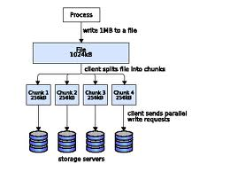

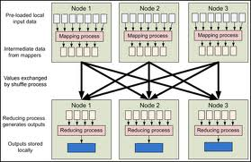



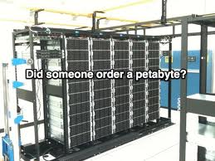
Scientific Cloud Service Offerings
Flow diagram
Small
GUI
Virtual Machine
(OS, Time, Type)
IaaS
Medium
PaaS
Large
SaaS
Cloud Portal
( Selects the Resource)
Virtual Cluster
(No. of nodes, type,
Time)
MPI Cluster
(No. of nodes, Time)
PSE for
Climate Modelling
Hadoop Cluster
(No. of nodes,
Time)
Job Submission Portal

Slide 5
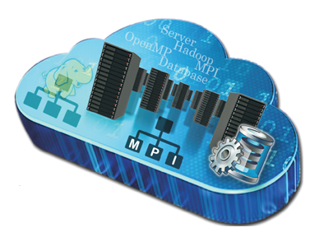
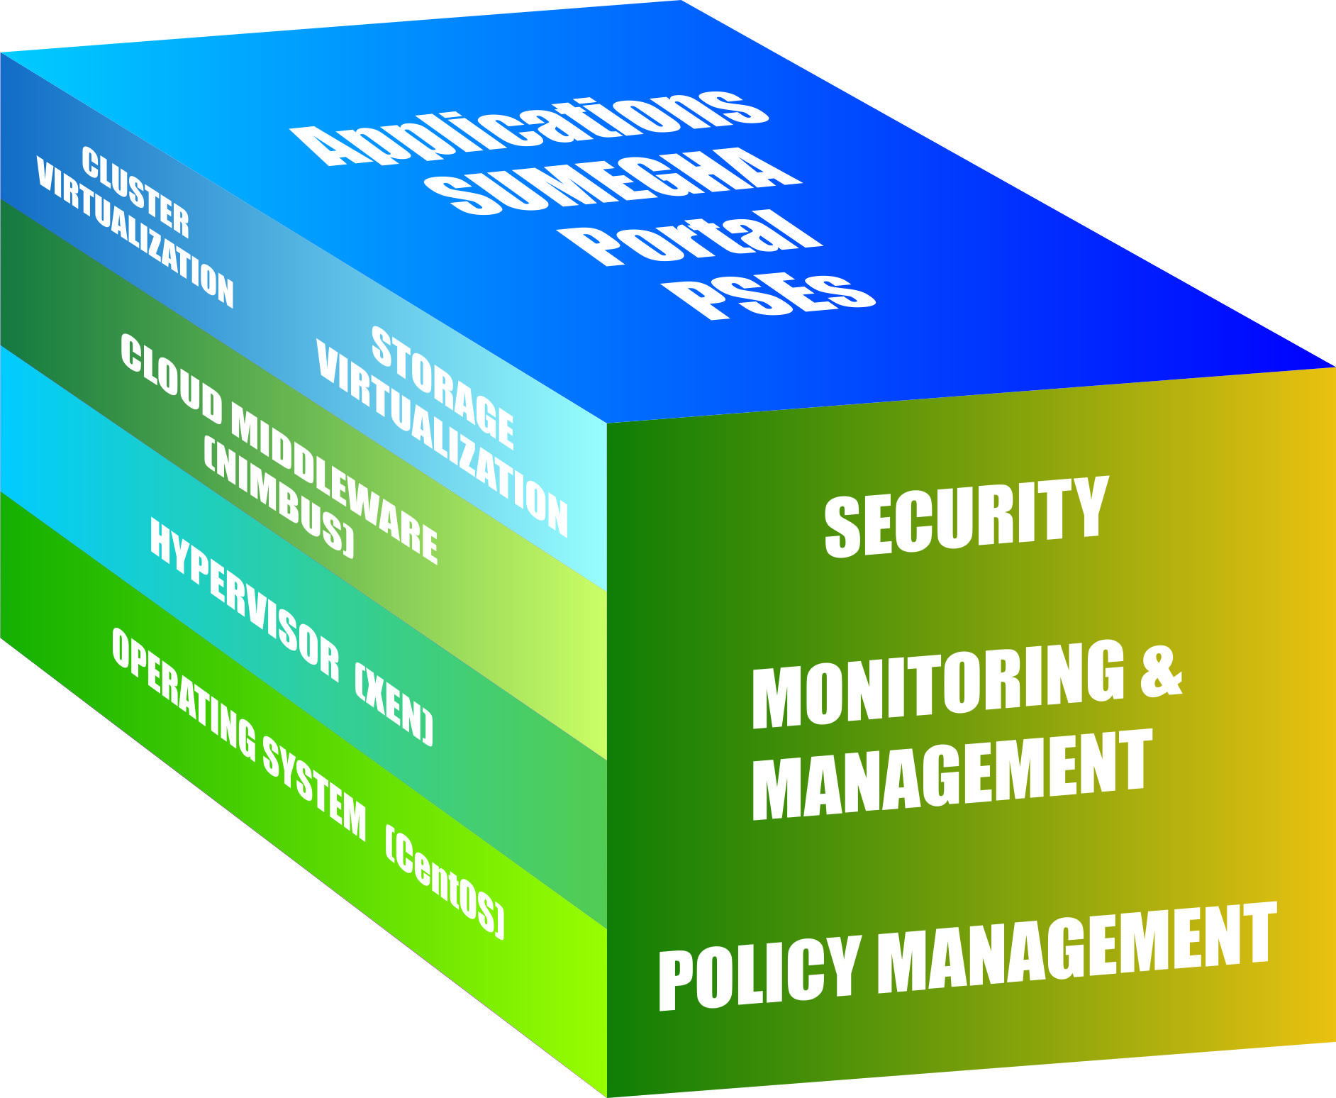
SuMegha Cloud Stack
Auto installation of cloud stack
Creation of Virtual clusters and Virtual machines
Provides HPC PaaS with OpenMP, MPI
SuMegha Portal for management of cloud services
Development and deployment of Scientific App.
IaaS - MPI & Hadoop Clusters and Virtual Storage
PaaS - MPI, Hadoop and OpenMP parallel Env
SaaS - Job Submission Portal and PSEs

Slide 6
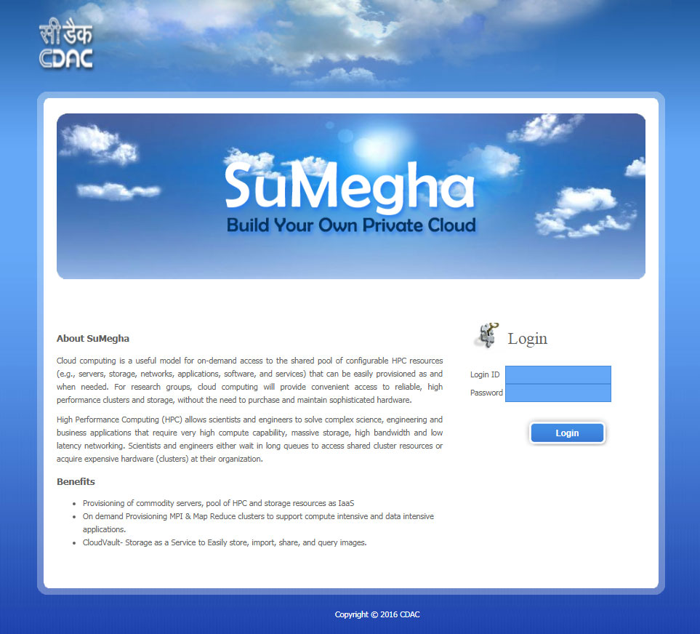

Slide 7
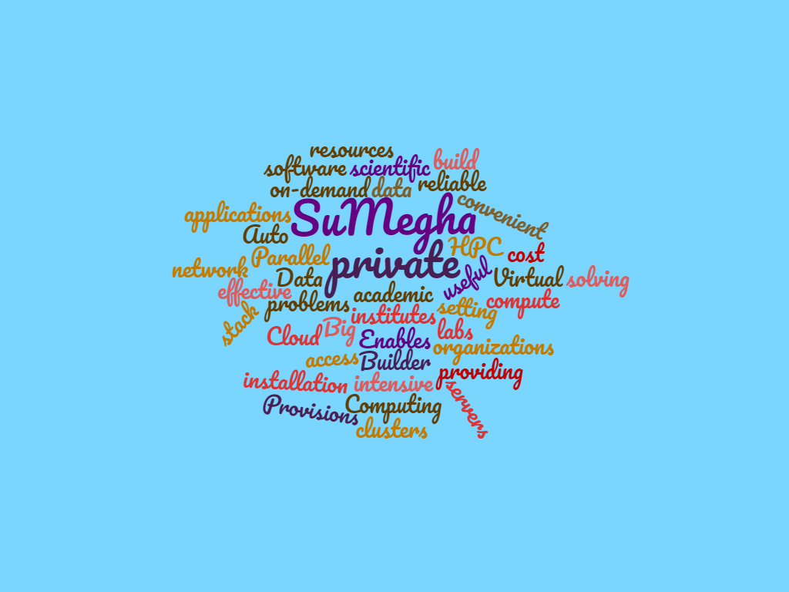
SuMegha Ecosystem
Notes:
Make it uncluttered

Slide 8




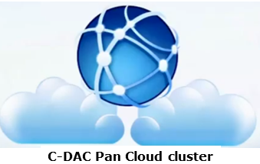


Installations and Awards
Awards
Skoch Order of Merit 2015, 2019

Slide 9
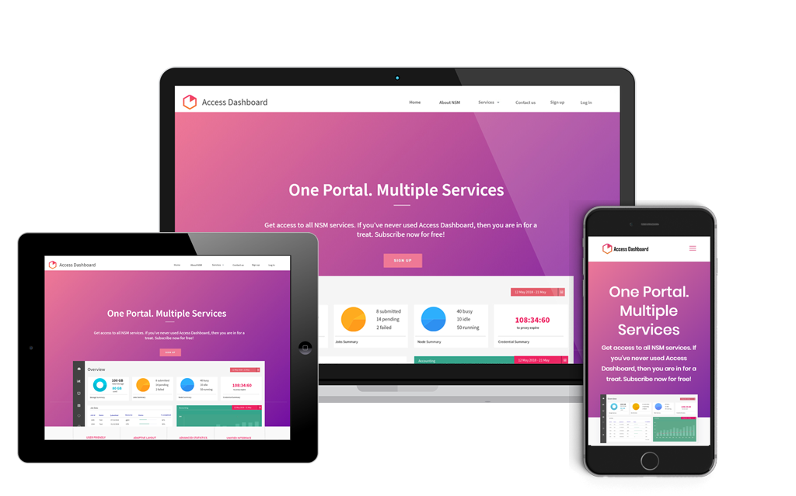

HPC Dashboard
Notes:
https://pixabay.com/photos/new-york-skyline-new-york-city-city-668616/

Slide 10
HPC Dashboard
HPC Dashboard is a unified interface to access all services offered in HPC. It provides users a consistent, accessible and uniform user experience.
Developed with responsive design principles dashboard offers optimal viewing and interaction experience for any screen size, device or orientation.
It also provides bird’s eye view of various functionalities and services of the HPC ecosystem, job submission interface with ready to use application templates, self-explanatory and intuitive interface helping end user with ease-of use experience.

Slide 11
HPC Dashboard –Features
Job Submission and Management
NLP (Natural Language Processing) based Job submission
Interactive voice assistant module
Advanced file manager
Secured web console
Integrated Automatic Parallelization (CAPC)
Monitoring of Cluster and jobs based on User
Graphs showing Job Accounting based on user
Widgets showing the resource availability and utilization

Slide 12
HPC Dashboard – Major Beneficiaries
Power users of HPC
System Administrators
Senior Management
Decision-makers at Government bodies and HPC facilities

Slide 13
Thank You!!

Slide 14

Overview
SuMegha is a Scientific Cloud providing cost effective and scalable HPC to researchers and organizations
Offers convenient access to reliable HPC clusters and storage, without the need to purchase and maintain sophisticated hardware.
Provisions virtual resources such as servers, storage, network, software and applications on-demand to the researchers for solving compute and data intensive problems
SuMegha Cloud Builder is useful for academic institutes and research organizations to establish their own private HPC cloud
Enables setting up a private scientific cloud capable of on-demand provisioning of Virtual OpenMP/MPI/Hadoop Clusters

