Slide 1
Project Ara
Bharat Vaidhyanathan
CCIS/Graduate 1st Year
vaidhyanathan.b@husky.neu.edu
Notes:
(be sure to introduce yourself)

Slide 2
Take away
What is Ara?(What?)
History : Phonebloks (When?)
Concept : Modular Smartphones (Why?)
Why Google discontinued it? (The other ‘why’)
Notes:
summary

Slide 3








Google I/O Projects
Hits | Misses
Android
Hangouts
Wave
Google TV
Project Tango
Wallet
Nexus Q
Project Ara

Slide 4
(Add descriptive title)
Do not change this font or use a smaller font size
Do not change the slide style or background. Focus on content
Use EXACTLY 18 slides total

Slide 5
(Add descriptive title)
Do not put too much text on any given slide
You only have 20s per slide!
Putting too much text on slides is a very common mistake ... But you will figure that out when you practice

Slide 6
(Add descriptive title)
Images are strongly preferred to text when they can be used to illustrate a concept
But, avoid gratuitous clip art or stock images; Images should be meaningful
If an image is pulled from somewhere else (as they usually are), you must include a credit for it (you can use a small font for that placed under the image)

Slide 7
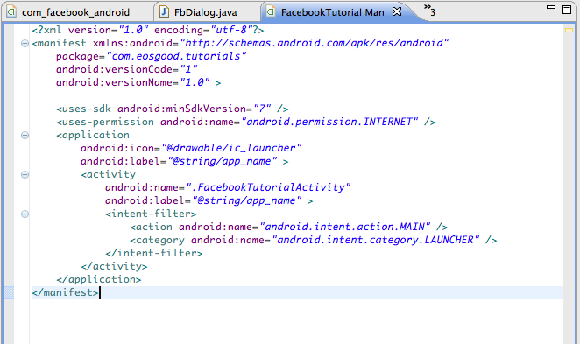
(Add descriptive title)
Do not put text or images on the slide that people will not have time to understand
E.g.:
Don’t do this

Slide 8
(Add descriptive title)
When you present, you will stand near the screen
These slides will advance automatically after 20s, no matter what
Look at the audience. You can do this, because you will have practiced so much you know what to say without the screen

Slide 9
(Add descriptive title)
If you do not practice
And practice
And practice
At least 3 times, you will get behind your slides and it will be painful to watch
You must also not make the mistakes in the presentation tips document; study it carefully

Slide 10
(Add descriptive title)
You are teaching us something new about the topic
You need to explain and highlight what you think are the most important or most thought-provoking or most controversial points
Where possible, emphasize material that has not been covered already in class over material that has been

Slide 11
(Add descriptive title)
By the time you are done, we should understand the pros/cons of the research or topic
We should have enough information to know if we should pursue the topic on our own

Slide 12
(Add descriptive title)
Sometimes you might have to step people through an idea with well-labeled images
DO NOT just put a big complex image or table on the screen and expect people to understand it; if only a portion is important, highlight the important parts incrementally so people know what to focus on as you talk

Slide 13
(Add descriptive title)
You can use animation on a slide (keeping within the 20s) if you think that adds clarity
DO NOT add animation just to make the slides look “fancy.” Only use it to illustrate an idea

Slide 14
(Add descriptive title)
Some concepts may be hard to describe and may require a series of several slides
Step us through it ... teach
(especially when showing code)
Beware: Doing this well takes preparation

Slide 15
(Add descriptive title)
Mistakes to avoid:
  Typos and poor grammar
  Inconsistent/sloppy punctuation/indentation
  Showing too much code without highlighting important parts
  Not distilling out the most interesting information we need to know
  Not practicing
  Messing up the timing format of the slides so they don’t advance properly

Slide 16
(Add descriptive title)
Remember ... you are teaching the class why the topic is relevant or important
You can also provide your own critique if you wish (e.g., this does not appear useful because...; a better choice might be...)
But back up your opinions!

Slide 17
(Add descriptive title)
Great things to do:
  Relate the topic to ideas in other readings
  Add important missing points
  Make the case for your point of view
  If possible/appropriate, illustrate key ideas using screenshots of a sample app
  Inspire us to care about this topic!

Slide 18
Take away
In these bullets
Reemphasize the most important take-away messages
That everyone should learn
From the paper/topic
This should be IDENTICAL to the Take away slide at the start

