Slide 1
Git
Distributed Version Control System

Slide 2
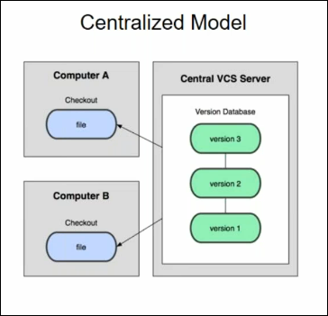
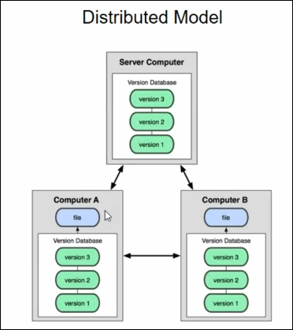
Centralized V/s Distributed Model
ex: CVS, Subversion, Perforce ex: Git, Mercurial

Slide 3
Git Basic
In Git everything is workspace.
Every workspace in Git will have copy of repository.
We can work offline/online
Check-in and Checkout is very fast as repo is local
We have two workspace central and local workspace.
Central workspace (store and Share)
Local Workspace(add, edit and Store and share)

Slide 4
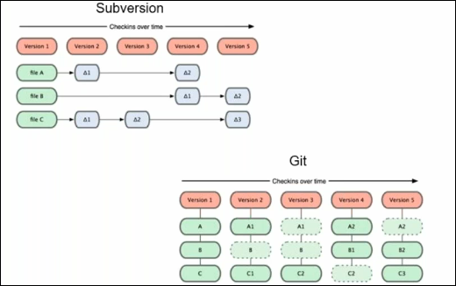
Git takes Snapshot

Slide 5
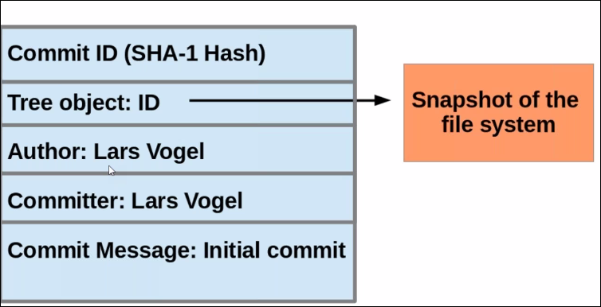
Git Uses Check Sum 40 character Commit iD

Slide 6
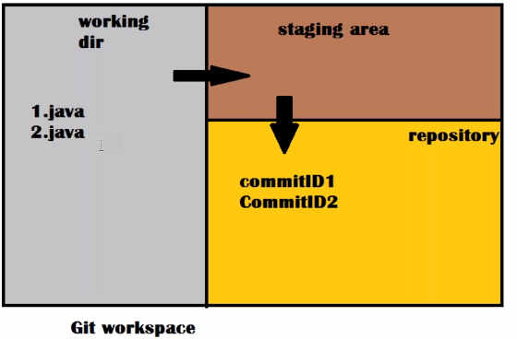
Git Workspace

Slide 7
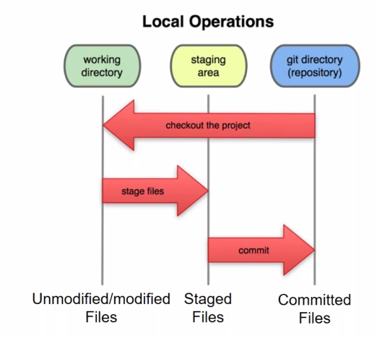
A Local Git Project Has Three Areas
Note: Working Directory Sometime Called the working tree, staging are sometime called the index

Slide 8
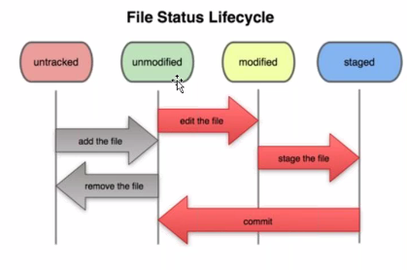
Git File Life Cycle

Slide 9
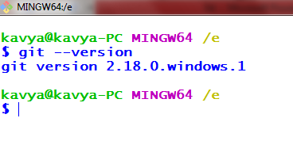
Git Installation
As per the system requirement download git
https://git-scm.com/download/win
Once download install exe and open git bash

Slide 10
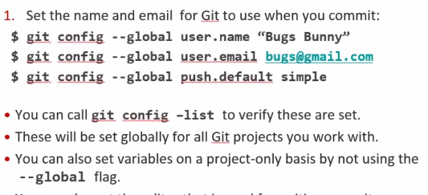
Get ready to Use Git

Slide 11
Create Local Repository
Step -1)
kavya@kavya-PC MINGW64 /e
$ mkdir myprog
Step 2)
kavya@kavya-PC MINGW64 /e
$ cd myprog/
Stp 3)
kavya@kavya-PC MINGW64 /e/myprog
$ git init
Initialized empty Git repository in E:/myprog/.git/
kavya@kavya-PC MINGW64 /e/myprog (master)
$

Slide 12
Git Commands

Slide 13
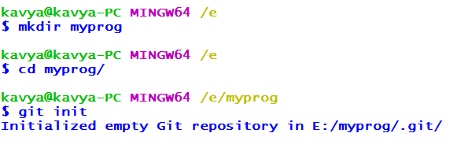
1) $git Init
git init - Create an empty Git repository or reinitialize an existing one

Slide 14
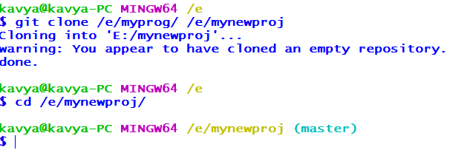
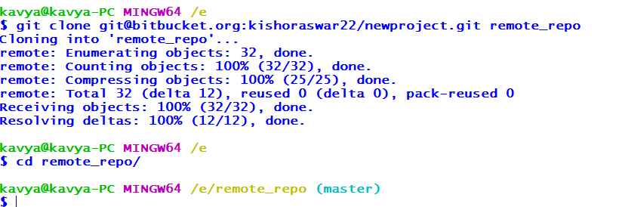
2)git clone
clone - Clone a repository into a new directory or clone from bitbucket to local

Slide 15
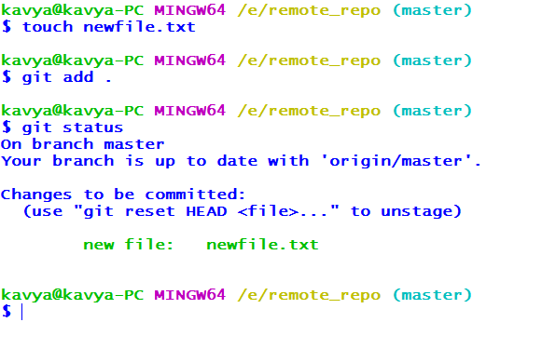
3)git add and 4)git status
add - Add file contents to the index
status - Show the working tree status

Slide 16
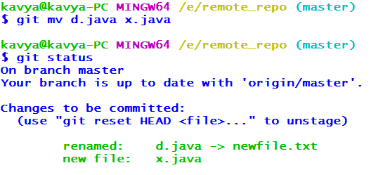
5)git mv
mv - Move or rename a file, a directory, or a symlink

Slide 17
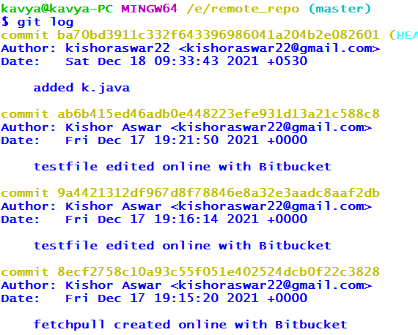
6)git log
Log - Show commit logs

Slide 18
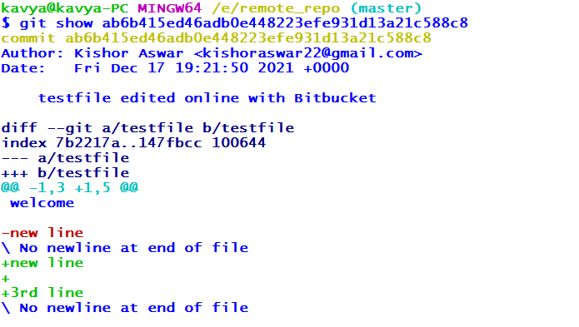
7)git show
show - Show various types of objects

Slide 19
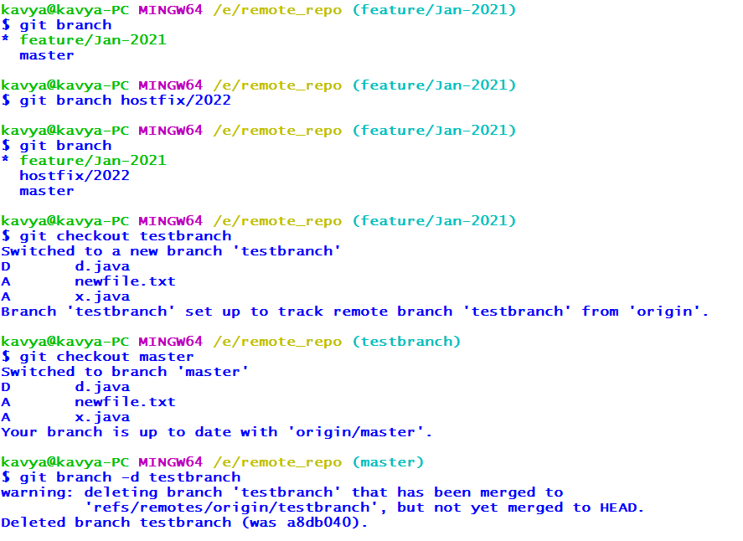
8)git branch
branch - List, create, or delete branches

Slide 20
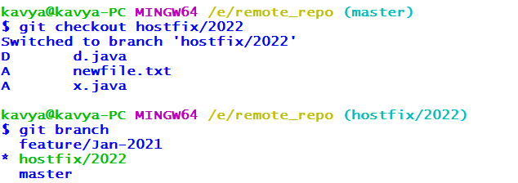
9)git checkout
checkout - Switch branches or restore working tree files

Slide 21
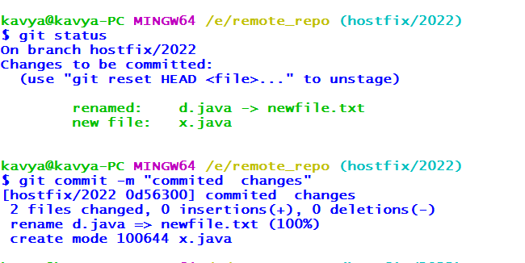
10)git commit
commit - Record changes to the repository

Slide 22
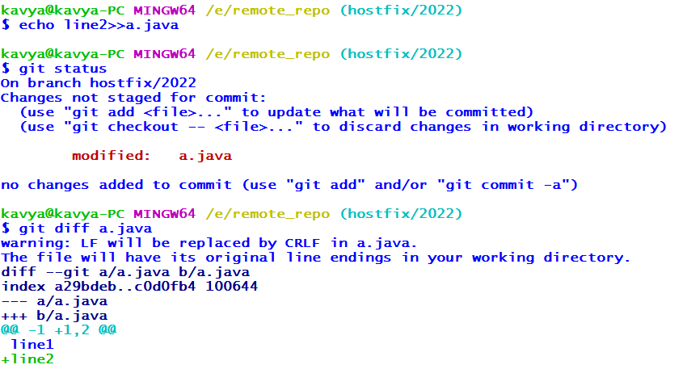
11)git diff
diff - Show changes between commits, commit and working tree, etc

Slide 23
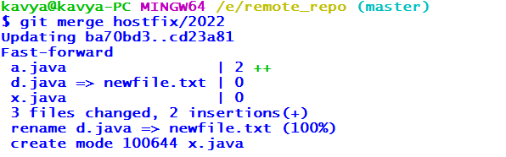
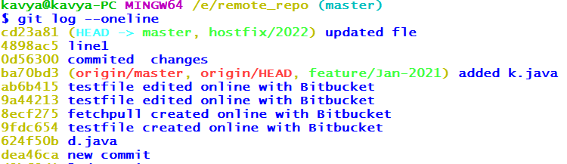
12)git merge
merge - Join two or more development histories together

Slide 24
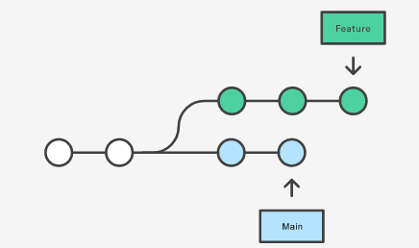
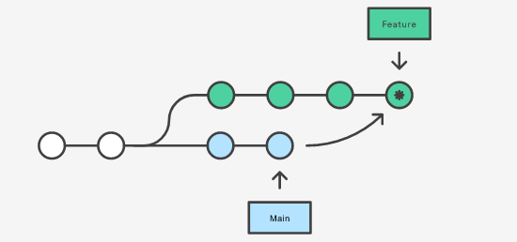
Its non-destructive operation
Existing branches are not changed in any way
Creates a new merge commit in the feature branch.

Slide 25
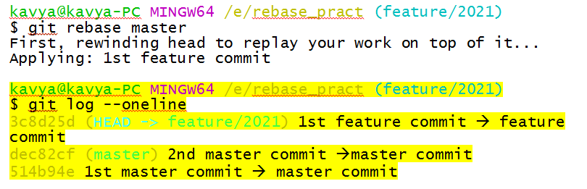
13)git rebase
rebase - Reapply commits on top of another base tip

Slide 26
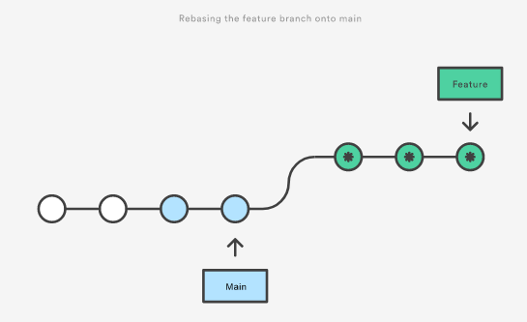
Its moves the entire feature branch to begin on the tip of the master branch
Re-Write the Project History
We get much cleaner and linear project history

Slide 27
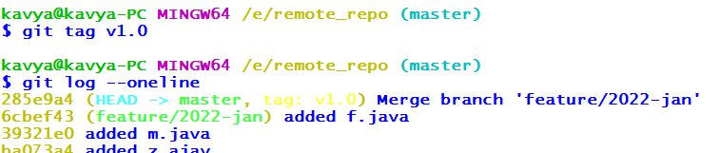
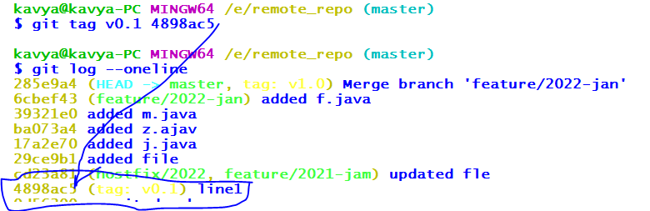
14)git tag
tag - This command is used to give tags to the specified commit

Slide 28
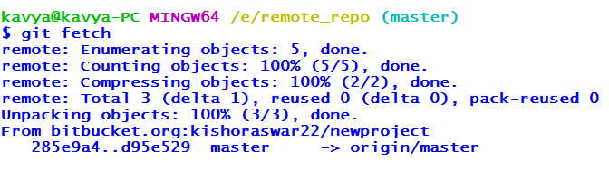
15)git fetch
fetch - Download objects and refs from another repository

Slide 29
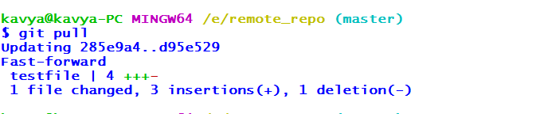
16)git pull
pull - Fetch from and integrate with another repository or a local branch

Slide 30
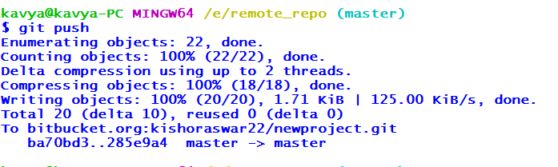
17)git push
push - Update remote refs along with associated objects

Slide 31
18)git reset
reset - Reset current HEAD to the specified state
The term reset stands for undoing changes. The git reset command is used to reset the changes. The git reset command has three core forms of invocation. These forms are as follows.
Soft
Mixed
Hard

Slide 32
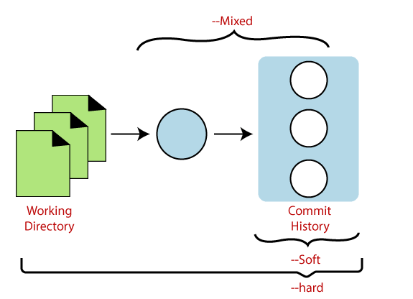
Git reset modes Diagram

Slide 33
Git reset --hard
It will move the HEAD pointer.
It will update the staging Area with the content that the HEAD is pointing.
It will update the working directory to match the Staging Area.

Slide 34
kavya@kavya-PC MINGW64 /e/remote_repo (master)
$ git log --oneline
d95e529 (HEAD -> master, origin/master, origin/HEAD) testfile edited online with Bitbucket
285e9a4 (tag: v1.0) Merge branch 'feature/2022-jan'
6cbef43 (feature/2022-jan) added f.java
39321e0 added m.java
ba073a4 added z.ajav
1bc9754 new repository
kavya@kavya-PC MINGW64 /e/remote_repo (master)
$ git reset --hard 39321e0
HEAD is now at 39321e0 added m.java
kavya@kavya-PC MINGW64 /e/remote_repo (master)
$ git log --oneline
39321e0 (HEAD -> master) added m.java
17a2e70 added j.java
29ce9b1 added file

Slide 35
Git reset --soft
The soft option does not touch the index file or working tree at all, but it resets the Head as all options do.
When the soft mode runs, the refs pointers updated, and the resets stop there. It will act as git amend command. It is not an authoritative command. Sometimes developers considered it as a waste of time.
It just changes head reference

Slide 36
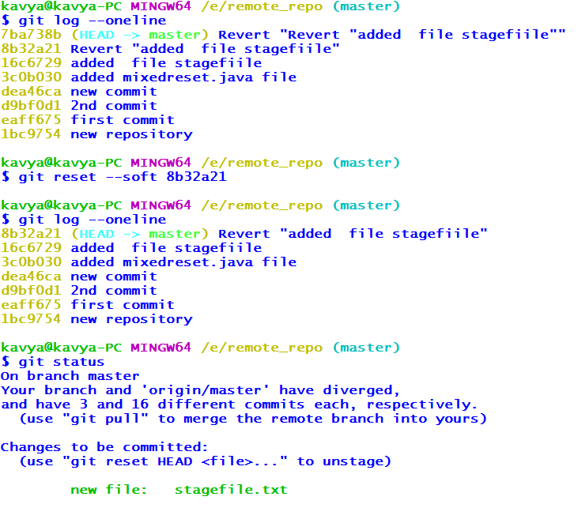

Slide 37
Git reset --mixed
If we would not pass any argument, then the git reset command considered as --mixed as default option
A mixed option updates the ref pointers. The staging area also reset to the state of a specified commit. The undone changes transferred to the working directory.
It compare index and stage area if any file found in staging area mixed reset will push that changes back to working tree

Slide 38
kavya@kavya-PC MINGW64 /e/remote_repo (master)
$ git log --oneline
3c0b030 (HEAD -> master) added mixedreset.java file
kavya@kavya-PC MINGW64 /e/remote_repo (master)
$ touch stagefile.txt
kavya@kavya-PC MINGW64 /e/remote_repo (master)
$ git add .
kavya@kavya-PC MINGW64 /e/remote_repo (master)
$ git reset --mixed
kavya@kavya-PC MINGW64 /e/remote_repo (master)
$ git status
On branch master
Your branch and 'origin/master' have diverged,
and have 1 and 16 different commits each, respectively.
(use "git pull" to merge the remote branch into yours)
Untracked files:
(use "git add <file>..." to include in what will be committed)
stagefile.txt ➔ file un staged
nothing added to commit but untracked files present (use "git add" to track)

Slide 39
19)git revert
Revert- In Git, the term revert is used to revert some changes.
The git revert command is used to apply revert operation.
It is an undo type command. However, it is not a traditional undo alternative.
It does not delete any data in this process; instead, it will create a new change with the opposite effect and thereby undo the specified commit.
Generally, git revert is a commit.

Slide 40
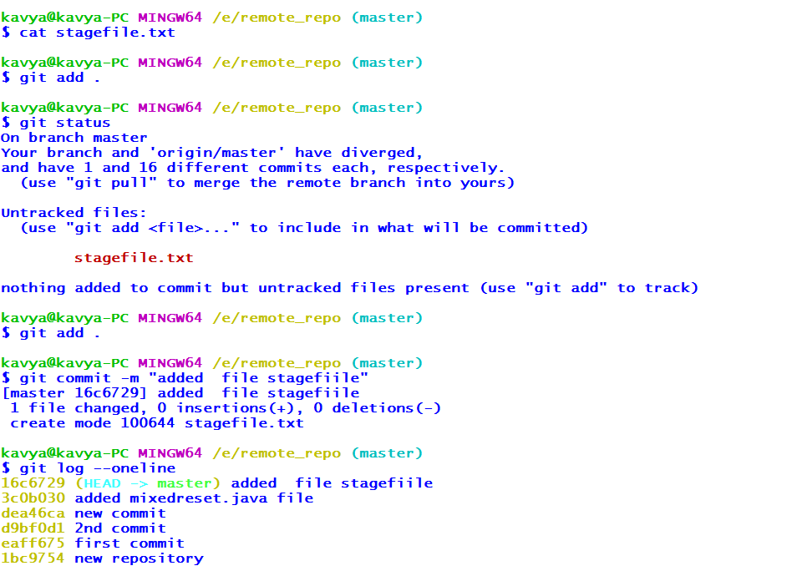
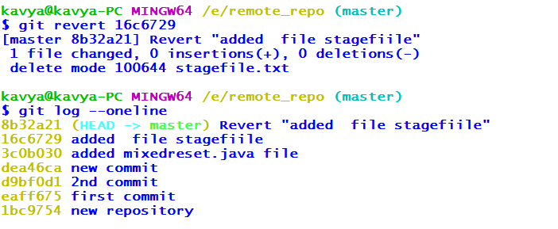

Slide 41
20)git stash
Stash - This command temporarily stores all the modified tracked files
#git stash save
This command temporarily stores all the modified tracked files
#git stash pop
This command restores the most recently stashed files.
#git stash list
This command lists all stashed changesets.
#git stash drop
This command discards the most recently stashed changeset

Slide 42
21)git cherry-pick
Git cherry-pick is a helpful command. It's a robust command and allows you to pick any commit from any branch and apply it to any other branch.
Usage
# git cherry-pick <commit-hash>
Git cherry-pick doesn’t modify the history of a repository; instead, it adds to the history.

