Slide 1
Programming Analysis Platform
Prolysis
Bharat Bhalla
Dhaval Srivastava
DELHI TECHNICAL CAMPUS, GREATER NOIDA

Slide 2
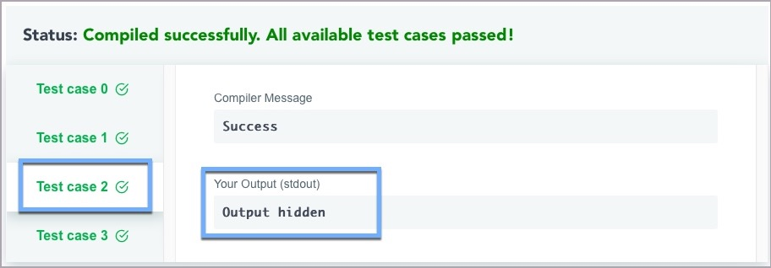



Problem Statement

Slide 3
Solution

Slide 4
Prolysis
A software which provides and documents real-time analytics of participants in a coding competition to gain better insight into their performance throughout the competition and make data-driven decisions.

Slide 5
Solution
Software Solution
Organization
Organization
Data
Analysis

Slide 6
Backend Developer
Role
Bharat Bhalla
Designing Database
Documentation
Agile Development
Time Manger& Strategic Decision Maker

Slide 7


Backend Development
Bharat Bhalla
Technical Stack
Database :
Server :

Slide 8
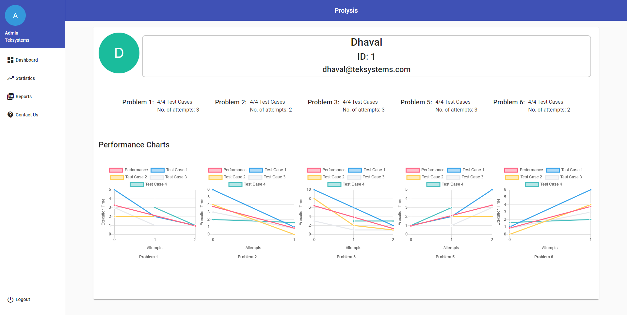


Backend System
JSON
API KEY
Code Chef Compiler Server
Server
Dashboard

Slide 9
APIs
FILE | PORT
Index.js | 3000 |  |  | Discription
 |  | /Scene1/:contestID | GET | [{"uName":"Dhaval","uID":123},{"uName":"Bharat","uID":12}...]
 |  | /Scene1/:contestID/:uID | GET | graph.json
 |  | /TimeTaken/:uID/:cID/:pID | POST | Accepts TestCase in Header Even followed by done done
 |  | /listOfContest | GET | getAllContestNames.json
RESTContest.js | 3001
 |  | /createContest/:cID | POST | Create a contest & accepts data in URL after ? | ?cName=solve1&cDate=20190312&cTime=1706&cDuration=50
 |  | /getContest/:cID | GET | Gets Contest Info
 |  | /deleteContest/:cID | DELETE | Deletes Contest
RESTExecutionTimeTaken.js | 3002
RESTProblem.js | 3003 | /createProblem/:pID | POST | creates a 'problem' in database by using json createProblem.json
RESTUser.js | 3004 | /user/:uID | POST | Creates a user with uID & accpects data in URL after ? | ?uEmail=bhartubhalla@gmail.com&uName=Bharat Bhalla
 |  | /user/:uID | DELETE | Delets a particular user
 |  | /user/:uID | GET | Gets the user info with specified Id
 |  | /linkUserContest/:uID/:cID | POST | Links User & contest
RESTcontestproblem.js | 3005 | /linkContestProblem/:cID | POST | Links contest and problem & Accepts a linkContestProblem.json

Slide 10
Frontend
Tech Stack
UI/UX
Implementation

Slide 11





Tech Stack
Angular 7
HTML
CSS
JavaScript
Bootstrap

Slide 12
User Interface and Experience

Slide 13

UI/UX | Contest Wise Analysis

Slide 14
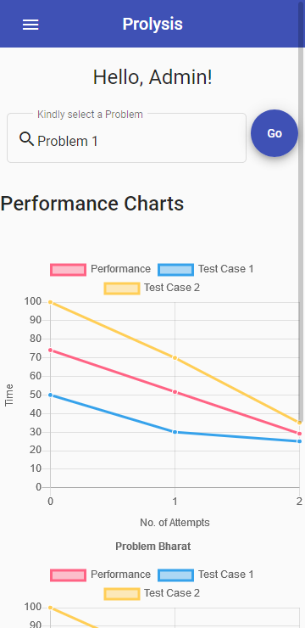
UI/UX | Responsive Layout

Slide 15
Implementation

Slide 16

Implementation
Linear Regression + Charts
Data
Angular 7

Slide 17
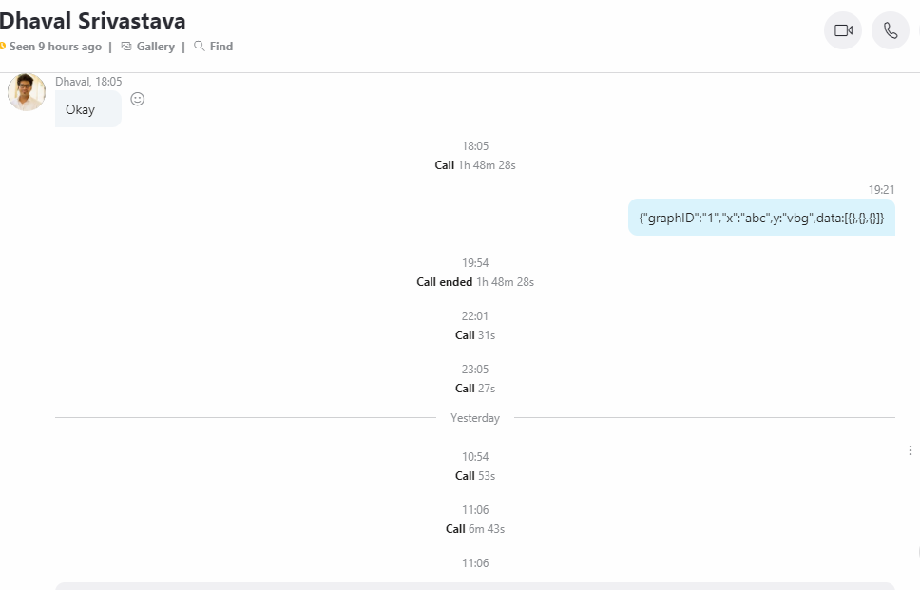
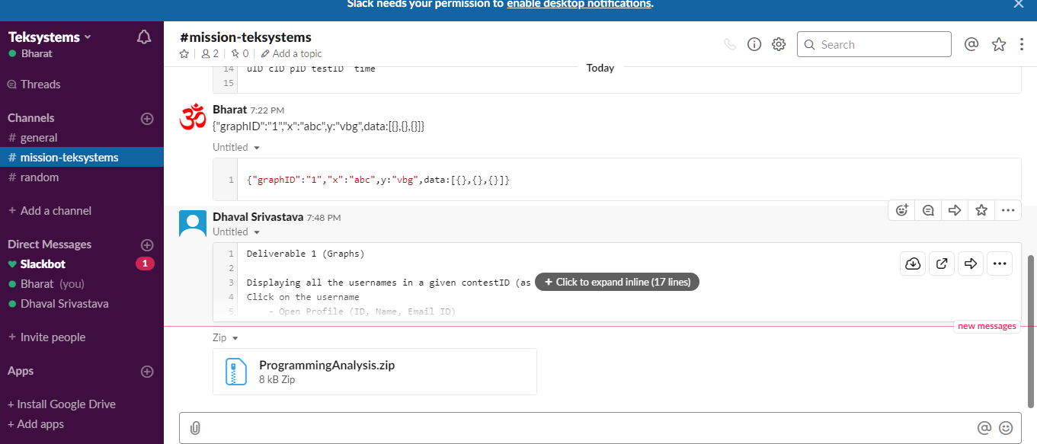
Proof Of Work

Slide 18
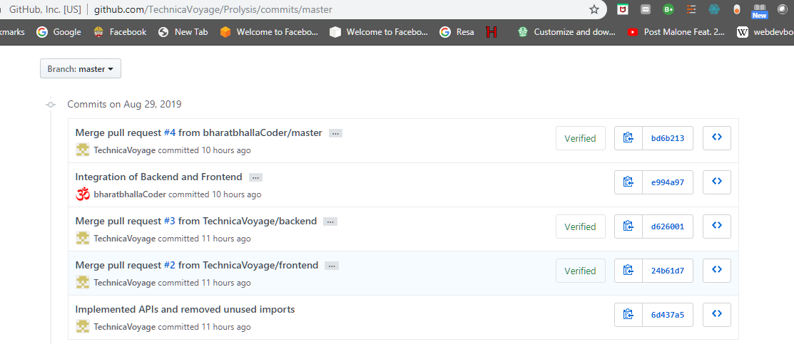
Proof Of Work

Slide 19
Roadmap

Slide 20
Roadmap
Increase security and robustness
Use AI to predict the performance based on his/her historical data
Launch mobile app on Android and iOS
Add a portal for each programmer profile for personal analysis

Slide 21
Future Plans

Slide 22
Future Plans
Integrate it with every online coding platform to gather statistics and provide analysis
Take into account the multiple parameters (coding language etc.) to provide accurate result
Analysis of programming platform and examination patterns

Slide 23
Thank You

