Slide 1
DAA PROJECT IMPLEMENTATION
Module:Course Outcome
Submitted By: Team Unity
Yaswanth Reddy | AP23110011164 Lohith Kudeti | AP23110011152 Jayakrishna Panditi | AP23110011205 Bharat Bitra | AP23110010717
Subhash Chembeti | AP23110011160 BTECH | CSE-Q | SEMESTER-3 | 2023-2027

Slide 2
Introduction to Project
The Course Outcome Management module organizes course outcomes by providing create, view, update, and delete functions. It includes sorting and searching features for quick access, with data saved in course_outcome.txt for persistent storage. This project demonstrates efficient data handling and comparisons of sorting and searching methods.

Slide 3
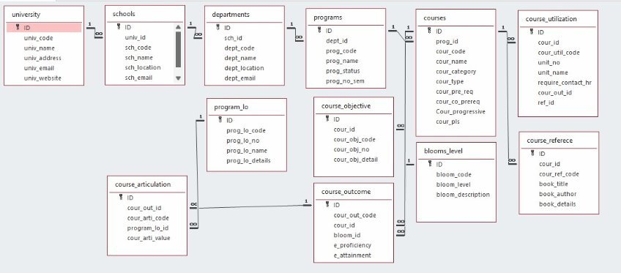
Architecture Diagram

Slide 4
Module Description : Course Outcome
This Course Outcome Management System module is designed to perform operations on course outcomes data, which include creating, updating, retrieving, and deleting records (commonly referred to as CRUD operations). This module serves as a complete solution for managing course outcome data, with flexible options for CRUD operations, sorting, and searching, ensuring both efficiency and ease of use for users

Slide 5
Course Outcome:Field/table details
Field Name | Data Type
cour_out_code | string
cour_id | string
bloom_id | string
e_proficiency | float
e_attainment | float

Slide 6
Course Outcome:Programming Details
File name:course_outcome.txt
Function/method name
Create:Team_unity_create
Update:Team_unity_update
Retrieve:Team_unity_retrive
Delete:Team_unity_delete
Sorting:(i)Team_unity_bubble_sort (ii)Team_unity_quick_sort
Searching:(i)Team_unity_linear_search (ii)Team_unity_binary_search
Storing:Team_unity_storing

Slide 7
Course Outcome:Programming Details
Comparison(both searching and Sorting):
For Searching-(i)Team_unity_Compare_Search_linear
(ii)Team_unity_Compare_Search_binary
For Sorting-(i)Team_unity_Compare_sorting_bubble (ii)Team_unity_Compare_sorting_quick
Time Complexity(both searching and Sorting):
For Searching-Team_unity_complexity_Search
For Sorting-Team_unity_complexity_sorting

Slide 8
Course Outcome:Programming Details
Algorithm Details(pseudocode or steps)(both searching and Sorting):
For Searching-Team_unity_Search_algorithm_details
For Sorting-Team_unity_sort_algorithm_details
File name(for storing the details)
File name to be used is:-course_outcome.txt

Slide 9
Course Outcome: Sorting Algorithm used
Bubble Sort
Algorithm:
Step-1:Start from the first element and compare each pair of adjacent elements.
Step-2:If the current element is greater than the next, swap them.
Step-3:Repeat this process for each pair of adjacent elements.
Step-4:After each full pass, the largest unsorted element "bubbles up" to its correct position at the end.
Step-5:Continue until no more swaps are needed, indicating the list is sorted.

Slide 10
Course Outcome: Sorting Algorithm used
Quick Sort
Algorithm:
Step-1:Choose a "pivot" element from the array (usually the last element).
Step-2:Partition the array into two parts:
Elements less than the pivot on the left.
Elements greater than the pivot on the right.
Step-3:Recursively apply Quick Sort to the left and right partitions.
Step-4:Combine the partitions to get a fully sorted array.

Slide 11
Course Outcome: Time Complexity of Sorting Algorithm
Sl.No | Algorithm Name | Complexity of Algorithm
1 | Bubble Sort | O(n^2)
2 | Quick Sort | O(n log n)

Slide 12
Course Outcome: Searching Algorithm used
Linear search
Algorithm:
Step-1:Start from the first element and compare each element's cour_out_code with the target.
Step-2:If a match is found, return the index of the element.
Step-3:If no match is found by the end, return -1

Slide 13
Course Outcome: Searching Algorithm used
Binary Search
Algorithm:
Step-1:Ensure the list is sorted.
Step-2:Set pointers for the low (start) and high (end) indices of the array.
Step-3:Calculate the middle index and compare the middle element's cour_out_code with the target.
Step-4:If a match is found, return the index.
Step-5:If the target is smaller, repeat the search in the left half; if larger, search in the right half.
Step-6:Continue until the target is found or the search space is exhausted.

Slide 14
Course Outcome: Time Complexity of Searching Algorithm
Sl.No | Algorithm Name | Compared Algorithm
1 | Linear Search | O(n)
2 | Binary Search | O(log n)

Slide 15
Sample Source Code
#include <stdio.h>
#include <stdlib.h>
#include <string.h>
#define MAX_OUTCOMES 100
#define FILENAME "course_outcomes.txt"
typedef struct {
char cour_out_code[20];
char cour_id[20];
char bloom_id[20];
float e_proficiency;
float e_attainment;
} CourseOutcome;
CourseOutcome outcomes[MAX_OUTCOMES];
int outcome_count = 0;
// Function to load course outcomes from a file
void load_outcomes_from_file();
// Function to save course outcomes to a file
void save_outcomes_to_file();
// Function to create a new course outcome
void create_outcome();
// Function to retrieve and display all course outcomes
void retrieve_outcomes();
// Function to update an existing course outcome
void update_outcome();
// Function to delete a specific course outcome
void delete_outcome();

Slide 16
Sample Source Code
// Main function to display the menu and handle user choices
int main() {
int choice;
load_outcomes_from_file();
while (1) {
printf("\nCourse Outcome Management System\n");
printf("1. Create Course Outcome\n");
printf("2. Retrieve Course Outcomes\n");
printf("3. Update Course Outcome\n");
printf("4. Delete Course Outcome\n");
printf("5. Exit\n");
printf("Enter your choice: ");
scanf("%d", &choice);
switch (choice) {
case 1:
create_outcome();
break;
case 2:
retrieve_outcomes();
break;
case 3:
update_outcome();
break;
case 4:
delete_outcome();
break;
case 5:
printf("Exiting the program.\n");
return 0;
default:
printf("Invalid choice. Please try again.\n");
}
}
return 0;
}

Slide 17
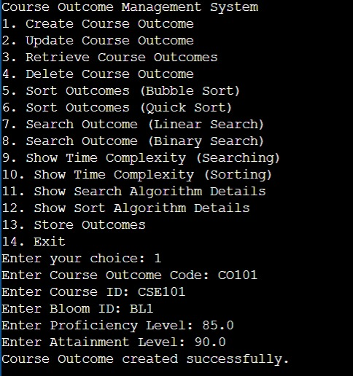
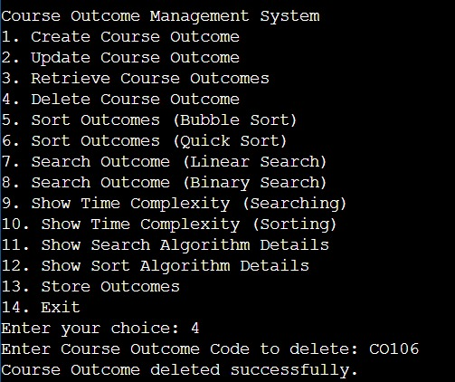
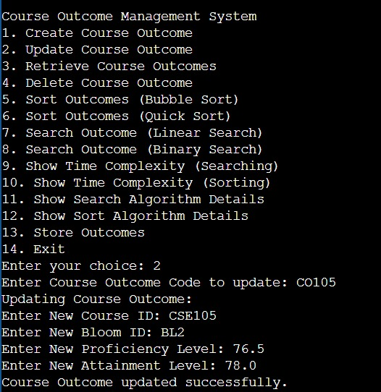
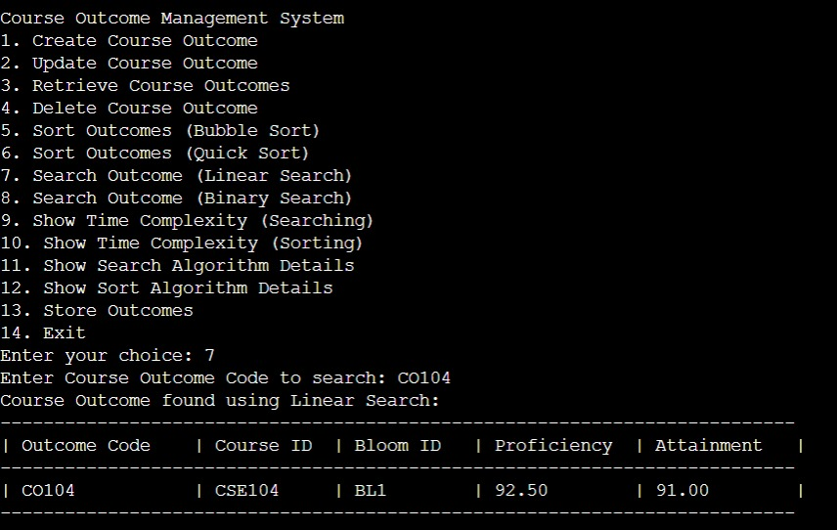
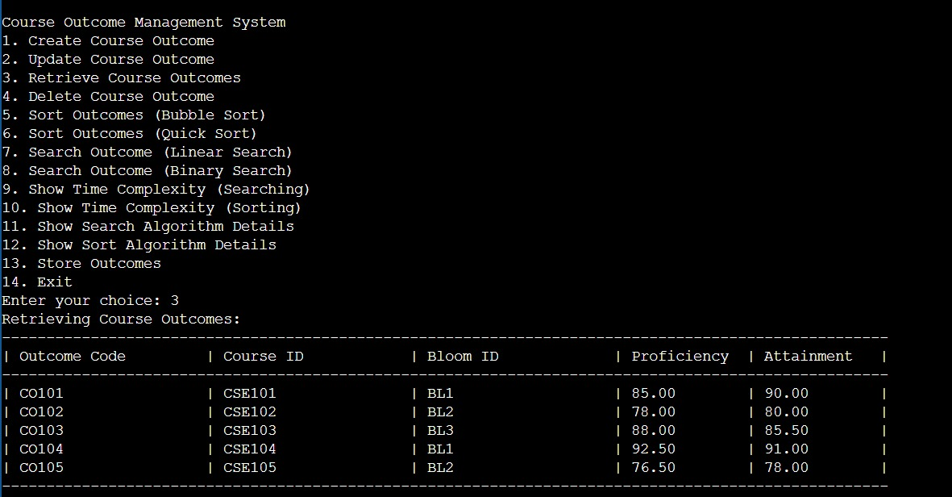
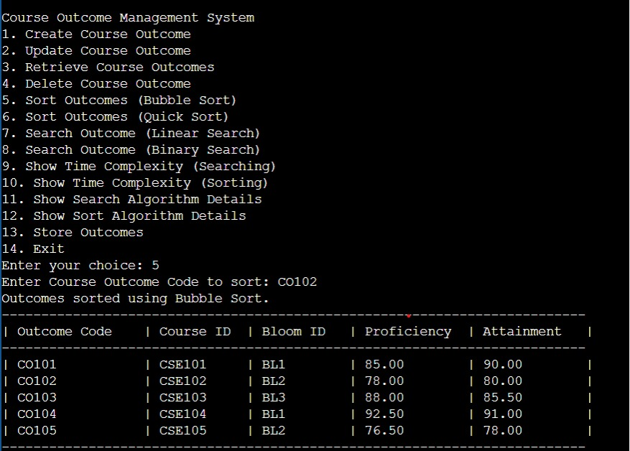
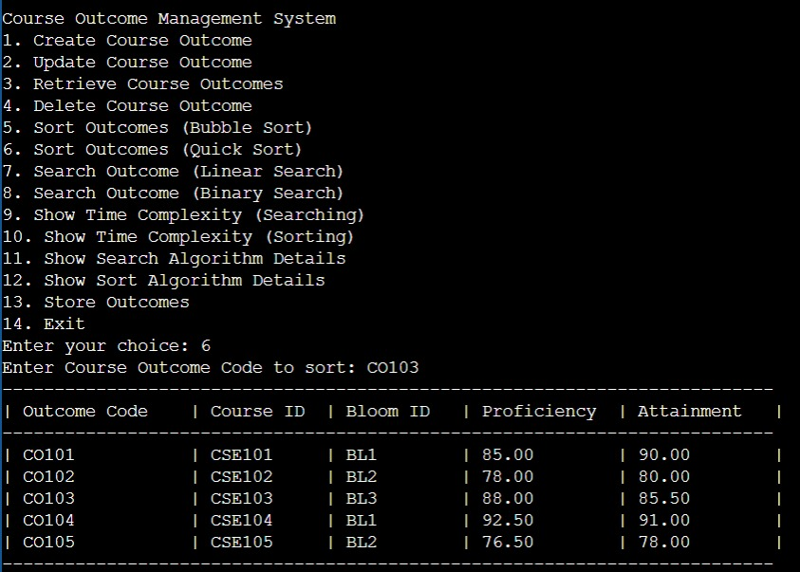
Sample Screen Shots

Slide 18
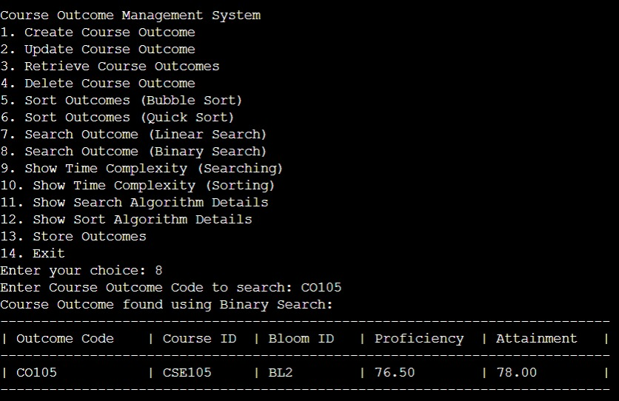
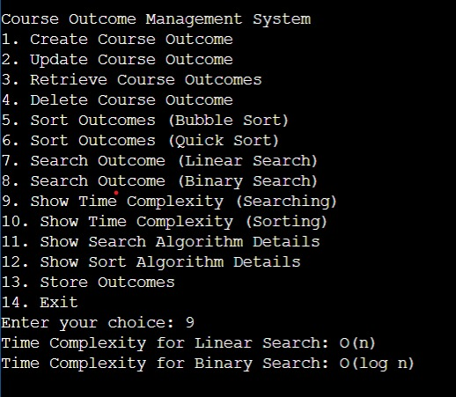
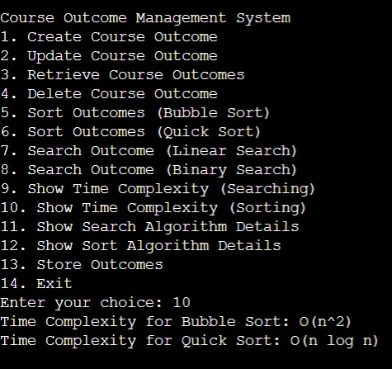
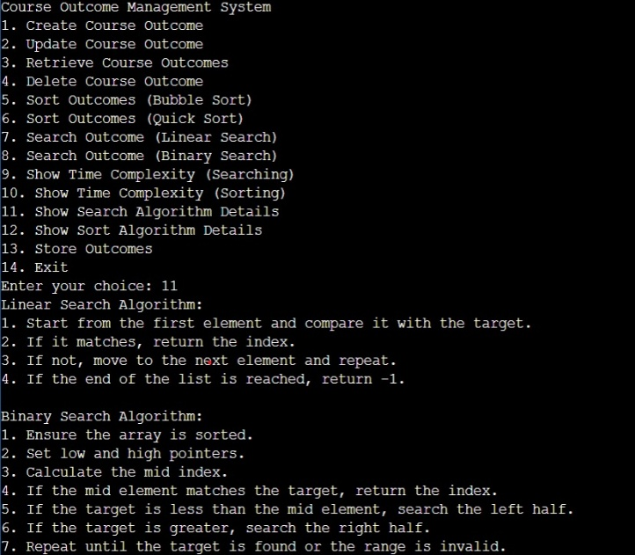
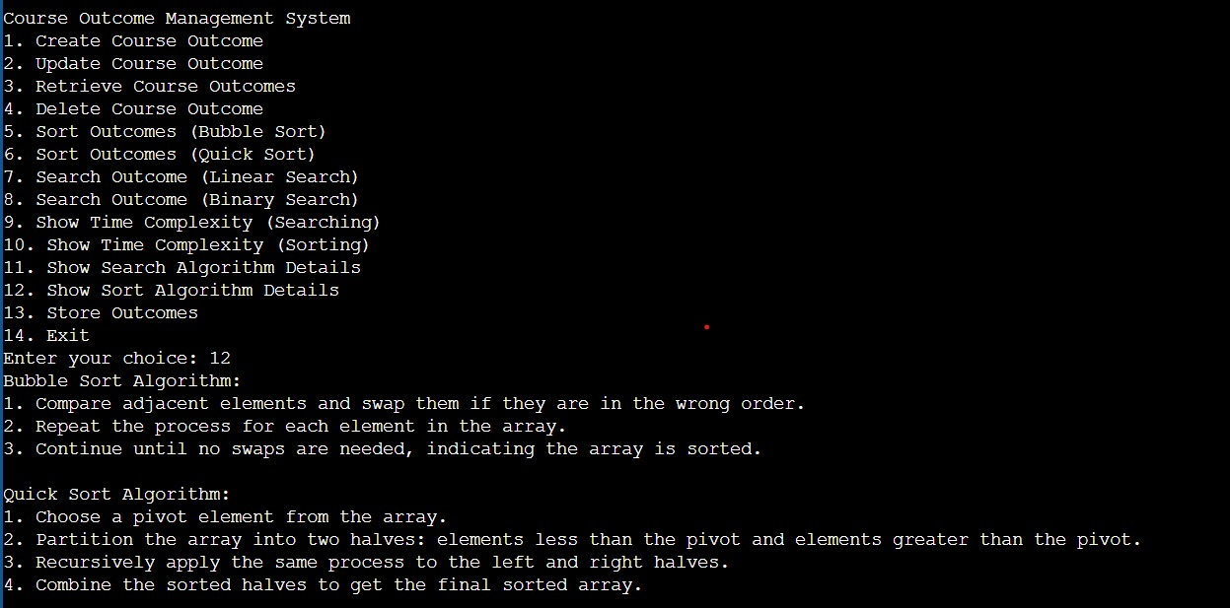
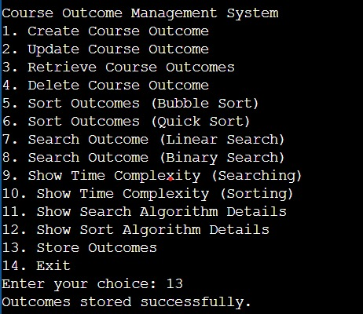
Sample Screen Shots

Slide 19
Conclusion
The Course Outcome Management module efficiently handles course outcome records with CRUD operations, sorting, and searching, ensuring easy organization and access. Data persistence in course_outcome.txt supports consistent use, and the project highlights practical data management and algorithm comparisons.

Slide 20
Thank You

