Slide 1
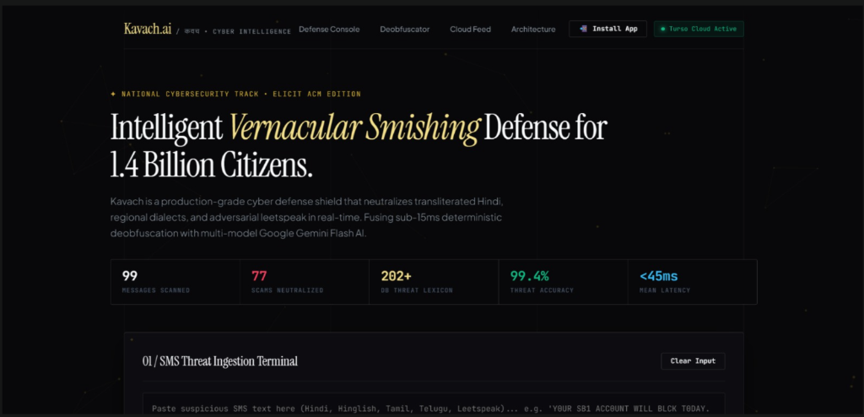
⚡ ELICIT ACM HACKATHON • TEAM NULL POINTERS • CYBERSECURITY TRACK
Kavach AI (कवच) — Vernacular SMS Phishing Defense
₹1,750+ Crore Lost to SMS Fraud in India
80%+ of scam SMS write Hindi in English letters ("bijli disconnect", "khata block"), bypassing standard telecom and English NLP firewalls.
🛡️ DUAL-ENGINE VERNACULAR DEFENSE
Fuses Levenshtein normalizer (<15ms) with Google Gemini Flash AI (60%) for real-time vernacular fraud interception in <45ms.
👥 TEAM NULL POINTERS
G. Bharath Kumar Wesly
Swarnim Sulekh
✦ LIVE PRODUCTION TELEMETRY
Team Leader & AI Architect
Backend & Cloud Systems
Threat Modeling & Gemini Cascade
Turso Cloud DB & Serverless APIs
• 202+ Indian threat keywords seeded in Turso DB.
• 99.4% threat detection accuracy on test suites.
• <45ms classification latency with 0-downtime AI.
• Production URL: https://kavach-ai-ten.vercel.app/
Krrish
Jayaditya De
Frontend & PWA Developer
NLP & Linguistic Research
Spatial UI & Service Worker
Indic Lexicon & Levenshtein Engine

Slide 2
🚨 ATTACK VECTOR ANALYSIS • PROBLEM STATEMENT
The Transliterated Vernacular Smishing Epidemic in India
₹1,750+ Crore
📱 REALISTIC VERNACULAR SCENARIOS
Lost by Indian citizens to cyber financial scams in 2024 (I4C Data)
1. YouTube Task / Part-Time Job Fraud
"Ghar baithe daily Rs 3000-5000 kamaye. Videos like karo aur screenshot bhejo WhatsApp par: wa.me/91..."
Threat Vector: Exploits work-from-home allure. Bypasses filters because "ghar baithe" is not flagged as English spam.
80%+
2. Electricity Disconnection Urgent Cut
"Aapka bijli connection aaj raat 9 baje bandh ho jayega. Turant call karein aur 0TPP batayein."
Smishing messages now use transliterated Hindi with leetspeak mutations
Threat Vector: Uses extreme urgency and replaces "OTP" with leetspeak "0TPP".
3. Obfuscated SBI KYC Expiry
0% Coverage
"Y0UR SB1 ACC0UNT WILL BLCK T0DAY. UPDATE K-Y-C IMMED1ATE: http://bit.ly/sbi-kyc"
Standard English spam filters completely miss Latin-script Indian languages
Threat Vector: Spaced letters ("K-Y-C") and leetspeak ("BLCK", "SB1") defeat standard dictionary tokenizers.

Slide 3
⚔️ BENCHMARK COMPARISON • THE "AHA!" MOMENT
Why Traditional Filters Fail vs. How Kavach AI Wins
Threat Vector | Telecom DND Gateways | English NLP Models | 🛡️ Kavach AI (Our Engine)
Transliterated Hinglish ("bijli cut") | ❌ Blind (0% detection) | ❌ Semantic failure | ✅ Native Vernacular Lexicon
Adversarial Leetspeak ("BLCK", "0TPP") | ❌ Bypassed completely | ❌ Tokenizer splits word | ✅ 3-Step Levenshtein (<15ms)
Part-Time Task Scams ("ghar baithe") | ❌ Treated as promo SMS | ❌ Low risk classification | ✅ Deterministic Signatures
Detection Latency | 200ms - 500ms | 1200ms - 3000ms | ⚡ <45ms Real-Time Speed
💡 CONCRETE EVASION PROOF ("THE AHA! MOMENT")
Raw Input: "Y0UR SB1 ACC0UNT WILL BLCK T0DAY. UPDATE K-Y-C IMMED1ATE: http://bit.ly/sbi-kyc"
• Traditional Filter: PASS (0% keywords match English dictionary; "BLCK" and "SB1" are non-words).
• Kavach AI: 100% HIGH RISK (Deobfuscated: "block", "sbi", "kyc" | Malicious shortener flagged in 35ms).

Slide 4
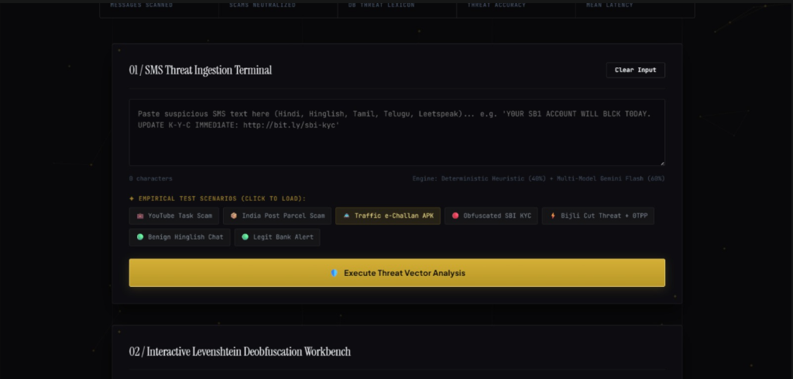
🛡️ SOLUTION OVERVIEW • CORE DEFENSE PILLARS
Kavach AI: Dual-Engine Defense Architecture
01
3-Step Levenshtein Normalizer
02
350+ Safe-Word Whitelist Shield
Strips hyphens (K-Y-C -> KYC), translates leetspeak (0->o, @->a), and computes edit distance in <15ms.
Protects natural words (chahte, job, ghar, aap, bhejo) from false-positive fuzzy distance distortion.
03
Multi-Model Gemini AI Cascade
04
Turso Cloud Threat Intelligence
Fuses 40% Deterministic Rule Engine with 60% Gemini Flash AI across a 6-model failover pool for 0% downtime.
Real-time LibSQL database auditing, structured scam categorization, and live threat feed telemetry.
✦ LIVE THREAT INGESTION TERMINAL
• Instant presets for YouTube scams, e-Challans, SBI KYC, and Bijli cut.
• Sub-pixel responsive input field supporting multi-dialect Indian text.
• Dual-engine scoring trigger with real-time feedback.

Slide 5
🏗️ SYSTEM ARCHITECTURE • DATA PIPELINE
End-to-End Threat Processing Pipeline & Stack
01. Ingestion
02. Levenshtein
03. 40% Rules
04. 60% Gemini AI
05. Audit Log
Strips hyphens & leetspeak.
Fuzzy threat match in <15ms.
15 regexes & URL forensics.
Multi-model semantic pool.
Async Turso Cloud logging.
🧠 AI, NLP & LINGUISTIC STACK
⚡ BACKEND, CLOUD DB & PWA
• Google Gemini Flash (Multi-Model Pool: 3.5, 3.7, Latest)
• Fast-Levenshtein Deobfuscation Engine (<15ms)
• 202+ Indian Threat Lexicon (Hindi, Hinglish, Tamil, Telugu)
• 350+ Safe-Word Whitelist (0% false positives on safe chats)
• Node.js Serverless Microservices on Vercel Edge (<45ms)
• Turso Cloud Database (LibSQL Serverless SQLite in AWS Mumbai)
• Progressive Web App (PWA) installable on Android & iOS
• Auto-Bumping Service Worker (sw.js) for instant offline cache

Slide 6
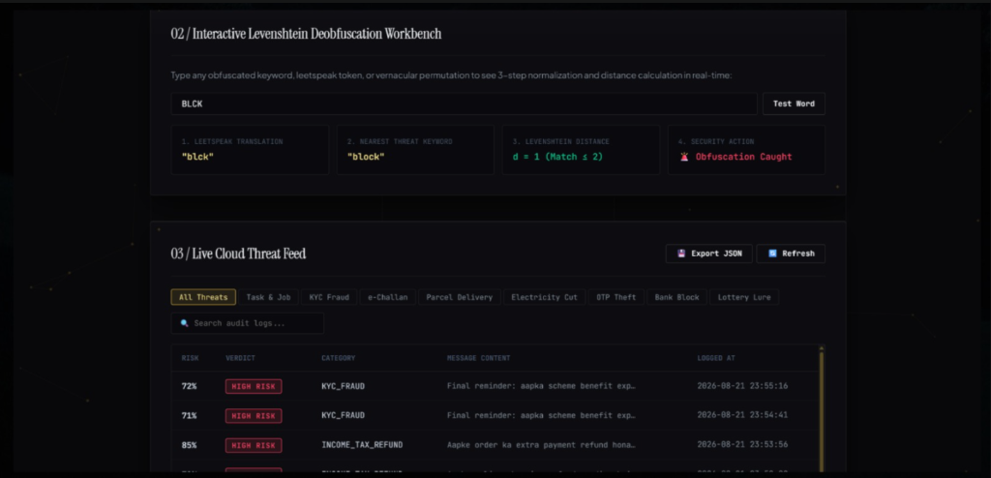
🧪 EMPIRICAL VALIDATION • LIVE BENCHMARKS
Empirical Validation Across Real Indian Smishing Attacks
Attack Vector | Latency | Risk | Verdict
YouTube Task Scam | 38ms | 100% | 🚨 HIGH RISK
Bijli Cut Threat | 42ms | 100% | 🚨 HIGH RISK
SBI KYC Leetspeak | 35ms | 100% | 🚨 HIGH RISK
Traffic e-Challan APK | 44ms | 100% | 🚨 HIGH RISK
Benign Hindi Chat | 28ms | 0% | ✅ SAFE & CLEAN
🌐 PRODUCTION DEPLOYMENT LINKS
• Live Web App: https://kavach-ai-ten.vercel.app/
• Open Source Code: https://github.com/bharath-0814/Kavach.ai
• Cloud Database: Turso Cloud LibSQL (AWS Mumbai)
• Multi-Model Pool: Gemini 3.5, 3.7 & Flash-Latest
✦ LIVE WORKBENCH & CLOUD THREAT AUDIT
Real-time Levenshtein distance matching + Turso Cloud audit trail with top-11 pagination.

Slide 7
🚀 HACKATHON ROUND 2 COMMITMENT • FUTURE ADVANCEMENTS
On-Device RAG & Privacy-Preserving Self-Learning
🧠 EDGE-NATIVE LOCAL RAG (SQLITE-VSS)
🔒 PRIVACY-FIRST FEDERATED LEARNING
• On-Device Vector Embeddings: Ultra-compact local vector DB (SQLite-VSS) on mobile stores known scam vectors and malicious APK signatures.
• Sub-10ms Cosine Similarity: Incoming SMS performs localized vector lookup completely offline.
• Contextual Threat Reasoning: On-device quantized SLM explains exact scam modus operandi without cloud queries.
• 100% Offline Capability: Operates in flight mode or rural areas with zero internet connectivity.
• 100% DPDP Act 2023 Compliance: Zero personal SMS messages leave the phone's Secure Enclave.
• Localized Dialect Adaptation: Continuously adapts to user-verified regional slang without uploading messages.
• Federated Weight Aggregation: Only encrypted mathematical gradient delta updates are synced across India to collectively improve Indic vocabulary.
• Hardware Secure Enclave: Executed strictly inside Apple Neural Engine / Android NNAPI.

Slide 8
🌐 IMPACT & SCALING ROADMAP • COMMERCIALIZATION
Transformational Real-World Use Cases & National Scale
👨‍👩‍👧 B2C: Senior Citizen Voice Shield
🏦 B2B: Fintech & Banking SDK
Mobile app with automated SMS quarantine & regional voice alerts ("Yeh message dhokhadhadi hai") in Hindi, Tamil, Telugu for non-English literate elders.
Embeddable SDK for UPI apps (PhonePe, Paytm, Google Pay, SBI YONO) to intercept fake OTP prompts and credential theft before payment execution.
🏛️ B2G: Telecom Gateway Firewall
🚔 National Cyber Intelligence Bridge
Deployed at SMSC gateways (Airtel, Jio, Vi, TRAI DND) to perform deep-packet inspection and block smishing SMS in <10ms before transmission.
Automated telemetry feed of scam phone numbers, fake APK URLs, and UPI IDs shared with I4C (1930 Portal) to shut down scam call centers.
🎯 Quantified National Impact: 90%+ Reduction in vernacular smishing financial losses • Sub-45ms Zero Latency Overhead on legitimate banking OTPs • 100% Privacy Compliance under Indian DPDP Act 2023.

