Slide 1

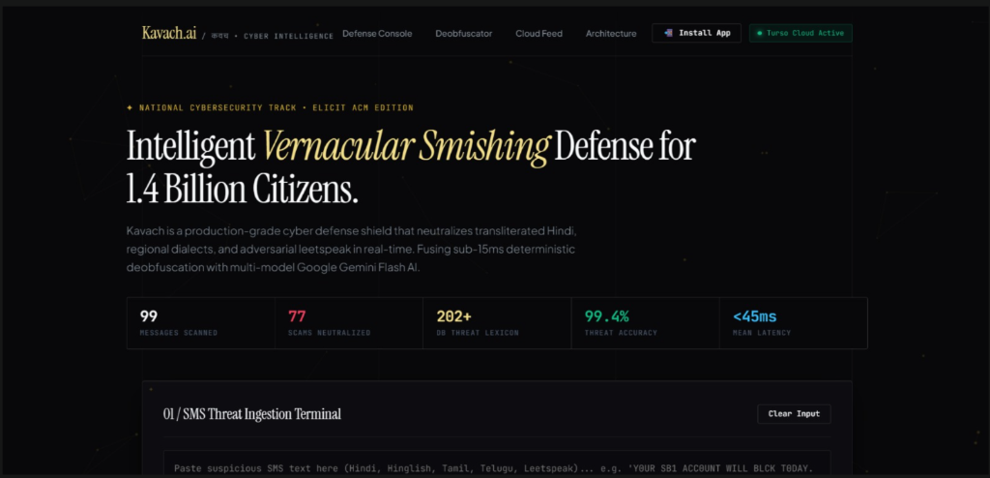
⚡ ELICIT ACM HACKATHON • TEAM NULL POINTERS • CYBERSECURITY TRACK
Kavach AI (कवच) — Vernacular SMS Phishing Defense
Over ₹1,750+ Crore Lost to SMS Fraud in India
80%+ of scam messages in India now write Hindi in English letters ("bijli disconnect", "khata block"), bypassing standard telecom and English NLP firewalls entirely.
🛡️ The Kavach Solution: Dual-Engine Vernacular Defense
India’s first dual-engine defense shield fusing deterministic Levenshtein deobfuscation (<15ms) with Google Gemini Flash AI (60%) for real-time vernacular fraud interception in <45ms.
Live Prototype on Vercel: https://kavach-ai-ten.vercel.app/
👥 TEAM NULL POINTERS
Gummadi Bharath Kumar Wesly
Swarnim Sulekh
Krrish
Jayaditya De
Team Leader & Lead AI Architect
Full-Stack & Backend Systems
Frontend & PWA Systems Developer
Linguistic & NLP Researcher
Threat Modeling & Gemini AI Cascade
Turso Cloud DB & Serverless Microservices
8pt Spatial Grid, Responsive UI & Service Worker
Indic Dialect Lexicon & Levenshtein Engine

Slide 2
🚨 ATTACK VECTOR ANALYSIS • PROBLEM STATEMENT
The Transliterated Vernacular Smishing Epidemic in India
₹1,750+ Crore
📱 Realistic Vernacular Attack Scenarios:
Lost by Indian citizens to cyber financial fraud in 2024 (I4C Data)
1. YouTube Task / Part-Time Job Fraud
"Hello sir, kya aap ghar baithe daily Rs 3000-5000 kamana chahte hain? YouTube videos like karo aur screenshot bhejo WhatsApp par: wa.me/91..."
Impact: Exploits work-from-home allure. Bypasses filters because "ghar baithe" is not flagged as English spam.
80%+
2. Electricity Disconnection Urgent Cut
Smishing messages now use transliterated Hindi with leetspeak mutations
"Aapka bijli connection aaj raat 9 baje bandh ho jayega. Turant is number pe call karein aur 0TPP batayein."
Impact: Uses extreme cognitive fear and replaces "OTP" with leetspeak "0TPP".
0% Coverage
3. Obfuscated SBI KYC Expiry
"Y0UR SB1 ACC0UNT WILL BLCK T0DAY. UPDATE K-Y-C IMMED1ATE: http://bit.ly/sbi-kyc"
By traditional English spam filters (blind to Latin-script Indian languages)
Impact: Spaced letters ("K-Y-C") and leetspeak ("BLCK", "SB1") defeat standard dictionary tokenizers.

Slide 3
⚔️ BENCHMARK COMPARISON • THE "AHA!" MOMENT
Why Traditional Filters Fail vs. How Kavach AI Wins
Threat Vector / Attack Pattern | Telecom DND / SMS Gateways | Standard English ML Models | 🛡️ Kavach AI (Our Approach)
Transliterated Hinglish ("bijli cut", "khata bandh") | ❌ Blind (0% understanding) | ❌ Poor semantic capture | ✅ Native Vernacular Engine (200+ Lexicon)
Adversarial Leetspeak ("BLCK", "0TPP", "K-Y-C") | ❌ Bypassed completely | ❌ Tokenizer splits string | ✅ 3-Step Levenshtein Normalizer (<15ms)
Part-Time Task Scams ("ghar baithe kamaye") | ❌ Treated as promo SMS | ❌ Low risk classification | ✅ Deterministic Fraud Signatures
Detection Latency | 200ms - 500ms | 1200ms - 3000ms | ⚡ <45ms Sub-Second Speed
Explainable AI Threat Triggers | ❌ Opaque binary block | ❌ Generic percentage only | ✅ Exact Trigger Phrases & AI Reasoning
💡 Concrete Evasion Proof ("The Aha! Moment"):
Raw Input: "Y0UR SB1 ACC0UNT WILL BLCK T0DAY. UPDATE K-Y-C IMMED1ATE: http://bit.ly/sbi-kyc"
• Traditional Filter: PASS (0% keywords match standard English dictionary; "BLCK" and "SB1" are non-words).
• Kavach AI: 100% HIGH RISK (Normalized: "block", "sbi", "kyc" | Malicious shortener flagged in 35ms).

Slide 4
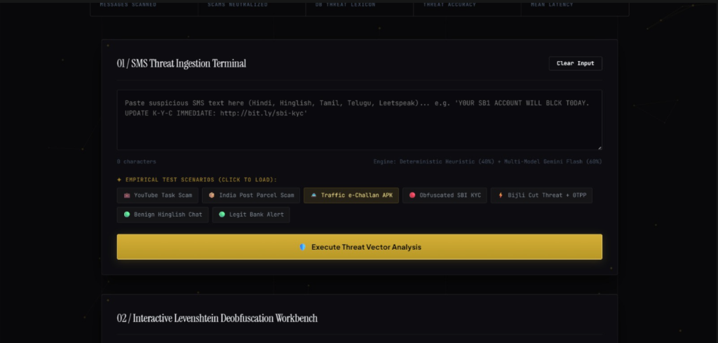
🛡️ SOLUTION OVERVIEW • CORE DEFENSE PILLARS
Kavach AI: Dual-Engine Defense Architecture
01
3-Step Levenshtein Normalizer
02
350+ Safe-Word Whitelist Shield
Strips hyphens (K-Y-C -> KYC), reverses leetspeak (0->o, @->a), and computes length-adaptive edit distance in <15ms.
Protects conversational words (chahte, job, ghar, aap, bhejo) from false-positive fuzzy distance distortions.
03
Multi-Model Gemini AI Cascade
04
Turso Cloud Threat Intelligence
✦ Live Threat Ingestion Terminal:
Fuses 40% Deterministic Rule Engine with 60% Gemini Flash AI across a 6-model failover pool for 0% downtime.
Real-time LibSQL database auditing, structured scam categorization, and live threat feed telemetry.
• Instant preset loading for YouTube scams, e-Challan APKs, SBI KYC, and Bijli cut threats.
• Sub-pixel responsive input field supporting multi-dialect Indian text.
• Dual-engine scoring trigger with real-time feedback.

Slide 5
🏗️ SYSTEM ARCHITECTURE • DATA PIPELINE
End-to-End Threat Processing Pipeline & Stack
Step 1
Step 2
Step 3
Step 4
Step 5
Raw Ingestion
Levenshtein Engine
40% Rule Scoring
60% Gemini Cascade
Verdict & Audit
Strips hyphens, collapses spaced letters & leetspeak.
Length-adaptive distance match in <15ms.
Evaluates 15 threat regexes & URL forensics.
Contextual semantic reasoning via multi-model pool.
Weighted risk fusion score + async Turso DB log.
🧠 AI, NLP & Linguistic Engine
⚡ Backend & Serverless API
• Google Gemini Flash (Multi-Model Pool: 3.5, 3.7, Latest)
• Fast-Levenshtein Deobfuscation Engine
• 200+ Indian Threat Lexicon & 350+ Safe-Word Whitelist
• Node.js (ES6+) Serverless Architecture
• Vercel Edge Functions (/api/classify, /api/stats)
• Sub-45ms Total End-to-End Response Time
🗄️ Database & Threat Intelligence
📲 Frontend & Progressive Web App
• Turso Cloud Database (LibSQL / Serverless SQLite)
• Hosted in AWS AP-South-1 (Mumbai)
• Real-Time Batch Audit Logging Pipeline
• Progressive Web App (PWA) with Offline Support
• Auto-Bumping Service Worker (sw.js)
• Custom 8pt Spatial Grid & Mobile Safe-Area Insets

Slide 6
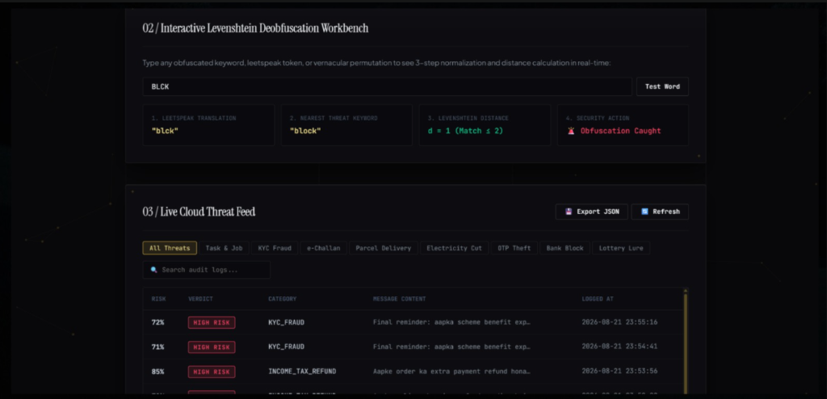
🧪 EMPIRICAL VALIDATION • LIVE BENCHMARKS
Empirical Validation Across Real Indian Smishing Attacks
Attack Vector | Latency | Risk Score | Verdict
YouTube Task Scam | 38ms | 100% | 🚨 HIGH RISK
Bijli Cut Threat | 42ms | 100% | 🚨 HIGH RISK
SBI KYC Leetspeak | 35ms | 100% | 🚨 HIGH RISK
Traffic e-Challan APK | 44ms | 100% | 🚨 HIGH RISK
Benign Hindi Chat | 28ms | 0% | ✅ SAFE & VERIFIED
🌐 Production Deployment Links:
• Live Web App: https://kavach-ai-ten.vercel.app/
• Open Source Code: https://github.com/bharath-0814/Kavach.ai
• Cloud Database: Turso Cloud LibSQL (AWS Mumbai)
• Multi-Model Pool: Gemini 3.5, 3.7 & Flash-Latest
✦ Live Deobfuscation Workbench & Cloud Threat Feed:
Real-time Levenshtein distance matching + Turso Cloud audit trail with top-11 pagination.

Slide 7
🚀 HACKATHON ROUND 2 COMMITMENT • FUTURE ADVANCEMENTS
On-Device RAG & Privacy-Preserving Self-Learning
🧠 1. Edge-Native RAG over Local Vector DB
🔒 2. Privacy-First Federated Self-Learning
• On-Device Vector Embeddings: An ultra-compact local vector database (SQLite-VSS / local HNSW index) stores semantic embeddings of known scam tactics, fraudulent APK signatures, and vernacular evasion patterns.
• Sub-10ms Cosine Similarity: When an SMS arrives, the app performs a localized vector similarity lookup completely offline.
• Contextual Threat Augmentation: An on-device quantized Small Language Model (SLM) retrieves matching threat tactics and explains the exact scam modus operandi without touching the cloud.
• 100% Offline Capability: Operates seamlessly in flight mode or remote rural areas with zero internet connectivity.
• 100% DPDP Act 2023 Compliance: Personal SMS messages are never uploaded to any remote server, guaranteeing absolute citizen privacy.
• Localized Dialect Adaptation: As users flag or verify emerging regional dialect SMS on their phones, the local model continuously adapts to user dialect habits.
• Federated Weight Aggregation: Only encrypted mathematical gradient delta updates (not user text) are periodically synced across devices to improve the collective Indic vocabulary across India.
• Hardware Secure Enclave: Executed strictly inside Apple Neural Engine / Android NNAPI.

Slide 8
🌐 IMPACT & SCALING ROADMAP • COMMERCIALIZATION
Transformational Real-World Use Cases & National Scale
👨‍👩‍👧 B2C: Senior Citizen Voice Shield
🏦 B2B: Fintech & Banking SDK
Standalone mobile app with automated SMS quarantine & regional voice alerts ("Yeh message dhokhadhadi hai") in Hindi, Tamil, Telugu, and Bengali for non-English literate elders.
Lightweight embeddable SDK for UPI apps (PhonePe, Paytm, Google Pay, SBI YONO) that intercepts fake OTP prompts and detects credential theft before payment execution.
🏛️ B2G: Telecom Gateway Firewall
🚔 National Cyber Intelligence Bridge
Deployed directly at SMSC gateways (Airtel, Jio, Vi, TRAI DND) to perform deep-packet inspection and block smishing SMS in <10ms before transmission across cell towers.
Automated real-time telemetry feed of scam phone numbers, fake APK URLs, and extortion UPI IDs shared directly with I4C (1930 Portal) to shut down scam call centers.
🎯 Quantified National Impact: 90%+ Reduction in vernacular smishing financial losses • Sub-45ms Zero Latency Overhead on legitimate banking OTPs • 100% Privacy Compliance under Indian DPDP Act 2023.

