Slide 1

Project report on
Tackling world hunger
through Gen Z practices
BY BS3 CODERS

Slide 2
The team : BS3 CODERS
Bharath HV r19cs329@cit.reva.edu.in
Sunil Seervi r19cs340@cit.reva.edu.in
Suhas Reddy BR r19cs336@cit.reva.edu.in
Vidya Suman RP r19cs370@cit.reva.edu.in

Slide 3
THE PROBLEM:
In the 2021 Global Hunger Index, India ranks 101st out of the 116 countries with sufficient data to calculate 2021 GHI scores. With a score of 27.5, India has a level of hunger that is serious.

Slide 4
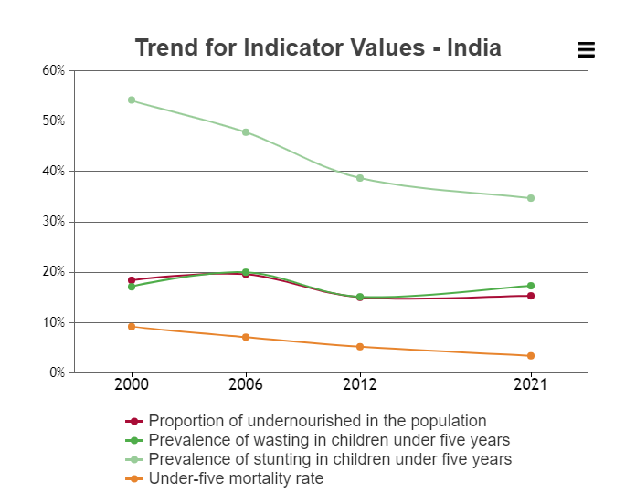

Slide 5
REASONS:
The reasons are complex and varied, and often interconnected.
Poverty. Poverty is the main cause of hunger in the world.
Job Instability.
Food Shortages and Waste.
Poor infrastructure.
Unstable Markets.
Climate Change.
War and Conflict.
Nutritional Quality.

Slide 6

OUR WAY OF DEALING WITH IT….

Slide 7


The Fist Full of Love we share…..

Slide 8
Project summary
The idea behind the project is to develop a smartphone application which helps in finding the location of people who are deprived of food and also to find where there is excess or wastage of food.

Slide 9
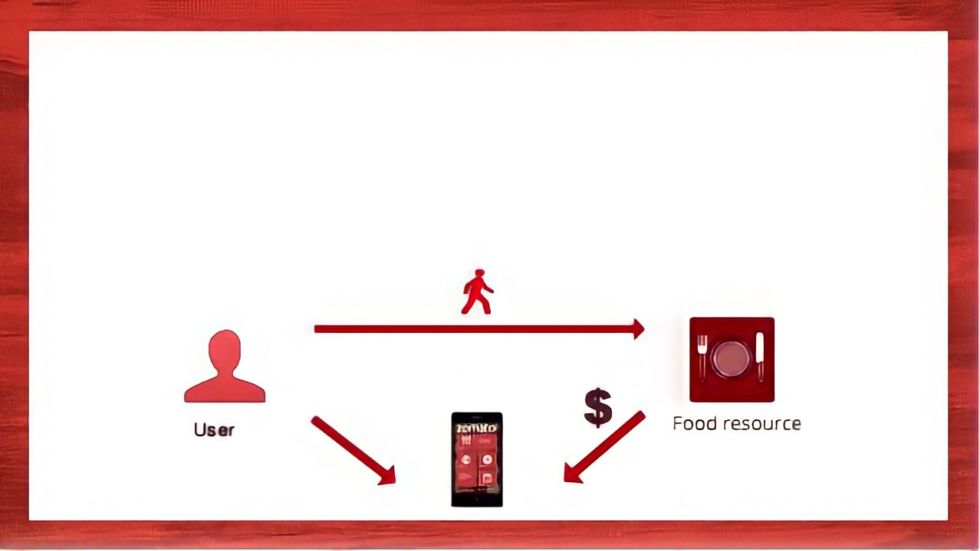
BUSINESS MODEL
User uploads the location of food deprived people on the app.
Source of Food will be uploaded by excess food producers on the app.
We collect the data
And we act as a logistics company to collect and deliver the food to the required locations.

Slide 10
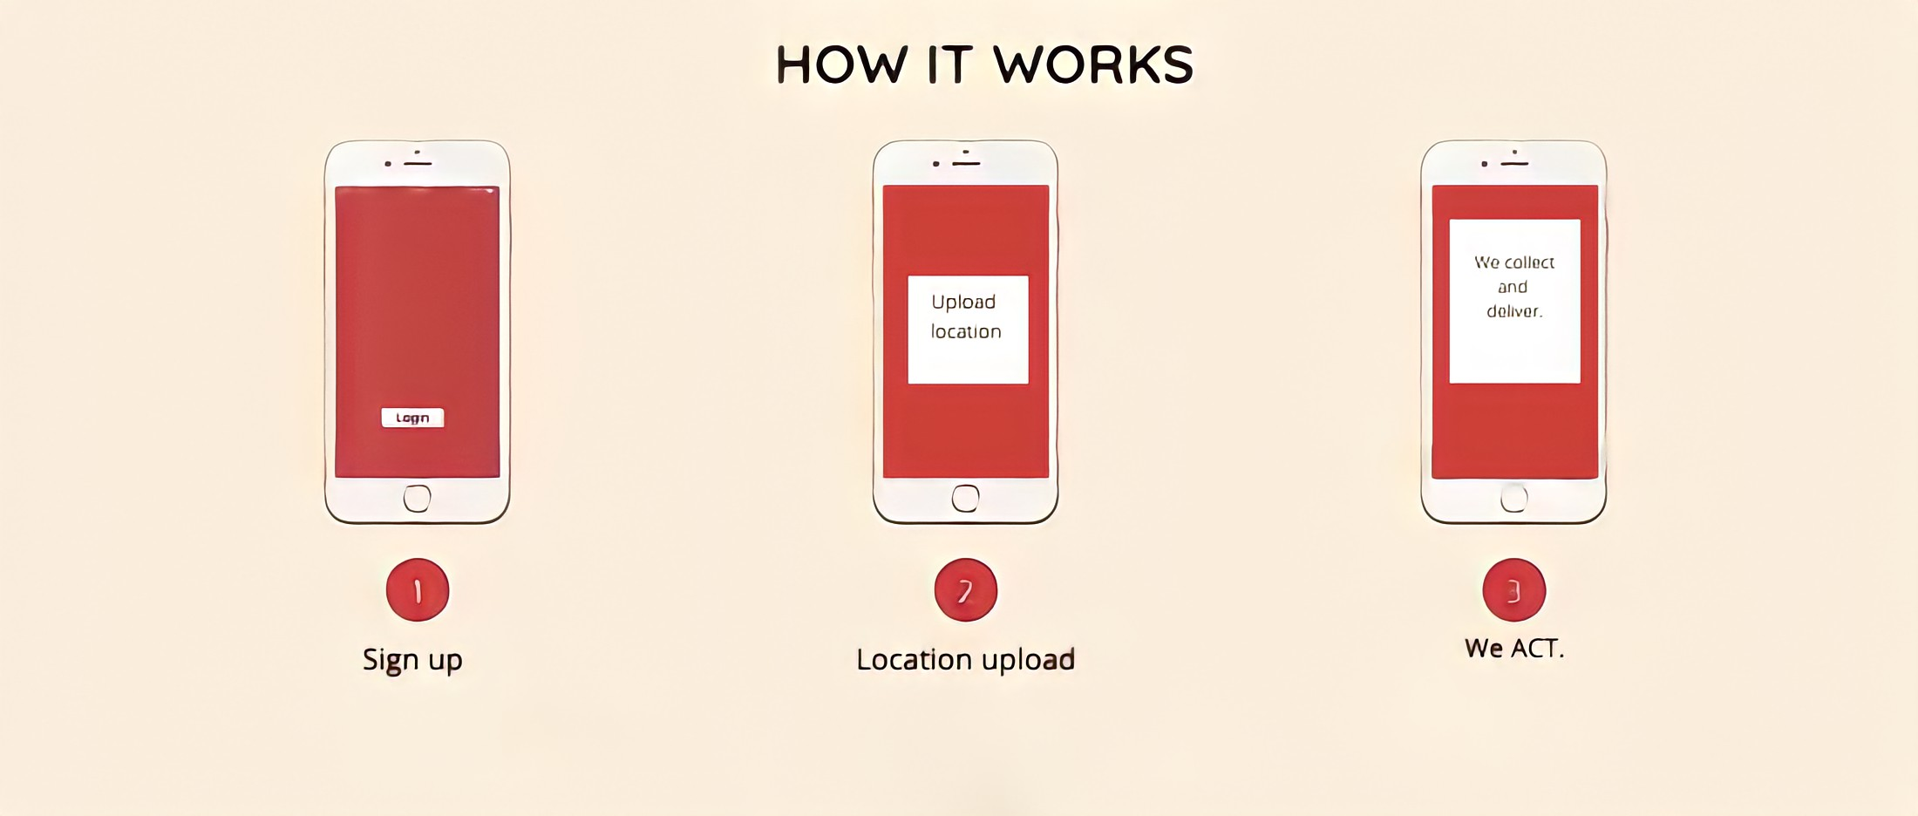


Slide 11
What’s the deal?
This app enables and offers assistance to the needy and satisfies one’s hunger , simultaneously contributing to decrease GHI of the nation and make The Nation BETTER!

Slide 12
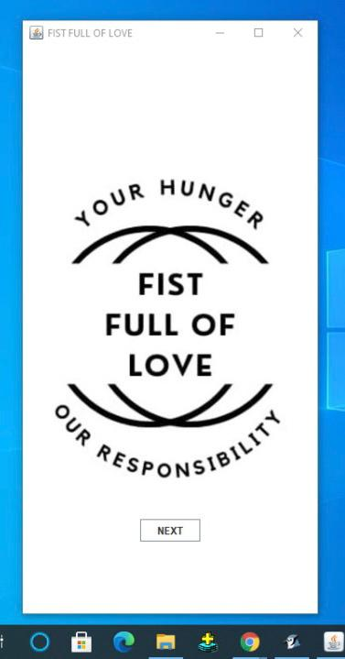
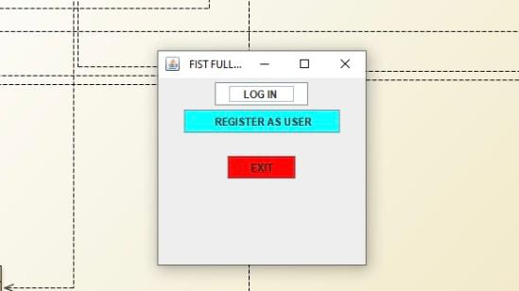
SNAPSHOTS

Slide 13
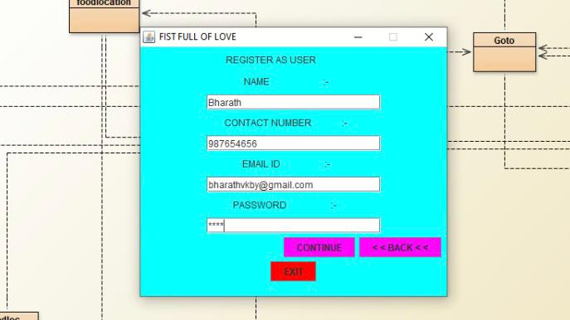
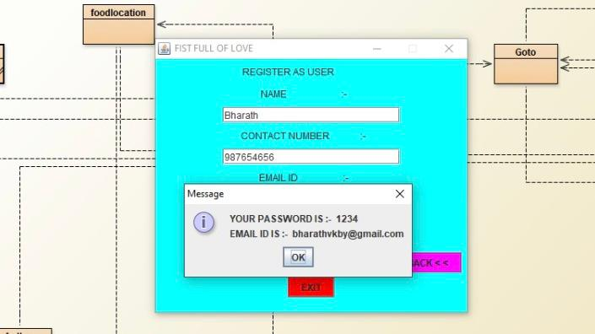

Slide 14
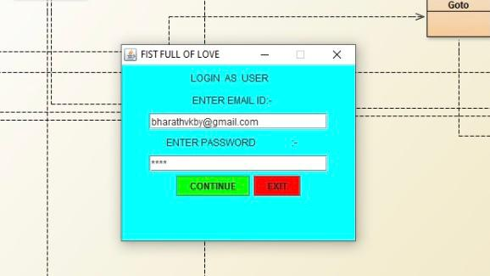
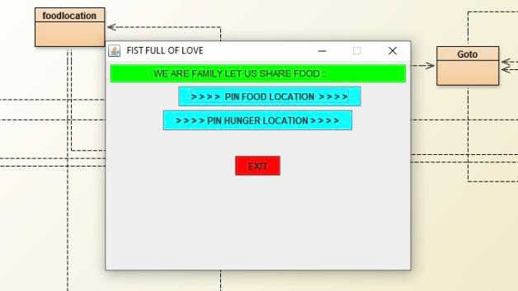

Slide 15
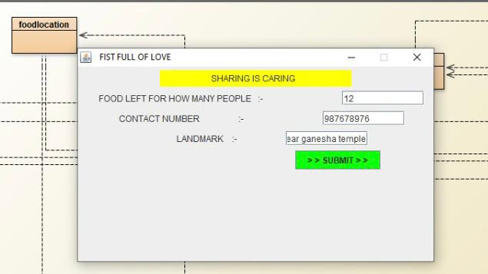
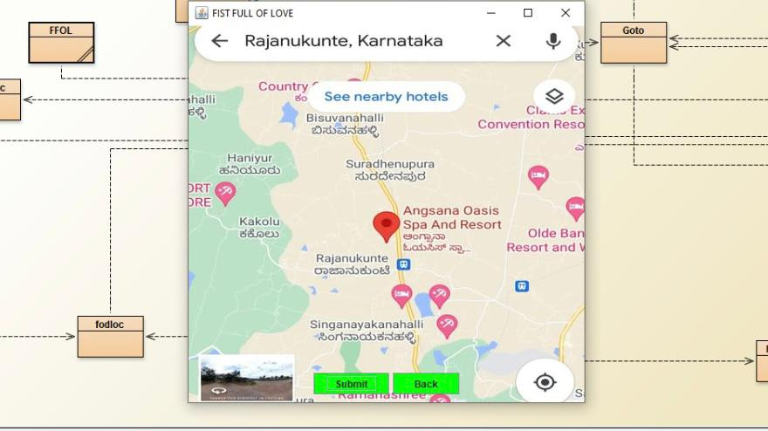

Slide 16
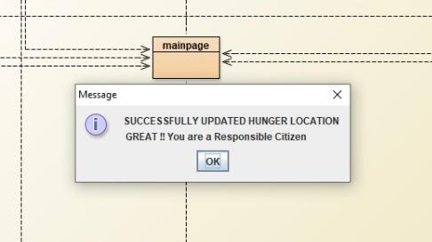
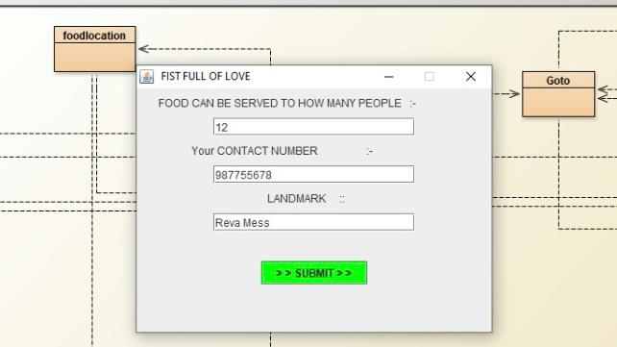

Slide 17
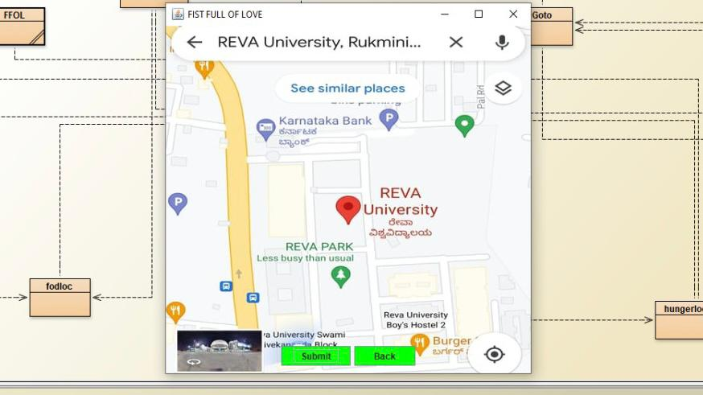
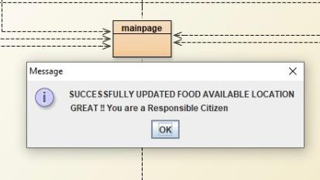

Slide 18


