Slide 1
Digital Portfolio
STUDENT NAME: K.BHARATH
REGISTER NO:212402333
NM ID : FC91F72735ED930823D40AFBB98B4BE8
DEPARTMENT: BCA
COLLEGE: AGURCHAND MANMULL JAIN COLLEGE

Slide 2
PROJECT TITLE
INTERACTIVE DIGITAL PORTFOLIO USING FRONT END DEVELOPMENT

Slide 3


AGENDA
Problem Statement
Project Overview
End Users
Tools and Technologies
Portfolio design and Layout
Features and Functionality
Results and Screenshots
Conclusion
Github Link
3/21/2024 Annual Review

Slide 4

PROBLEM STATEMENT
resumes and portfolios often don’t attract viewers or showcase skills .
An interactive digital portfolio built with HTML, CSS, and JavaScript can solve this by being responsive, attractive.

Slide 5

This Interactive Digital Portfolio using Front-End Development shows an individual’s profile, skills, projects, and contact details.
PROJECT OVERVIEW
It’s Developed with HTML, CSS, and JavaScript, it has smooth navigation and interactive elements.

Slide 6

WHO ARE THE END USERS? 1.Students & Job Seekers – use the portfolio to highlight skills, projects, and achievements for recruiters. 2.Recruiters & Employers – review the portfolio to assess a candidate’s abilities and creativity. 3.Educators & Peers – view the portfolio for learning, mentoring, or networking.

Slide 7

TOOLS AND TECHNIQUES TOOLS: HTML5 – for structuring the web pages and content. CSS3 – for styling, layout design, and responsiveness. JavaScript – for adding interactivity and dynamic features. Code Editor (VS Code/Codepen) – for writing and managing code. TECHNIQUES: Flexbox and Grid Layouts – for modern, flexible page structuring. Form Handling – for creating a functional contact section. Smooth Navigation & Animations – to improve user experience and engagement.

Slide 8
PORTFOLIO DESIGN AND LAYOUT
PORTFOLIO:
1.Header/Nav Bar – links to “About me, skills, Contact”.
2.Home – introduction with name, tagline, and banner.
3.About – technical skills.’
4.Contact – form and social media links.
8

Slide 9
FEATURES AND FUNCTIONALITY 1.Navigation Bar – Easy movement between Home, About, Skills, Projects, and Contact. 2.Interactive UI – Hover effects, smooth scrolling, and animations. 3.Contact Form – Allows users to send queries directly.

Slide 10

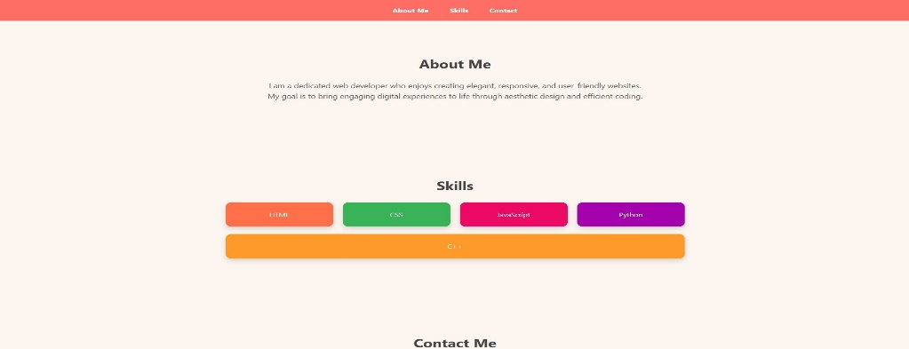


RESULTS AND SCREENSHOTS:
3/21/2024 Annual Review
10

Slide 11
CONCLUSION The project “Interactive Digital Portfolio using Front-End Development” uses HTML, CSS, and JavaScript to build a responsive, interactive portfolio. Unlike regular resumes, it professionally showcases details, skills, and projects, helping students, job seekers, and professionals present themselves to recruiters and clients.
11

Slide 12
GITHUB LINK:
https://bharath-9876.github.io/my-server/

