Slide 1

Keyboard Configuration
using Genetic Algorithm
Bio-Inspired Optimization for Ergonomic Typing
Machine learning | Artificial Intelligence | Computer Science | Carpalx Biomechanical Model
49.4% (English) | 49.6% (Java)

Slide 2
The Problem with QWERTY
Why the world's most common keyboard is hurting your hands
QWERTY Layout
QWERTY was designed in 1873 for mechanical typewriters — to prevent type-arm jams, not to protect hands.
Q
W
E
R
T
Y
U
I
O
P
Frequent letters placed far from home row
Heavy workload on weak pinky & ring fingers
Common pairs (TH, HE, ER) force awkward reaches
Left/right hand imbalance — left hand overloaded
A
S
D
F
G
H
J
K
L
;
Z
X
C
V
B
N
M
,
.
'
High freq
Med freq
Low freq
30! = 2.65 × 10³² possible keyboard arrangements — too many to search exhaustively → Genetic Algorithm required

Slide 3
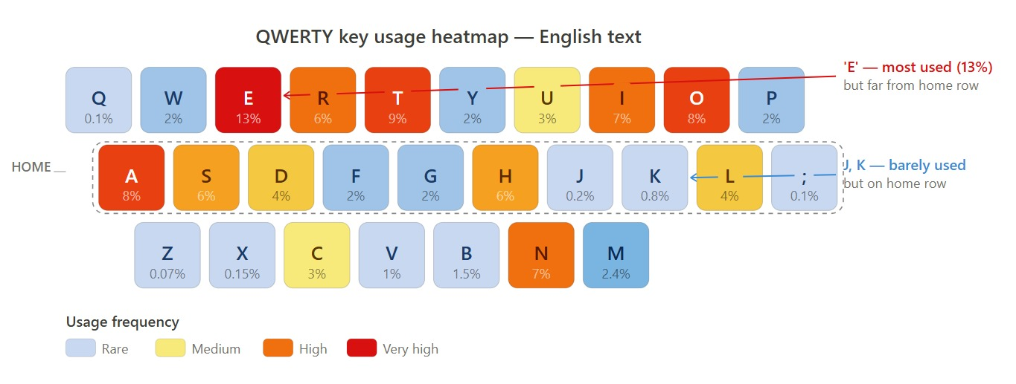

Slide 4



Medical Impact of Typing
Conditions caused or worsened by inefficient keyboard layouts
Carpal Tunnel
Syndrome
Tendonitis /
Tenosynovitis
Median nerve compressed by inflamed tendons. Numbness & weakness in thumb/index fingers.
Tendon inflammation from repetitive micro-movements. Pain along the back of the hand.
Osteoarthritis
Aggravation
Trigger Finger
Keypress micro-impacts worsen existing cartilage degradation in finger joints.
Narrowed sheath causes finger to lock in bent position — common in the dominant typing hand.

Slide 5

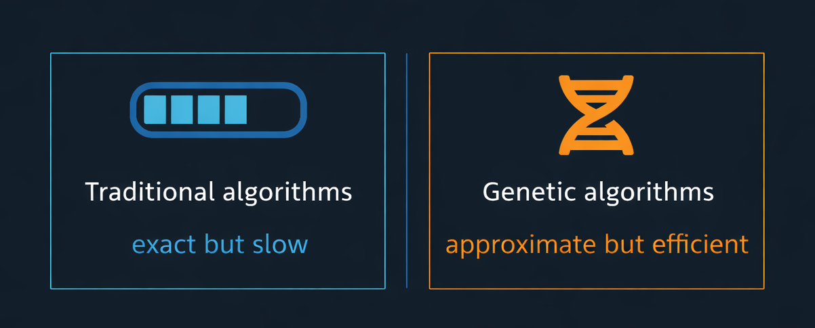
What is a Genetic Algorithm?
Nature-inspired search — mimicking Darwinian evolution
A Genetic Algorithm (GA) is an optimization technique modelled on natural selection. It starts with a population of random solutions and evolves them over thousands of generations — selecting the fittest, combining them, and introducing random mutations — until a near-optimal solution emerges.
Why GA? The keyboard search space has 30! ≈ 2.65 × 10³² possibilities. No exact algorithm can search this — evolution can.

Slide 6
GA Concepts → Keyboard Problem
Every genetic algorithm concept maps directly to a keyboard design decision
GA Concept | Keyboard Mapping
Chromosome | One complete 30-key layout (Python list of 30 characters)
Gene | A single character at a specific key position (index = physical slot)
Population | 200 randomly generated keyboard layouts evolving together
Fitness Function | 1 ÷ Carpalx effort score → lower effort = higher fitness
Selection | Tournament: pick best from 5 random layouts to become a parent
Crossover | OX1 Order Crossover — combines two parents, always valid permutation
Mutation | Swap two random keys with 8% probability per child
Elitism | Top 10% survive unchanged into the next generation
Termination | After 1,000 generations

Slide 7
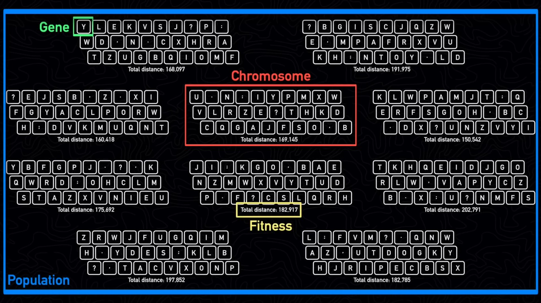
COURTESY : adumb

Slide 8
Fitness Function — Carpalx Model
How the algorithm measures whether a layout is ergonomic
Fitness = 1 ÷ Σ ( K1·e₁ + K2·e₂ + K3·e₃ ) × freq(trigram)
Trigram Path Cost
Same-Finger Penalty
K1=1.0, K2=0.367, K3=0.235 — each key in a 3-char sequence weighted by position. 2nd and 3rd keys cost less (finger already moving).
+1.5× the key's effort when two consecutive keys use the same finger. Primary mechanical cause of RSI.
Same-Hand Penalty
Hand Balance Penalty
+0.8 when all 3 keys in a trigram land on one hand. Encourages hand alternation.
Measures left/right load imbalance across all bigrams. Max penalty = 200 for fully one-sided layouts.

Slide 9

Dataset — Carpalx Corpus
Real text drives real optimization — not toy frequencies
2,373,664
806
6,978
valid characters
processed
distinct bigrams
extracted
trigrams used
(after pruning)
14 Classic Novels in the Carpalx corpus:
Alice's Adventures in Wonderland
Dracula — Bram Stoker
Great Expectations — Dickens
The Picture of Dorian Gray
Huckleberry Finn — Twain
Jane Eyre — Charlotte Brontë
Moby-Dick — Melville
The Count of Monte Cristo
Pride and Prejudice — Austen
Sense and Sensibility — Austen
Adventures of Sherlock Holmes
Tom Sawyer — Mark Twain
Ulysses — James Joyce
Walden — Thoreau

Slide 10

Algorithm — Step by Step
How the GA evolves a better keyboard over 1,000 generations
1
Load corpus Read books_short.txt → extract 806 bigrams + 6,978 trigrams, normalize to per-1000 rates
2
Initialize Generate 200 random keyboard layouts — every character appears exactly once (valid permutations)
3
Evaluate fitness Score each layout using the Carpalx effort formula. fitness = 1 / total_effort
4
Elitism Copy the top 10% (20 layouts) unchanged to the next generation — never lose a good layout
5
Tournament selection Draw 5 random layouts, pick the best-scoring one as Parent 1. Repeat for Parent 2
6
OX1 Crossover Copy a random segment from P1 into child, fill remaining slots from P2 in order — always valid
7
Swap Mutation With 8% probability, swap two random keys in the child layout to maintain diversity
8
Repeat Replace old population with new generation. Repeat steps 3–7 for 1,000 generations

Slide 11
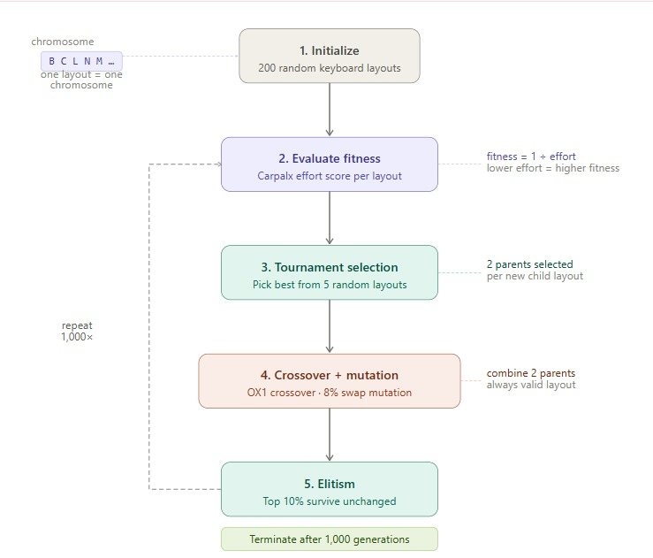

Slide 12
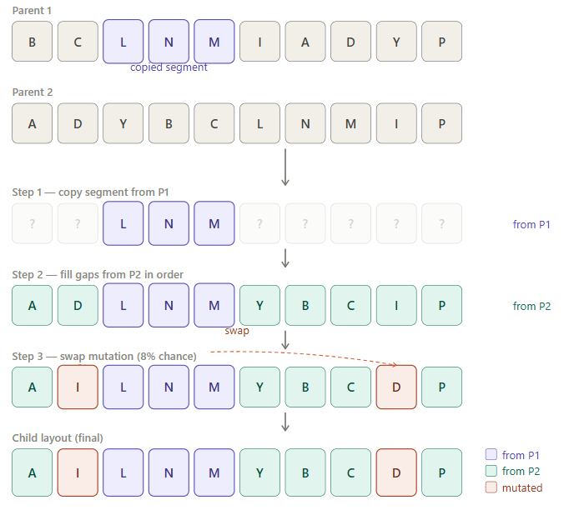

Slide 13

Results — English Prose
1,000 generations | Population 200 | books_short.txt | 2,373,664 characters
49.4%
Reduction in typing effort vs QWERTY
3,521.37 → 1,781.59 Carpalx effort units | converged at Gen ~500
Metric | QWERTY | GA Optimized
Effort score | 3,521.37 | 1,781.59
Finger travel | High | Reduced
Home row frequent keys | Low | High
Pinky / ring load | Heavy | Minimal
Hand balance | Uneven | ~50 / 50
Same-finger bigrams | Common | Avoided

Slide 14

Results — Java Code
1,000 generations | Population 200 | java.txt | 1,467,254 characters
49.6%
Reduction in typing effort vs QWERTY
3,745.99 → 1,886.61 Carpalx effort units | converged at Gen ~400
Metric | QWERTY | GA Optimized (Java)
Effort score | 3,745.99 | 1,886.61
Finger travel | High | Reduced
Semicolon ; placement | Home row | Home row
Vowels on home row | A | I, U, A
Hand balance | Uneven | ~50 / 50
Same-finger bigrams | Common | Avoided

Slide 15
Optimized Layout
GA result after 1,000 generations on the Carpalx literary corpus
books_short.txt -- 2,373,664 chars → 806 bigrams, 6,978 trigrams
QWERTY (Baseline)
GA Optimized
TOP
Q
W
E
R
T
Y
U
I
O
P
TOP
Q
J
G
F
V
;
'
K
X
Z
HME
A
S
D
F
G
H
J
K
L
;
HME
B
C
L
N
M
I
A
D
Y
.
BOT
Z
X
C
V
B
N
M
,
.
'
BOT
P
W
T
S
R
O
E
H
U
,
Vowel (home row)
High freq (home)
High freq (off-row)
Home row (English): B C L N M I A D Y . — vowels I, A + frequent consonants L, N, M all under the fingers

Slide 16
Optimized Layout — Java
GA result after 1,000 generations on the Java corpus
java.txt … 1,467,254 chars → 861 bigrams, 6,861 trigrams
QWERTY (Baseline)
GA Optimized (Java)
TOP
Q
W
E
R
T
Y
U
I
O
P
TOP
'
Q
J
B
X
,
K
M
W
Z
HME
A
S
D
F
G
H
J
K
L
;
HME
Y
G
I
N
P
U
A
L
;
V
BOT
Z
X
C
V
B
N
M
,
.
'
BOT
H
D
E
R
C
O
S
T
.
F
Vowel (home row)
High freq (home)
High freq (off-row)
Home row (Java): Y G I N P U A L ; V — vowels I, U, A + semicolon ; on home row for Java syntax

Slide 17


Advantages & Limitations
What genetic algorithms do well — and where they fall short
Advantages
Limitations
Handles 30! ≈ 2.65 × 10³² search space without exhaustive enumeration
Fitness function is data-driven — 2.37M real characters, authentic biomechanical model
Trigram-aware cost captures realistic multi-stroke typing dynamics
Elitism guarantees best layout is never lost between generations
Flexible corpus: swap to java.txt to optimize for programming
Computationally expensive — 200 layouts × 6,978 trigrams per generation
No guarantee of global optimum — result varies between runs
Optimized layouts need significant learning curve to adopt
Biomechanical model is an approximation of real typing strain

Slide 18

Conclusion
The keyboard layout problem is too large for any exact method (30! ≈ 2.65 × 10³² possibilities). Genetic algorithms provide an effective evolutionary search — starting from random layouts and progressively breeding more ergonomic ones over 1,000 generations.
By grounding the fitness function in the authentic Carpalx biomechanical model and 2.37 million real characters, the algorithm achieves a 49.4% reduction for English and 49.6% for Java vs QWERTY — with frequent characters naturally migrating to the home row under strong fingers.
~49%
30!
1,000
effort reduction
vs QWERTY
search space
(≈ 10³² layouts)
generations
to converge
References: Krzywinski (2007) carpalx.bcgsc.ca | Eggers et al. (2020) researchgate.net | Norvig (2012) norvig.com | Goldberg (1989)

