Slide 1
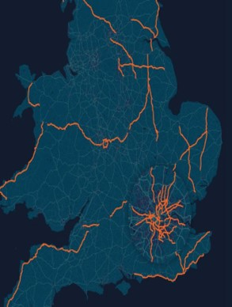

ROAD ACCIDENT DASHBORD
Using Excel
By
Sai Bharath Chand .A​

Slide 2





Contents
INTRODUCTION
PROCESS
KPI-ANALYSIS
INSIGHTS & CREDITS
DASHBOARD

Slide 3

Introduction
Welcome to the Road Accident Dashboard project!
The dataset for this analysis contains road accident information from the UK. This comprises over 300,000 rows with critical data fields
Using Excel as my primary tool, I've developed this informative dashboard
The primary goal of this project is to offer a user-friendly interface enabling stakeholders to quickly grasp key insights. This will helps to take informed decisions for accident prevention and safety improvement on UK roads.

Slide 4
Process
1
2
3
4
5
Data Gathering
Data Cleaning
Data Processing
Data Analysis/ Visualization
Dashboard

Slide 5
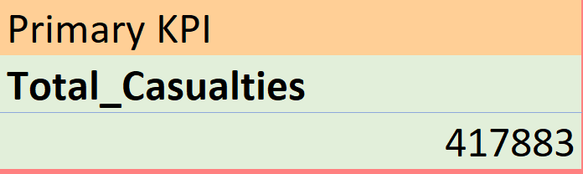
Primary KPI’s
Total Casualties with respect to vehicle type
Total Casualties & percentage of total with respect to accident severity and maximum casualties by type of vehicle
Out of total 417883 causalities
1.7% are fatal causalities
14.2% are serious causalities with severe injuries.
Slight causalities having major percent of 84.1% indicating the overall accident severity is less.
Through dashboard we can observe that Car type vehicles causing maximum accidents with over 79.8%.

Slide 6
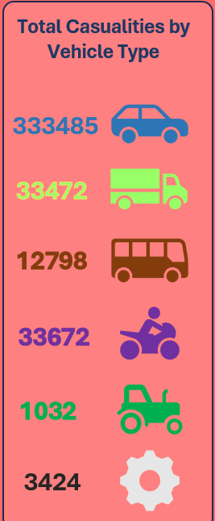
Secondary KPI’s
Total Casualties with respect to vehicle type
Cars: From the picture we can observe that most accidents happen with cars, causing the most injuries. This might be because there are a lot of cars on the road.
Vans: They generally less common than cars, but still cause a significant number of accidents.
Buses: Compare to cars & vans accidents involving buses happen less often, but when they do, they can affect many people at once because buses carry more passengers.
Bikes: Bikes are involved in quite a few accidents, highlighting the need for better safety for motorcyclists on the roads.
Tractors: Since tractors are agricultural vehicles accidents involving them are not very common
Others: This includes various other types of vehicles like cycles that contribute to a smaller portion of accidents.

Slide 7
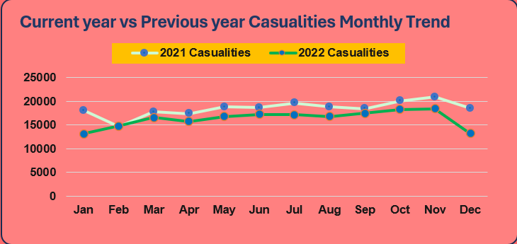
Secondary KPI’s
Monthly trend showing comparison of casualties for Current Year and Previous Year
Monthly Variations:
January to March: In the early months of 2022, there was a decline in casualties compared to the same period in 2021, but causalities count still increased slightly which needs further investigation.
April to September: The casualty numbers remained relatively stable during this period, with minor fluctuations. Although lower than the previous year, the decrease was not significant.
October to December: Toward the end of the year, there's a consistent decline in casualties compared to 2021, but notably less than earlier months in 2022. December, in particular, saw a significant drop compared to the previous year.

Slide 8
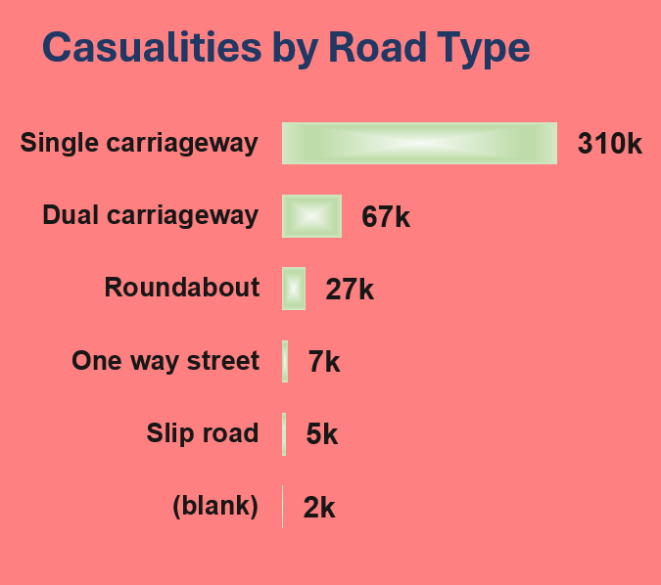
Secondary KPI’s
Maximum casualties by Road Type
Single Carriageway: These roads have the most casualties. Since with traffic moving in both directions, in a single lane accidents happens more often.
Dual Carriageway: These roads have fewer casualties compared to single carriageways but still a significant number. They have separate lanes for each direction.
Roundabout: Roundabouts have fewer accidents than the first two types. They're safer because they have slower traffic and better merging points.
One Way Street: Accidents here are less common. These streets are for one-way traffic, but accidents can still occur.
Slip Road: Fewer accidents happen on slip roads. These roads connect main roads to highways and usually have controlled access and lower speed limits.
Blank/Unknown: There are very few accidents recorded in this category, likely because the road type wasn't specified or is unknown.

Slide 9

Secondary KPI’s
Distribution of casualties by Road Surface
Dry Surfaces: The majority of casualties occur on dry road surfaces,
This could be due to a higher volume of traffic during these conditions, leading to more incidents.
Snow/Ice: A significantly lower number of casualties occur on snow or ice-covered roads. This could be due to reduced traffic or more cautious driving during these conditions.
Wet Surfaces: Wet roads contribute to a substantial number of casualties but are lower than those on dry surfaces. Wet conditions might increase the likelihood of accidents due to decreased traction and visibility.

Slide 10
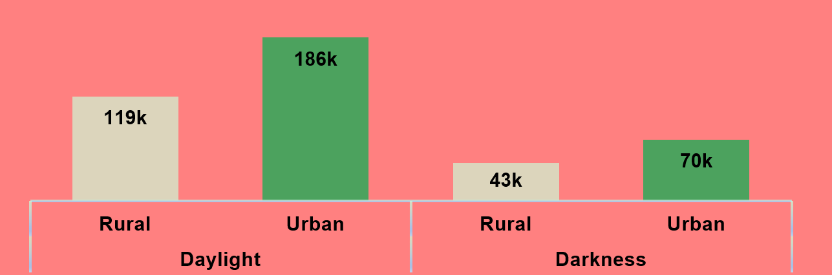
Secondary KPI’s
Relation between Casualties by Area/ Location & by Day/ Night
Daylight Casualties: The majority of casualties occurred during daylight hours,
with a higher number in urban areas compared to rural areas.
This might be due to higher traffic density and more activities during the day in urban.
Darkness Casualties: Fewer casualties occurred during darkness compared to daylight.
with more casualties in urban areas during the night than in rural areas.
Factors like reduced visibility and possibly higher speeds in urban areas during the night could contribute to these numbers.

Slide 11
Insights
Safety Measures: There could be a need for enhanced safety measures for car users, given the highest casualty count.
Improving road safety during dry conditions, such as through awareness campaigns or better traffic management, could help reduce the majority of accidents. Additionally, emphasizing caution and preparedness during wet weather could contribute to fewer casualties on these road surfaces.
Overall Trend: 2022 generally showed lower casualties compared to 2021, especially towards the end of the year.
Urban Areas have more Casualties: The higher number of casualties in urban areas suggests that accidents are more frequent in cities and densely populated regions due to higher traffic volumes and complex road networks
Credits :
Thanks to Data Tutorials YouTube channel for teaching this amazing dashboard creation :
Video link : https://youtu.be/XeWfLNe3moM?si=4WHIlw1hj5pcw967

Slide 12
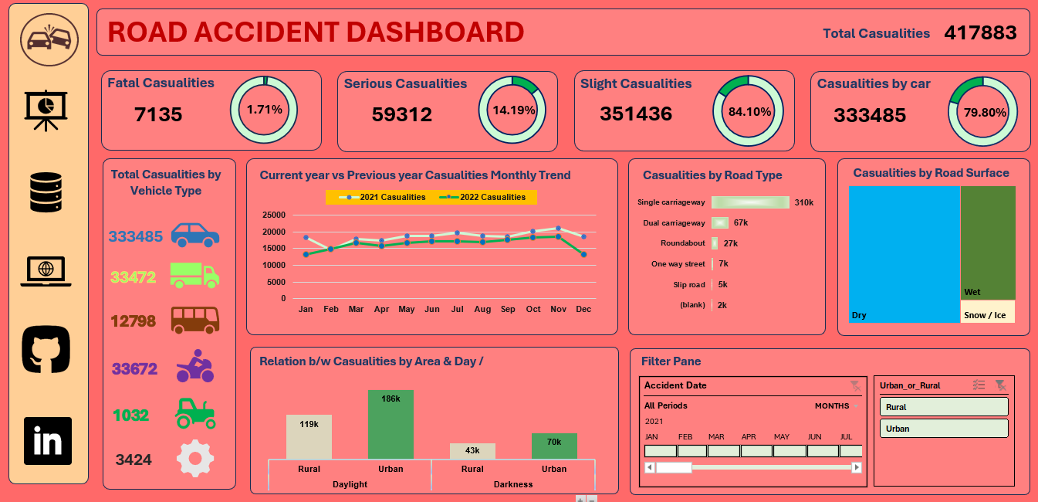
Dashboard

Slide 13


To find more info ! Follow ME @
GitHub
Linked In

