Slide 1
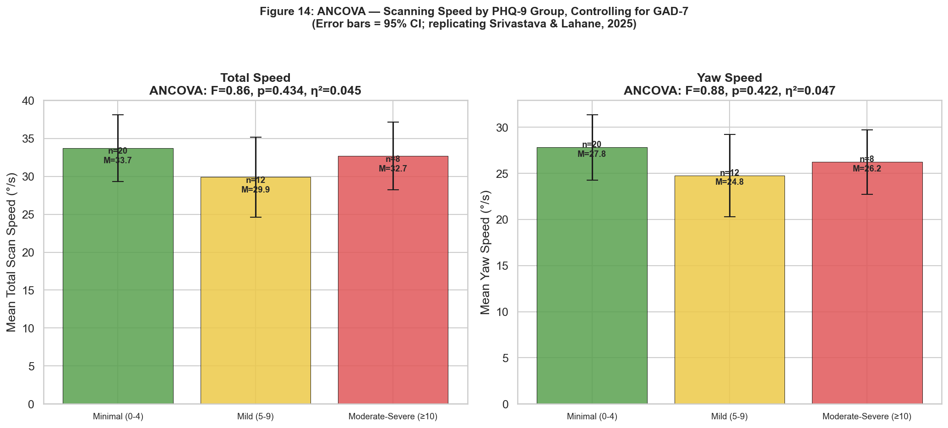
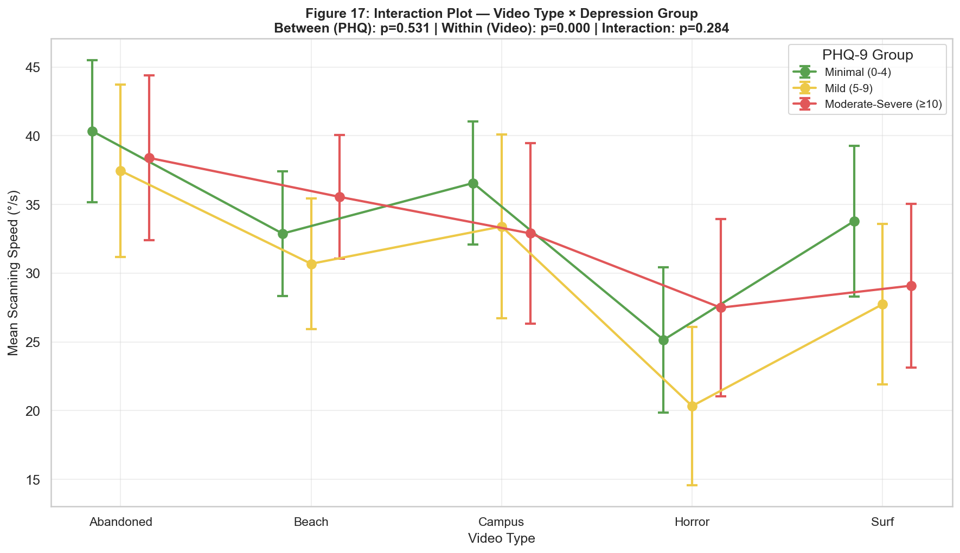
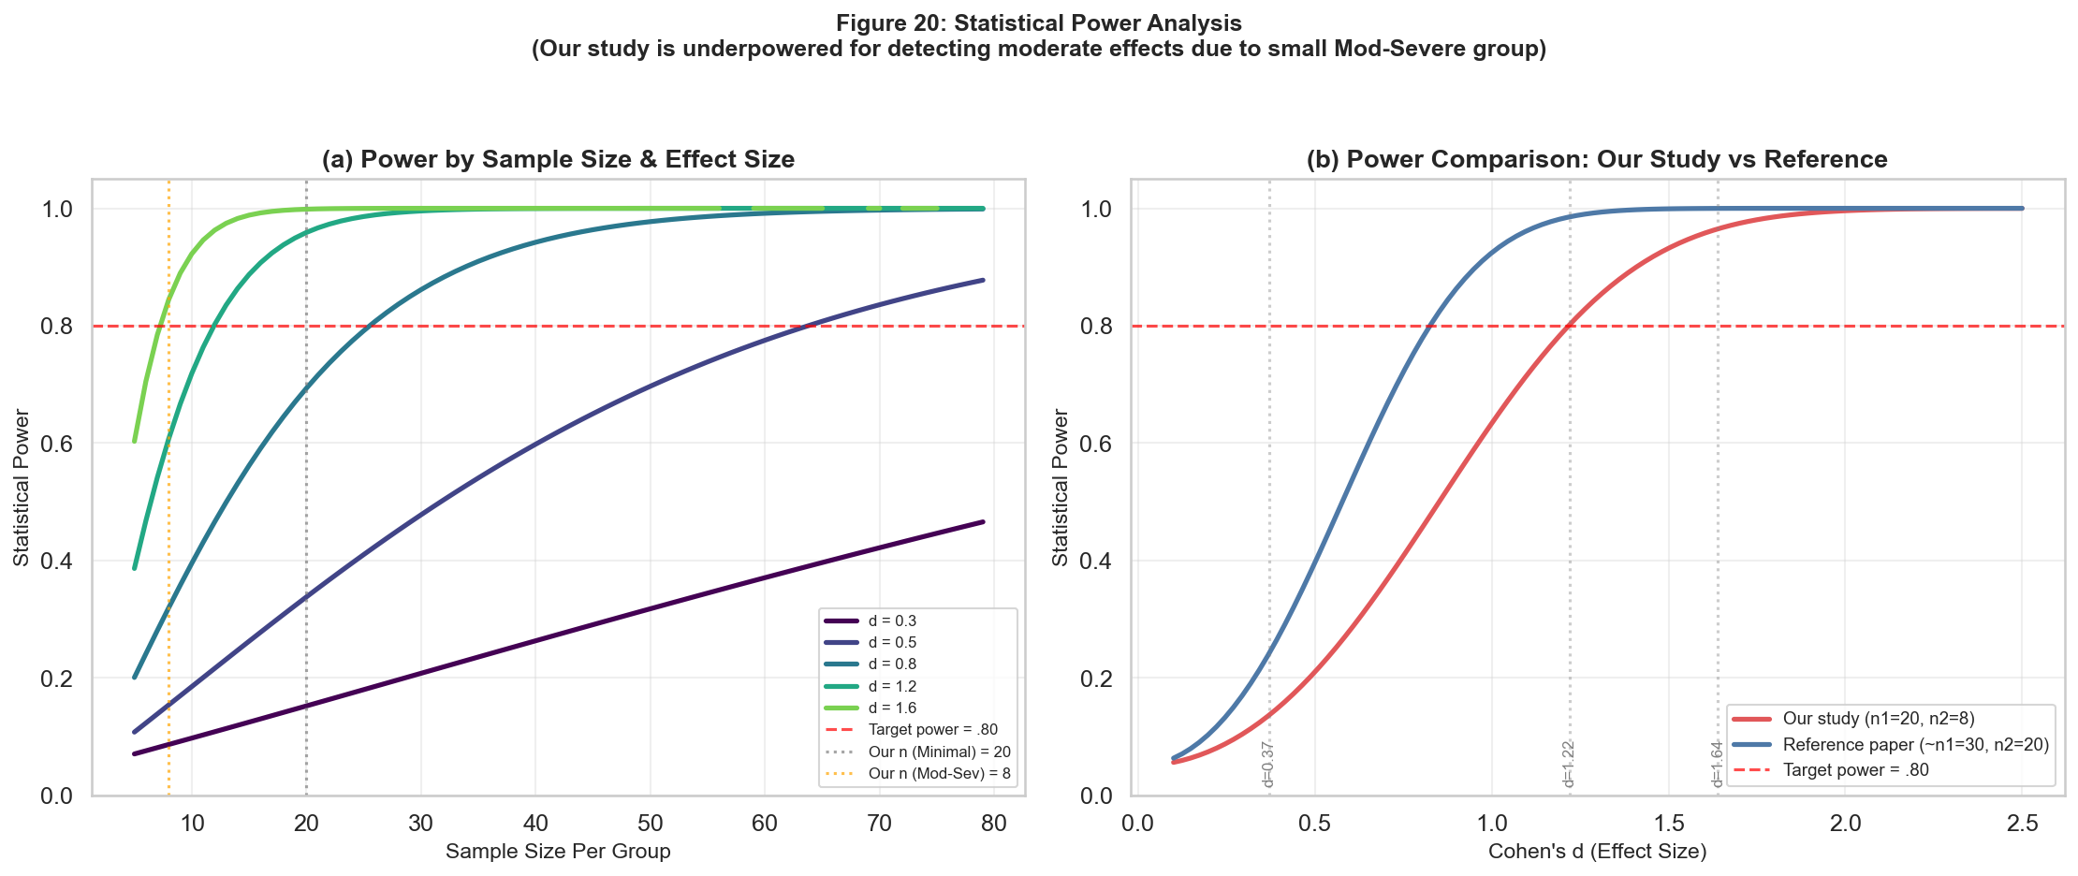
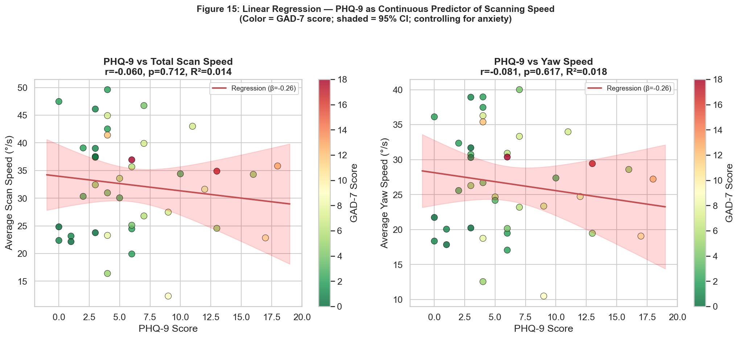
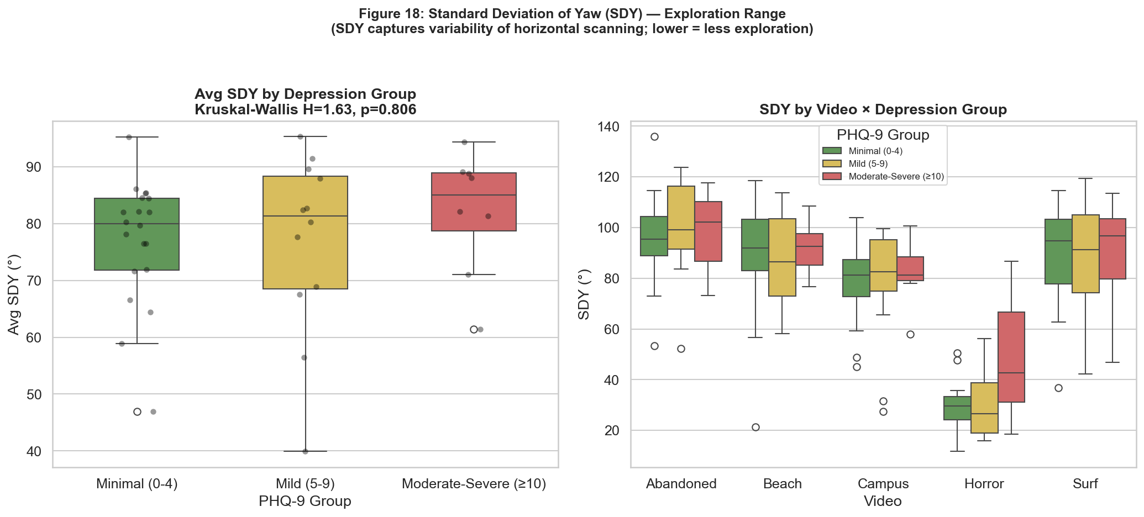
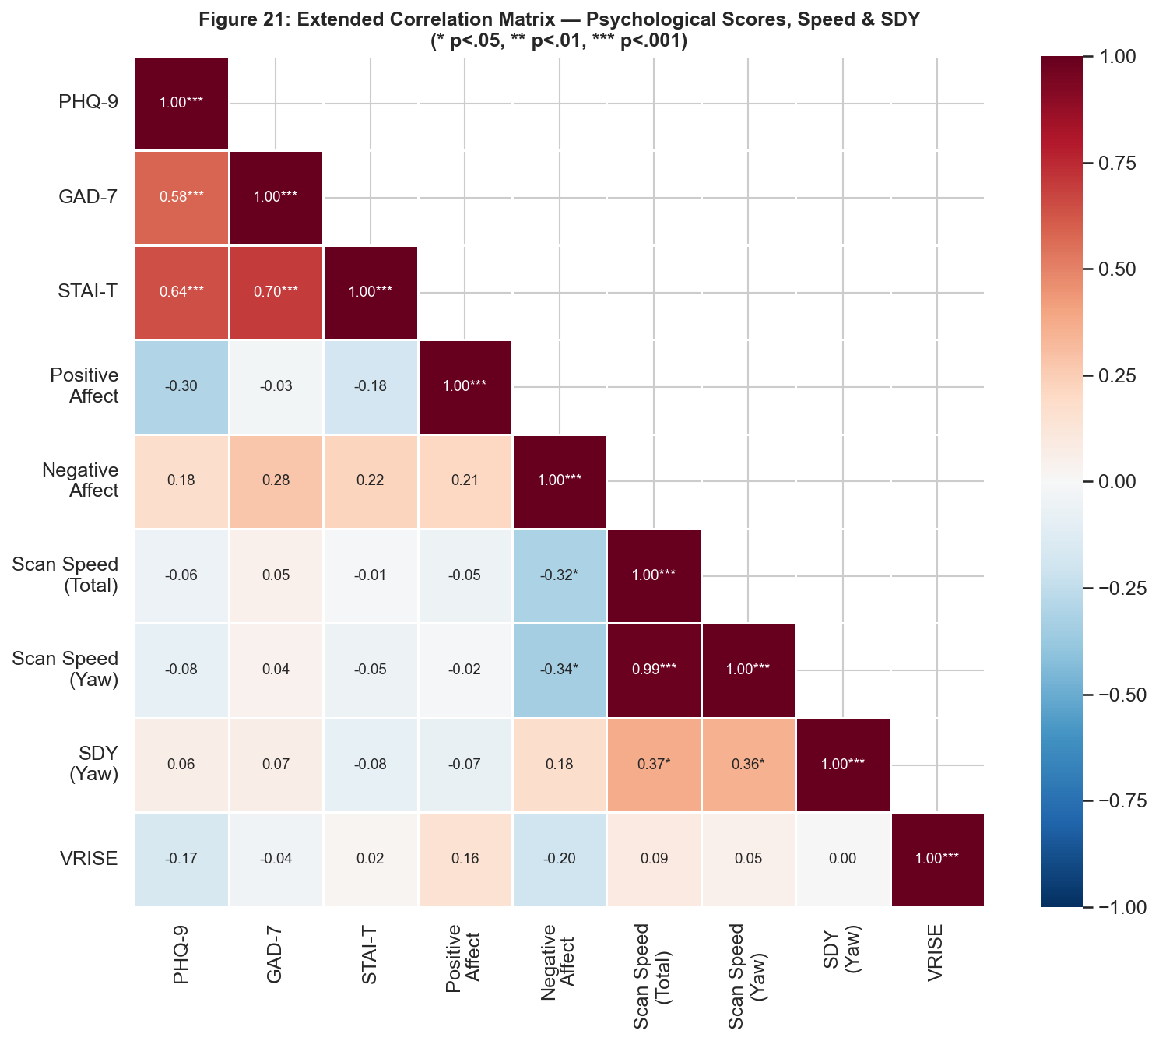
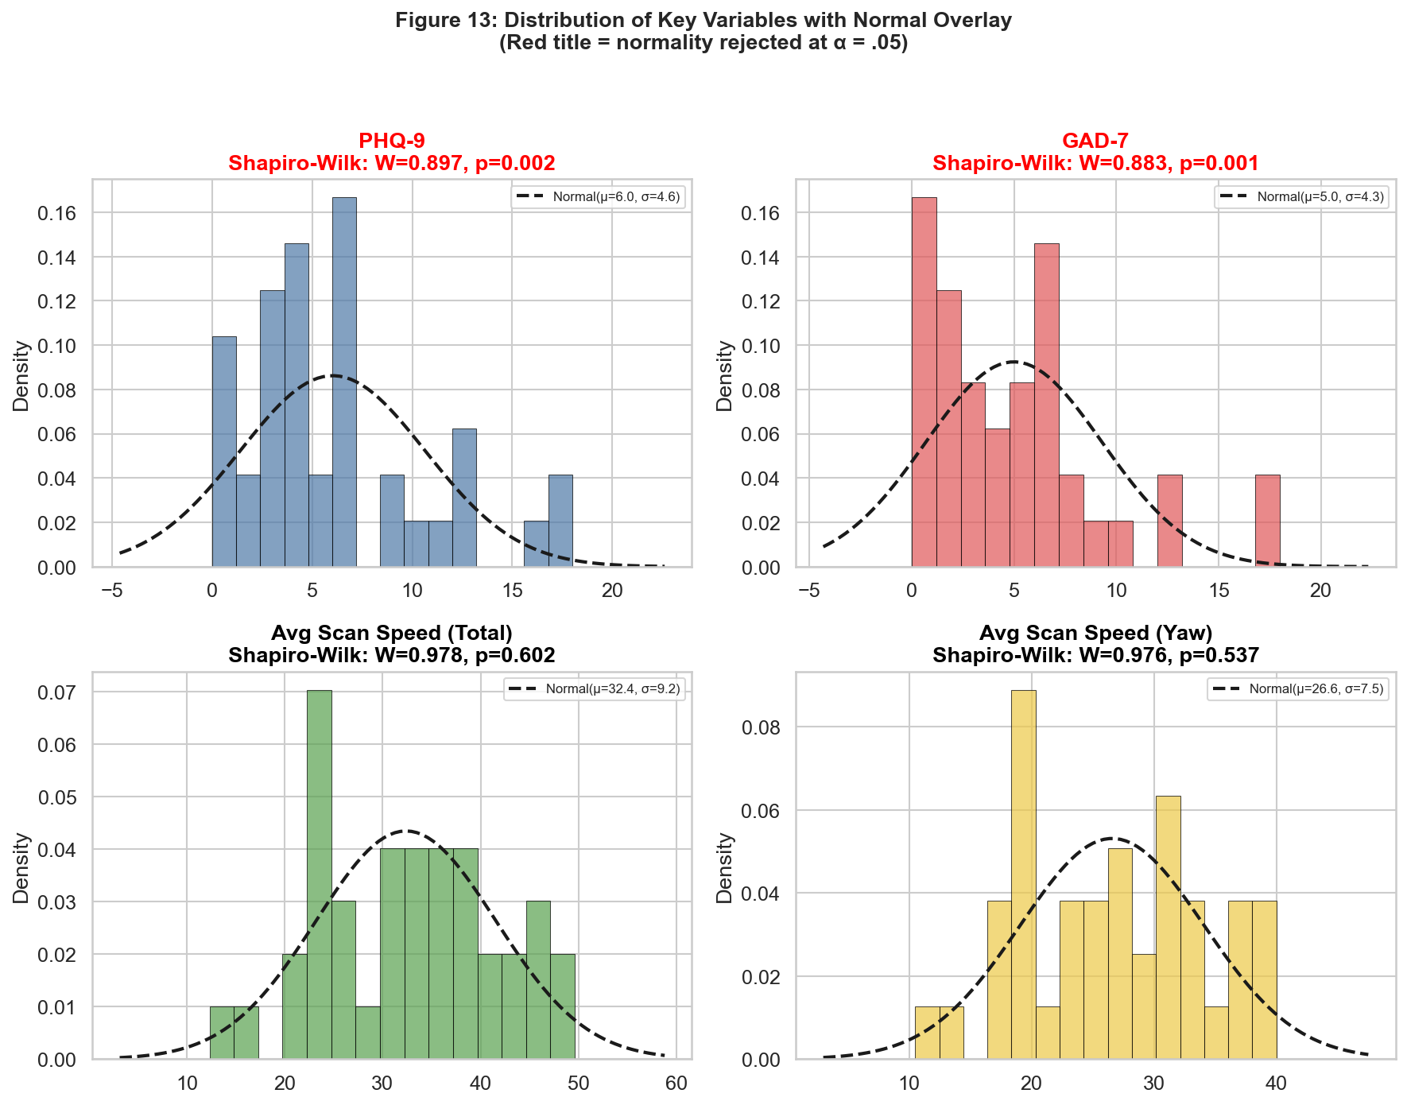
Are Headtracking Measures an Indicator of Depressive Symptoms?
BRSM PROJECT
POSTER PRESENTATION
SP 2026
360° VR Experiment · IIIT Hyderabad
ABSTRACT
RESULTS
CONCLUSION & FUTURE WORKS
Background: Depression screening relies on self-reported questionnaires (e.g., PHQ-9) prone to recall bias. Psychomotor retardation, slowed movements, is a hallmark of depression that VR headtracking can objectively capture. Reference Study: Srivastava & Lahane (2025) found scanning speed differentiated depression groups with large effects (Cohen's d=1.22–1.64, N=50). Moderate-severe group scanned significantly slower (M=3.88°/s) vs. no depression (M=5.29°/s). Our Study: N=40 college students (IIIT Hyderabad; 36M/4F; age M=22.78±1.80) viewed 5 different 360° videos on Meta Quest 3, completed PHQ-9, GAD-7, STAI-T, and PANAS questionnaires, and rated each video on valence, arousal, and presence. Hypotheses: H1: Higher PHQ-9 → lower scanning speed. H2: Effect strongest for yaw (horizontal scanning). H3: Effect uniform across video types (psychomotor retardation, not stimulus-specific blunting).
Normality (Shapiro-Wilk): Scanning speed (total W=0.978,p=.602; yaw W=0.976,p=.537). both normal → parametric tests appropriate. PHQ-9 (W=0.898,p=.002) and GAD-7 (W=0.883,p=.001) are right-skewed as expected. All within-group speed distributions normal (all p>.20). ANCOVA (controlling GAD-7 anxiety): No significant main effect of depression group. Total Speed F(2,36)=0.855, p=.434, η²p=.045; Yaw Speed F(2,36)=0.883, p=.422, η²p=.047. Adding STAI-T as second covariate did not change results (p=.471). All ANCOVA assumptions verified: Levene p=.119 (homogeneity of variances ✓); Group×Covariate interaction p=.958 (slope homogeneity ✓).
Replication result: No significant headtracking-depression relationship found across all analyses (ANCOVA, regression, mixed ANOVA, SDY). 96.5% power to detect reference d=1.64 (Minimal vs Moderate-Severe) yet observed d=0.125. This is not a power failure. The effect simply is not present at that magnitude. Key finding: Pre-VR Negative Affect (state, PANAS) correlates with reduced scanning speed: r=−.32, p=.044 (total); r=−.34, p=.031 (yaw). State mood predicts VR behavior better than trait depression. Likely explanations: (1) Reference effect sizes inflated (2) Population differences (Indian tech-university sample) (3) Only 20% moderate-severe vs 40% in reference Future directions: Recruit clinical/diverse samples; manipulate state mood experimentally; perform trajectory analysis across video duration; examine anxiety-specific VR scanning with fear stimuli.
Fig 14: ANCOVA — Mean Scanning Speed by PHQ-9 Group (GAD-7 controlled)
METHODOLOGY
Fig 17: Interaction Plot — Video Type × Depression Group
Groups: Minimal 0–4 (n=20, 50%) · Mild 5–9 (n=12, 30%) · Moderate-Severe ≥10 (n=8, 20%) Stimuli (5 × 360° videos): Abandoned Buildings (eerie), Beach (calm), Campus (neutral), The Nun Horror (~3 min), Tahiti Surf (~3 min) Measures: PHQ-9 (depression), GAD-7 (anxiety), STAI-T (trait anxiety), PANAS (affect pre/post), headtracking rotational speed (total/pitch/yaw/roll), SDY (std dev of yaw), SAM valence/arousal, VRISE sickness Analysis Pipeline: ① Shapiro-Wilk normality ② ANCOVA (GAD-7 covariate) ③ Regression (PHQ-9 continuous) ④ Mixed ANOVA (Video×PHQ group) ⑤ SDY Kruskal-Wallis ⑥ Post-hoc power analysis
Linear Regression — PHQ-9 as Continuous Predictor
Mixed ANOVA (Video × PHQ) + SDY Analysis
Using PHQ-9 continuously avoids grouping-related power loss. All models non-significant: PHQ-9 β=−0.17 to −0.28, all p>.60; R²≈.005 (~0.5% variance explained). Direction is negative (expected) but effect is trivially small. Diagnostics confirmed: VIF<2.5 (no multicollinearity); Breusch-Pagan p=.788 (homoscedasticity ✓); no influential outliers (Cook's D below 4/n threshold).
Video type: F(4,148)=34.99, p<.001, η²p=.486 ✓ (Horror induces freeze/focus response). PHQ Group: F(2,37)=0.644, p=.531 (ns). Interaction: F(8,148)=1.233, p=.284 (ns). Sphericity met (Mauchly p>.05). SDY (yaw exploration range): Kruskal-Wallis H(2)=1.63, p=.443 (ns). Notable: Horror video Moderate-Severe (M=49.06) > Minimal (M=28.82), p=.053, d=1.09 — opposite direction, possibly anxious vigilance.
Fig 20: Statistical Power Analysis — our study vs reference paper
ACKNOWLEDGMENT
We thank IIIT Hyderabad for providing research facilities, and all participants for their time and cooperation in this study.
Fig 21: Extended Correlation Matrix — Psychological Scores, Speed & SDY
REFERENCES
Kroenke et al. (2001). PHQ-9. JGIM, 16(9), 606–613. Spitzer et al. (2006). GAD-7. Arch Intern Med, 166(10), 1092–1097. Srivastava & Lahane (2025). Head scans & depression. CogSci 2025. Watson et al. (1988). PANAS. JPSP, 54(6), 1063–1070.
Fig 13: Key variable distributions — scanning speed normal, PHQ-9/GAD-7 right-skewed
Fig 15: PHQ-9 as Continuous Predictor of Scanning Speed
Fig 18: SDY Exploration Range by Depression Group and Video Type
Author names Bharath 2022101044, Vishnu 2023121009, Pooja Rani 2024204019

