Slide 1
Instagram user analytics
By,
Bharath G M
Data Analyst Intern at Trainity

Slide 2
PROJECT DESCRIPTION:
We are analyzing the user interactions and the engagement with Instagram application to provide valuable insights which can help the business growth.
Analysis involves:
A) Marketing Analysis
Loyal User to reward them.
Inactive User Engagement to encourage their usage.
Contest Winner Declaration.
Popular Hashtag Research
Best day to launch Ad Campaigns
B) Investor Metrics
User Engagement
Bots & Fake Accounts

Slide 3
APPROACH:
At first, I have loaded the DDL queries provided to create a Database and Tables.
Then I started understanding the columns in all the tables of the database & relationships among them.
Additionally I have performed Select queries on all the tables to identify rows.
Furthermore I have executed queries of all questionnaire to do the marketing analysis & investor metrics.

Slide 4
TECH-STACK USED:
Tools & Software : SQL and MySQL Workbench
Version: 8.0.36.0
It is easy to use and open the source tool.

Slide 5
INSIGHTS:
I have encountered that Darby, Emilio, Nicole, Elenor, Jordyn are the Oldest users who have created account back then from 2016.
We have around 26 users who haven’t posted a single picture out of which 13 are found to be Bots/Fake accounts those have liked each single picture but haven’t posted any.
The oldest user i.e, Darby found to be inactive since he/she haven’t posted any picture yet.
We can conclude that users use majorly smile, beach, party, fun, concert hashtags which signifies that users most likely to share their happiness.
It is better to launch campaigns/Ads on Thursdays or Sundays being the most active days.

Slide 6
RESULT:
It was a great experience to work with SQL statements.
I used the aggregates, types of joins, types of subqueries, group by, having clause, distinct clause and more to solve the problem which was more fun like solving puzzles.
There was a good exposure to explore all the complex queries and worked on some ongoing practical applications.

Slide 7
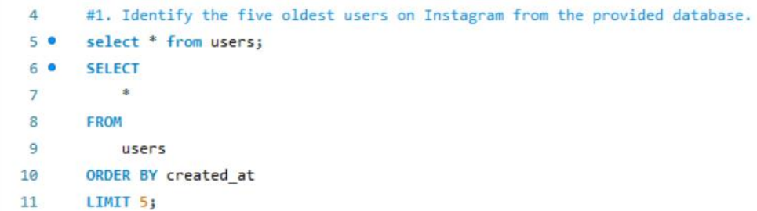
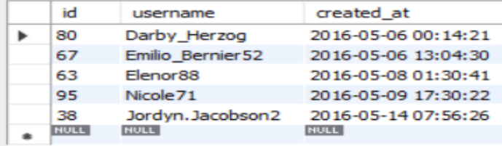
A) MARKETING ANALYSIS:
LOYAL USER REWARD: The marketing team wants to reward the most loyal users i.e, those who have been using this platform for the longest time.
Task: Identify the five oldest users on Instagram from the provided database.

Slide 8
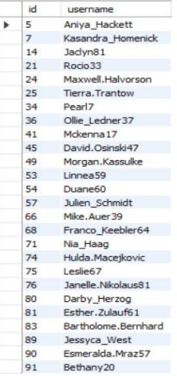
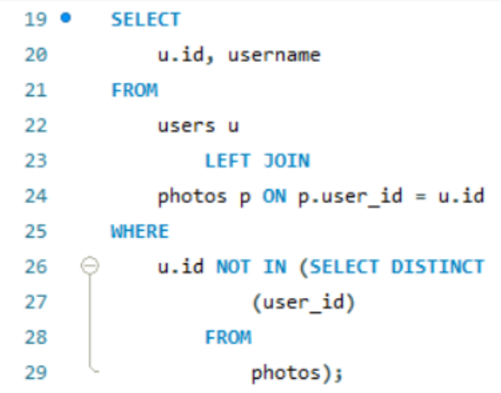
INACTIVE USER ENGAGEMENT: the team wants to encourage inactive users to start posting by sending them promotional mails.
Task: Identify users who have never posted a single photo on the Instagram.
It is observed that there are around 26 users who are inactive & it is to be noted that the oldest user named Darby Herzog with ID as 80 is also inactive.

Slide 9
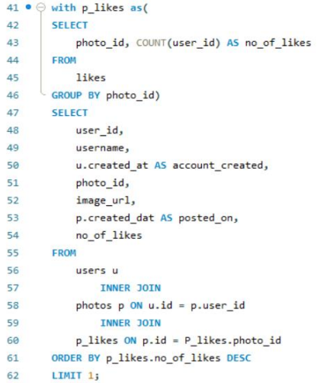
CONTEST WINNER DECLARATION: The team has organized a contest where the user with the most likes on a single photo wins.
Task: Determine the winner of the contest and provide their details to the team.
The winner of the contest with most likes is Zack_Kemmer93 who has got around 48 likes for the photo.
Hence it is like that image has elements referring as ‘Drink party at the concert in the beach with fun’ has attracted the users.

Slide 10
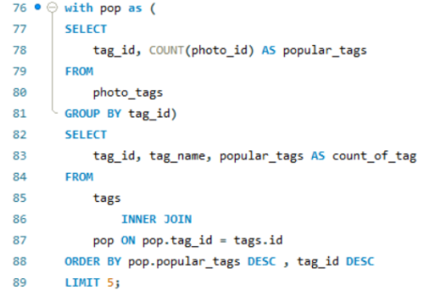
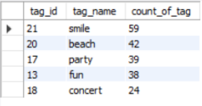
HASHTAG RESEARCH: A partner brand wants to know the most popular hashtags to use in their posts to reach the most people.
Task: Identify and suggest the top Five most commonly used hashtags on the platform.
If we add hashtags such as smile, beach, party, concert, fun, lol, food. It is high that the post will reach maximum people.
We also found the contest winner ‘Zack_Kemmer93’ have used above hashtags like beach, party, fun concert and drunk.

Slide 11
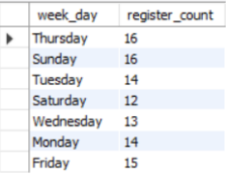
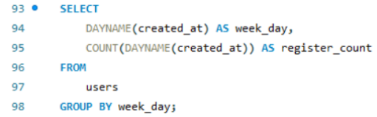
AD CAMPAIGN LAUNCH: The team wants to know the best day of the week to launch Ads.
Task: Determine the day of the week when most users register on Instagram and provide insights on scheduling an AD Campaign.
Hence it is highly recommended to launch Ads on Thursdays and Sundays as we see most of the users register on above days and it seem to be the active days of week for the users to use the application.

Slide 12
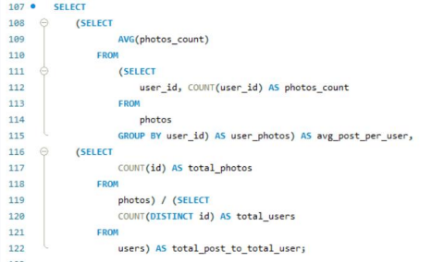

B) INVESTOR METRICS:
USER ENGAGEMENT: Investors want to know if users are still active & posting on Instagram or if they are making fewer posts.
Task: Calculate the average number of posts per user on Instagram and provide the total number of photos on Instagram divided by the total number of users.

Slide 13
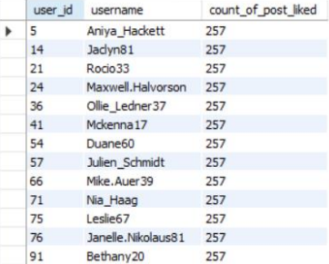
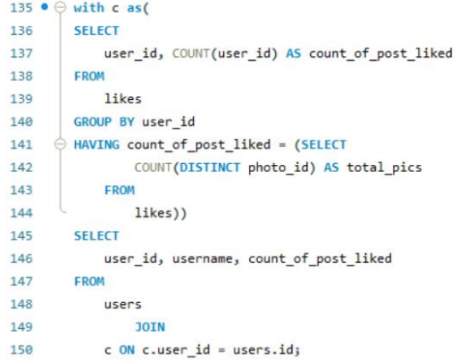
BOTS & FAKE ACCOUNTS: Investors want to know if the platform is crowded with fake & dummy accounts.
Task: Identify users (potential bots) who have liked every single photo on the platform, as this is not typically possible for a normal user.
All the 13 registered accounts here seems to be fake or bots.
I have also encountered that these are the 13 users among 26 inactive users who haven’t posted any pictures that we analyzed before.

Slide 14
THANK YOU

