Slide 1
OPERATION ANALYTICS AND INVESTIGATING METRIC SPIKE
By,
Bharath G M
Data Analyst Intern at Trainity

Slide 2
PROJECT DESCRIPTION
The analysis involves understanding and explaining sudden changes in key metrics, such as a dip in
Daily/Weekly user engagement or a drop in sales.
Case Study 1: Job Data Analysis
Day-wise Jobs Reviewed per hour.
7-day rolling average of throughout(number of events per second).
Percentage share of each language in the last 30 days.
Duplicate Rows Detection

Slide 3
PROJECT DESCRIPTION
Case Study 2: Investigating Metric Spike
Activeness of the users on a weekly basis.
User Growth Analysis over-time.
Weekly Retention Analysis after signing up for a product.
Weekly User Engagement Per Device.
Email Engagement Analysis.

Slide 4
APPROACH
Initially, I have checked for the null values using Excel for all the tables.
Then, I have created the table structure and loaded the DDL queries to insert data into the tables.
Additionally converted string format of Date column to Datetime datatype.
Then I started understanding the columns in all the tables of the database and relationships among them.
Additionally I have performed select queries on all the tables to identify rows.
Then I altered job_data table by adding a primary key (id) and inserted couple of duplicate rows in job_data table to validate the analysis.
Then I started building queries like ‘bottom up approach’ by creating inner/smaller queries and slowly building on it to solve the questionnaire.

Slide 5
TECH-STACK USED
Tools & software : SQL and MySQL Workbench
Version: 8.0.36.0
It is easy to use and open source tool.

Slide 6
INSIGHTS – CASE STUDY 1
- I have added a row as id as primary key and inserted two rows of duplicate data which replicate all values of that particular row to do some analysis.
JOBS REVIEWED OVER TIME –We have noticed that very less jobs were reviewed per hour on 29th November and more jobs were reviewed per hour on 27th November
THROUGHPUT ANALYSIS - Both Daily metric and Seven-day rolling average can be used in different scenarios, if we want to identify patterns for short term (daily basis) it is good to use daily metric. But if we want ignore short term outliers and look for long term patterns to get the overall trend,it is good to use 7-day rolling average.
LANGUAGE SHARE ANALYSIS – We have noticed Persian is holding the highest share followed by Hindi.

Slide 7
INSIGHTS – CASE STUDY 2
We have noticed the count of users who signed up for retention was higher in 34th week and lowest in 18th week.
We encounter on an average of 219 users have signed up for retention between 24th week to 30th week, which has then
increased to peak of 259 retention count on 34th week and suddenly dropped to just 18 count in the next week.
We have noticed there is more email engagement(4294) in 34th week and dropped to just 48 count in 35th week.

Slide 8
RESULT
It was good to explore different engagement metrics and understand them better.
I used aggregates, types of joins, types of subqueries, group by, having clause, distinct clause, windows function, case and more to solve the problem which was more fun like solving puzzles.
There was a good exposure to explore all complex queries and worked on some ongoing practical application.

Slide 9
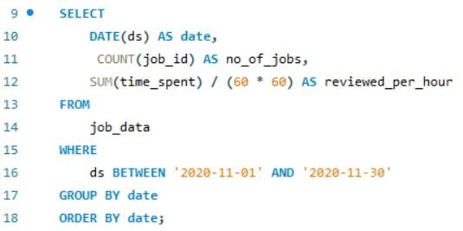
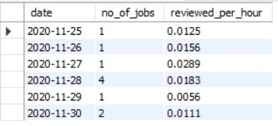
CASE STUDY – 1 : JOB DATA ANALYSIS
  JOBS REVIEWED OVER TIME:
OBJECTIVE: CALCULATE THE NUMBER OF JOBS REVIEWED PER HOUR FOR EACH DAY IN NOVEMBER 2020.
YOUR TASK: WRITE AN SQL QUERY TO CALCULATE THE NUMBER OF JOBS REVIEWED PER HOUR FOR EACH DAY IN NOVEMBER 2020.
We have noticed very less jobs were reviewed per hour on 29th November and more jobs were reviewed per hour
on 27th November

Slide 10
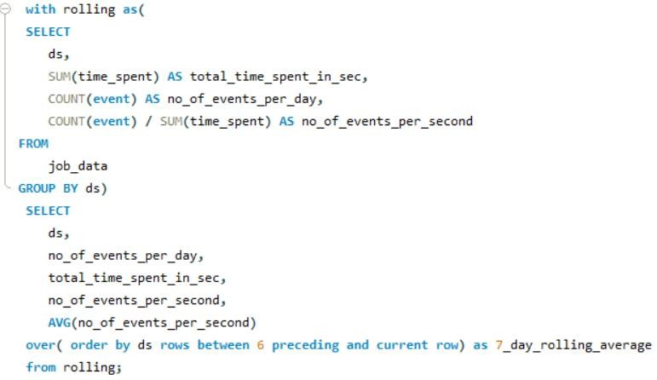
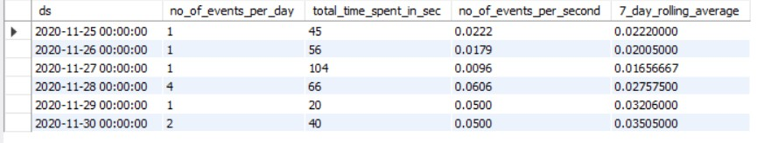
2. THROUGHPUT ANALYSIS:
OBJECTIVE: CALCULATE THE 7-DAY ROLLING AVERAGE OF THROUGHPUT (NUMBER OF EVENTS PER SECOND).
YOUR TASK: WRITE AN SQL QUERY TO CALCULATE THE 7-DAY ROLLING AVERAGE OF THROUGHPUT. ADDITIONALLY, EXPLAIN WHETHER YOU PREFER USING THE DAILY METRIC OR THE 7-DAY ROLLING AVERAGE FOR THROUGHPUT, AND WHY.
Both Daily metric and 7-day rolling
average can be used in different scenarios, if we want to identify patterns for short term (daily basis) it is good to use daily metric.
But if we want ignore short term outliers and look for long term patterns to get the overall trend it is good to use
7-day rolling average.

Slide 11
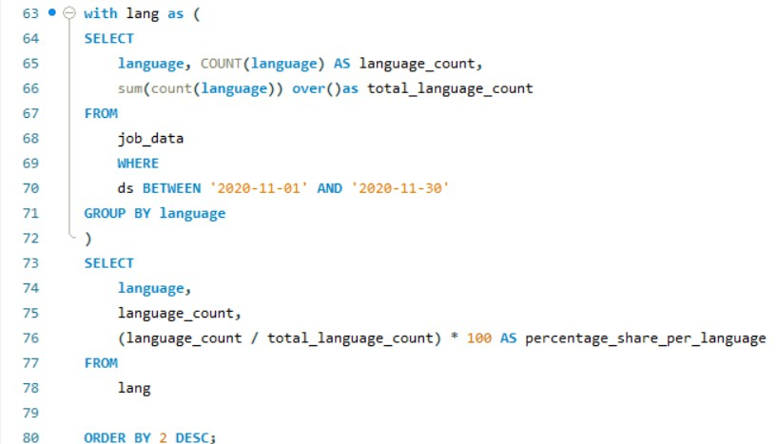
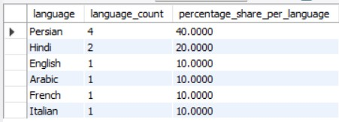
3. LANGUAGE SHARE ANALYSIS:
OBJECTIVE: CALCULATE THE PERCENTAGE SHARE OF EACH LANGUAGE IN THE LAST 30 DAYS.
YOUR TASK: WRITE AN SQL QUERY TO CALCULATE THE PERCENTAGE SHARE OF EACH LANGUAGE OVER THE LAST 30 DAYS.
We have noticed Persian is holding the highest
share followed by Hindi.

Slide 12
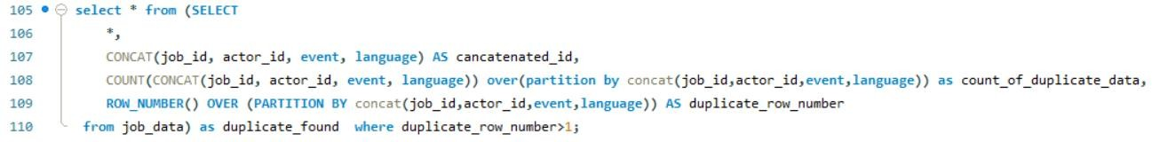
4. DUPLICATE ROWS DETECTION:
OBJECTIVE: IDENTIFY DUPLICATE ROWS IN THE DATA.
YOUR TASK: WRITE AN SQL QUERY TO DISPLAY DUPLICATE ROWS FROM THE JOB_DATA TABLE.
I have inserted 2 rows of duplicate data which replicate all values of that particular row.
Since same job_id can be used by multiple actors for multiple events for multiple languages. Instead of finding duplicate for a single column which is non-primary key, I have combined four columns (concatenated_id) which will result unique value and replication of that combination will be marked as duplicate

Slide 13
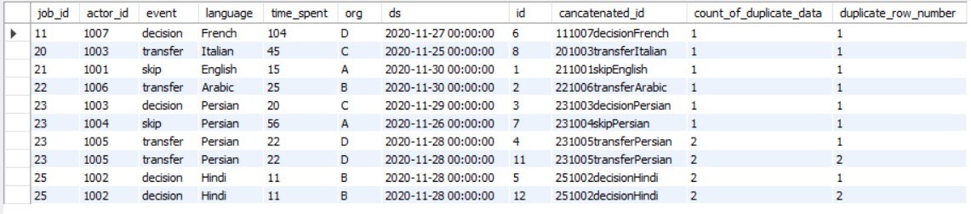
Working of above analysis:
I used concat function to combine user_id,actor_id,event and language as concatenated_id which is unique
Then performed count of concat and marked row_number based on concat which would help to identify the duplicate row, so that we can delete it later based on the table id.
So we see id column with 11 and 12 are the duplicate rows and the two rows in result table in previous slide has the same id.

Slide 14
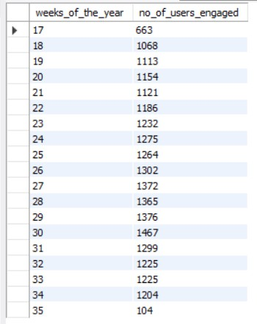
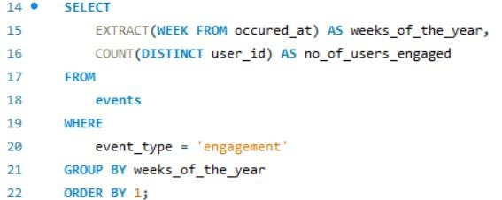
CASE STUDY – 2 : INVESTIGATING METRIC SPIKE
  WEEKLY USER ENGAGEMENT
OBJECTIVE: MEASURE THE ACTIVENESS OF USERS ON A WEEKLY BASIS.
YOUR TASK: WRITE AN SQL QUERY TO CALCULATE THE WEEKLY USER ENGAGEMENT.
The user engagement was slowly
increasing and also there’s small fluctuations with dropping and raising until 30th week.
We notice greater user engagement in 30th week.
After which we see a the user
engagement is dropping rapidly by week.

Slide 15
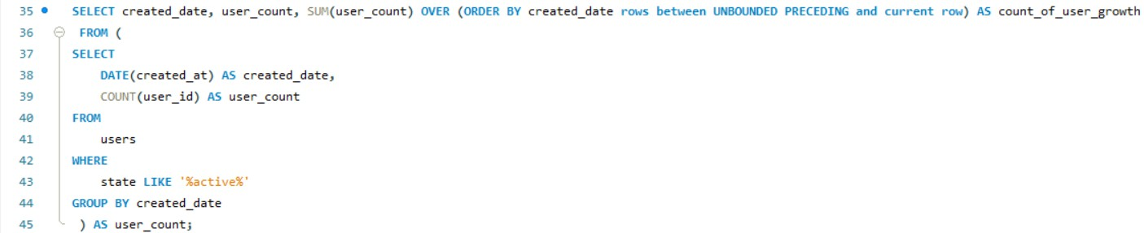
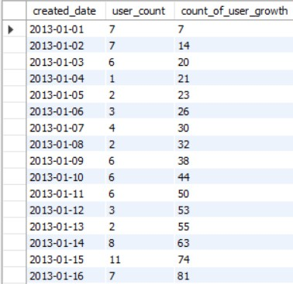
2. USER GROWTH ANALYSIS:
OBJECTIVE: ANALYZE THE GROWTH OF USERS OVER TIME FOR A PRODUCT.
YOUR TASK: WRITE AN SQL QUERY TO CALCULATE THE USER GROWTH FOR THE PRODUCT.
1. DAILY BASIS
The analysis was done for user growth on the basis of a day.
We have received around 605 rows in the result table.

Slide 16
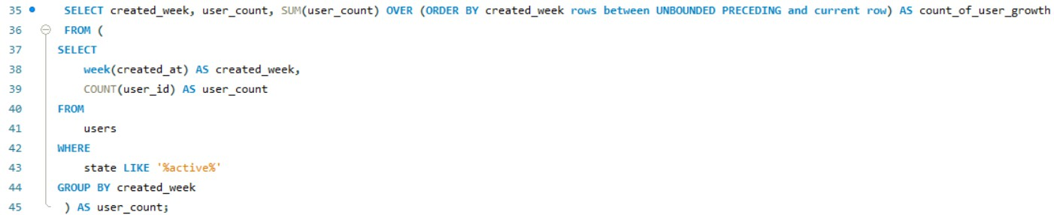
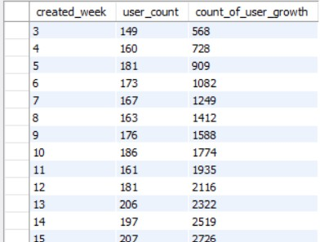
2. USER GROWTH ANALYSIS:
WEEKLY BASIS:
The analysis was done for user growth on weekly basis.
We have received data for 53 weeks in the result table.

Slide 17
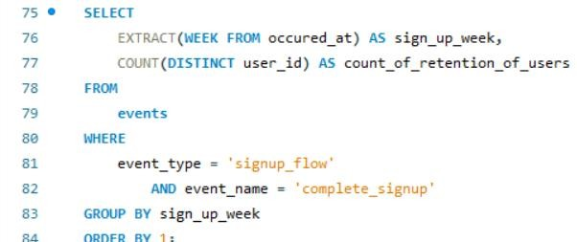
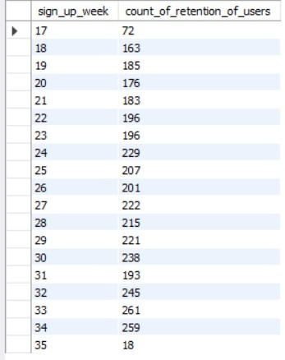
3. WEEKLY RETENTION ANALYSIS:
OBJECTIVE: ANALYZE THE RETENTION OF USERS ON A WEEKLY BASIS AFTER SIGNING UP FOR A PRODUCT.
YOUR TASK: WRITE AN SQL QUERY TO CALCULATE THE WEEKLY RETENTION OF USERS BASED ON THEIR SIGN-UP COHORT.
We notice the count of users who signed up for retention was higher in 34 ^{th} week and
lowest in 18th week.
We encounter on an average of 219 users have signed up for retention between 24 ^{th} week to 30th week, which has then increased to peak of 259 retention count and suddenly dropped to just 18 count in the next week.

Slide 18
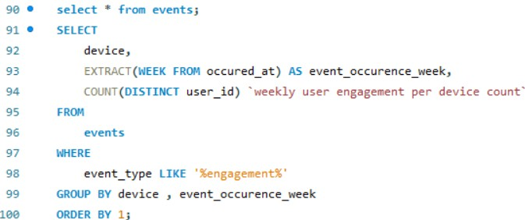
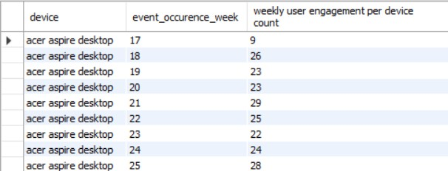
4. WEEKLY ENGAGEMENT PER DEVICE :
OBJECTIVE: MEASURE THE ACTIVENESS OF USERS ON A WEEKLY BASIS PER DEVICE.
YOUR TASK: WRITE AN SQL QUERY TO CALCULATE THE WEEKLY ENGAGEMENT PER DEVICE.
I have sorted in such a way that for a device, listed down all
the weeks in ascending order and calculated the count of user_engagement for the device in that week.

Slide 19
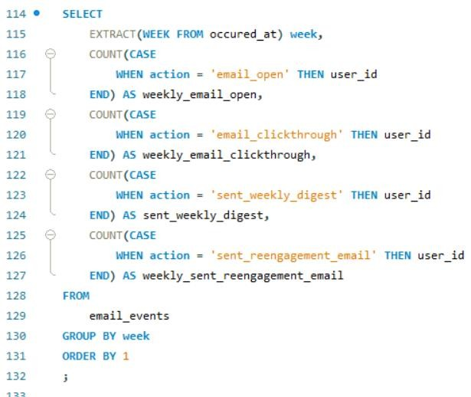
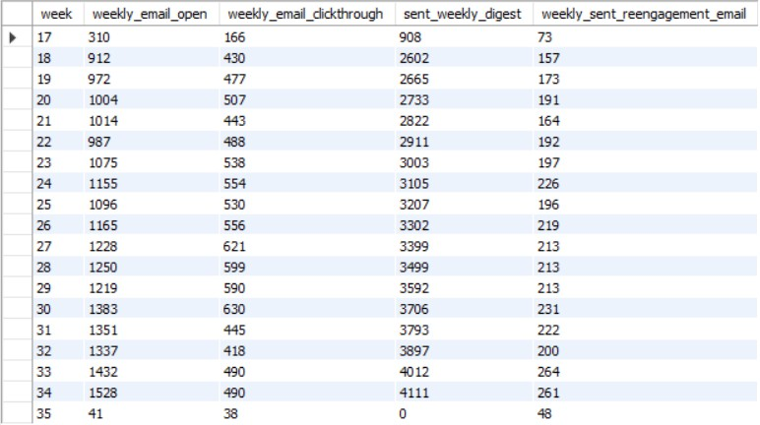
5. EMAIL ENGAGEMENT ANALYSIS:
OBJECTIVE: ANALYZE HOW USERS ARE ENGAGING WITH THE EMAIL SERVICE.
YOUR TASK: WRITE AN SQL QUERY TO CALCULATE THE EMAIL ENGAGEMENT METRICS.
I have used case function to segregate users_action based on email engagement.
We notice there is more email engagement(4294) in 34th week and
dropped to just 48 count in 35th week.

Slide 20
THANK YOU

