Slide 1
IMDB MOVIE ANALYSIS
By,
Bharath G M
Data Analyst Intern at Trainity

Slide 2
PROJECT DESCRIPTION
To analyze what factors influence the success of a movie on IMDB?" Here, success can be defined by high IMDB ratings. The impact of this problem is significant for movie producers, directors, and investors who want to understand what makes a movie successful to make informed decisions in their future projects.
Data Analytics Tasks:
Movie Genre Analysis
Movie Duration Analysis
Language Analysis
Director Analysis
Budget Analysis

Slide 3
APPROACH
Initially, I imported data and converted it to range.
Data Cleaning:
  Handling duplicates by removing them
  Handling missing values in each column by removing them
  Hiding the unwanted columns
  Performed Feature engineering by adding profit margin column and more
  Separated genres using text to column and added count genre count column
Used descriptive statistics tables, Pivot tables and charts to infer the results of analysis
Formatted charts to make it look great.
Created a dynamic dashboard with important key metrics and charts.

Slide 4
TECH-STACK USED
Tools & software : Microsoft Excel 2021
Version: 2403 Build 16.0.17425.20176) 64-bit
It is easy to use and open source tool.

Slide 5
INSIGHTS
We notice Drama had high datapoints of drama dataset are closely clustered around the mean
In the Duration vs IMDB score plot, we see a positive trendline which is upwards shows as duration increases IMDB score increases.
In the Duration vs Budget plot we see a positive trendline signifies as duration increases budget also increases which leads to have high IMDB score.
As budget increase popularity of cast also increase (likes increases). When producer is able to cast more people with increase in budget there is more popularity which results in higher IMDB score.
In the descriptive statistics plot we notice German has got high mean, median and less variance and standard deviation which signifies high number of datapoints are clustered towards mean that it has got high scores.
The most common country seems to be USA and most common language used in USA seems to be English and determines that English is the most common language
The correlation between Gross and Budget is positive.
That is, the relationship shows that as budget of movies increase, there is a very high probability that the gross collectionof the movie will also increase.

Slide 6
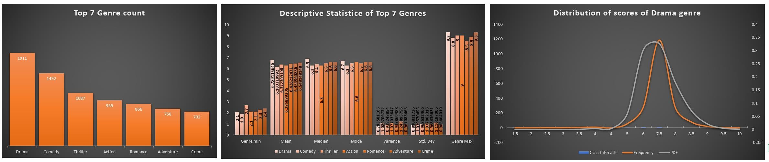
A. MOVIE GENRE ANALYSIS:
ANALYZE THE DISTRIBUTION OF MOVIE GENRES AND THEIR IMPACT ON THE IMDB SCORE.
TASK: DETERMINE THE MOST COMMON GENRES OF MOVIES IN THE DATASET. THEN, FOR EACH GENRE, CALCULATE DESCRIPTIVE STATISTICS (MEAN,
MEDIAN, MODE, RANGE, VARIANCE, STANDARD DEVIATION) OF THE IMDB SCORES.
What are the genres that has got top scores - Drama, Comedy, Thriller, Action, Romance, Adventure and Crime are top 7 Genres with high scores.
  The statistics of top 7 genres are almost nearly same.
  We notice Drama has got highest mean, median and mode but less variance and standard deviation which signifies high datapoints of drama dataset
are closely clustered around the mean whereas Adventure has comparatively got more deviation that signifies datapoints are spreaded little more.
2. Why Drama has got large range but small deviation?
It follows normal distribution and we can say 99.7% of datapoints lies between 4 and 9.5 IMDB scores.

Slide 7
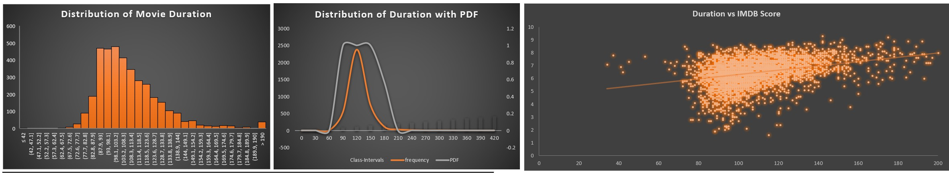
B. MOVIE DURATION ANALYSIS:
ANALYZE THE DISTRIBUTION OF MOVIE DURATIONS AND ITS IMPACT ON THE IMDB SCORE.
TASK: ANALYZE THE DISTRIBUTION OF MOVIE DURATIONS AND IDENTIFY THE RELATIONSHIP BETWEEN MOVIE DURATION AND IMDB SCORE.
We found the datapoints closely follows normal distribution and see 99.7 datapoints lies between 60 min to 200 min. In the Duration vs IMDB score plot, we see a positive trendline which is upwards shows as duration increases IMDB score increases.

Slide 8
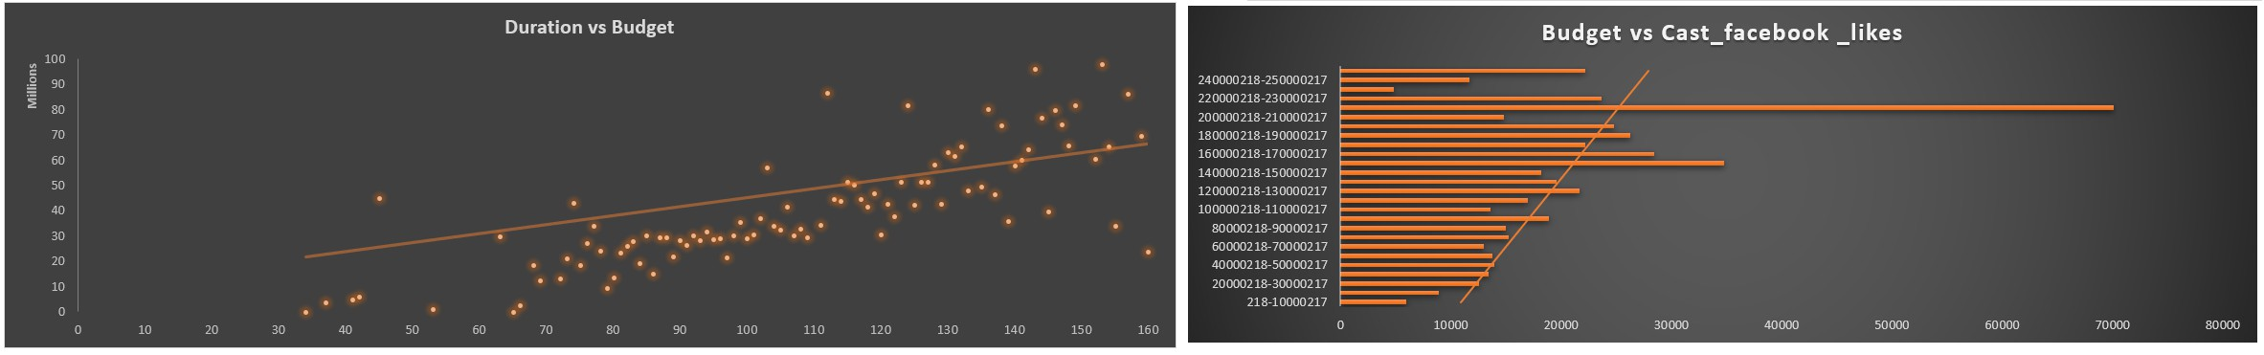
Why Higher duration has higher score
In the Duration vs Budget plot we see a positive trendline signifies as duration increases budget also increases which leads to have high IMDB score.
Why high budget movies has high scores
As budget increase popularity of cast also increase (likes increases). When producer is able to cast more people with increase in budget there
is more popularity which results in higher IMDB score.

Slide 9
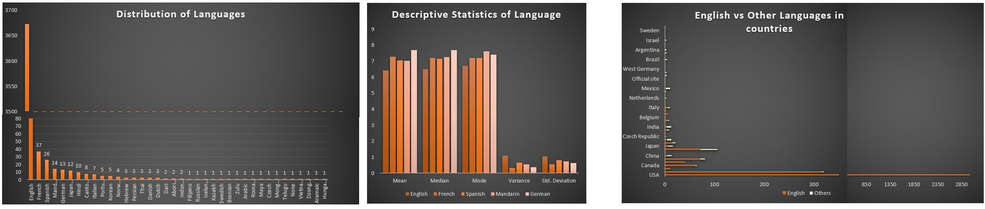
C. LANGUAGE ANALYSIS: SITUATION:
EXAMINE THE DISTRIBUTION OF MOVIES BASED ON THEIR LANGUAGE.
TASK: DETERMINE THE MOST COMMON LANGUAGES USED IN MOVIES AND ANALYZE THEIR IMPACT ON THE IMDB SCORE USING DESCRIPTIVE
STATISTICS.
The most common language of movies is English followed by French, Spanish, Mandarin and German
In the descriptive statistics plot we notice German has got high mean, median and less variance and standard deviation which signifies high number of datapoints are clustered towards mean that it has got high scores.
Why English is the common language?
The most common country seems to be USA and most common language used in USA seems to be English and determines that English is the most common language

Slide 10
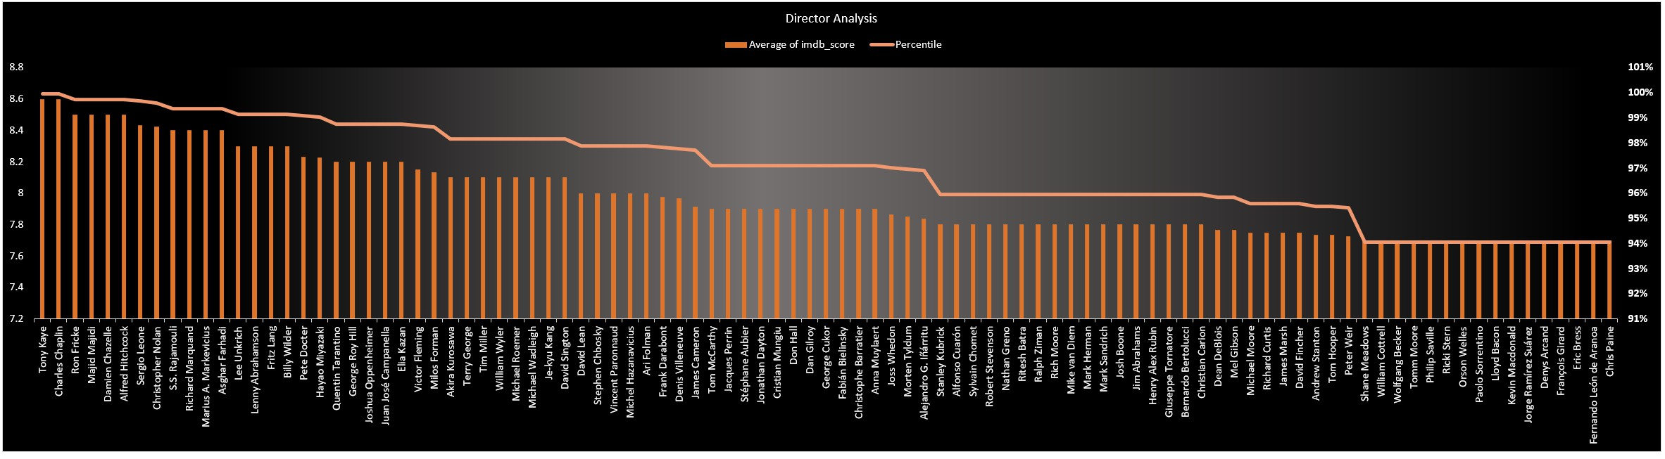
D. DIRECTOR ANALYSIS:
INFLUENCE OF DIRECTORS ON MOVIE RATINGS.
TASK: IDENTIFY THE TOP DIRECTORS BASED ON THEIR AVERAGE IMDB SCORE AND ANALYZE THEIR CONTRIBUTION TO THE SUCCESS OF MOVIES
USING PERCENTILE CALCULATIONS.
The top directors to those who has performed well in movies.

Slide 11
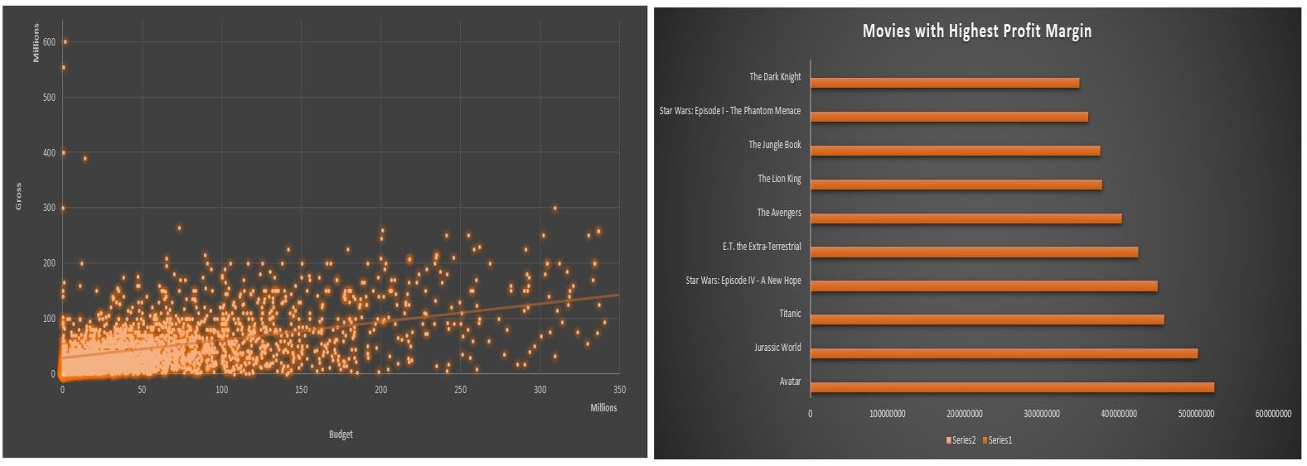
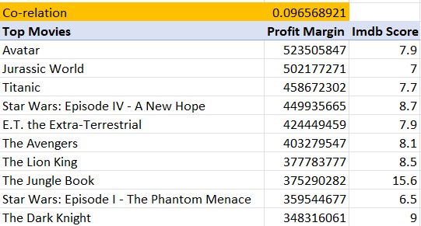
E. BUDGET ANALYSIS:
EXPLORE THE RELATIONSHIP BETWEEN MOVIE BUDGETS AND THEIR FINANCIAL SUCCESS.
TASK: ANALYZE THE CORRELATION BETWEEN MOVIE BUDGETS AND GROSS EARNINGS, AND IDENTIFY THE MOVIES WITH THE HIGHEST PROFIT
MARGIN.
The correlation between Gross and Budget is positive.
That is, the relationship shows that as budget of movies increase, there is a very high probability that the gross
collection of the movie will also increase.

Slide 12
RESULT
It was good to explore different statistical formular and understand the distribution
I used scatter plots, column charts, histogram and combo charts more to find the results.
There was a good expoosure to explore all formatting options and worked on some ongoing practical application.

Slide 13
THANK YOU

