Slide 1

Bank loan case study
By,
Bharath G M
Data Analyst Intern at Trainity

Slide 2

PROJECT DESCRIPTION
The main aim of this project is to identify patterns that indicate if a customer will have difficulty paying their installments.
This information can be used to make decisions such as denying the loan, reducing the amount of loan, or lending at a higher interest rate to risky applicants.
To use Exploratory Data Analysis (EDA) to analyze patterns in the data and ensure that capable applicants are not rejected.
2

Slide 3




TECH-STACK USED
3

Slide 4

APPROACH
Loaded the Worksheet in Excel and checked for duplicates which was 0.
Then checked blanks using formulas like isblank, if , transpose into new sheet and performed Descriptive statistics for each all the columns.
In Jupyter imported packages and cleaned the data and handled them.
Plotted Box plot for all the numeric values to idedntify outliers and removed them.
Found the imbalance proportions for each dataset
Using Pivot chart created univariate , segmented and bivariate plots to perform EDA.
Created correlation matrices and plotted heatmaps for different targets
4

Slide 5
CLEANING THE DATA
Cleaning the data is an crucial step in any data analysis as it ensures the data is accurate, reliable and consistent .
STEP 1: Removing Duplicates
Assuming SK_ID_CURR as unique key, with Excel function performed Remove Duplicates in data tab which was found to be 0 duplicates.
STEP 2: Finding missing Values
With
if(isblank(application_data!A$2:A$49999),1,0)
formula I created a worksheet which gives me 1 incase
of blank else gives 0.
Used
• =IFERROR(AVERAGE(application_data!A:A),"")
• =IFERROR(MEDIAN(application_data!B:B),"")
• =IFERROR(MIN(application_data!B:B),"")
• =IFERROR(MAX(application_data!B:B),"")
With above formulas calculated Descriptive statistics of missing values.
formula to count blanks with the above worksheet.
COUNTIF(Worksheet1!C$2:C$49999,1)

Slide 6
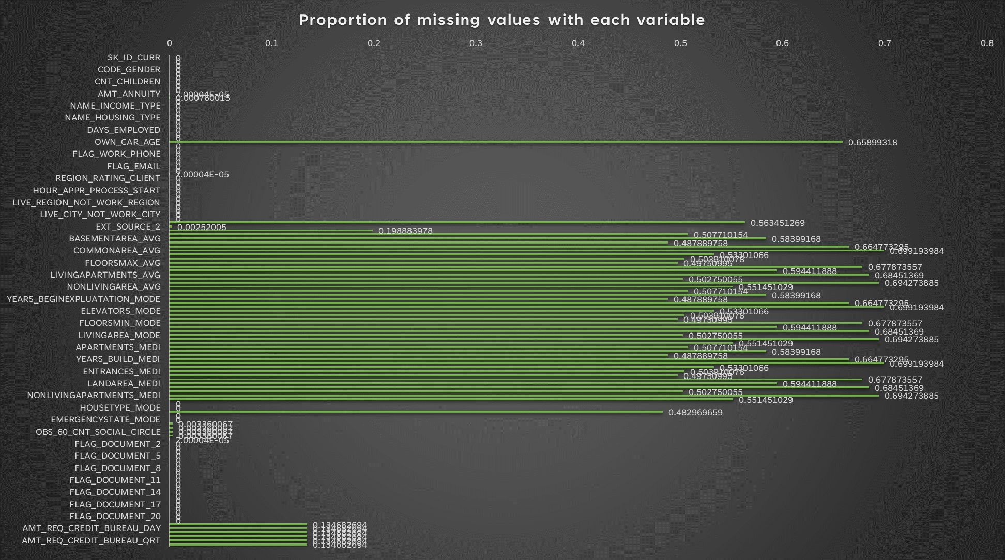

Slide 7
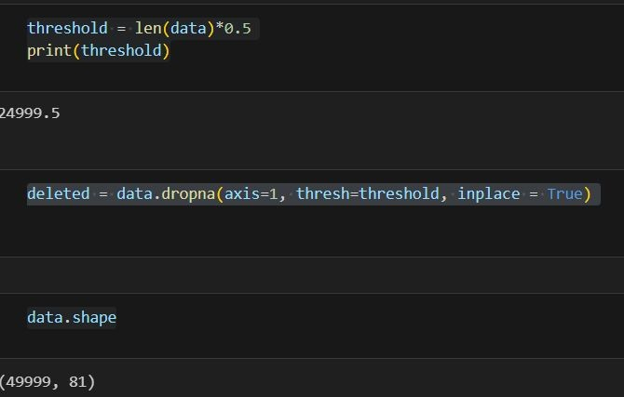
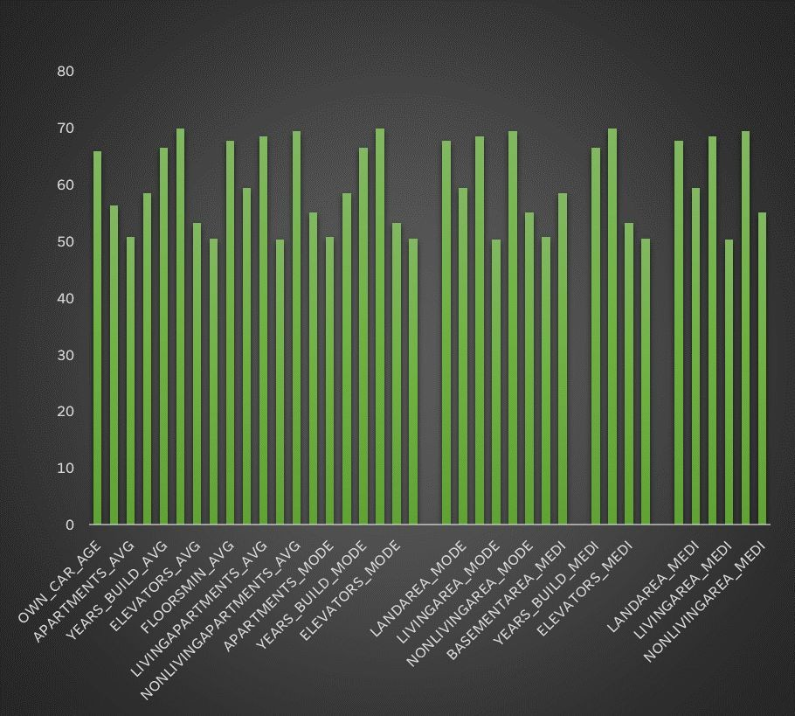
Step 3: Handling missing values
Removing the columns that has empty values above 50% that is 24999.5 by calculating the percentage.
In Python I dropped all columns that has empty values and is above 50% with dropna formula.

Slide 8
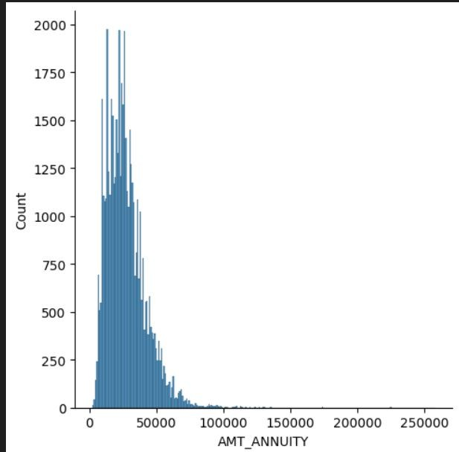
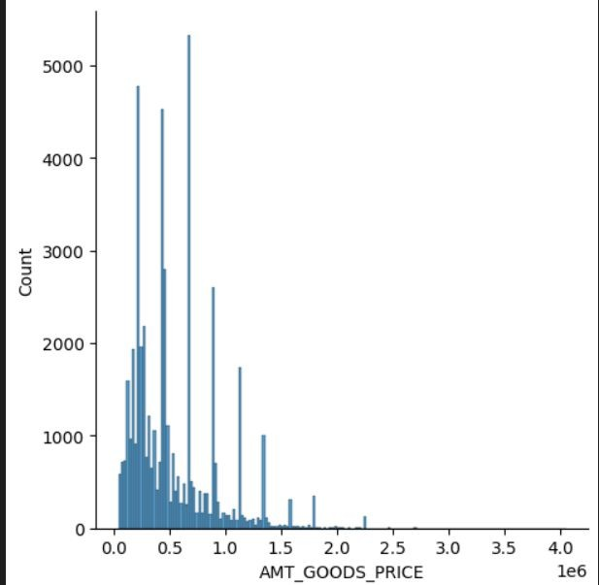
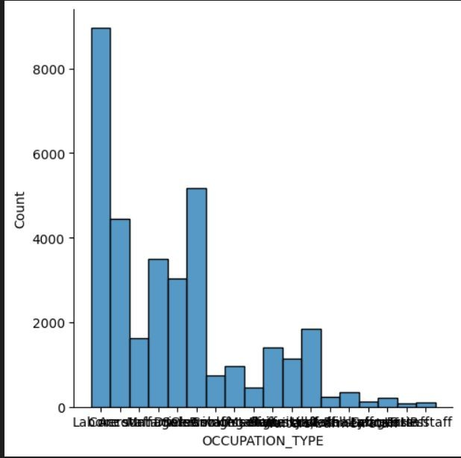
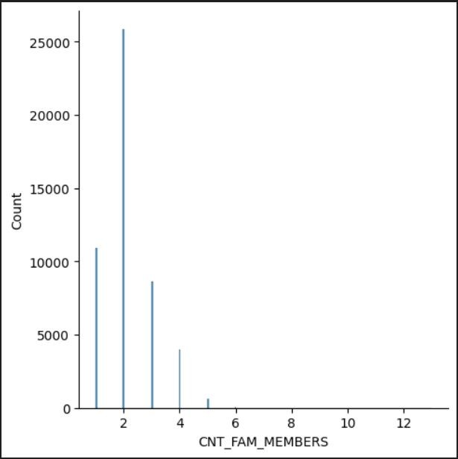
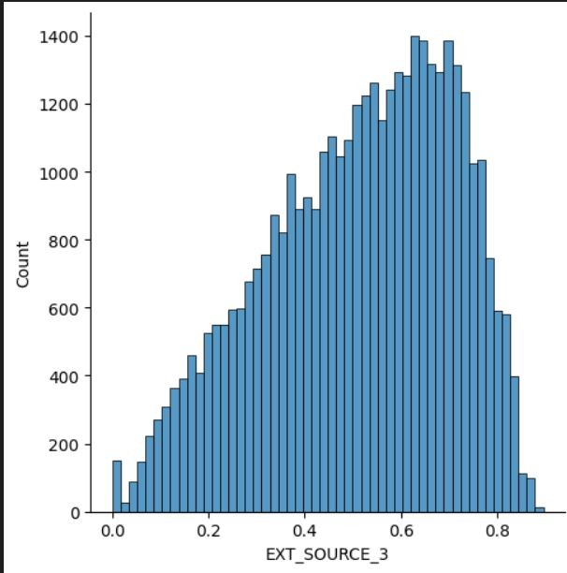
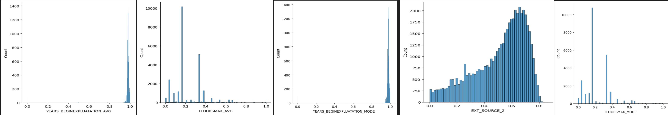
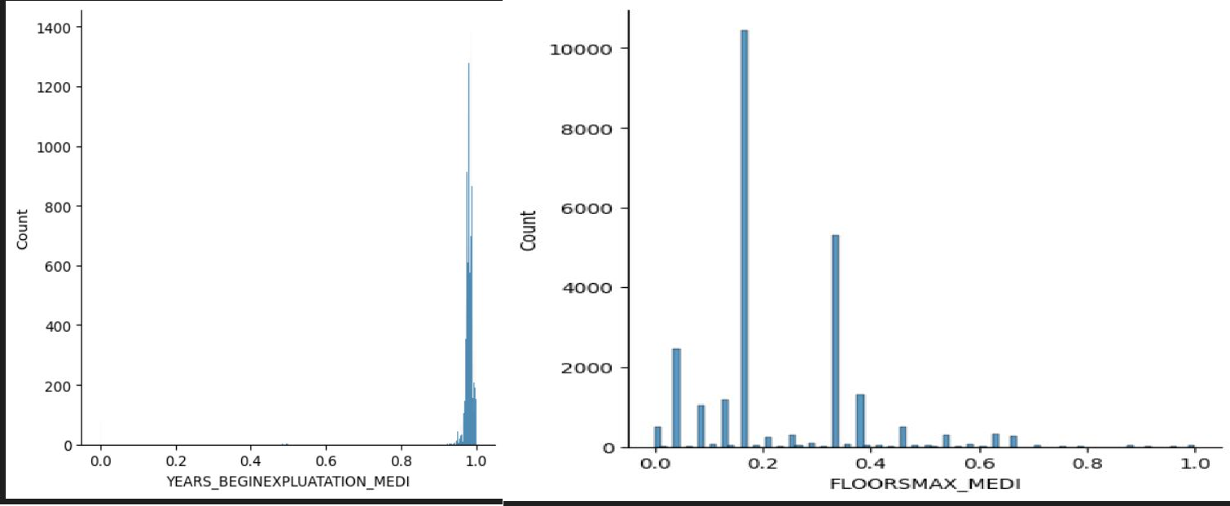
Step 4: Imputation with Mean and Median
Calculated mean and median with below formulas and replaced null values with them using find and replace
• =IFERROR(AVERAGE(application_data!A:A),"")
• =IFERROR(MEDIAN(application_data!B:B),"")
Below are the columns with empty values to be handled with mean and median, hence I plotted Normal distribution graph
sns.displot(data['AMT_ANNUITY'])
All the above graphs seems to be skewed and has no normal distribution hence to be replaced with median values

Slide 9
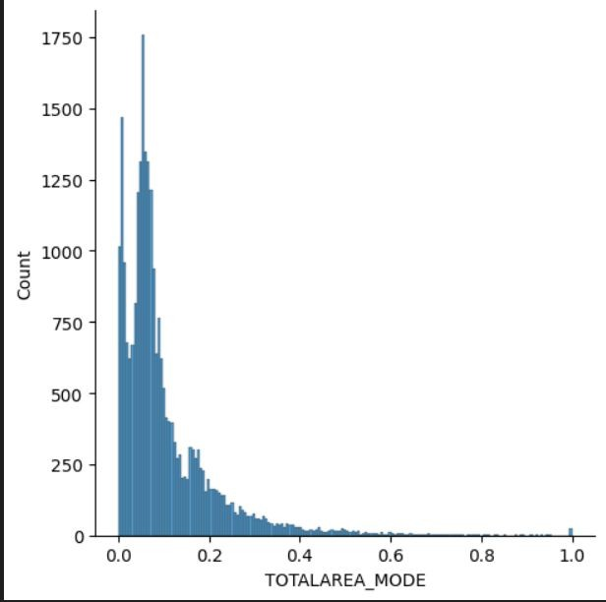
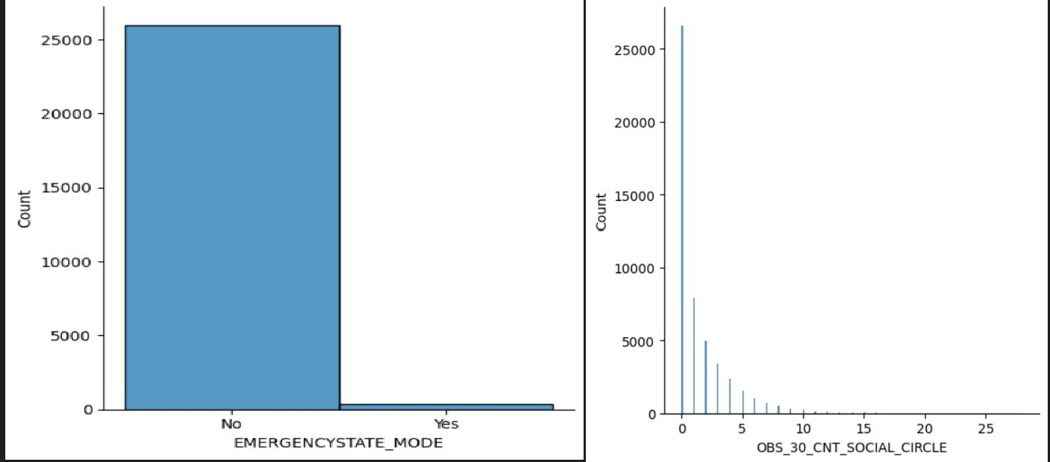
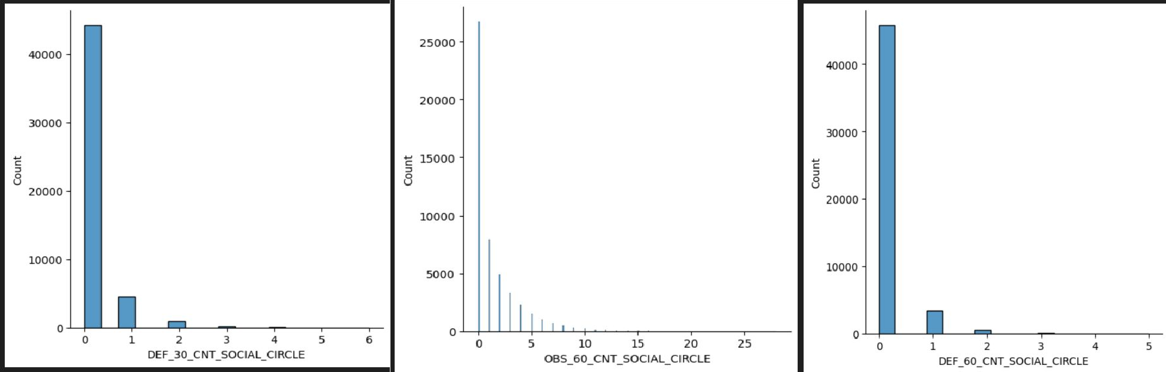
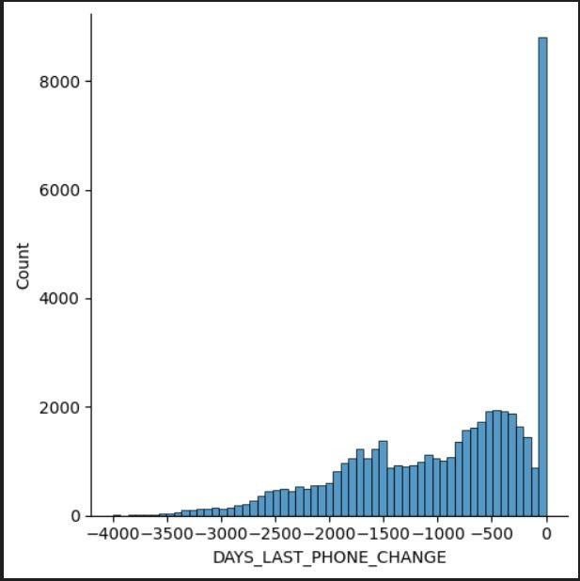
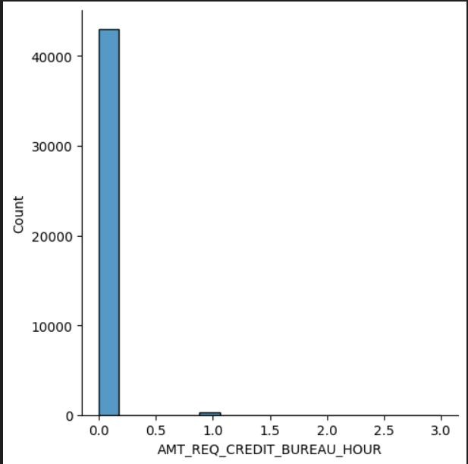
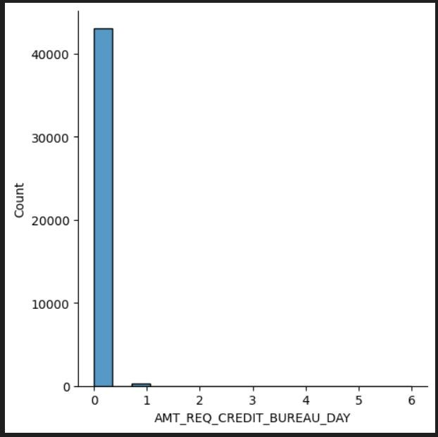
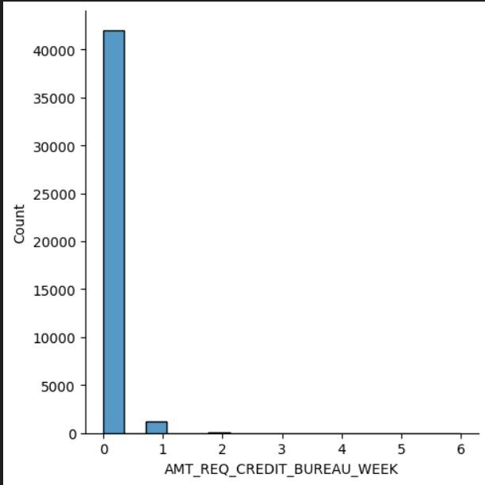
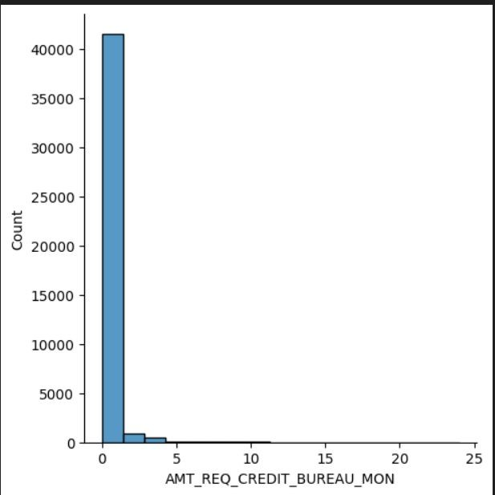

Slide 10
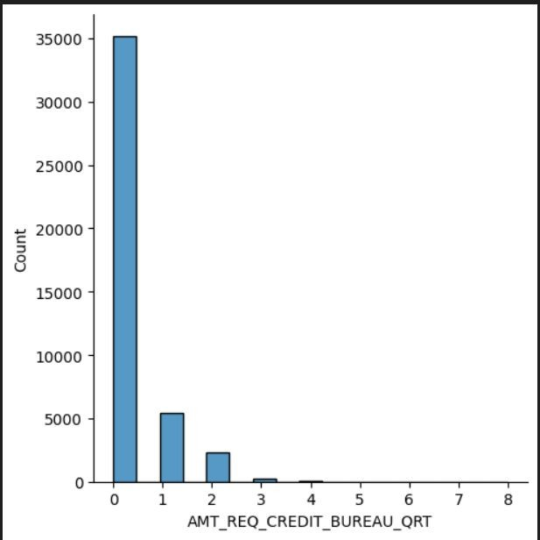
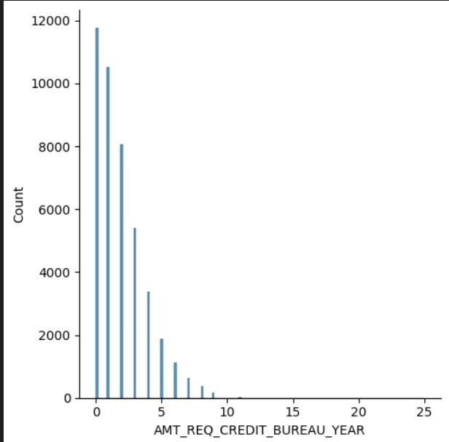
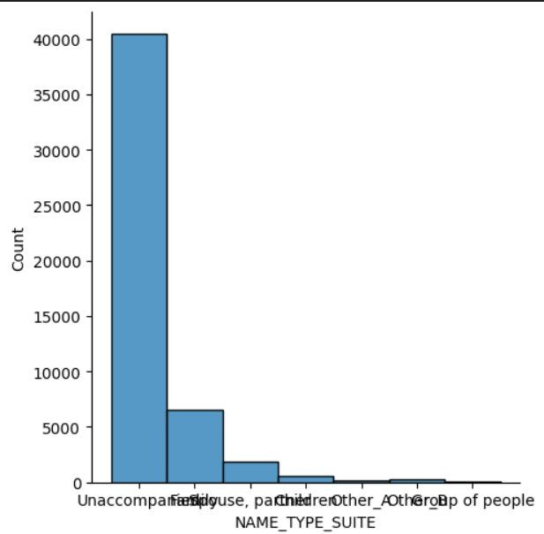
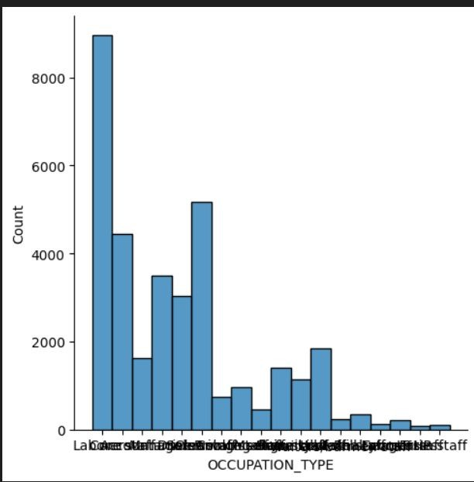
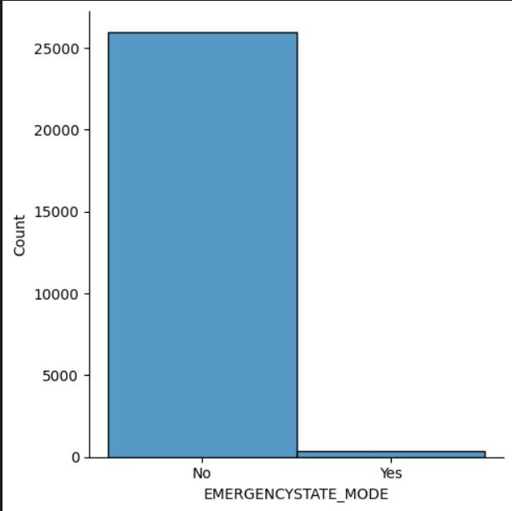

Slide 11
MEDIAN
Columns Removed
OWN_CAR_AGE EXT_SOURCE_1 APARTMENTS_AVG BASEMENTAREA_AVG YEARS_BUILD_AVG COMMONAREA_AVG ELEVATORS_AVG ENTRANCES_AVG FLOORSMIN_AVG LANDAREA_AVG LIVINGAPARTMENTS_AVG LIVINGAREA_AVG NONLIVINGAPARTMENTS_AVG NONLIVINGAREA_AVG APARTMENTS_MODE BASEMENTAREA_MODE YEARS_BUILD_MODE COMMONAREA_MODE ELEVATORS_MODE ENTRANCES_MODE FLOORSMIN_MODE LANDAREA_MODE LIVINGAPARTMENTS_MODE LIVINGAREA_MODE NONLIVINGAPARTMENTS_MODE NONLIVINGAREA_MODE APARTMENTS_MEDI BASEMENTAREA_MEDI YEARS_BUILD_MEDI COMMONAREA_MEDI ELEVATORS_MEDI ENTRANCES_MEDI FLOORSMIN_MEDI LANDAREA_MEDI LIVINGAPARTMENTS_MEDI LIVINGAREA_MEDI NONLIVINGAPARTMENTS_MEDI NONLIVINGAREA_MEDI FONDKAPREMONT_MODE HOUSETYPE_MODE WALLSMATERIAL_MODE
MODE
NAME_TYPE_SUITE OCCUPATION_TYPE EMERGENCYSTATE_MODE
AMT_ANNUITY AMT_GOODS_PRICE CNT_FAM_MEMBERS EXT_SOURCE_2 EXT_SOURCE_3
YEARS_BEGINEXPLUATATION_AVG FLOORSMAX_AVG YEARS_BEGINEXPLUATATION_MODE FLOORSMAX_MODE YEARS_BEGINEXPLUATATION_MEDI FLOORSMAX_MEDI TOTALAREA_MODE OBS_30_CNT_SOCIAL_CIRCLE DEF_30_CNT_SOCIAL_CIRCLE OBS_60_CNT_SOCIAL_CIRCLE DEF_60_CNT_SOCIAL_CIRCLE DAYS_LAST_PHONE_CHANGE AMT_REQ_CREDIT_BUREAU_HOUR AMT_REQ_CREDIT_BUREAU_DAY AMT_REQ_CREDIT_BUREAU_WEEK AMT_REQ_CREDIT_BUREAU_MON AMT_REQ_CREDIT_BUREAU_QRT AMT_REQ_CREDIT_BUREAU_YEAR
Rows: If a row has a high percentage of missing values and you have enough data, it may be better to drop these rows as they might not provide much useful information.
Columns: If a column has a high percentage of missing values (e.g., more than 50%), and the column is not critical to the analysis, it might be better to drop the column.
a = data['AMT_ANNUITY’]
a = a.fillna(a.median(),inplace=True)
aaa= data['NAME_TYPE_SUITE']
aaa= aaa.fillna(aaa.mode()[0],inplace=True)

Slide 12
IDENTIFYING OUTLIER
Outliers are the data points that lie far away from the rest of the data points due to some measurement errors , data entry errors and some other natural errors.
STEP 1: Finding 1st Quartile Q1 and 3rd Quartile Q3 STEP 2: Finding IQR (Q3 – Q1)
STEP 3: Finding Upper Bound (Q3+(1.5*IQR)
STEP 4: Finding Lower Bound (Q1-(1.5*IQR)
STEP 5: With conditional formatting any data points above upper bound and below lower bound are marked and coloured

Slide 13
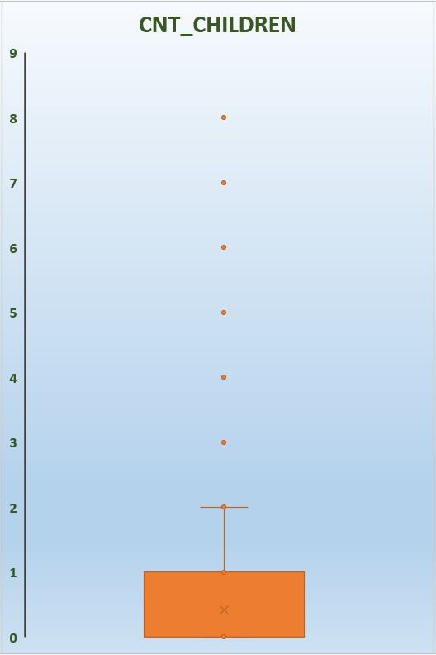
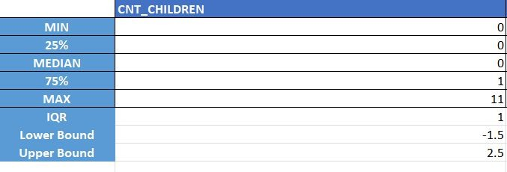
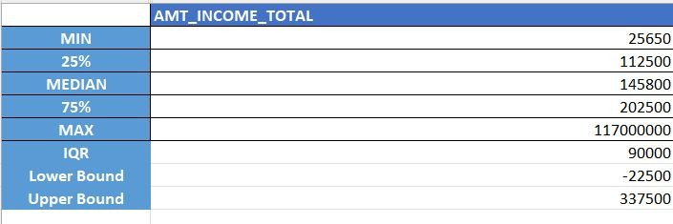
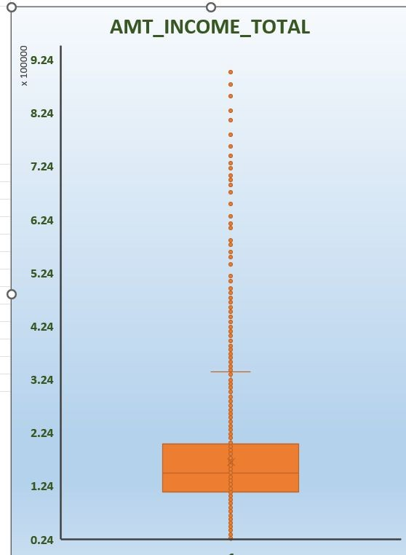

Slide 14
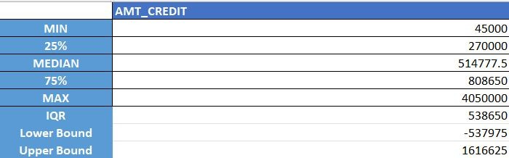
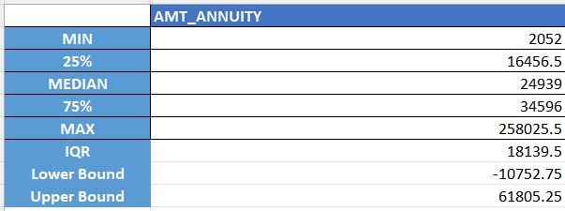

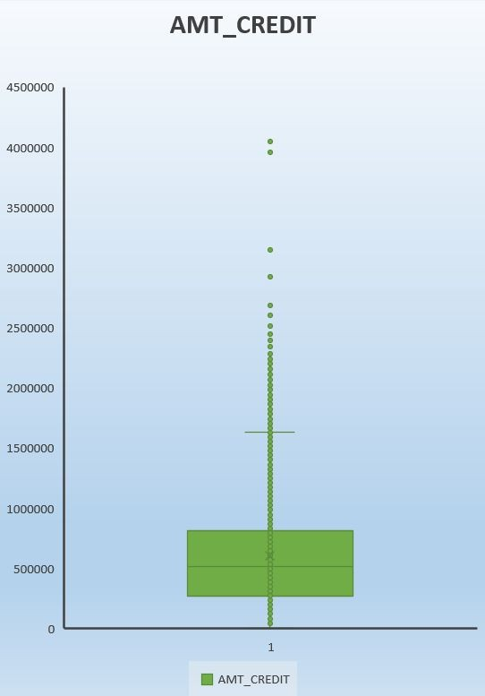
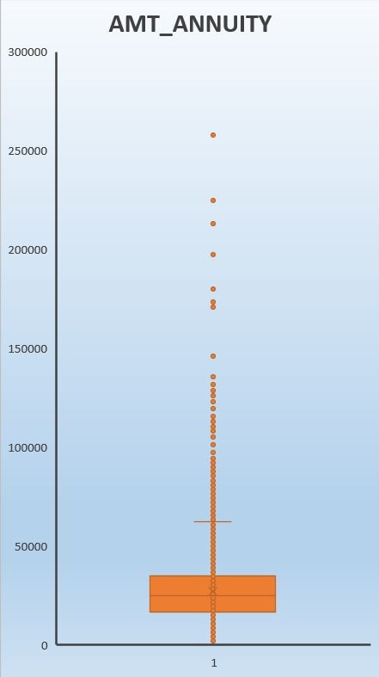
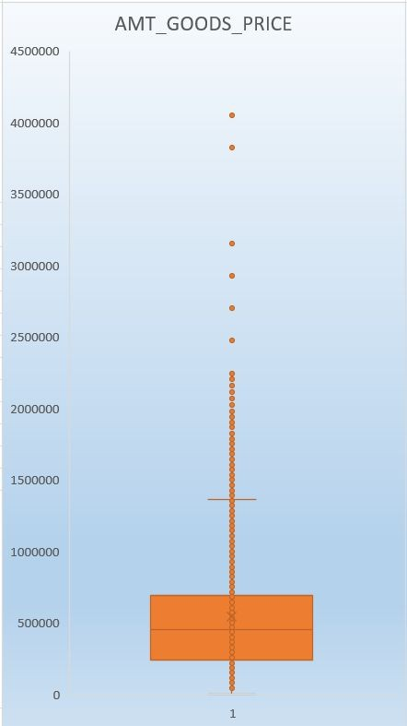

Slide 15
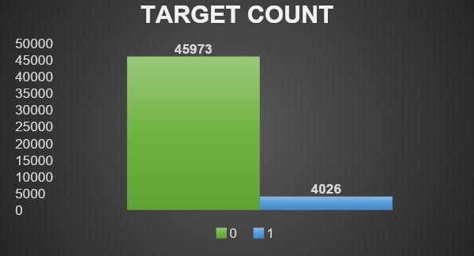
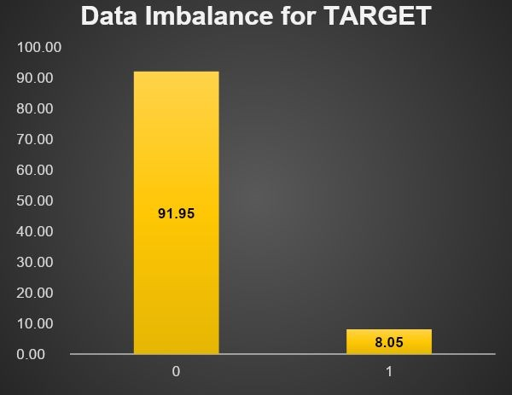
DATA IMBALANCE
Data Imbalance refers to situation where the classes in classification problem are not equally represented in the dataset.
Created Pivot table and segmented charts to identify the imbalance between categories of each data set.
In Target variable, Client with payment difficulties are just about 8.05% and with no difficulties are 91.95%

Slide 16
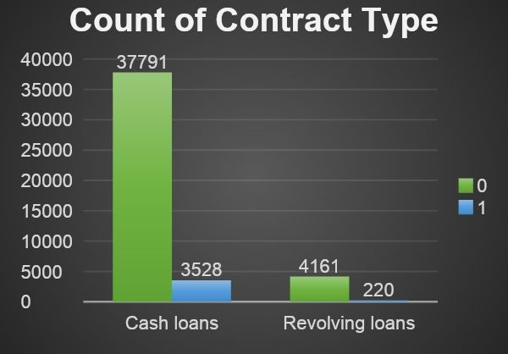
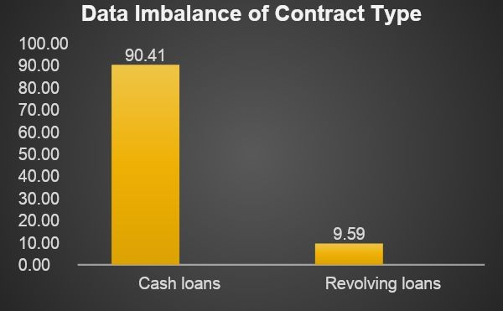
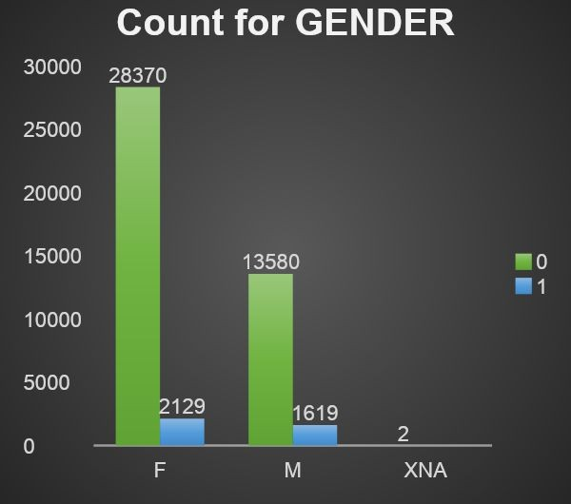
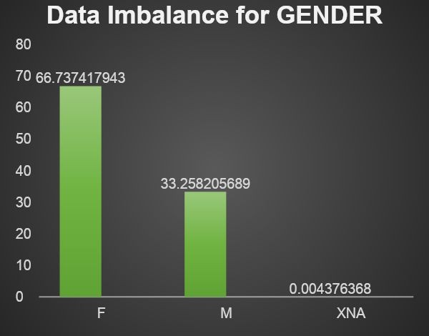
We can notice
90.41% (41319) have taken
cash loans
and
9.50% (4381) have taken
revolving loans.
Out of 3748 clients who have difficulties
repaying loan
3528 are under the category
cash loan
contract type and
220 belongs to
revolving loan
contract type
We can notice
66.74% (30499) are females
and
33.26% (15199) are males
and 2 of
them have not disclosed.
Out of 3748 clients who have difficulties
repaying loan and
2129 are females
1619
are male.

Slide 17
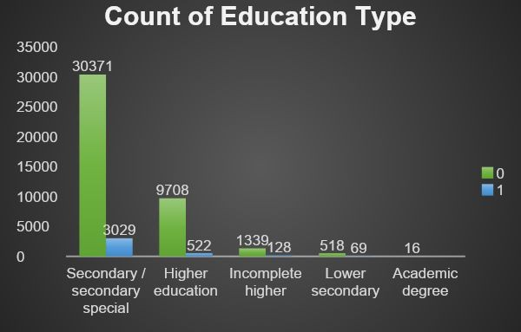
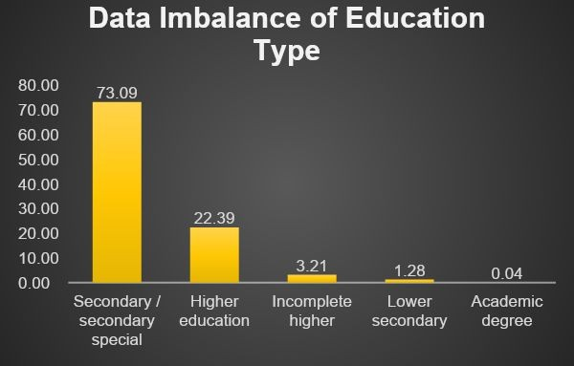
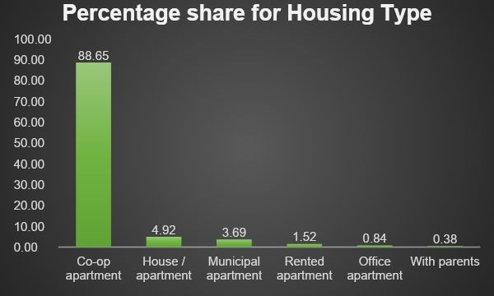
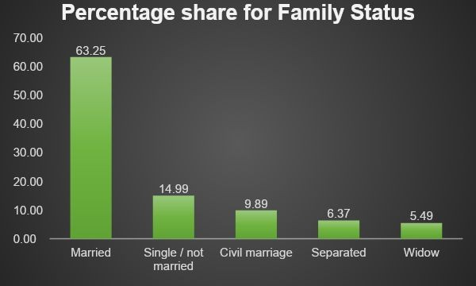
Around 73.09% of clients have completed secondary education followed by 22.39% of higher education, 3.21% of Incomplete higher, 1.28 of incomplete lower secondary 0.04 are academic degree.
In Housing type variable, we notice a greater imbance between Co-op apartment and other types.
In Family status variable we notice married are with 63.25% loan buyers that shows greater data imbalance

Slide 18
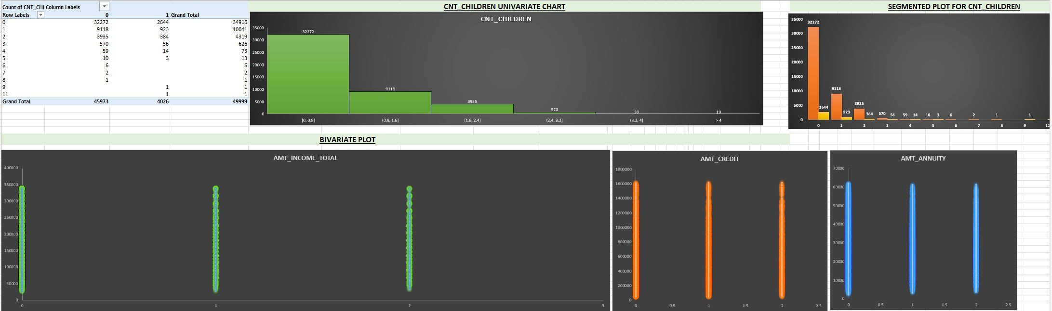
EDA with Univariate, Segmented and Bivariate Analysis
CNT_CHILDREN
We can conclude that majority of loan defaulters either don’t have kids or have just 1 or 2 kids. That is out of 4026 defaulters 3951 of them have utmost 2 children

Slide 19
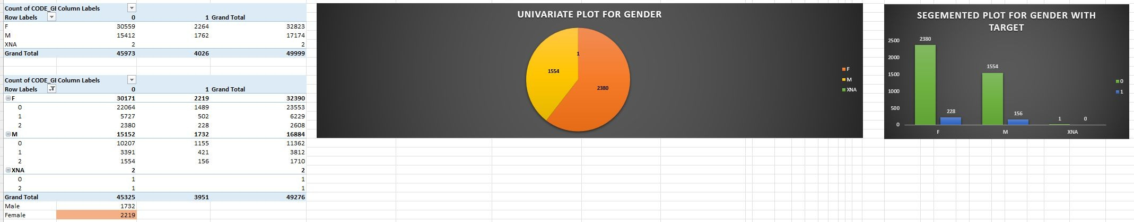
Univariate analysis is statistical method to analyze the data with one variable.
GENDER
Out of 3951 loan defaulters with utmost 2 kids, 2219 are female

Slide 20
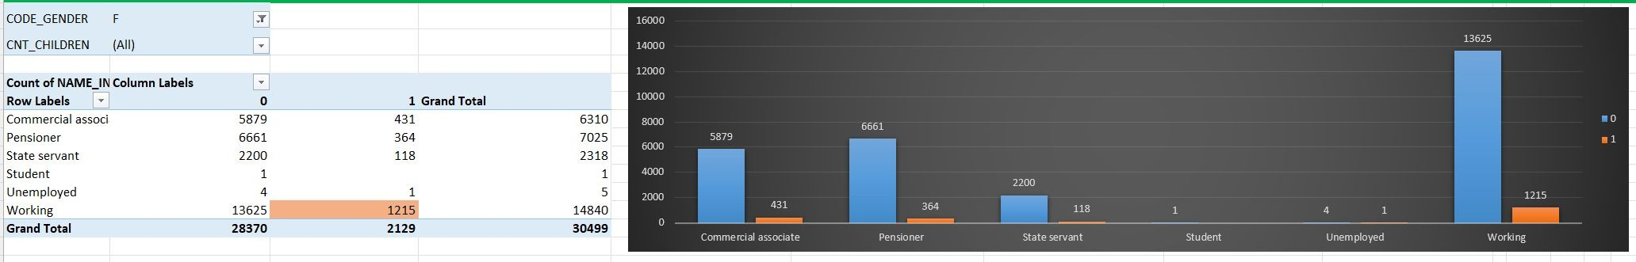
INCOME TYPE
About 1215 females are working professionals

Slide 21
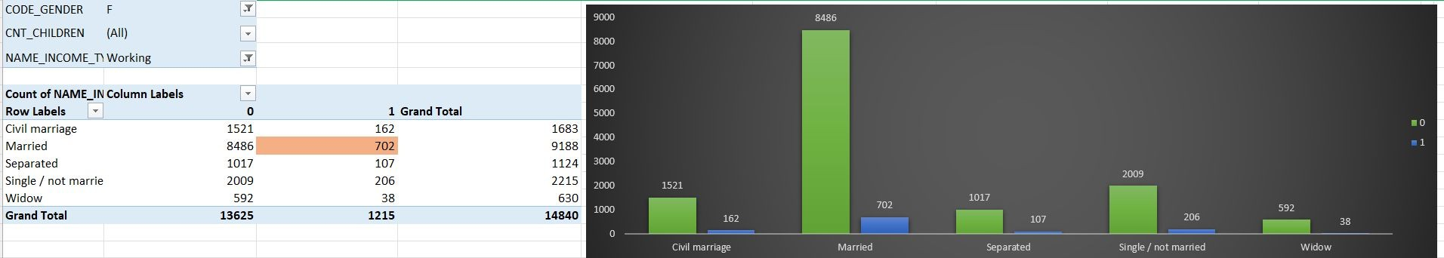
FAMILY STATUS TYPE
And we can see 702 are married female with utmost 2 children who seems to be working professionals

Slide 22
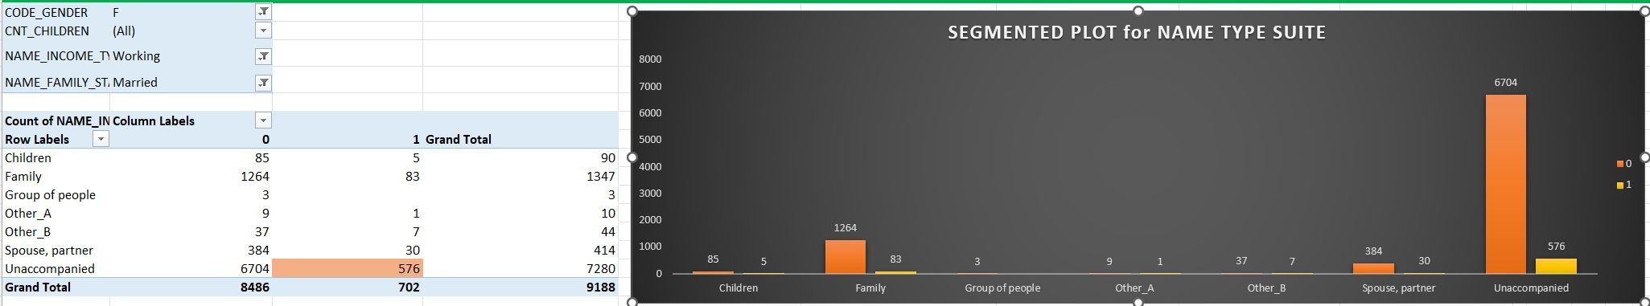
NAME TYPE SUITE
And we can see 576 are female working professional who are married with utmost 2 children who seems to be unaccompanied while applying loan

Slide 23
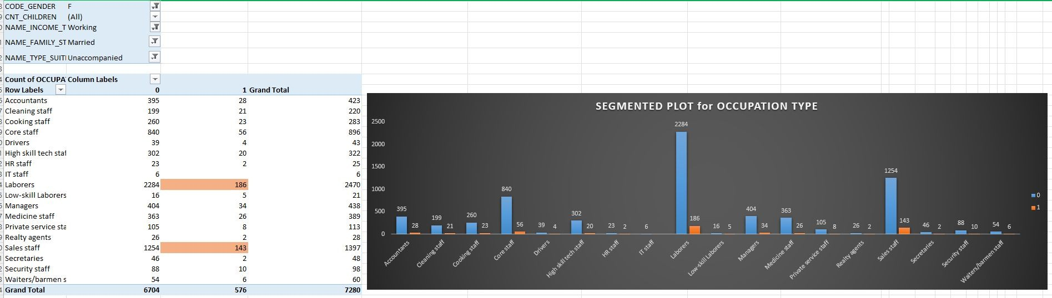
OCCUPATION TYPE
We can see 186 are labourers and 143 are sales staff.

Slide 24
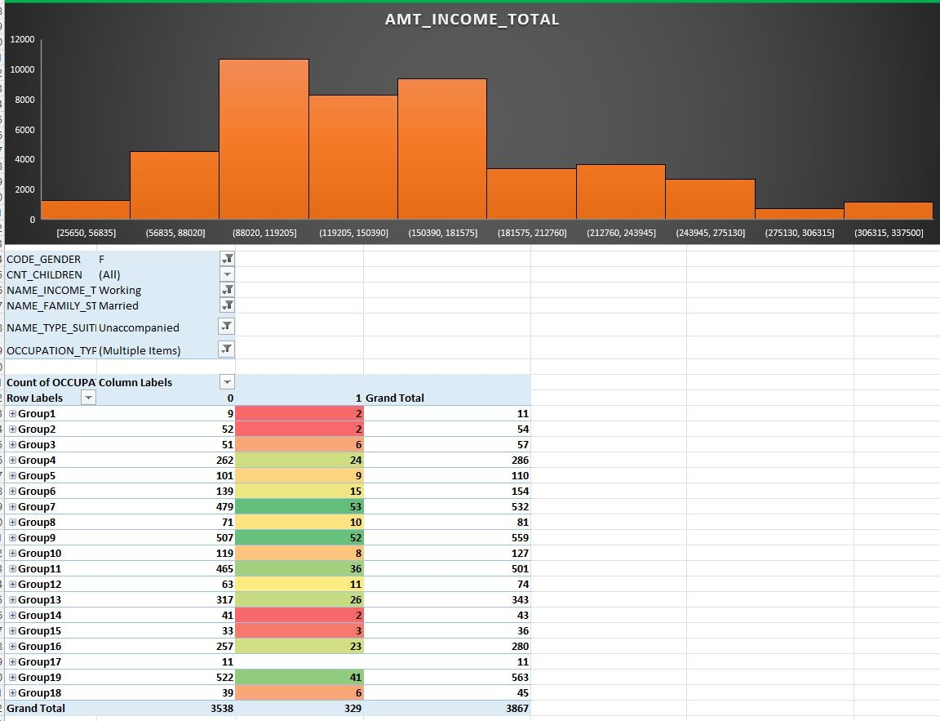
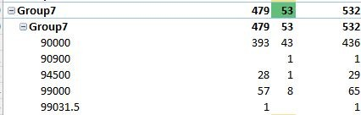

we can see 53 are between 90K to 1L and 52 are between 11L to 12L are labourers and 143 are sales staff which is highlighted in green shades.

Slide 25

We see more loan defaulters have credit_amt with amt_annuity of range 1L to 8L which is marked in red shades.

Slide 26


Slide 27



Slide 28



Slide 29


Slide 30
RESULT :
The key indicators of clients with difficulties paying loans are:
We can conclude that majority of loan defaulters either don’t have kids or have just
1 or 2 kids. That is out of defaulters
4026
3951 of them have utmost 2 children
Out of 3951 loan defaulters with utmost 2 kids,
2219 are female
1. Credit amount and amount annuity of
About
1215 females are working professionals
range 1L to 8L
And we can see
702 are married
female with utmost 2 children who seems to be
2. The
female
working
working professionals
professionals
who are
married
and have
And we can see
576
are female working professional who are married with utmost
2 children who seems to be
utmost 2 children
and
unaccompanied while applying loan
have
unaccompanied
We can see
186 are labourers
and
143 are sales staff.
while applying loan
working as
labourers
we can see
53 are between 90K to 1L
and are labourers
and
sales staff
earning
52 are between 11L to 12L
and sales staff.
We see more loan defaulters have
in the range of
90K to
credit_amt with amt_annuity of range 1L to 8L.
12L

Slide 31



Male Clients are more capable than Female Clients in repaying the loans
Clients who taken Revolving loans are facing less difficulty in repaying the loan when compared to clients who took other type of loans
Clients who hold Academic degree are highly capable of paying loans in time

Slide 32
CORRELATION of TARGET VARIABLES
Correlation analysis is Statistical method used to measure strength and direction of the relationship between two variables.
Correlation Coefficient is the measure of linear relationship between two variables. The value of correlation coefficient ranges from -1 to +1
Positive value indicates positive relationship and Negative Value indicates negative relationship. Zero value indicates there is no relationship between those variables
Filtered Defaulters keeping target as 1 and copied to a sheet. Similarly filtered loan repayers with target as 0 and copied table to another sheet.

Slide 33

Co-relation Matrices with Heatmap for Defaulters

Slide 34

Co-relation Matrices with Heatmap for Non-Defaulters

Slide 35


AMT_GOODS_PRICE vs AMT_CREDIT
The Correlation coefficient between these two variables is 0.97 and 0.98 which is very close to 1.
I have plotted Scatter Plot to show Visually. If the amount of credit increases then Amount of goods price also increases for both Defaulters and Non-Defaulters.
There is a strong linear relationship between these two variables.

Slide 36


AMT_ANNUITY vs AMT_CREDIT
The Correlation coefficient of these two variables is around 0.74 and 0.77 which is somewhat strong linear relationship between those variables.
If the credit amount increases amount annuity also increases in both Defaulters and Non-Defaulters case.
The Scatter plot visualizes the data efficiently.

Slide 37


AMT_GOODS_PRICE vs AMT_ANNUITY
The Correlation coefficient between Amount Annuity and Goods price is very close to 0.77 and 0.73 which indicates the Strong linear relationship between both of them.
More the amount of annuity more will be the Amount of Goods price

Slide 38
PREVIOUS APPLICATION DATA
38

Slide 39
CLEANING THE DATA
Cleaning the data is an crucial step in any data analysis as it ensures the data is accurate, reliable and consistent .
STEP 1: Removing Duplicates
Assuming SK_ID_PREVas unique key, with Excel function performed Remove Duplicates in data tab which was found to be 0 duplicates.
STEP 2: Handling missing Values empty= data.isnull().sum()
empty2 = empty[empty >24999.5 ] print(empty2)

Slide 40
MEDIAN
MODE
Columns Removed
AMT_ANNUITY
AMT_DOWN_PAYMENT | 25198
RATE_DOWN_PAYMENT | 25198
RATE_INTEREST_PRIMARY | 49834
AMT_GOODS_PRICE
NAME_TYPE_SUITE
CNT_PAYMENT
PRODUCT_COMBINATION
DAYS_FIRST_DRAWING
RATE_INTEREST_PRIVILEGED
49834
DAYS_FIRST_DUE
DAYS_LAST_DUE_1ST_VERSION
DAYS_LAST_DUE DAYS_TERMINATION NFLAG_INSURED_ON_APPROVAL
Rows: If a row has a high percentage of missing values and you have enough data, it may be better to drop these rows as they might not provide much useful information.
Columns: If a column has a high percentage of missing values (e.g., more than 50%), and the column is not critical to the analysis, it might be better to drop the column.
a = data['AMT_ANNUITY’]
aaa= data['NAME_TYPE_SUITE']
a = a.fillna(a.median(),inplace=True)
aaa= aaa.fillna(aaa.mode()[0],inplace=True)

Slide 41


DATA IMBALANCE & UNIVARIATE ANALYSIS
Data Imbalance refers to situation where the classes in classification problem are not equally represented in the dataset.
Created Pivot table and segmented charts to identify the imbalance between categories of each data set.

Slide 42







Slide 43
CONCLUSION
Contract_Type:
Consumer loans are most taken loans by clients and cash loans also good number .Revolving loans are the least taken loans.
Client Type :
We can observe that Most of the clients who kept applied are “Repeaters” only. New client applications are less percent when compared to repeaters.
Channel_Type:
“Credit and cash offices” and “Country Wide” are most acquired channel type for the clients on the previous application.
Contract_Status :
Most the status of the contract got Approved and only few of them rejected.

Slide 44

CO-RELATION MATRICES FOR PREVIOUS APPLICATION

Slide 45



AMT_ANNUITY with Amt_application , amt_credit, amt_goods_price has a correlation of 0.8 which is close to 1 following a linear relationship.
Amt_application with amt_credit and amt_goods_price
has a correlation of 0.97 and 0.98 close to 1.
Amt_credit with amt_goods_price has a correlation of 0.97 and close to 1 following a linear realtionship.

Slide 46
THANK YOU

