Slide 1




Impact of CAR FEATURES
BHARATH G M
07 - 08 - 2024

Slide 2



BHARATH G M
DATA ANALYST INTERN
@ TRAINITY

Slide 3


Project Description
Approach
Tech-Stack Used
Data Understanding
AGENDA
Data Cleaning
Data Preparation & Analysis
Dashboard Tasks
Dashboard
Result
File URL’s

Slide 4


PROJECT DESCRIPTION

Slide 5

Description: The automotive industry has been rapidly evolving
over the past few decades, with a growing focus on fuel efficiency,
environmental sustainability, and technological innovation. With increasing competition among manufacturers and a changing consumer landscape, it has become more important than ever to understand the factors that drive consumer demand for cars.
Analysis: How can a car manufacturer optimize pricing and
product development decisions to maximize profitability while meeting consumer demand?

Slide 6
APPROACH
DATA
GATHERING
DATA CLEANING
DATA
PRESENTATION
DATA ANALYSIS
DATA UNDERSTANDING
DATA PREPARATION
DATA VISULAIZATION

Slide 7


TECH-STACK USED
MS EXCEL
POWERPOINT

Slide 8

TECH-STACK USED
JUPYTER NOTEBOOK

Slide 9
DATA UNDERSTANDING
TOTAL ROWS : 11,914
TOTAL COLUMNS: 16
NUMERIC DATASET: 7
NON-NUMERIC DATASET: 8
DATE TYPE DATASET : 1

Slide 10
COLUMN DESCRIPTION
Make: the make or brand of the car
Model: the specific model of the car
Year: the year the car was released
Engine Fuel Type: the type of fuel used by the car
(gasoline, diesel, etc.)
Engine HP: the horsepower of the car's engine
Engine Cylinders: the number of cylinders in the car's
engine
Transmission Type: the type of transmission (automatic or manual)
Driven_Wheels: the type of wheels driven by the car (front, rear, all)
Number of Doors: the number of doors the car has
Market Category: the market category the car belongs to (Luxury, Performance, etc.)
Vehicle Size: the size of the car
Vehicle Style: the style of the car (Sedan, Coupe, etc.)
Highway MPG: the estimated miles per gallon the car gets on the highway
City MPG: the estimated miles per gallon the car gets in the city
Popularity: a ranking of the popularity of the car (based on the number of times it has been viewed on Edmunds.com)
MSRP: the manufacturer's suggested retail price of the car

Slide 11
715 duplicates were removed.
DATA CLEANING
Model dataset was formatted with number datatype.
2,557 rows of outliers were removed.
108 missing values are handled with MEDIAN and MODE
imputation.
Total No. of Rows after Cleaning: 8642

Slide 12
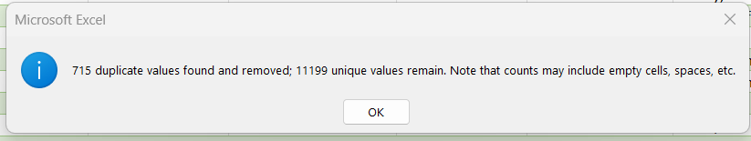
STEP 1: FIND DUPLICATES
715 duplicates were found and removed
STEP 2: CHECK DATA TYPE
With format cells made sure entire dataset follows same datatype. Model column had mixed type as text and nos. converted all into number
STEP 3: COUNT BLANKS
Columns |  | Count of Blanks
Make |  | 0
Model |  | 0
Year |  | 0
Engine Fuel Type |  | 3
Engine HP |  | 69
Engine Cylinders |  | 30
Transmission Type |  | 0
Driven_Wheels |  | 0
Number of Doors |  | 6
Market Category |  | 0
Vehicle Size |  | 0
Vehicle Style |  | 0
highway MPG |  | 0
city mpg |  | 0
Popularity |  | 0
MSRP |  | 0
•
Utilized =COUNTBLANK(Car_data!$D$2:$D$11200)
Engine Fuel Type has 3 blanks,
Engine HP has
Engine Cylinders has 30 blanks
Number of Doors has 6 blanks
69 blanks

Slide 13
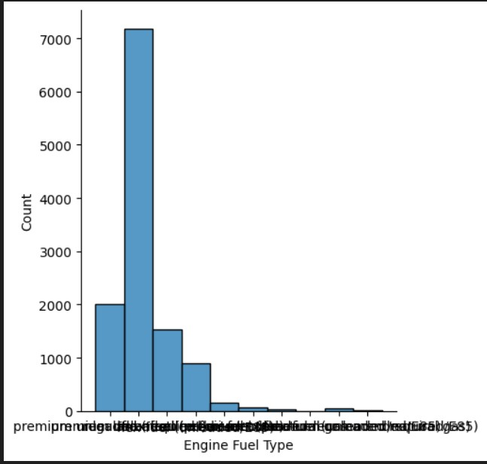
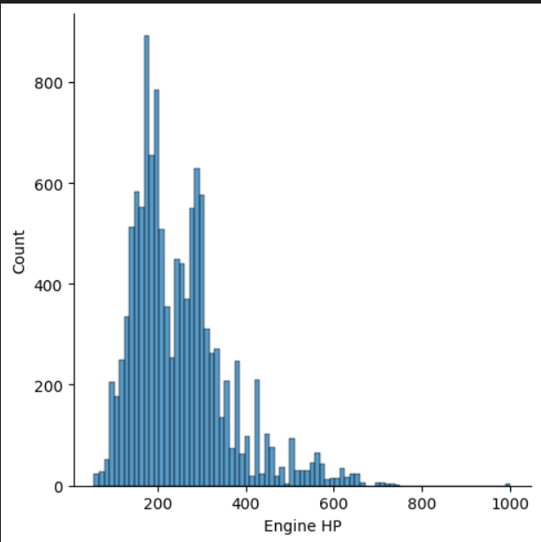
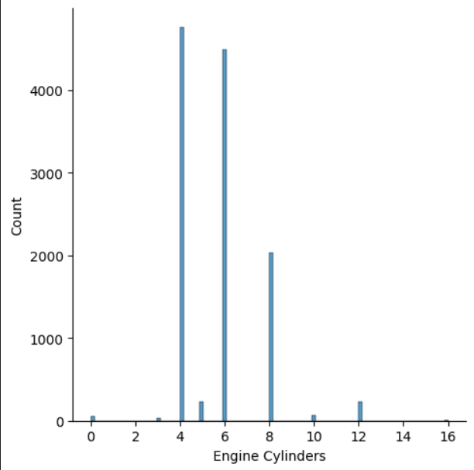
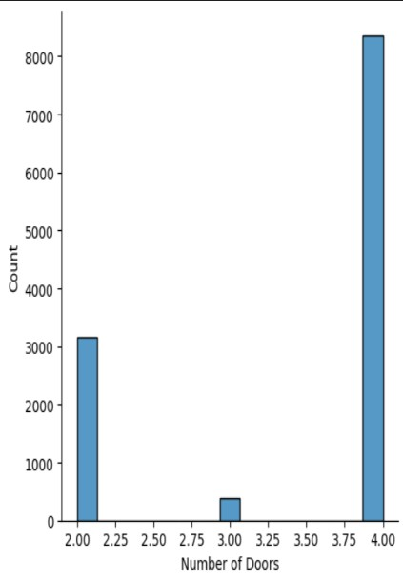
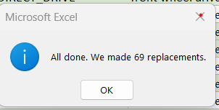
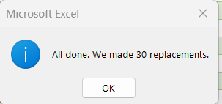
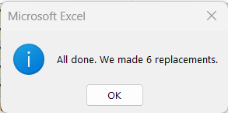
STEP 4: HANDLE MISSING DATA
Count of Rows |  |  | 50 |  | 40 |  | 30
11199 |  | 5599.5 |  | 4479.6 |  | 3359.7
We see the missing values count are less than 30%. Hence need to impute with Mean, Median and Mode respectively.
All the plots are not normally distributed. Hence imputing them with MEDIAN and for the text column with MODE
=MEDIAN(Car_data!E:E)
=AVERAGE(Car_data!E:E)
FOR MODE: USED Pivot
Columns |  | Mean |  | Median |  |  | Mode
Engine Fuel Type |  |  |  |  |  |  | regular unleaded
Engine HP |  | 253.3002054 |  |  |  | 239
Engine Cylinders |  | 5.666845254 |  | 6
Number of Doors |  | 3.454415573 |  | 4
table and sorted
in descending
order of count

Slide 14
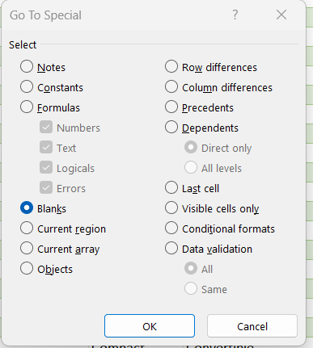

The Data has no blanks after Replacing the data with MEDIAN and MODE using FIND & REPLACE
STEP 5: HANDLING OUTLIERS:
2557 rows of outliers were removed from all the numeric dataset
 | YEAR |  |  |  |  | ENGINE HP |  |  | ENGINE CYLINDERS |  |  |  | NUMBER OF DOORS
Q1 |  |  | 2007 | Q1 | 172 |  |  | Q1 |  | 4 |  | Q1 |  | 2
Q3 |  |  | 2016 | Q3 | 303 |  |  | Q3 |  | 6 |  | Q3 |  | 4
IQR |  |  | 9 | IQR | 131 |  |  | IQR |  | 2 |  | IQR |  | 2
Lower Bound |  |  | 1993.5 | Lower Bound | -24.5 |  |  | Lower Bound |  | 1 |  | Lower Bound |  | -1
Upper Bound |  |  | 2029.5 | Upper Bound | 499.5 |  |  | Upper Bound |  | 9 |  | Upper Bound |  | 7
 | HIGHWAY MPG |  |  |  |  | CITY MPG |  |  | POPULARITY |  |  |  |  | MSRP
Q1 |  | 22 |  | Q1 | 16 |  |  | Q1 |  | 549 |  | Q1 | 21599.5
Q3 |  | 30 |  | Q3 | 22 |  |  | Q3 |  | 2009 |  | Q3 | 43032.5
IQR |  | 8 |  | IQR | 6 |  |  | IQR |  | 1460 |  | IQR | 21433
Lower Bound |  | 10 |  | Lower Bound | 7 |  |  | Lower Bound |  | -1641 |  | Lower Bound | -10550
Upper Bound |  | 42 |  | Upper Bound | 31 |  |  | Upper Bound |  | 4199 |  | Upper Bound | 75182
Highlighted all the numeric columns using CONDITIONAL FORMATTING with upper bounds and
lower bounds.
NOTE: NOW THE CLEANED DATA CONTAINS rows of DATA
8642

Slide 15

ANALYSIS

Slide 16
TASK - 1
How does the popularity of a car model vary across different market categories?

Slide 17
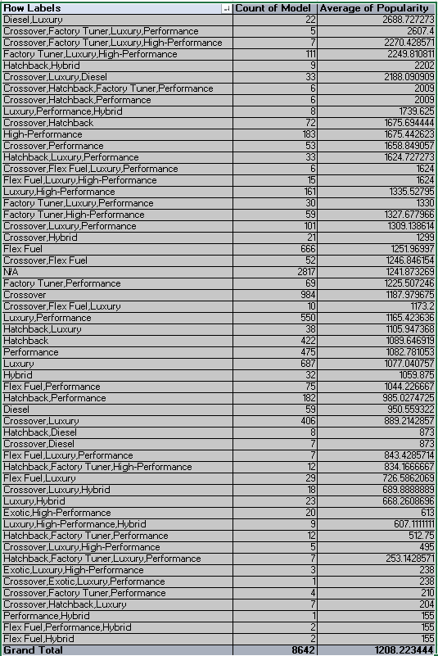
Task 1.A: Create a pivot table that shows the number of car models in each market category and their corresponding popularity scores.

Slide 18



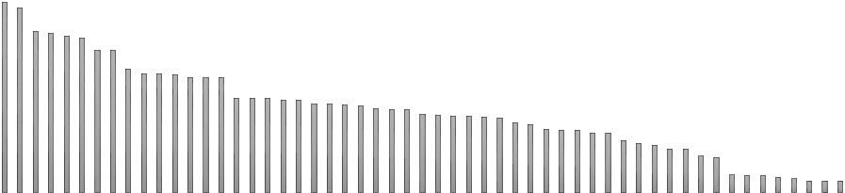














Task 1.B: Create a combo chart that visualizes the relationship between market
category and popularity.
Average of Popularity
Count of Model
We notice Diesel,Luxury has got more popularity but less count of model, whereas Crossover has got better popularity with better count.
has the highest
3000
2500
2000
1500
1000
500
0
Diesel,Luxury
Crossover,Factory…
Crossover,Factory Tuner,Luxury,High-…
Factory Tuner,Luxury,High-Performance
Hatchback,Hybrid
Crossover,Luxury,Diesel
Crossover,Hatchback,Factory…
Crossover,Hatchback,Performance Luxury,Performance,Hybrid Crossover,Hatchback
High-Performance Crossover,Performance Hatchback,Luxury,Performance Crossover,Flex Fuel,Luxury,Performance Flex Fuel,Luxury,High-Performance Luxury,High-Performance
Factory Tuner,Luxury,Performance Factory Tuner,High-Performance Crossover,Luxury,Performance
Crossover,Hybrid
Flex Fuel
Crossover,Flex Fuel
N/A Factory Tuner,Performance
Crossover Crossover,Flex Fuel,Luxury Luxury,Performance Hatchback,Luxury
Hatchback
Performance
Luxury Hybrid
Flex Fuel,Performance Hatchback,Performance
Diesel
Crossover,Luxury Hatchback,Diesel Crossover,Diesel
Flex Fuel,Luxury,Performance Hatchback,Factory Tuner,High-Performance
Flex Fuel,Luxury Crossover,Luxury,Hybrid
Luxury,Hybrid Exotic,High-Performance Luxury,High-Performance,Hybrid
Hatchback,Factory Tuner,Performance
Crossover,Luxury,High-Performance
Hatchback,Factory…
Exotic,Luxury,High-Performance Crossover,Exotic,Luxury,Performance Crossover,Factory Tuner,Performance Crossover,Hatchback,Luxury Performance,Hybrid
Flex Fuel,Performance,Hybrid
Flex Fuel,Hybrid
N/A
count

Slide 19
TASK - 2
What is the relationship between a car's engine power and its price?

Slide 20
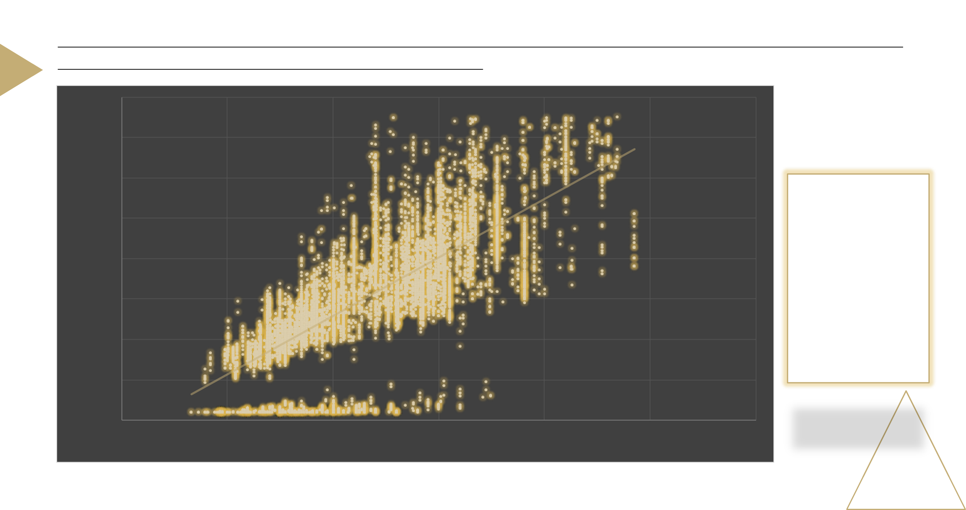
Task 2: Create a scatter chart that plots engine power on the x-axis and price on the y-axis. Add a trendline to the
chart to visualize the relationship between these variables.
₹ 80,000
₹ 70,000
₹ 60,000
We can see a positive trendline that shows as Horsepower of Engine increases the price also increases.
₹ 50,000
MSRP Price
₹ 40,000
₹ 30,000
₹ 20,000
₹ 10,000
₹ 0
0
100
200
300
ENGINE POWER
400
500
600

Slide 21
TASK - 3
Which car features are most important in determining a car's price?

Slide 22



Task 3: Use regression analysis to identify the variables that have the strongest relationship with a car's price. Then create a column chart that shows the coefficient values for each variable to visualize their relative importance.
 | Vehicle Style
 |  |  |  |  | Engine Fuel Type
Coupe |  |  | 1
 |  |  |  | premium unleaded (required) |  |  |  |  | 1
Convertible |  |  | 2
Wagon |  |  | 3 | regular unleaded |  |  |  |  | 2
Sedan |  |  | 4
 |  |  |  | premium unleaded (recommended) |  |  |  |  | 3
4dr Hatchback |  |  | 5
2dr Hatchback |  |  | 6 | flex-fuel (unleaded/E85) |  |  |  |  | 4
4dr SUV |  |  | 7
 |  |  |  | diesel |  |  |  |  | 5
Passenger Minivan |  |  | 8
Cargo Minivan |  |  | 9 | flex-fuel (premium unleaded recommended/E85) |  |  |  |  | 6
Crew Cab Pickup |  |  | 10
 |  |  |  | natural gas |  |  |  |  | 7
Regular Cab Pickup |  |  | 11
Extended Cab Pickup |  |  | 12 | flex-fuel (unleaded/natural gas) |  |  |  |  | 8
2dr SUV |  |  | 13
 |  |  |  | flex-fuel (premium unleaded required/E85) |  |  |  |  | 9
Cargo Van |  |  | 14
Convertible SUV |  |  | 15
Passenger Van |  |  | 16 |  |  | Driven_Wheels
 |  |  |  | rear wheel drive |  |  |  |  | 1
 | Vehicle Size
 |  |  |  | front wheel drive |  |  |  |  | 2
Compact |  |  | 1
Midsize |  |  | 2 | all wheel drive |  |  |  |  | 3
Large |  |  | 3 | four wheel drive |  |  |  |  | 4
Provided numeric values to each category in the mentioned text columns as pasted here.
With
formula created new columns and replaced the text with numeric values
=VLOOKUP($A2,$Q$3:$R$11,2,0)

Slide 23
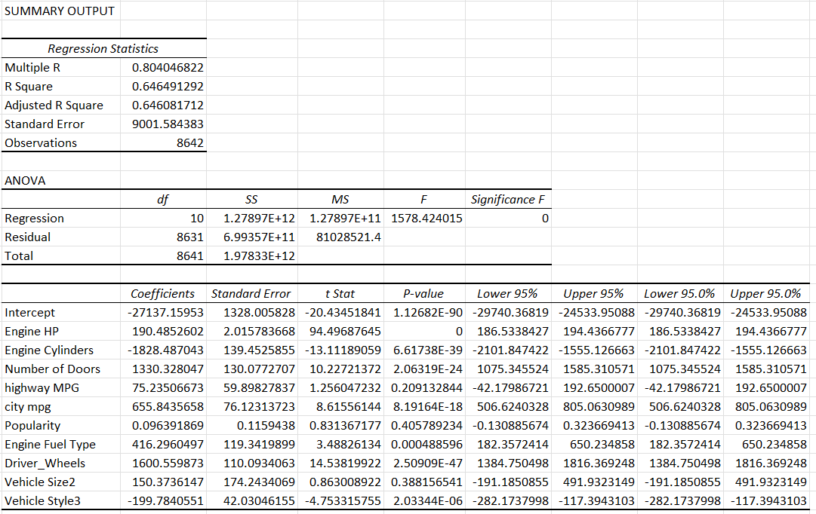


With Data Analysis icon in Data Tab, created Regression statistics for all the numeric columns keeping MSRP as dependant variable and others as independent variable

Slide 24


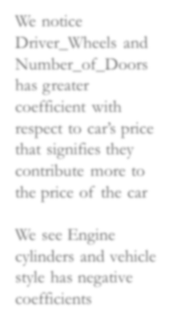
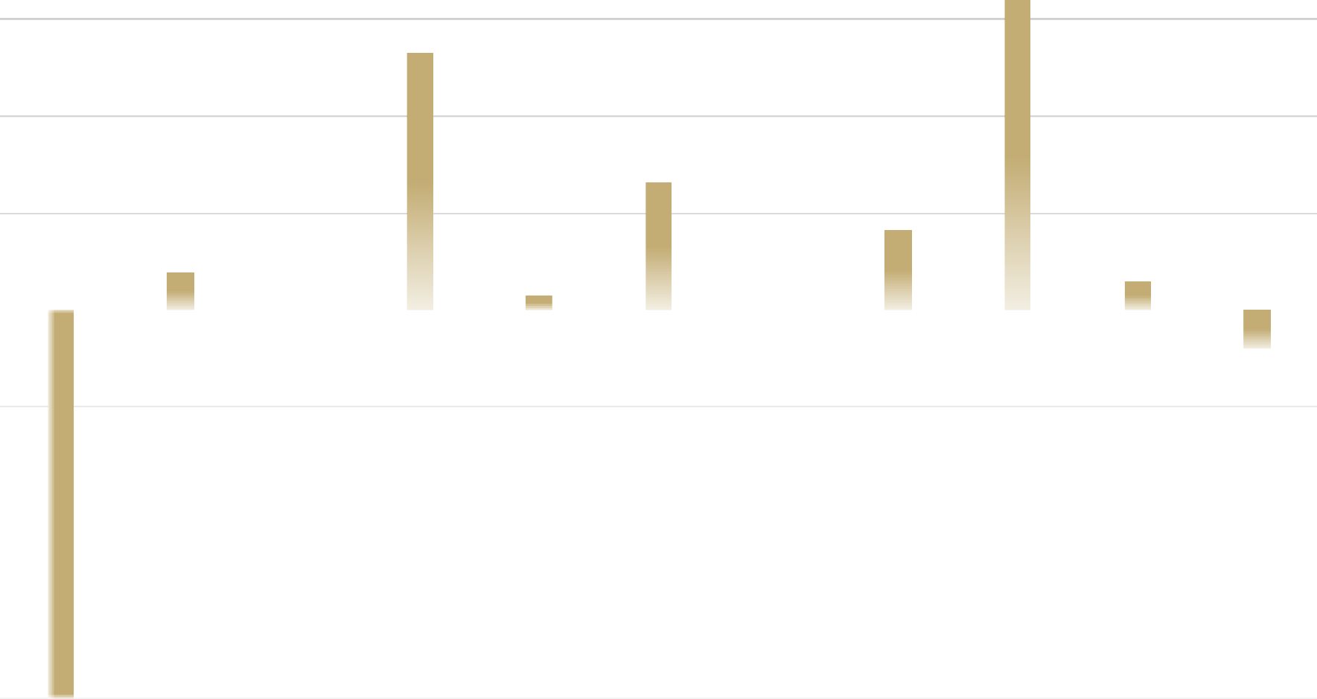





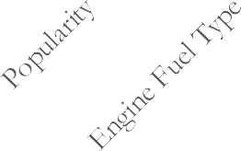



COEFFICIENT VALUE OF VARIABLE
2000
1600.559873
1500
1330.328047
We notice Driver_Wheels and Number_of_Doors has greater coefficient with respect to car’s price that signifies they contribute more to the price of the car
1000
655.8435658
500
416.2960497
COEFFICIENTS
190.4852602
150.3736147
75.23506673
0.096391869
0
-199.7840551
-500
We see Engine cylinders and vehicle style has negative coefficients
-1000
-1500
-2000
-1828.487043

Slide 25
TASK - 4
How does the average price of a car vary across different
manufacturers?

Slide 26

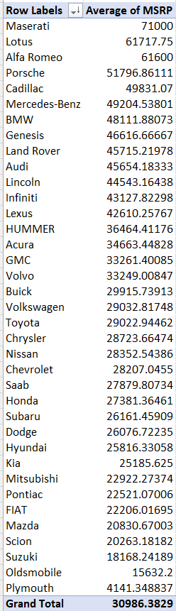

Slide 27



Task 4.B: Create a bar chart or a horizontal stacked bar chart that visualizes the
relationship between manufacturer and average price.
Plymouth
Suzuki Mazda Pontiac
Kia
Dodge Honda Chevrolet Chrysler Volkswagen
Volvo Acura Lexus Lincoln Land Rover
BMW
Cadillac
Alfa Romeo
Maserati
We see has the highest average price and
being the lowest average price.
0
10000
20000
30000
40000
AVERAGE PRICE
50000
60000
70000
80000

Slide 28
TASK - 5
What is the relationship between fuel efficiency and the number of cylinders in a car's engine?

Slide 29
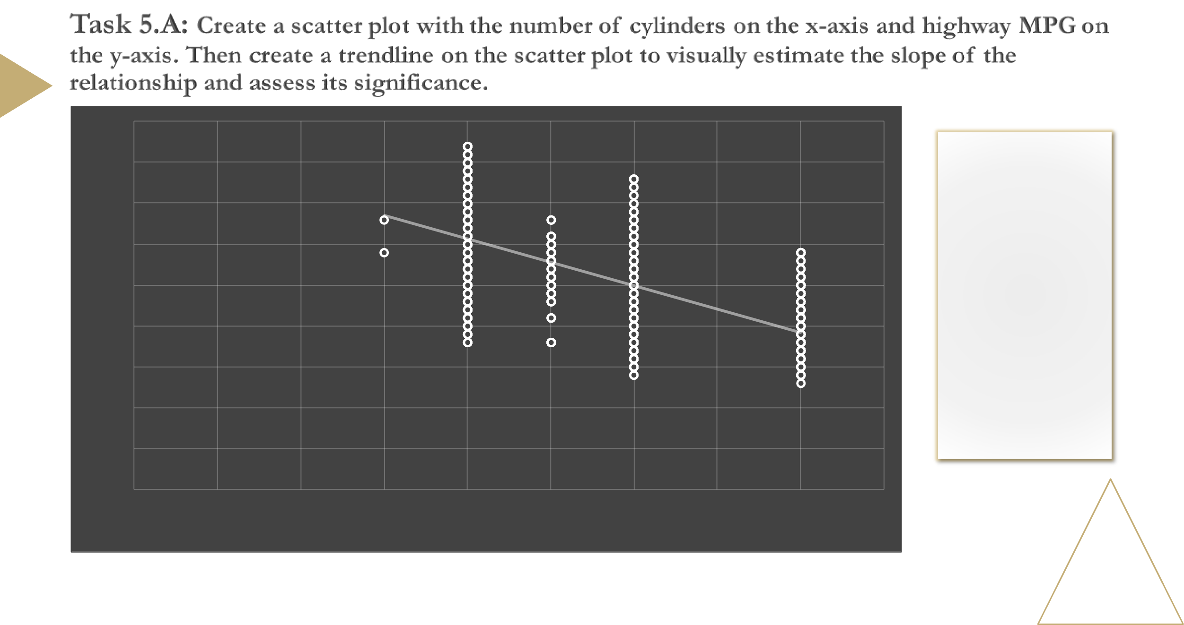
45
40
35
There is a negative slopeline between number of cylinders and Highway MPG which signifies as number of cylinders increases the highway MPG decreases.
30
Highway MPG
25
20
15
10
5
0
0
1
2
3
4 5
No. of Cylinders
6
7
8
9

Slide 30


Correlation coefficient : -0.6979

Slide 31
BUILDING DASHBOARD

Slide 32
TASK - 1
How does the distribution of car prices vary by brand and body style?

Slide 33






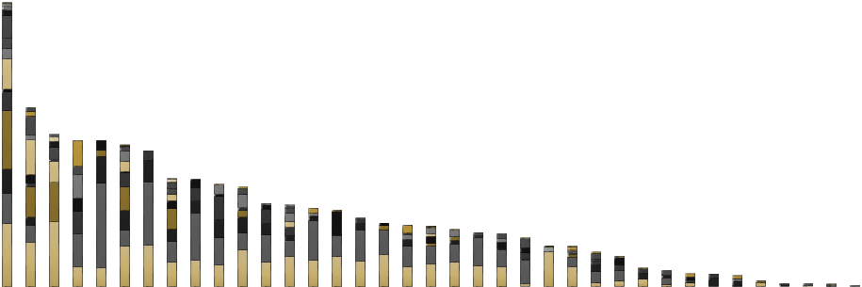


35000000
30000000
Convertible SUV Cargo Minivan 2dr SUV
Cargo Van
Passenger Van Regular Cab Pickup 2dr Hatchback Passenger Minivan 4dr Hatchback Extended Cab Pickup Wagon
Convertible Crew Cab Pickup Coupe
Sedan
4dr SUV
25000000
CAR PRICES
20000000
15000000
10000000
5000000
0
CAR BRAND
CHEVROLET with 4dr SUV style contributes more for the CAR’s PRICE and GENESIS contributes less to the price.

Slide 34
TASK - 2
Which car brands have the highest and lowest average MSRPs, and how does this vary by body style?

Slide 35




2dr Hatchback
Coupe
2dr SUV
Crew Cab Pickup
4dr Hatchback
Extended Cab Pickup
4dr SUV
Passenger Minivan
Cargo Minivan
Passenger Van
Cargo Van
Regular Cab Pickup
Convertible
Sedan
Convertible SUV
Wagon
80000
70000
60000
50000
40000
30000
20000
10000
0
AVERAGE MSRP
CAR BRANDS
Sedan style of Maserati Brand and Coupe style of Lotus, Alfa Romeo and Porsche brand has the highest number of average car price.

Slide 36
How do the different feature such as transmission type affect the MSRP, and how does this vary by body style?
TASK - 3

Slide 37




























AUTOMATED_MANUAL
AUTOMATIC
MANUAL
UNKNOWN
60000
50000
40000
MSRP
30000
20000
10000
0
0
1
2
3
4
5
6
7
8 9
Vehicle Style
10
11
12
13
14
15
16
17
AUTOMATIC and MANUAL are highly contributing to CAR’s MSRP

Slide 38
How does the fuel efficiency of cars vary across different body styles and model years?
TASK - 4

Slide 39









25
24.63
24.56
24.5
24.28
24.21
24
23.88
23.65
23.55
23.5
23.24
23.35
AVERAGE OF MPG
23
22.5
22.04
22
21.5
21
20.5
2000
2001
2002
2003
2004
2005
2006
2007
2008
2009
YEAR
This shows the overall fuel efficiency(Highway MPG) is slightly decreased as time passes.

Slide 40


































40
35
2dr Hatchback 2dr SUV
4dr Hatchback 4dr SUV Cargo Minivan
Cargo Van Convertible Convertible SUV Coupe
Crew Cab Pickup Extended Cab Pickup Passenger Minivan Passenger Van Regular Cab Pickup Sedan
Wagon
30
AVERAGE OF FUEL EFFICIENCY
25
20
15
10
5
0
2000
2001
2002
2003
2004
2005
2006
2007
2008
2009
YEAR

Slide 41
How does the car's horsepower, MPG, and price vary across different Brands?
TASK - 5

Slide 42




37
FIAT
Alfa Romeo
32
Scion
Volkswagen
Honda
SubarHuyundai
Audi
Acura
Volvo
BMW
Kia
Mazda
Mercedes-Benz
27
Buick Saab
HIHGWAY MPG
Plymouth
ChryNsleisrsan
Cadillac
Porsche
Infiniti
Suzuki
Oldsmobile Mitsubishi
Pontiac
Lotus
Lexus
Chevrolet
Genesis
Maserati
Toyota
Dodge
Lincoln
22
Land Rover
GMC
17
HUMMER
12
120
170
220
270
320
370
ENGINE HP
The car brand with less engine power and high MPG contributes less to MSRP whereas high engine power and less MPG contributes more to MSRP

Slide 43




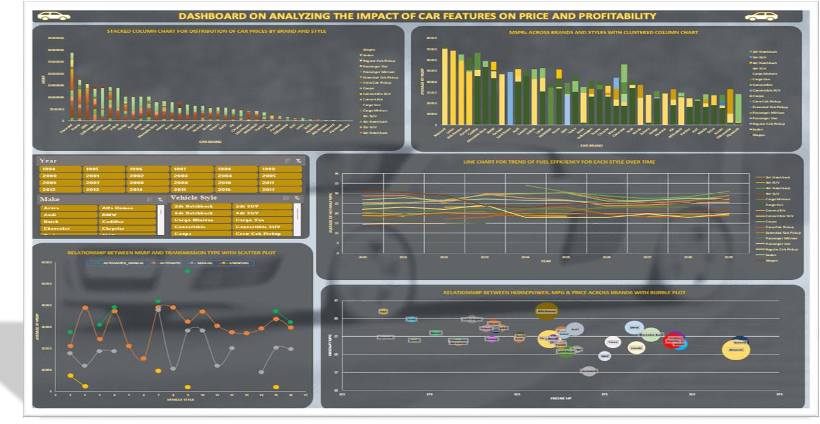

Slide 44

RESULT
CHEVROLET with 4dr SUV style contributes more for the CAR’s PRICE and GENESIS contributes less to the price.
The coupe body style has high average MSRP
A car with automated and manual has more advantages.
To see good profit, the company must enable good fuel efficiency and engine power.
Coupe body style, good fuel efficiency and great engine HP has a significant impact on the cost and probability of the car.

Slide 45

Thank You

