Slide 1
ABC CALL VOLUME TREND ANALYSIS
By,
Bharath G M
Data Analyst Intern at Trainity

Slide 2
Agenda
P r o je ct D e s c ri p t i o n
A p p r oa ch
T e ch - S t a ck U s e d
D at a U n d e rs t a n d i n g
D at a C l e a n i n g
D at a P r e p a ra t i on & An al y s is
I n s i g h t & R e su l t
L e ar n i n g
F i l e U R L ’ s

Slide 3

PROJECT DESCRIPTION

Slide 4
I n this p roj ec t, we’ l l be using our analytic al skills to
understand the trends in the c all vo lume of the CX team and derive valuable ins ig hts from i t.
I nbo und c us tomer s up port, whic h is the foc us of this
projec t, involves hand ling inc oming calls from ex is ting o r
pros pective c us tomers . The goal is to attrac t, engage,
and delight customers, turning them into loyal advocates fo r the b usines s. A dataset that sp ans 23 d ays of d ata.
Objective: The goal is to gain insights into call volume trends, determine average call durations, and propose effective manpower planning to reduce call abandon rates and improve customer satisfaction.

Slide 5









DATA UNDERSTANDING
(description, Assumptions)
DATA CLEANING
(using countblank, find and replace)
DATA ANALYSIS
(pivot table and formulas)
DATA VISUALIZATION
(With charts)

Slide 6


TECH- STACK USED

Slide 7
DATA UNDERSTANDING
TOTAL NO. OF ROWS: 1,17,988
TOTAL NO. OF COLUMNS: 13 TEXT COLUMNS: 6
NUMERIC & DATE COLUMNS: 7

Slide 8
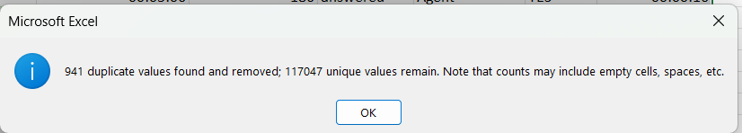
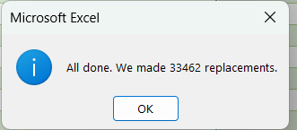
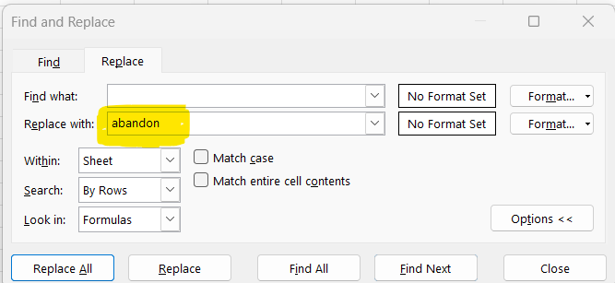
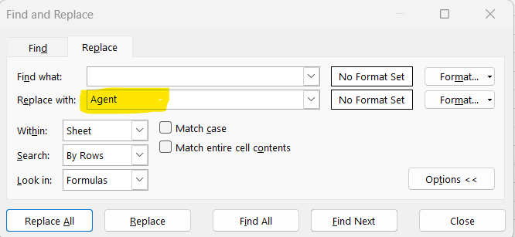
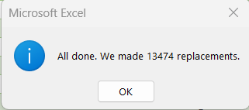
DATA CLEANING
94 1 Du pli ca tes were rem oved, 1 , 17 , 047 rows re mai n.
Wra pped_by colum n ha s 46 , 93 6 e mpty ce ll s
33 ,4 62 rows of Em pty val ues i n
Wra pped_by are repl aced wi th a bandon f or
those t hat cal l_ sta tus as A bandon
13 ,4 74 rows of rem ai ning em pty cel ls of Wra pped_by was repl aced wi th h ighe st Mode frequ ency i .e .., Age nt

Slide 9
DATA ANALYSIS

Slide 10
Avera ge Call Du ra tion : Det ermi ne the avera ge du rat ion of a ll i ncom ing call s recei ved by age nts. Thi s sh oul d be cal cu lat ed for e ach ti me bucket.
You r Task: Wh at i s the average dura tion of call s for ea ch ti me bucke t?
200
182
180
174
180
170
160
146
151
148
145
AVERAGE_OF_CALL(S)
140
The average call time is more
120
118
99
107
100
94
between 3pm to 7pm for
80
60
about 3 minutes, and least
40
20
between 9am – 11am
0
10_11 11_12 12_13 13_14 14_15 15_16 16_17 17_18 18_19 19_20 20_21
TIME_BUCKET
9_10

Slide 11
Call Volum e Analys is : Vis ualiz e the total numb er of c alls rec eived . This s hould be represented as a grap h or c hart s howing the number of c alls ag ainst time. Time should be represented in b uc kets ( e. g., 1 - 2 , 2- 3 , etc.).
Your Task: Can you create a chart or graph that s hows the number of c alls received in each time bucket?
NO. OF CALLS RECEIVED FOR EACH TIME BUCKET
We can notice more number
16000
14,444
14000 13,081
of calls are received between
12,562
NO. OF CALLS RECEIVED
12000
11,485
10,509
10am – 3pm and as time
10000
9,141
8,785
9,376
8,530
8000
7,235
6,444
goes on calls are reduced.
6000
5,455
4000
Hence should not schedule
2000
0
meetings or any other tasks
10_11 11_12 12_13 13_14 14_15 15_16 16_17 17_18 18_19 19_20 20_21
TIME_BUCKET
9_10
during these times.

Slide 12


Manpower Planning: Th e cu rr en t rate of a ba nd o ne d calls i s a pp r ox imate ly 3 0 % . Pr op o s e a p lan f or m an p owe r allo catio n d u rin g ea ch t im e b u ck et ( f ro m 9 am to 9 pm ) to r ed u ce th e ab an d on rate to 1 0 %. In o th er wo r ds , yo u n eed to calcu late th e min im um n u mb er o f ag en ts r eq uir ed in each t ime bu ck et to en s u re th at at le as t 9 0 ou t of 1 0 0 calls ar e a ns w er ed.
Your Task: Wh at i s th e min imu m n u mb er of a gen ts re qu i r ed in e ach t im e b u ck et to r ed u ce the ab an d on rate to 1 0 % ?
25
22
20
20
19
18
16
16
15
14
15
15
14
14
13
13
13
11
11
10
11
10
8
8
8
5
5
0
9_10
10_11
11_12
12_13 13_14 14_15
Count of Agents there for answering calls
15_16 16_17 17_18
Agents needed to reduce Abandon calls
18_19
19_20
20_21

Slide 13
ABANDON RATE
53% _{51%}
47%
40%
28%
24%
22%
23%
13%
13%
8%
9%
9_10
10_11
11_12
12_13
13_14
14_15 15_16
TIME_BUCKET
16_17
17_18
18_19
19_20
20_21
Abandon % is high during the beginning and end of the shifts.

Slide 14
Agent Working Hours per Day
Total Working Hours
9 hrs
Lunch time
1.5hrs
Actual working hours
7.5hrs
Agent time spent on call per day
Occupancy
60%
60% of actual working hours(7.5h)
4.5hrs
Working capacity in minutes(m)
270m
ASSUMPTIONS
In seconds
16200s
Agent Availabilty per month
Total days in month
30 days
An agent works for 6 day s a week;
Working days per week
6days
Total working days per month
24days
On av erage, each ag ent takes 4 unplanned leaves per month;
Average unplanned leaves
4 days
An agent' s total working hours are 9 hours, out of which 1 . 5 hours are spent on lunch and snacks in the off ice.
Effective working days
20 days
Average call handling capacity
On av erage, an agent spends 60 % of their total ac tual working hours ( i .e., 60 % of 7 .5 hours) on calls with custom ers/users.
Average Handling time for each call in seconds
140.65(s)
In minutes
2.34(m)
The total number of day s in a month i s 30 .
No. of calls that can be handled for 4.5 hours = Working Capacity(s)/Average
time of a call(s) (16200/140.6)
115 calls/day
Per hour of actual working hours
(115/4.5)
26 calls/hr

Slide 15
Each call’s average duration is about 2.3 minutes (141 s). A person can handle 115 calls per day. For each hour a person can handle 26 calls To calculate Total agents present to answer the calls for past 23 days | Time Bucket | Answered calls per day | Average call handling capacity per hour. | Total agents present | Total calls per day | Percentag e to achieve | 90% of total calls per day | Call Handling capacity | Agents needed to achieve 90% to answer and reduce abandon to 10%
with 30% abandon rate = | 9_10 | 192.5 | 25.6 | 8 | 407.7 | 90% | 366.9 | 26 | 14
Total answered call per day/average call handling capacity per hour. | 10_11 | 276.9 | 25.6 | 11 | 568.7 | 90% | 511.9 | 26 | 20
To calculate Total agents needed to reduce abandon percentage from | 11_12 | 372.2 | 25.6 | 15 | 628.0 | 90% | 565.2 | 26 | 22
 | 12_13 | 410.1 | 25.6 | 16 | 546.2 | 90% | 491.6 | 26 | 19
30% to 10%, Follow below steps | 13_14 | 383.9 | 25.6 | 15 | 499.3 | 90% | 449.4 | 26 | 18
100%- 10% = 90% (Hence we should attend 90% of calls received) | 14_15 | 346.7 | 25.6 | 14 | 456.9 | 90% | 411.2 | 26 | 16
Find the count of 90% on total calls per day for each time_bucket = 90% * | 15_16 | 337.4 | 25.6 | 13 | 397.4 | 90% | 357.7 | 26 | 14
Total calls per day. | 16_17 | 341.4 | 25.6 | 13 | 382.0 | 90% | 343.8 | 26 | 13
 | 17_18 | 330.5 | 25.6 | 13 | 370.9 | 90% | 333.8 | 26 | 13
Calculate Agents needed = 90% of calls per day/ call handling capacity of | 18_19 | 269.6 | 25.6 | 11 | 314.6 | 90% | 283.1 | 26 | 11
an agent. | 19_20 | 199.0 | 25.6 | 8 | 280.2 | 90% | 252.2 | 26 | 10
 | 20_21 | 124.8 | 25.6 | 5 | 237.2 | 90% | 213.5 | 26 | 8

Slide 16
N i g ht Sh i f t Man p owe r Pl an n i ng : C u s tom ers als o ca l l A B C I n s ur an ce C omp an y at n ig h t b u t d on ' t g et a n an s we r be cau s e the re
ar e n o ag en ts availa ble. Th i s cr eate s a p oo r cu s tom er ex p erie nc e. A s s u me tha t f or ever y 1 0 0 c alls th a t cu s to mer s m ak e
b etwee n 9 a m an d 9 p m, the y als o m ak e 3 0 calls at n igh t betw een 9 p m a n d 9 a m. Th e dis tr ib u t ion o f th es e 3 0 calls i s a s fo l low s .
You r Tas k: P ro po s e a m an p owe r pla n fo r ea ch t ime b u cke t th r ou g ho u t th e da y, k eep in g th e m ax imu m ab an d on r ate at 1 0 %.
ASSUMPTIONS :
Totat 90% of calls calls received to be answered are = 4580 calls per day (today9am –next day 9am).
30 % of 4,580 calls are during Night = 4580 * 30% = 1,374 calls
A total of 90% of calls received were answered | 4580.1
30% of them are | 1374.03

Slide 17
































TIME_BUCKET | DISTRIBUTION OF CALLS | Percentage share of 30 calls | Calls received at night | Manpower needed at night | Total agents needed for entire day | Total agents at morning shift
9_10 | 3 | 10% | 137.403 | 5 | 14 | 9
10_11 | 3 | 10% | 137.403 | 5 | 20 | 15
11_12 | 2 | 7% | 91.602 | 4 | 22 | 19
12_1 | 2 | 7% | 91.602 | 4 | 19 | 16
1_2 | 1 | 3% | 45.801 | 2 | 18 | 16
2_3 | 1 | 3% | 45.801 | 2 | 16 | 14
3_4 | 1 | 3% | 45.801 | 2 | 14 | 12
4_5 | 1 | 3% | 45.801 | 2 | 13 | 12
5_6 | 3 | 10% | 137.403 | 5 | 13 | 8
6_7 | 4 | 13% | 183.204 | 7 | 11 | 4
7_8 | 4 | 13% | 183.204 | 7 | 10 | 3
8_9 | 5 | 17% | 229.005 | 9 | 8 | -1
25
Night Shift Manpower (9pm - 9am)
22
20
Total Manpower for the day
Morning Shift Manpower (9am - 9pm)
20
19
19
18
16
15
16
16
14
NO. OF AGENTS
14
15
14
12
13
12
13
10
11
9
10
7
9₈
8
5
7
4
5
5
5
4
4
3
2 2 2
1_2 2_3 3_4
TIME_BUCKET
2
0
-1
8_9
9_10
10_11
11_12
12_1
4_5
5_6
6_7
7_8
-5

Slide 18
INSIGHTS & RESULT
Since Abandon Rate i s high at the beginning and end of shifts need to concentrate
on increasing agents during these time to reduce the abandon rate.
Any engagement activities should not be performed between 9am – 4pm as there is much traffic during these hours and also we can observe we have enough
agents post 4pm to answer the calls as traffic i s less.

Slide 19
LEARNING
Skills :
Problem-solving
Planning the Manpower with EXCEL

Slide 20
THANK YOU

