Slide 1
A DEMONSTRATION OF TEXT INPUT AND VALIDATION WITH ANDRIOD COMPOSE
A PROJECT REPORT
Submitted by
HARILAKSHMINARAYANA R - 812022104029
BHARATH K - 802022104015
ASWIN RISHAL K - 812022104013
KALAI KUMAR PM - 812022104032
COMPUTER SCIENCE AND ENGINEERING
M.A.M. COLLEGE OF ENGINEERING AND TECHNOLOGY, TRICHY
ANNA UNIVERSITY : CHENNAI 600 025
NOVEMBER 2024

Slide 2
Description :
“ Text Validator “ is a simple Android app show casing text input and validation using jetpack compose .
This app Features ,
User Input fields for name , email and password.
2. Real Time input validation for email and password.
Error message displayed below each field .
4. “Submit “ button enabled only when all fields are valid.

Slide 3
Introduction :
Text input and validation are crucial components of any mobile application, ensuring data integrity and enhancing user experience. This project leverages Android Compose, a modern toolkit for building native Android UI, to achieve these goals.
Objectives :
• To demonstrate the use of text input components in Android Compose.
• To implement effective validation mechanisms.
• To enhance user experience through responsive UI design.

Slide 4
Project code :
import android.os.Bundle
import android.widget.Toast
import androidx.activity.ComponentActivity
import androidx.activity.compose.setContent
import androidx.compose.foundation.layout.*
import androidx.compose.material.*
import androidx.compose.runtime.Composable
import androidx.compose.runtime.mutableStateOf
import androidx.compose.runtime.remember
import androidx.compose.ui.Alignment
import androidx.compose.ui.Modifier
import androidx.compose.ui.graphics.Color
import androidx.compose.ui.platform.LocalContext
import androidx.compose.ui.tooling.preview.Preview
import androidx.compose.ui.unit.dp
class MainActivity : ComponentActivity() {
override fun onCreate(savedInstanceState: Bundle?) {
super.onCreate(savedInstanceState)
setContent {
// Calling the composable function
// to display element and its contents
MainContent()
}
}
}

Slide 5
// Creating a composable
// function to display Top Bar
@Composable
fun MainContent() {
Scaffold(
topBar = { TopAppBar(title = { Text("GFG | Validation", color = Color.White) }, backgroundColor = Color(0xff0f9d58)) },
content = { MyContent() }
)
}
// Creating a composable function
// to create two TextFields
// Calling this function as content
// in the above function
@Composable
fun MyContent(){
// fetching local context
val mContext = LocalContext.current
Column(
Modifier
.fillMaxSize()
.padding(20.dp), horizontalAlignment = Alignment.CenterHorizontally, verticalArrangement = Arrangement.Center) {
// Declaring two string values
// for storing username and password
val mUsername = remember { mutableStateOf("") }
val mPassword = remember { mutableStateOf("") }
// Creating two outlined text fields for
// fetching username and password from the user
OutlinedTextField(
value = mUsername.value,
onValueChange = { mUsername.value = it },
label = { Text(text = "Username") },
modifier = Modifier.fillMaxWidth()
)

Slide 6
OutlinedTextField(
value = mPassword.value,
onValueChange = { mPassword.value = it },
label = { Text(text = "Password") },
modifier = Modifier.fillMaxWidth()
)
// Adding a Spacer
Spacer(modifier = Modifier.height(100.dp))
// Button onclick would check
// for the below conditions
Button(onClick = {
if(mUsername.value.isEmpty() and mPassword.value.isNotEmpty()){
Toast.makeText(mContext, "Username is Empty", Toast.LENGTH_SHORT).show()
}
if (mPassword.value.isEmpty() and mUsername.value.isNotEmpty()){
Toast.makeText(mContext, "Password is Empty", Toast.LENGTH_SHORT).show()
}
if(mUsername.value.isEmpty() and mPassword.value.isEmpty()){
Toast.makeText(mContext, "Username and Password are Empty", Toast.LENGTH_SHORT).show()
}
if(mUsername.value.isNotEmpty() and mPassword.value.isNotEmpty()){
Toast.makeText(mContext, "Successfully Validated", Toast.LENGTH_SHORT).show()
}
},
colors = ButtonDefaults.buttonColors(backgroundColor = Color(0XFF0F9D58)),
) {
Text("Next", color = Color.White)
}
}
}
// For displaying preview in
// the Android Studio IDE emulator
@Preview(showBackground = true)
@Composable
fun DefaultPreview() {
MainContent()
}

Slide 7
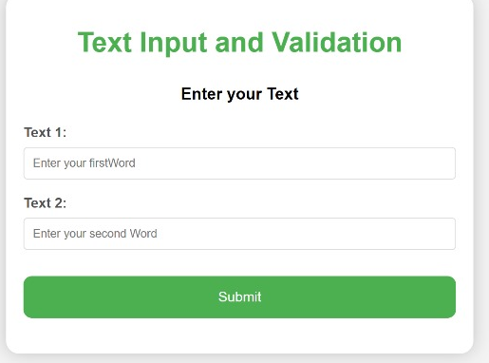
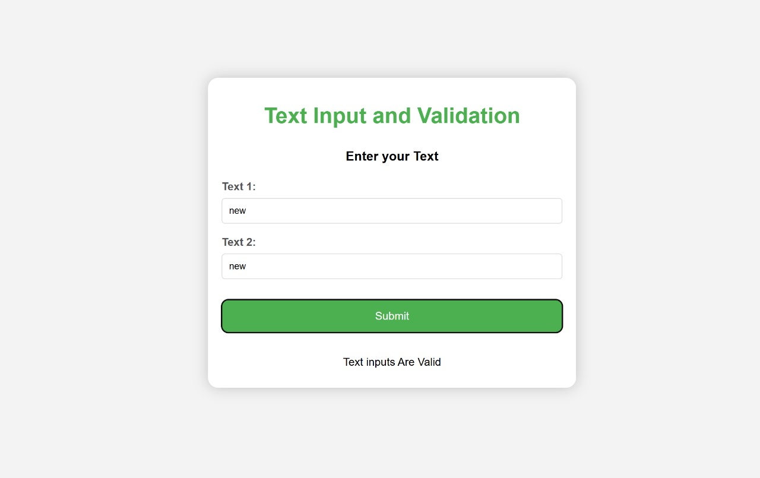
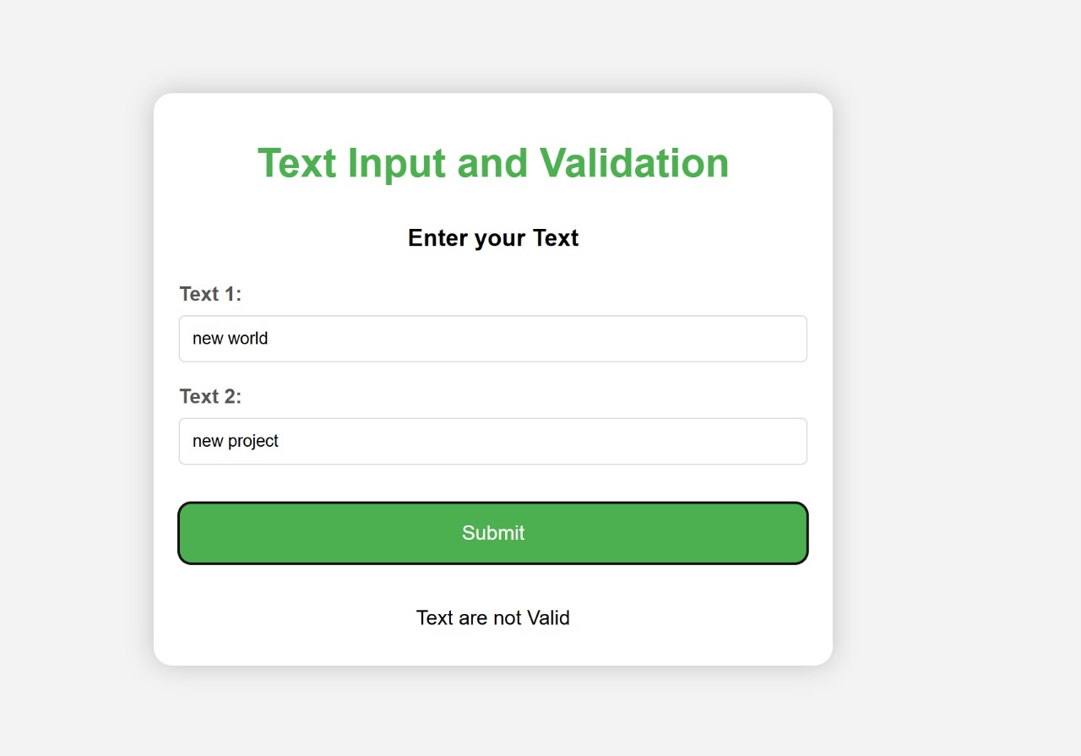
Output :

Slide 8
Conclusion :
This project successfully developed an Android app demonstrating text input validation using Jetpack Compose. The app validates user input for name, email, and password fields, displaying error messages for invalid inputs. Key features include real-time input validation, secure password input, and a user-friendly interface.

