Slide 1

COURSE NAME : APPLIED MACHINE LEARNING FOR TEXT ANALYSIS COURSE CODE : 24ALT3101
ML-Based Personalized Nutrition Recommendation System

Slide 2
Team Members :
2420030380 | M. Bharath
2420030263 | K. Abhinav

Slide 3
Problem Statement
Generic diet plans ignore individual biology — age, BMI, biomarkers (glucose, HbA1c), and medical conditions.
Existing academic models predict calories/macros but rarely turn predictions into real, verified meal plans.
LLM-based meal generators can produce nutrition claims not grounded in real food data.
Recommendation quality (relevance, ranking) is almost never formally evaluated in prior work.

Slide 4
Objectives
To develop a predictive model that estimates personalized calorie and macronutrient needs using NHANES health data.
To design a stronger ensemble prediction model by combining LightGBM, XGBoost, and Random Forest.
To develop a medical safety mechanism that enforces biomarker-based constraints (HbA1c, glucose) on recommendations.
To design an explainability module using SHAP that justifies every recommendation made by the system.

Slide 5
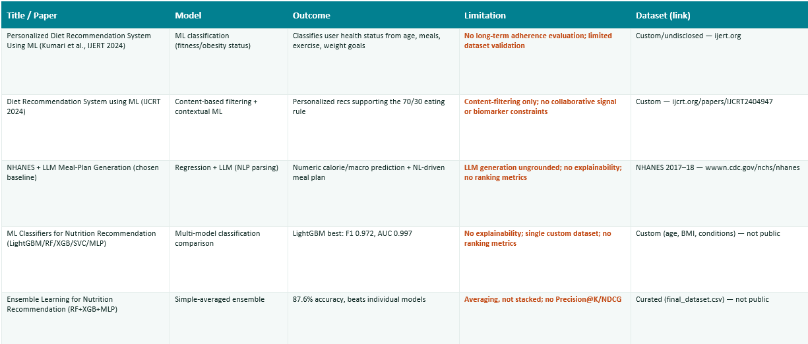
Literature Survey

Slide 6
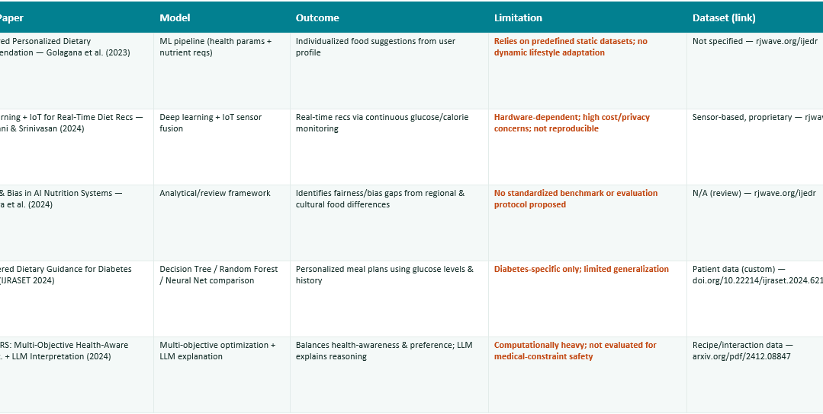

Slide 7
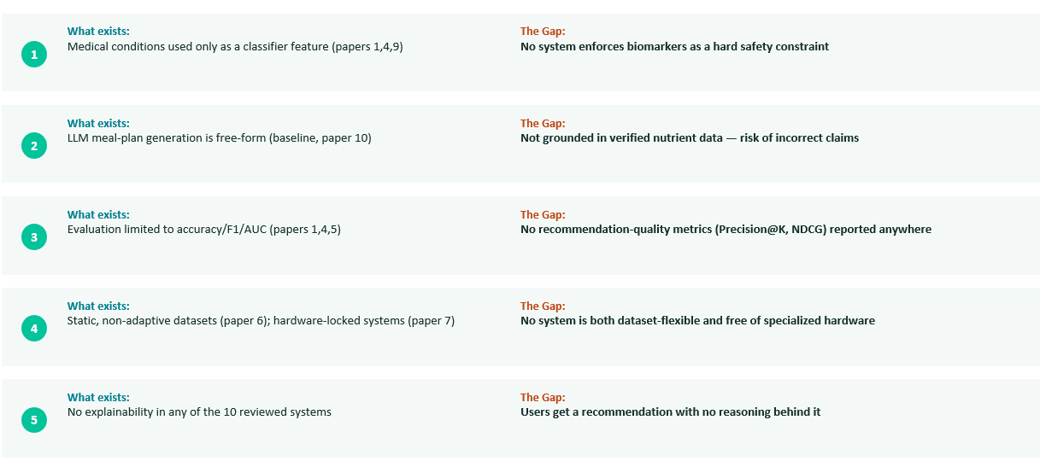
Research Gap

Slide 8
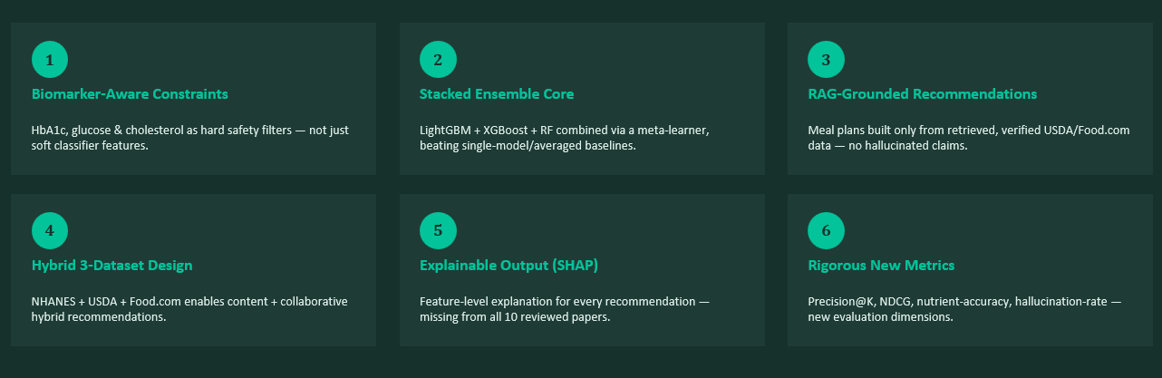
Innovation, Creativity & Novelty

Slide 9
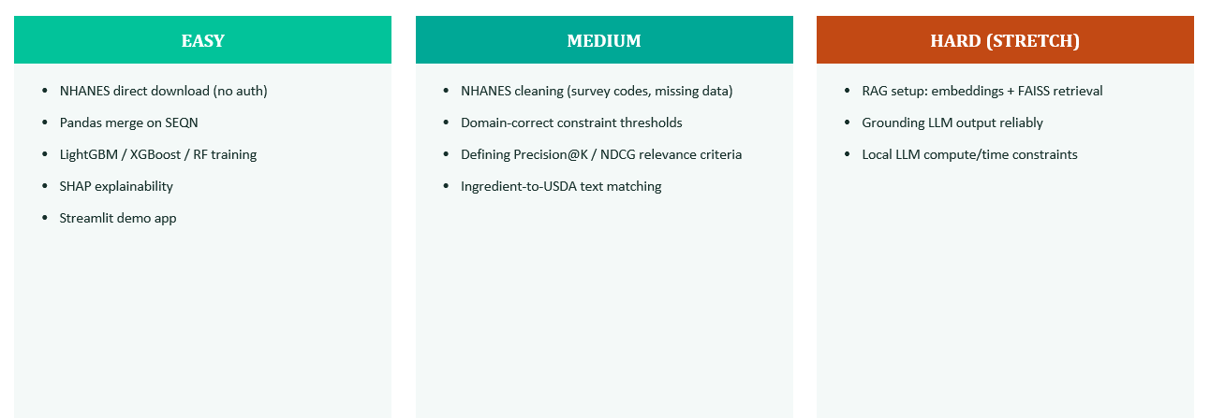
Feasibility Analysis

Slide 10
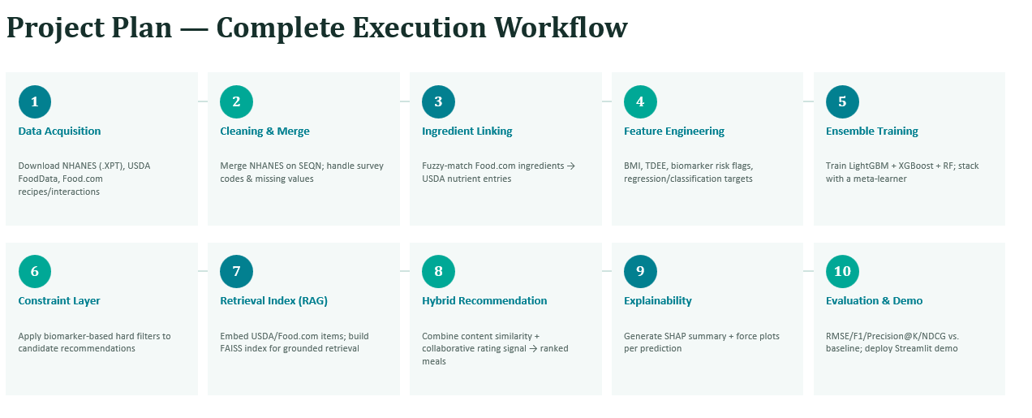

Slide 11
THANK YOU

