Slide 1


Granules India Limited
Investor Presentation
August 2023

Slide 2
Safe harbour
The Presentation is to provide the general background information about the Company’s activities as at the date of the Presentation. The information contained herein is for general information purposes only and based on estimates and should not be considered as a recommendation that any investor should subscribe / purchase the company shares. The Company makes no representation or warranty, express or implied, as to, and does not accept any responsibility or liability with respect to, the fairness, accuracy, completeness or correctness of any information contained herein.
This presentation may include certain “forward looking statements”. These statements are based on current expectations, forecasts and assumptions that are subject to risks and uncertainties which could cause actual outcomes and results to differ materially from these statements. Important factors that could cause actual results to differ materially from our expectations include, amongst others general economic and business conditions in India, ability to successfully implement our strategy, our research and development efforts, our growth and expansion plans and technological changes, changes in the value of the Rupee and other currencies, changes in the Indian and international interest rates, change in laws and regulations that apply to the Indian and global pharmaceuticals industries, increasing competition, changes in political conditions in India or any other country and changes in the foreign exchange control regulations in India. Neither the company, nor its directors and any of the affiliates or employee have any obligation to update or otherwise revise any forward-looking statements. The readers may use their own judgment and are advised to make their own calculations before deciding on any matter based on the information given herein.
No part of this presentation may be reproduced, quoted or circulated without prior written approval from Granules India Limited.

Slide 3

Company overview
About Us
Granules India is a vertically integrated, high-growth pharmaceutical company with 38 years of proven performance and increasing presence across the world. Headquartered in Hyderabad, India, Granules offers collaborative and strategic partnership to global pharmaceutical leaders by producing best quality API, PFI and FD through manufacturing excellence, process innovation and regulatory expertise
Business Verticals
Global Reach
Top 5 products
Vertically integrated across value chain
80+ countries
300+ customers
60+ ANDA filings
Paracetamol
Metformin
Ibuprofen
Guaifenesin
Methocarbamol
Establishment in 1984
R&D
Manufacturing Base
Installed Capacity
Regulatory Approvals
People Strength
Inaugurated a new 20,000 sqft state of the art R&D facility at Genome Valley with more than 170 scientists across both divisions
8 facilities; 6 in India, 2 in US (1 is packing unit)
One of the world’s largest paracetamol API facilities
World’s largest PFI facility
One of the largest single-site FD facilities
39,360 TPA of API
24,640 TPA of PFI
28.3 Bn dosages of FD
USFDA, EDQM, EU GMP, COFEPRIS, WHO GMP, TGA, KFDA, DEA, MCC, HALAL
5,000+ people
90+ people at GPI, Chantilly, USA

Slide 4

Our journey so far..
Expanding into complex generics + Strengthening market penetration in regulated markets
Global footprint, Established dominance in Core APIs + PFIs, Entered Finished dosages space
Moving towards complex technology
Formative years with focus on APIs
1984
1990
1991
1993
1995
2001
2002
2003
2005
2008
2010
2013
2014
2014
2015
2016
2019
2021
2022
2022
2023
Established first PFI facility at Jeedimetla
Listed on
the BSE
Entered the Finished dosage segment
Acquired API manufacturing facility in Vizag to further strengthen the API portfolio
Laid down the foundation for its Oncology API and OSD Plant in Vizag
Acquired Sajjla
Bio Labs to augment Biotechnology R&D
Setup GPAK, a 79,000 sqft packaging facility in the US
Incorporated
Granules India
Private Limited
Merger of Triton with Granules
New Paracetamol plant at Bonthapally
Established 15,000 sqft R&D facility in Hyderabad
Entered OTC business in US through Granules Consumer Healthcare
Setup the largest single manufacturing site for MUPS facility
Opened 2nd API facility in Jeedimetla
Listed on the Hyderabad Stock Exchange
Granules formed as Triton Labs to produce Paracetamol API at Bonthapally
Set up a large-volume
PFI facility in Gagillapur
and a wholly owned
subsidiary - Granules
USA for marketing in
the US
Received USFDA approval for its first ANDA
Incorporated Granules Pharmaceutical Inc in the US to focus on formulations in the US
Completed share buy-back worth Rs.311 Cr (including taxes and transaction cost)
Commenced sale of Rx Products in the US under the GPI Label

Slide 5
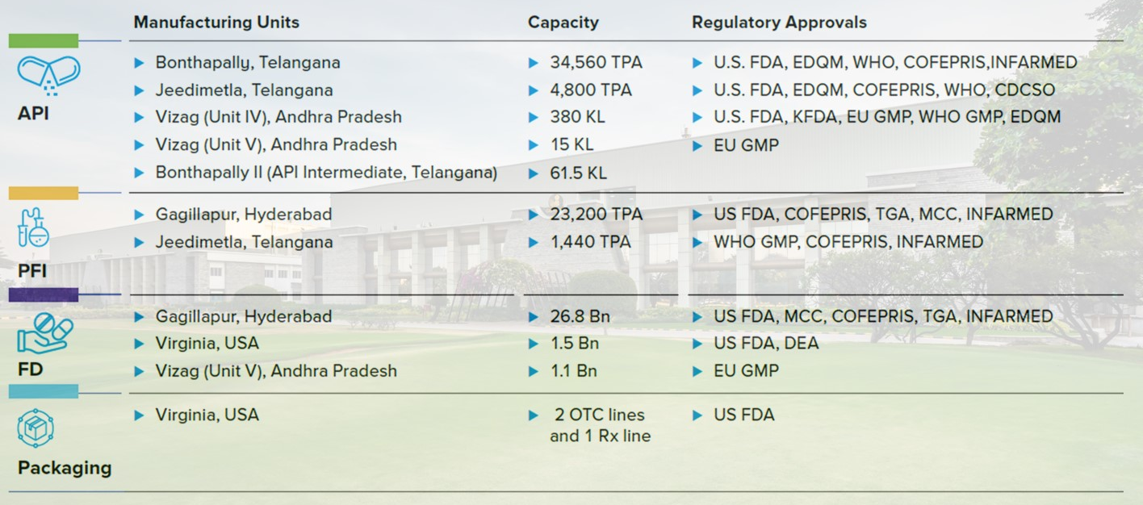
Our manufacturing footprint

Slide 6
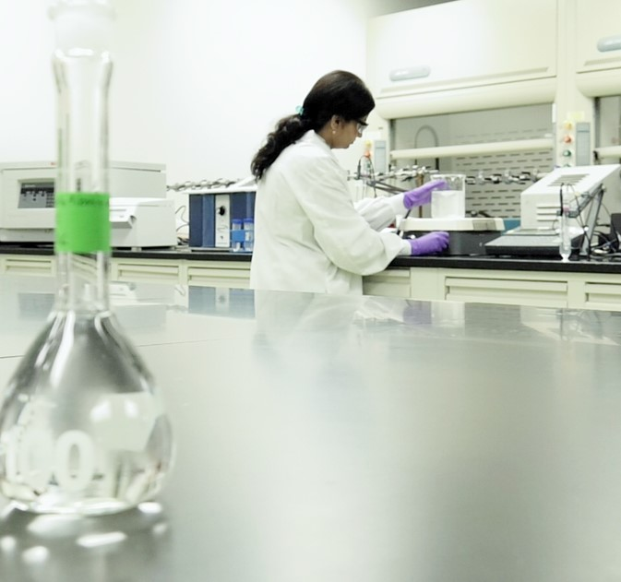
R&D Capabilities
Strengthened headcount to ̴ 300 across spectrum of R&D centers with complementary capabilities
Integrated Product Development
Genome Valley – MN Park
R&D facility for Integrated Product Development
̴ 170 scientists across API & FD R&D
Fast tracking product development through seamless coordination & shared analytical resource
Controlled Substances
New Technologies
Pragathi Nagar R&D
CoE for CII API Development
Select KSMs
GPI R&D
CII Finished Dosage
Complex technologies FD
Bio Lab at Pragathi Nagar
Enzyme & Fermentation
Pune R&D
New technologies
KSM & Backward Integration

Slide 7
Our Geographic footprint: Revenue share (FY23)
North America
58%
Europe
23%
India
6%
Latin America
8%
RoW
6%

Slide 8










Our Leadership team: Management Committee
C Krishna Prasad
Chairman and Managing Director
Dr. K.V.S. Ram Rao
Joint Managing Director & Chief Executive Officer
Uma Devi Chigurupati
Executive Director
Priyanka Chigurupati
Executive Director of GPI and GUSA
Harsha Chigurupati
Executive Director
Mukesh Surana
Chief Financial Officer
Uma Rao G
Chief Human Resources Officer
PV Srinivas
Chief Technology Officer
Anil Arora
President - Formulation Operations
Sanjay Kumar
Senior Vice President – Corporate Strategy & Planning

Slide 9
Our Business structure
Granules India Ltd
(GIL)
(100%)
Granules USA
(GUSA)
Granules Pharmaceuticals Inc (GPI)
Granules Europe Ltd (GEL)
Granules Lifescience Pvt. Ltd
Granules CZRO
(100%)
Granules Consumer Health
(GCH)
GIL: Parent company with presence across the entire pharmaceutical manufacturing value chain from API to finished dosages
GUSA: B2B Marketing & Distribution arm for APIs, PFIs and OTC FDs from GIL in the US
GCH: Focused on marketing private-label OTC drugs to retailers in the US. Also, built a packing facility (GPAK) for Rx, OTC and Controlled substances for internal use as well as contract packing services
GPI: R&D, manufacturing and front-end division for marketing of Rx products including controlled substances in the US
GEL: B2B Marketing & Distribution arm for APIs, PFIs and FDs from GIL in Europe
GLPL: Created for commissioning new plants in India (applicable for favourable tax regime with lower income tax rate)
GCZRO: Created to establish Integrated Green Pharmaceutical Zone in Kakinada to manufacture products with zero carbon footprint

Slide 10
Strategic Priorities and Organizational Transformation

Slide 11
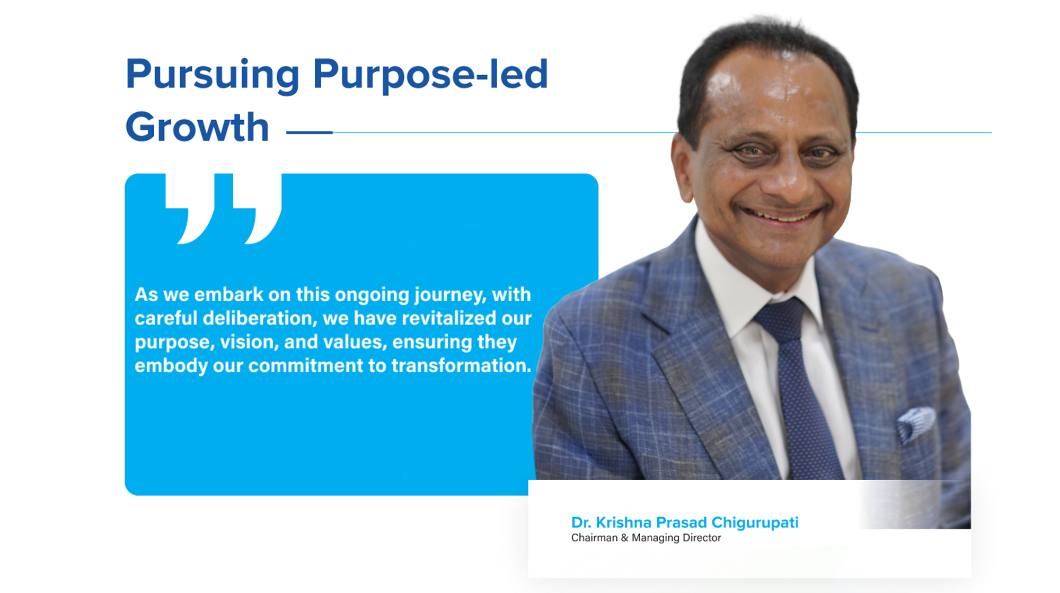

Slide 12
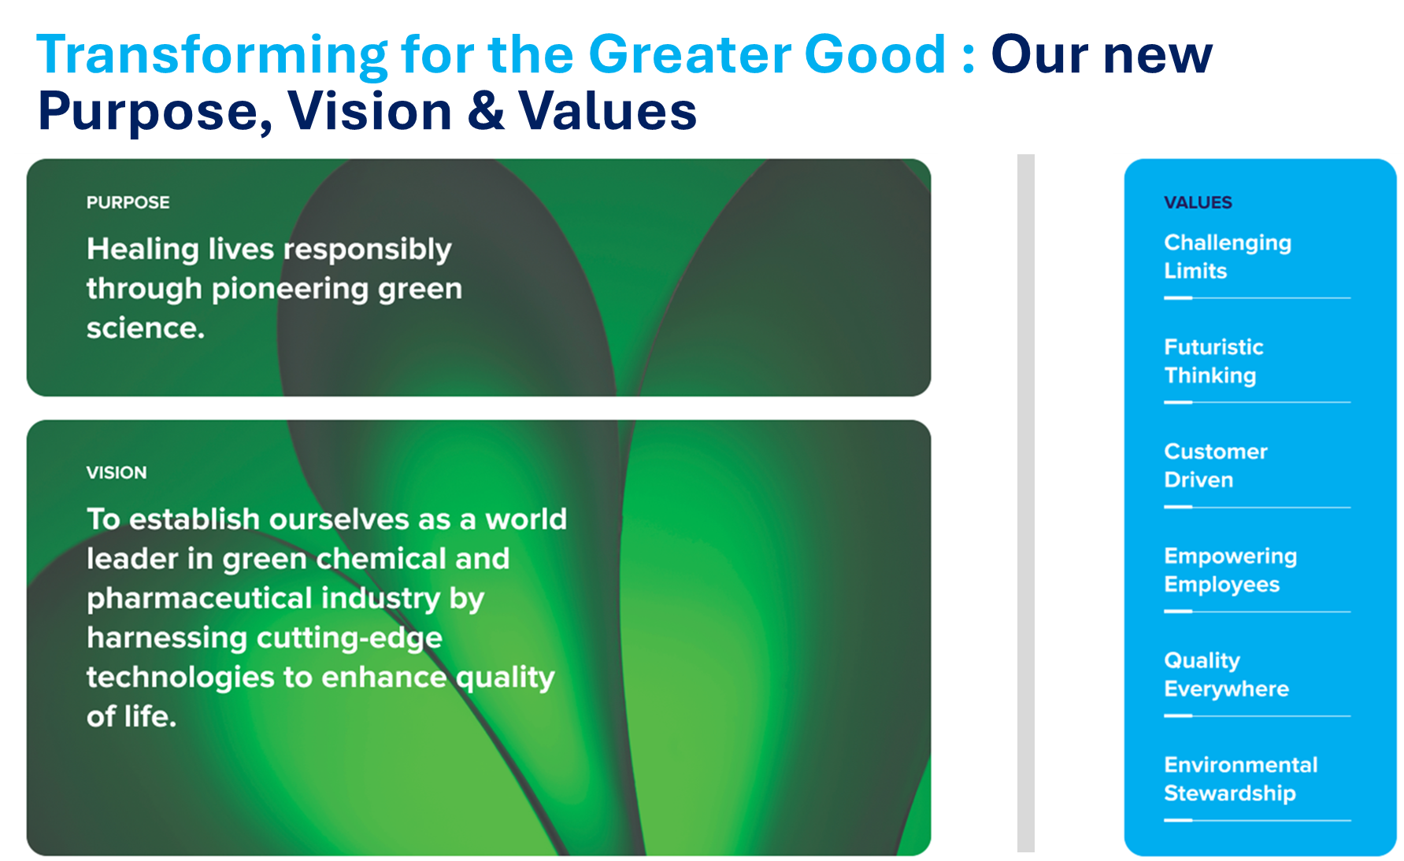

Slide 13
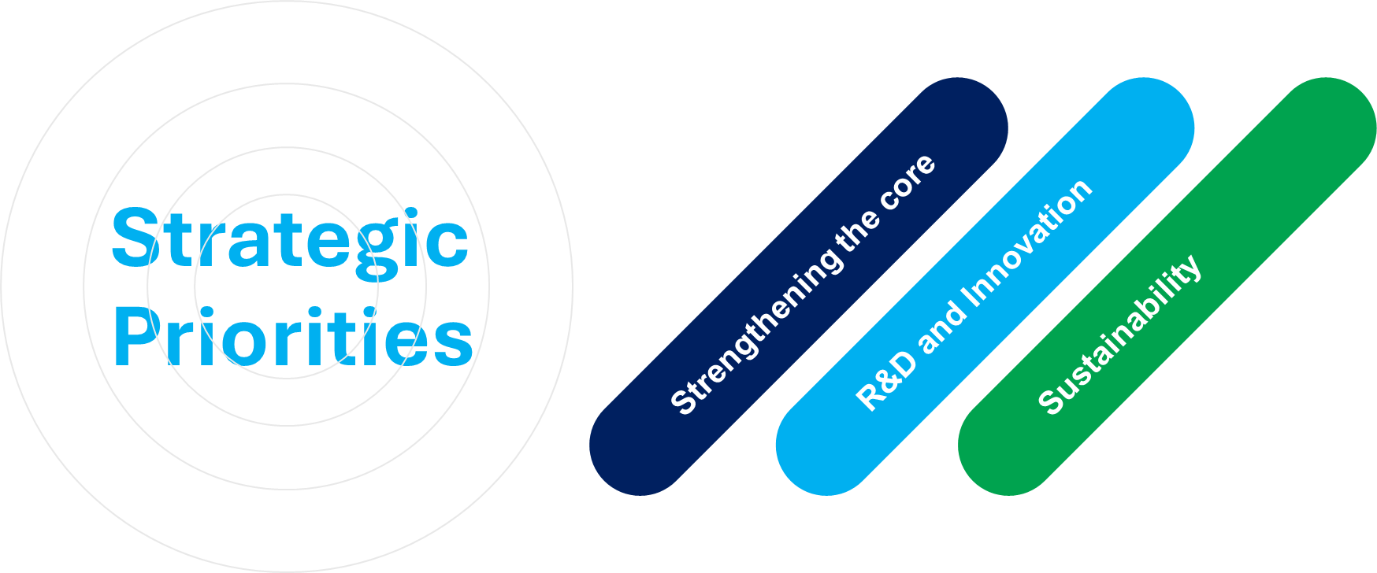

Slide 14
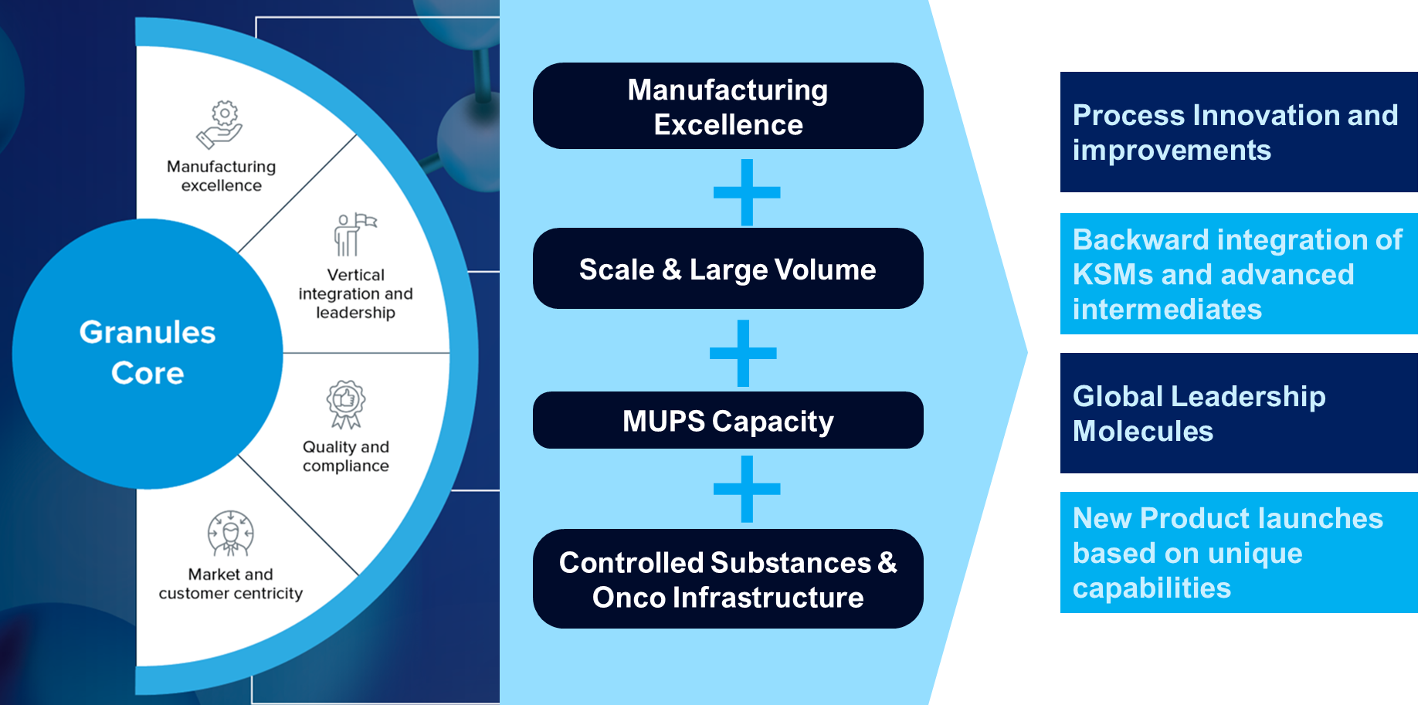
Strengthening the core: Building & sustaining our competitive advantage

Slide 15
R&D and Innovation: Becoming an innovation and science-led enterprise
Enzyme & Bio Transformation
Flow Technology Platform
Green Score in R&D Development
Eco friendly substitute to metallo-catalysis
Excellence in identified chemistries
Implementation of Green card and Eco scale initiatives. From the early stages of development
Efficient Heat/Mass transfer
Mild Reaction Conditions
Green Chemistry Matrix
Greater Selectivity
Safer & Lean Operations
Atom Economy
Atom efficiency
Better Control over Process
E-factor
Simplified Work Streams
Simplified Processing & Purification
Faster Reactions & Smaller Lead Time
Eco-Scale for process efficiency
Capital Efficiency - Higher Asset
Turn
Fewer byproducts
6 parameters & 38 sub-parameters at every stage of the reaction
Improved Productivity
Sustainable & Lower Carbon Footprint
Yield
Safety
Effluent
Input/ RM Cost
Operations Parameters
Infrastructure considerations

Slide 16
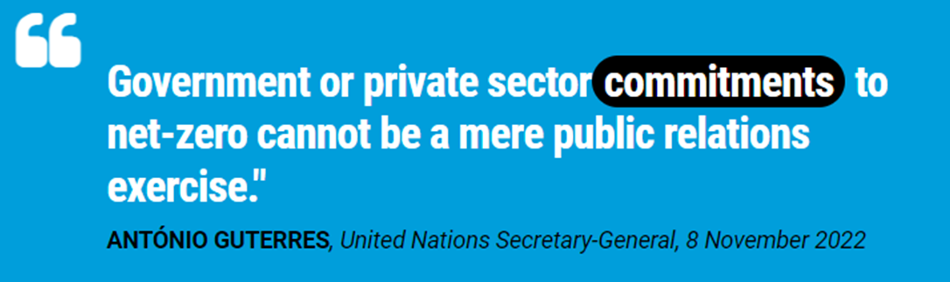
Sustainability & Response to Climate Change
An area of emerging opportunities
From Vision to Action
Industries need to Lead the Way in Sustainable Supply Chains and Green-Tech

Slide 17
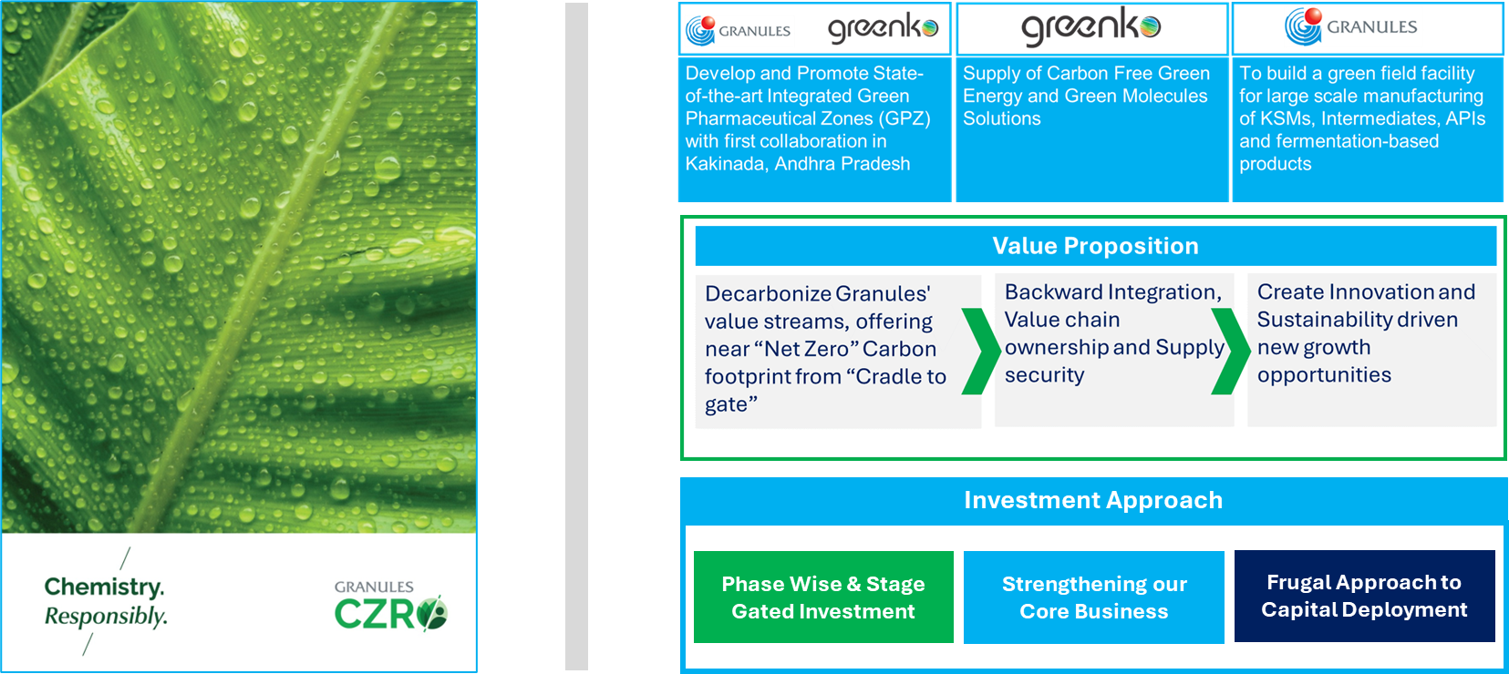
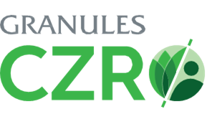
Sustainability Redefined: Innovating for a Greener Future
* Granules CZRO is the wholly owned subsidiary of Granules

Slide 18
Financial information

Slide 19
Financial highlights: Revenue and profitability
FY23
FY22
Y-o-Y Gr%
(In ₹ Mn)
Revenue
45,119
37,649
20%
Value Added
22,046
18,813
17%
Value Added %
48.9%
50.0%
EBITDA
9,138
7,222
27%
EBITDA %
20.3%
19.2%
PAT
5,166
4,128
25%
PAT %
11.4%
11.0%

Slide 20
Financial highlights: Cashflow and ratios
(In ₹ Mn)
FY23
FY22
FY23
FY22
FY23
FY22
ROCE%
21.1%
19.3%
Fixed asset turn
2.06
2.02
Net debt/ EBITDA
0.84x
0.97x
ROCE = Annualised EBIT / Average capital employed Capital employed = Equity + Total Borrowings + LT liabilities - Cash
Fixed asset turn = Annualised Sales / Average Tangible Gross block
Net debt = Gross debt – Cash and cash equivalents
FY23
FY22
FY23
FY22
FY23
FY22
CCC
132
138
Operating Cashflow
7,387
3,321
Capex
4,105
3,967
CCC = DIO + DSO - DPO
DIO and DPO are calculated using Material Cost consumed and DSO is calculated using Sales

Slide 21
Financial highlights: Revenue split
Region wise share
Division wise share
(In ₹ Mn)
FY23
FY22
Y-o-Y Gr%
FY23
FY22
Y-o-Y Gr%
USA
23,780
18,251
30%
API
13,414
9,751
38%
Canada
2,099
1,290
63%
PFI
9,021
8,456
7%
Europe
10,210
7,902
29%
FD
22,684
19,442
17%
LATAM
3,443
3,811
(10%)
India
2,895
4,415
(34%)
ROW
2,691
1,979
36%

Slide 22
Last 5 years performance: Sales and profitability
(In ₹ Mn)
Sales: 5yr CAGR: 22%
VA and VA%: 5yr CAGR: 23%
EBITDA and EBITDA%: 5yr CAGR: 27%
PAT and PAT%: 5yr CAGR: 31%

Slide 23
Last 5 years performance: Cashflow and ratios
(In ₹ Mn)
ROCE%
Asset turns
Net debt and Net debt/EBITDA
Cash to Cash cycle
Operating Cash flow
Capex

Slide 24
ANDA and Dossier Filing status
Filing Status | GPI IP | GIL IP |  |  |  |  |  | Total
 | USA | USA | Europe | Canada | South Africa | UK | Others | Total
Approved | 24 | 57 | 5 | 6 | - | 3 | 1 | 72
Tentatively Approved | 1 | 2 | - | - | - | - | - | 2
To be approved | 5 | 12 | 3 | 1 | 6 | - | 3 | 25
Total Products | 30 | 71 | 8 | 7 | 6 | 3 | 4 | 99

Slide 25






Mr. Puneet Varshney
GM Business Finance and Head Investor Relations
Email: puneet.varshney@granulesindia.com
www.granulesindia.com
Ms. Payal Dave
payal.dave@linkintime.co.in
Mr. Irfan Raeen
+91 97737 78669
Irfan.raeen@linkintime.co.in
www.orientcap.com
532482
GRANULES
Corporate address:
Floor 2 Block 3 My Home Hub Madhapur Hyderabad 500081
CIN: L24110TG1991PLC012471
Voice: +91 40 69043600
www.granulesindia.com
GRAN:IN
GRAN:NS

