Slide 1
API Façade Pattern with Apache Synapse
Hiranya Jayathilaka
hiranya@apache.org

Slide 2

Apache Synapse
A lightweight, open source Enterprise Service Bus (ESB)
Visit http://synapse.apache.org
Connect and integrate heterogeneous systems

Slide 3
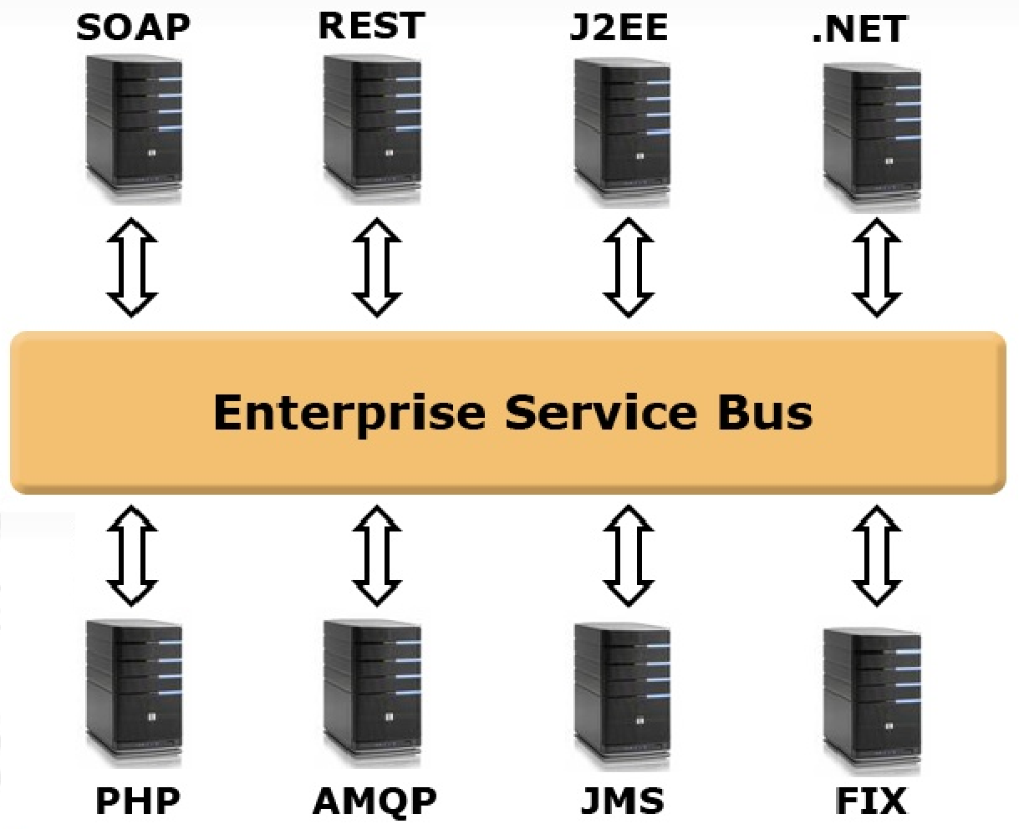
What is an ESB?

Slide 4
Key Features of Synapse
Message routing
Message filtering
Message transformation
Message enrichment
Protocol switching
Load balancing
Fail-over routing
QoS enforcement
Service virtualization
Traffic throttling
Task scheduling

Slide 5
Supported Protocol/Standards
Communication protocols (Transports)
HTTP/S, E-Mail (POP/IMAP), JMS, AMQP, FIX, FTP and other file transfer protocols, Raw TCP and UDP and more…
Message formats (Content exchange formats)
XML, SOAP, JSON, HTML, Plain text, Hessian, HL7, Various binary formats and more…
Other
JDBC/SQL, WSDL and other WS-* standards, REST, SNMP, JMX

Slide 6
Synapse Messaging Model
Several types of configurable and composable constructs
Mediators
Sequences
Proxy Services
APIs
Endpoints
Templates
Message stores and processors

Slide 7
Mediators
Smallest configurable message processing unit in Synapse
Synapse ships with a wide range of built-in mediators
Mediator
Input Message
Output Message
Config

Slide 8
Sequences
An ordered list of mediators
Provides the “message flow” abstraction
Log Mediator
Header Mediator
Send Mediator

Slide 9
APIs/Proxy Services
Connects a client application to a backend service
Comprised of several sequences
In sequence – Processes requests from client
Out sequence – Processes responses from the service
Fault sequence – Handles errors
API/Proxy Service
In Sequence
Client Application
Backend Service
Out Sequence

Slide 10
Synapse Configuration
XML-based metalanguage
Simple and intuitive – Protocol and message format agnostic programming model
Supports the familiar constructs of a programming language
If-Then, Switch-Case, Try-Catch
Reusable function-like constructs
Hot deploy and hot update

Slide 11
API Façade Pattern
Expose a non-RESTful application through a REST API
Example use cases
Expose a SOAP service as a RESTful service
Expose a database as a service
Expose a legacy system as a service

Slide 12
Demo
Synapse/ESB
REST Client
SOAP Service

Slide 13
Questions?

Slide 14
References
Apache Synapse – http://synapse.apache.org
WSO2 ESB - http://wso2.com/products/enterprise-service-bus/
Demo artifacts - https://github.com/hiranya911/rest-gateway-demo
Demo documentation - https://rest-gateway-demo.readthedocs.org/en/latest/
API façade pattern - http://asanka.abeysinghe.org/2013/04/pragmatic-approach-to-api-facade-pattern.html

