Slide 1

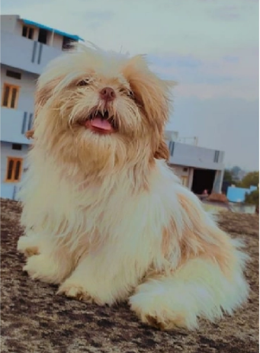
PAWfect Care Platform
S.Bharath Reddy 1602-21-737-144
S.Saipraneetha 1602-21-737-170
A.Hasitha 1602-21-737-315

Slide 2

Problem Statement:
Pet care involves various tasks, pet parents often find difficulties in finding reliable help for pet care and also understanding the specific needs of different breeds.
However finding reliable resources and services for these tasks can be challenging and time-consuming for pet owners.

Slide 3
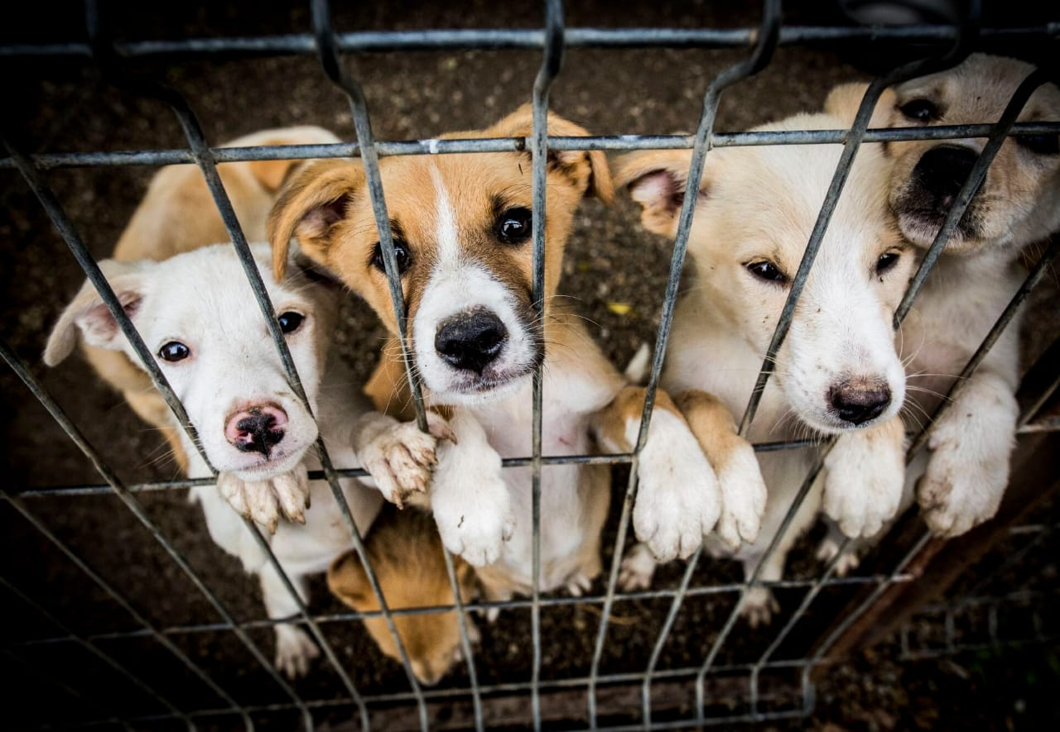
Motivation:
Pets are cherished members of many households, but ensuring their well-being requires access to essential services and resources. Additionally, understanding a pet's breed is crucial for tailoring care and addressing specific needs. We aim to empower pet owners to provide the best possible care for their beloved companions

Slide 4

Abstract:
Our pet care website offers a one-stop solution for pet owners, providing easy access to essential services and resources. With features such as pet adoption, grooming center locators, collaborations with local pet sellers, scheduling veterinary appointments, and a breed recognition chatbot.
Our goal is to enhance the pet care experience by optimizing every step, from ensuring pets receive top-notch care and attention while making the entire process convenient and enjoyable for their owners.

Slide 5
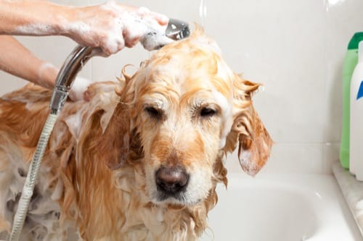

Features:
Adoption Assistance: Facilitate pet adoption by connecting users with shelters, rescue organizations, and individual pet owners.
Grooming Services: Provide resources, tips, and access to professional groomers for pet hygiene and grooming needs.
Veterinary Care Directory: Maintain a database of trusted veterinarians, clinics, and emergency services for pet health needs.
Breed Identification Tool: Utilize advanced Machine Learning algorithms to provide users with accurate breed identification for pets.
Community Support: Forums, chat groups, and online communities will allow pet owners to connect with each other, share experiences, and seek advice on pet care issues.

Slide 6

Technology Stack:
Front End:
HTML
JavaScript
CSS
Back End:
Node.js
API
Flask or Django
TensorFlow
OpenCv
Database:
MongoDB

Slide 7
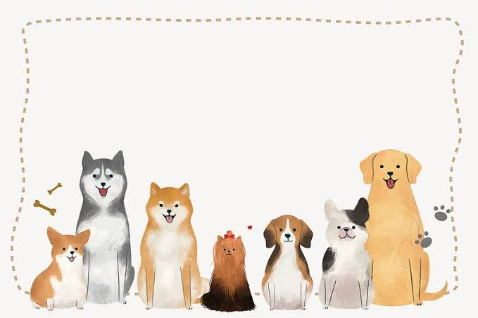
Thank You

