Slide 1
Table of contents
Architecture
Use Case Diagram
Use Case Descriptions

Slide 2
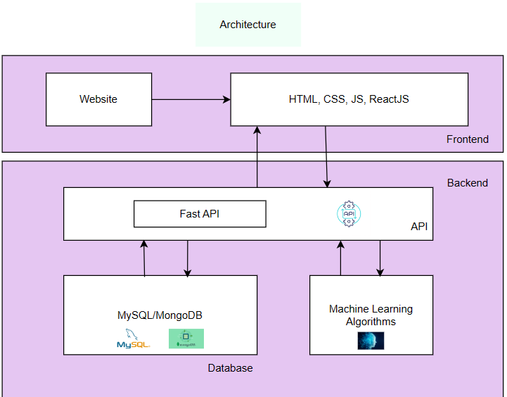
Architecture

Slide 3
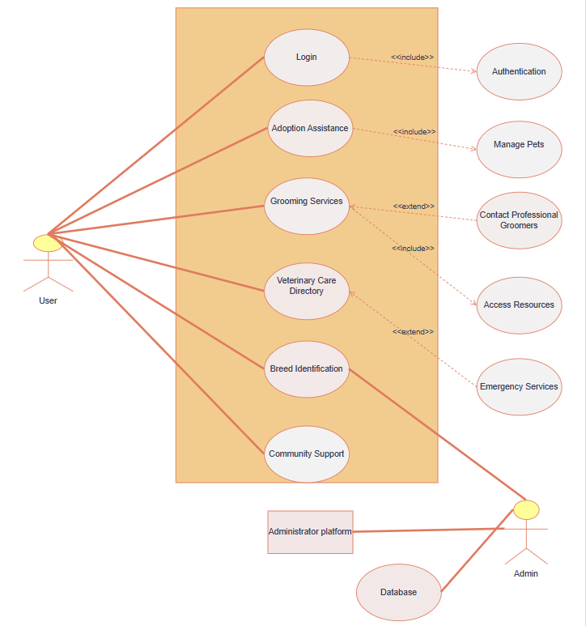
Use Case Diagram

Slide 4
Use Case Description:
Login: The "Login" use case allows registered users to authenticate themselves and gain access to the Pawfect Care platform. Users are required to provide their credentials, typically a username/email and password, to verify their identity. Upon successful authentication, users are granted access to their personalized account and can utilize the platform's functionalities. If authentication fails (e.g., due to incorrect credentials), users are notified of the error and prompted to retry or reset their password if needed.
Adoption Assistance: Facilitates pet adoption by connecting users with shelters, rescue organizations, and individual pet owners. Users can search for pets available for adoption based on various criteria such as species, breed, age, location, etc.
Scenario:
User searches for pets available for adoption based on desired criteria.
System retrieves and displays a list of pets matching the search criteria.
User selects a pet for adoption and initiates the adoption process.
User completes the necessary steps for adoption (e.g., filling out adoption forms, contacting the shelter/rescue organization).
Adoption process is successfully completed.

Slide 5
Grooming services: Provides resources, tips, and access to professional groomers for pet hygiene and grooming needs. Users can access grooming services such as bathing, haircuts, nail trimming, etc., as well as informational resources on pet grooming best practices.
Scenario:
User navigates to the "Grooming Services" section of the Pawfect Care platform.
User explores available grooming services and informational resources.
User selects a grooming service they are interested in.
Veterinary Care Directory: Maintains a database of trusted veterinarians, clinics, and emergency services for pet health needs. Users can find veterinary care providers based on location, specialization, availability, etc.
Scenario:
User navigates to the "Veterinary Care Directory" section of the Pawfect Care platform.
User searches for veterinary care providers based on desired criteria (e.g., location, specialization).
System retrieves and displays a list of veterinary clinics and emergency services matching the search criteria.
Breed Identification: Utilizes advanced Machine Learning algorithms to provide users with accurate breed identification for pets. Users can upload images of their pets, and the system identifies the breed using machine learning models, system displays the breed identification results to the user.
Community Support: Forums, chat groups, and online communities will allow pet owners to connect with each other, share experiences, and seek advice on pet care issues. Users can engage in community support activities such as participating in discussions, asking questions, and providing advice.

Slide 6
Include Relationships:
"Adoption Assistance" includes "Manage Pets", indicating that managing pets is part of the adoption assistance process.
"Grooming Services" includes "Access Resources", suggesting that accessing resources is a step in utilizing grooming services.
“Login“ includes “Authentication” , indicating that authentication is a part of Logging in .These relationships indicate that certain functionalities are integral to the main use cases.
Extend Relationships:
“Grooming services“ can extend “Contacting professional groomers", suggesting that the grooming services may involve additional steps beyond the basic grooming functionalities like contacting professional groomers.
“Veterinary Care Directory" can extend "Emergency Services", suggesting that users may need access to emergency veterinary services in certain situations.

Slide 7
