Slide 1
AN INTELLIGENT IOT BASED WATER QUALITY MONITORING SYSTEM USING ARDUINO AND TURBIDITY SENSOR NETWORKS
PIP104 University Project-II
Review-1
Batch Number:1
Roll Number | Student Name
20201CEI0009 | BHARATH N
20201CEI0007 | DADA LAKSHMI CHARAN
20201CEI0073 | KUMMETHA JYOTHIKA REDDY
Under the Supervision of,
Dr. SASIDHAR BABU SUVANAM
Professor
School of Computer Science & Engineering
Presidency University

Slide 2
ABSTRACT
Wireless communication developments are creating new sensor capabilities. The current developments in the field of sensor networks are critical for environmental applications.
Internet of Things (IoT) allows connections among various devices with the ability to exchange and gather data.
IoT also extends its capability to environmental issues in addition to automation industry by using industry 4.0.
As water is one of the basic needs of human survival, it is required to incorporate some mechanism to monitor water quality time to time. Around 40% of deaths are caused due to contaminated water in the world.

Slide 3
ABSTRACT
Hence, there is a necessity to ensure supply of purified drinking water for the people both in cities and villages.
Water Quality Monitoring (WQM) is a cost-effective and efficient system designed to monitor drinking water quality which makes use of Internet of Things (IoT) technology.
the proposed system consists of several sensors to measure various parameters such as pH value, the turbidity in the water, level of water in the tank, temperature and humidity of the surrounding atmosphere.

Slide 4
Introduction
In the 21st century, there were lots of inventions, but at the same time were pollutions, global warming and so on are being formed, because of this there is no safe drinking water for the world’s pollution.
Nowadays, water quality monitoring in real time faces challenges because of global warming limited water resources, growing population, etc.
Hence there is need of developing better methodologies to monitor the water quality parameters in real time.
The water quality parameters pH measures the concentration of hydrogen ions. It shows the water is acidic or alkaline.
Pure water has 7pH value, less than 7pH has acidic, more than 7pH has alkaline.

Slide 5
The range of pH is 0-14 pH.
For drinking purpose it should be 6.5-8.5pH.
Turbidity measures the large number of suspended particles in water that is invisible.
Higher the turbidity higher the risk of diarrheoa, collera. Lower the turbidity then the water is clean.
Temperature sensor measures how the water is, hot or cold.
Flow sensor measures the flow of water through flow sensor.

Slide 6
The traditional methods of water quality monitor involves the manual collection of water samples from different locations.
Water pollution is one of the biggest fears for the green globalization. In order to ensure the safe supply of the drinking water the quality needs to be monitor in real time.
we present a design and development of a low cost system for real time monitoring of the water quality in IOT(internet of things).

Slide 7
Literature Review
1) Nikhil Kedia entitled “Water Quality Monitoring for Rural Areas-A Sensor Cloud Based Economical Project.” Published in 2015 1st International Conference on Next Generation Computing Technologies (NGCT-2015) Dehradun, India.
Review: This paper highlights the entire water quality monitoring methods, sensors, embedded design, and information dissipation procedure, role of government, network operator and villagers in ensuring proper information dissipation. It also explores the Sensor Cloud domain. While automatically improving the water quality is not feasible at this point, efficient use of technology and economic practices can help improve water quality and awareness among people.
2] Jayti Bhatt,Jignesh Patoliya entitled “Real Time Water Quality Monitoring System”.
Review: This paper describes to ensure the safe supply of drinking water the quality should be monitored in real time for that purpose new approach IOT (Internet of Things) based water quality monitoring has been proposed. In this paper, we present the design of IOT based water quality monitoring system that monitor the quality of water in real time. This system consists some sensors which measure the water quality parameter such as pH, turbidity, conductivity, dissolved oxygen, temperature.

Slide 8
Literature Review
3] Michal Lom, Ondrej Pribyl, Miroslav Svitek entitled “Industry 4.0 as a Part of Smart Cities”.
Review: This paper describes the conjunction of the Smart City Initiative and the concept of Industry 4.0. The term smart city has been a phenomenon of the last years, which is very inflected especially since 2008 when the world was hit by the financial crisis. The main reasons for the emergence of the Smart City Initiative are to create a sustainable model for cities and preserve quality of life of their citizens.
4] Sokratis Kartakis, Weiren Yu, Reza Akhavan, and Julie A. McCann entitled “Adaptive Edge Analytics for Distributed Networked Control of Water Systems”
Review: This paper presents the burst detection and localization scheme that combines lightweight compression and anomaly detection with graph topology analytics for water distribution networks. We show that our approach not only significantly reduces the amount of communications between sensor devices and the back end servers, but also can effectively localize water burst events by using the difference in the arrival times of the vibration variations detected at sensor locations. Our results can save up to 90% communications compared with traditional periodical reporting situations

Slide 9
Existing system
Sensors to detect the hydrocarbons, chemical and metal content in the soil can be combined into a soil tentative and for monitoring the soil quality and waste material content. And sensors for detection pH, conduction, liquid oxygen, turbidity, etc. can be used for measurement the water quality in the rivers, ponds, lakes etc.
Since the work is already done with the detection component like temperature sensor, pH sensor, and few has to check manual short text down the outcome that's been displayed in LCD. And it make more time consumption to note down the results of the improvement quantity that displayed. And it take more time to create the all-purpose results of the change of state processes.

Slide 10
Proposed Method
The proposed system uses four sensors which are pH, turbidity, ultrasonic, DHT-11, microcontroller unit as the main processing module and one data transmission module ESP8266 Wi-Fi module (NodeMCU).
The microcontroller unit is a significant part of the system developed for water quality measurement because The Arduino Mega consumes low power, and it is a small size, where the size is a good use for a crucial point-of-sale technology criterion.
Among four sensors, two of the sensors collect the data in the form of analog signals; the MCU has an on-chip ADC that translates the sensor analog signals into the digital format for further study.

Slide 11
Proposed Method
So, to get this analog output from the sensor, the sensor's analog output of will be connected to the MCU's analog pins.
Whereas the other two sensors output directly connected to the digital pins of the MCU units. All the sensors data processed by the MCU and updated to the ThingSpeak server using the Wi-Fi data communication module ESP8266 (NodeMCU) to the central server.

Slide 12
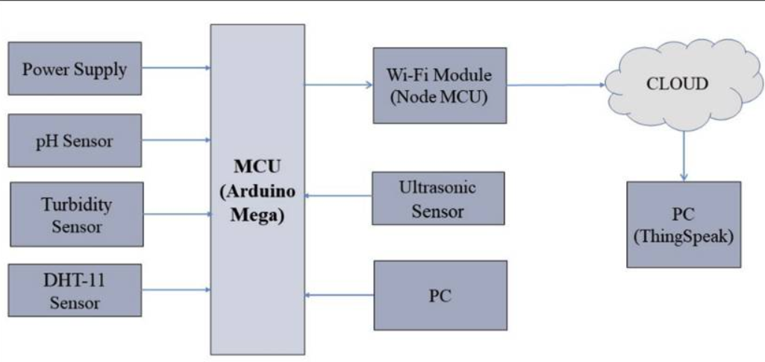
Proposed Method
FIG: The block diagram of the system proposed for water quality measurement

Slide 13
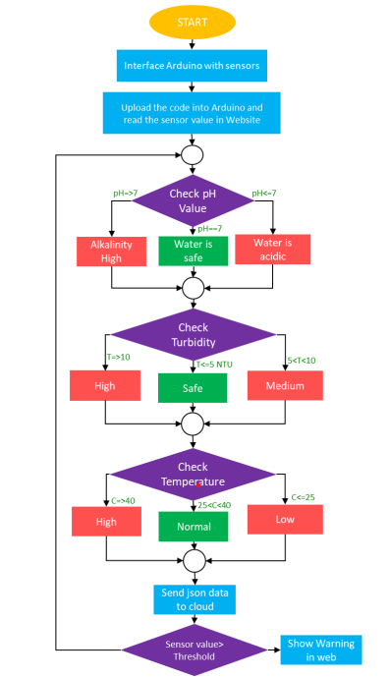
Proposed Method
Fig: Flow chart

Slide 14
Components
Arduino
NodeMCU
pH Meter
Turbidity Sensor
Temperature Sensor
Logic Level Converter
Serial Communication
Firebase Connection
Processing data and send data to cloud

Slide 15
Objectives
Ensuring Safe Drinking Water and Real-time Monitoring : The primary objective is to ensure that the water purifier consistently provides safe and clean drinking water to the residents of the home. This includes monitoring for contaminants such as bacteria, viruses, heavy metals, and other harmful substances in the input water and ensuring they are effectively removed in the output water.To provide real-time monitoring of water quality. This allows homeowners to have immediate information about the safety of the water they are consuming.
Early Detection of Contaminants and Energy Efficiency : Detect contaminants or changes in water quality early, allowing for timely maintenance and replacement of purification components to prevent health risks.Optimize energy usage by the water purifier by only activating the purification process when necessary. For instance, the system could detect when water quality is below a certain threshold and activate purification accordingly.

Slide 16
Objectives
3. Water Conservation and User Alerts : Promote water conservation by ensuring that the water purifier is only treating water that actually requires purification. This is especially relevant in areas facing water scarcity.Notify homeowners when the water quality falls below acceptable levels or when the purification system requires maintenance or replacement of filters. This ensures that users are aware of potential issues and can take corrective action.

Slide 17
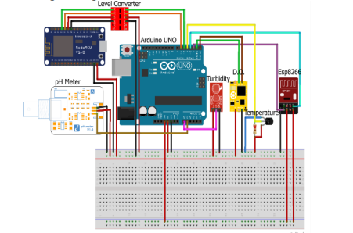
Circuit Diagram
Fig: Circuit Diagram of water quality monitoring system

Slide 18
Methodology
Select Sensors: Choose appropriate sensors to measure key water quality parameters like pH, turbidity, total dissolved solids (TDS), temperature, and conductivity.
IoT Hardware: Select suitable IoT hardware, such as microcontrollers (e.g., Arduino or Raspberry Pi) and connectivity modules (Wi-Fi, Bluetooth, etc.).
Data Acquisition: Connect the sensors to the IoT hardware to collect data. You may need analog-to-digital converters for some sensors.
Data Transmission: Send the collected data to a central server or cloud platform using MQTT, HTTP, or other suitable protocols.
Cloud Platform: Utilize a cloud platform (e.g., AWS IoT, Azure IoT, or Google Cloud IoT) to manage and store data. Set up a database to store water quality information.

Slide 19
Timeline of the Project
S.NO- | Review | Dates
1.Title Finalization with Supervisor | Review-0 | 11-10-2023
2.Problem Definition/Novelty | Review-1 | 08-11-2023
3.50% implementation details | Review-2 | 28-11-2023
4.100% implementation details | Review-3 | 27-12-2023
5.Demonstration | Final Viva | 10-01-2024

Slide 20
Expected Outcomes
Improved Water Safety: Enhanced monitoring and real-time data analysis can lead to safer drinking water by detecting and mitigating contaminants and impurities more effectively.
Consistent Water Quality: Homeowners can expect a consistent and high level of water quality, ensuring that the water purifier consistently delivers clean and safe water.
Early Detection of Contaminants: The system's ability to detect contaminants early allows for timely maintenance and component replacement, reducing health risks associated with poor water quality.
Energy Efficiency: Optimization of energy usage results in cost savings and a reduced environmental footprint. Homeowners can expect lower utility bills.

Slide 21
Conclusion
Monitoring of Turbidity, PH & Temperature of Water makes use of water detection sensor with unique advantage and existing GSM network. The system can monitor water quality automatically, and it is low in cost and does not require people on duty.
So the water quality testing is likely to be more economical, convenient and fast. The system has good flexibility.
Only by replacing the corresponding sensors and changing the relevant software programs, this system can be used to monitor other water quality parameters. The operation is simple.
The system can be expanded to monitor hydrologic, air pollution, industrial and agricultural production and so on. It has widespread application and extension value.

Slide 22
References
[1] Yaroshenko, I.; Kirsanov, D.; Marjanovic, M.; Lieberzeit, P.A.; Korostynska, O.; Mason, A.; Frau, I.; Legin, A. Real-time water quality monitoring with chemical sensors. Sensors 2020, 20, 3432. [Google Scholar] [CrossRef]
[2] Ruchitra K, Reshma N, Seema LB, Sharanamma, Suvanam Sasidhar Babu, Water Quality Monitoring and Filter System to Preserve Water Resource Using IOT, Published by: The Mattingley Publishing Co., Inc, May-June 2020 ISSN: 0193-4120 Page No. 4156-4159.
[3] Varsha Lakshmikantha, Anjitha Hiriyannagowda, Akshay Manjunath, Aruna Patted, Jagadeesh Basavaiah∗ , Audre Arlene Anthony, IoT based smart water quality monitoring system, Global Transitions Proceedings 2 (2021)

Slide 23
[4] A. N. Prasad, K. A. Mamun, F. R. Islam and H. Haqva, "Smart Water Quality Monitoring System",2nd Asia-Pacific World Congress on Computer Science and Engineering 1-6.-References-Scientific Research Publishing“, 2021 IEEE.
[5] G. N. Satya Sai, R. Sudheer, K. S. Manikanta, S. G. Arjula, B. N. Rao and D. V. Sai Maneeswar Mutyala, "IoT based Water Quality Monitoring System," 2021 IEEE 9th Region 10 Humanitarian Technology Conference (R10-HTC), Bangalore, India, 2021, pp. 01-06, doi: 10.1109/R10-HTC53172.2021.9641630.
[6] K. Shanmugam, M. E. Rana, D. Tan Zi Xuen and S. Aruljodey, "Water Quality Monitoring System: A Smart City Application With IoT Innovation," 2021 14th International Conference on Developments in eSystems Engineering (DeSE), Sharjah, United Arab Emirates, 2021, pp. 571-576, doi: 10.1109/DeSE54285.2021.9719480.

Slide 24
Thank You

