Slide 1
BLOCK CHAIN
i

Slide 2
What is block chain?
Block chain technology is an advanced database mechanism that allows transparent information sharing within a business network. A block chain database stores data in blocks that are linked together in a chain.

Slide 3
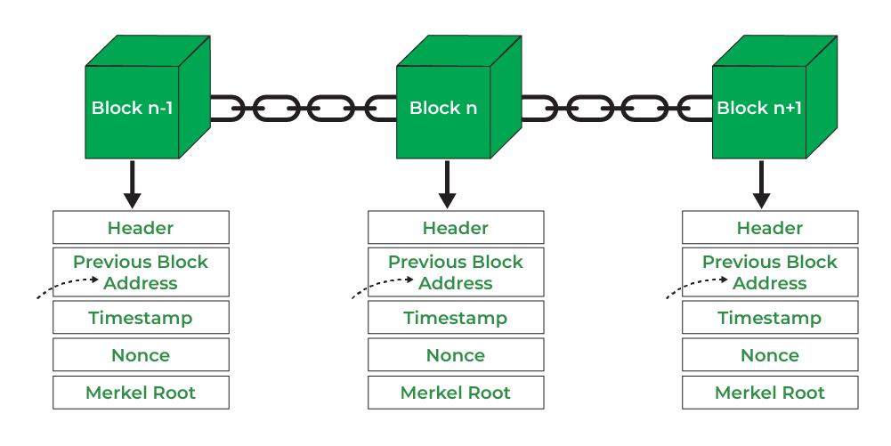
Structure of block chain

Slide 4
Importance of block chain
Traditional database technologies present several challenges for recording financial transactions. For instance, consider the sale of a property. Once the money is exchanged, ownership of the property is transferred to the buyer. Individually, both the buyer and the seller can record the monetary transactions, but neither source can be trusted. The seller can easily claim they have not received the money even though they have, and the buyer can equally argue that they have paid the money even if they haven’t.

Slide 5
Different industries use block chain
Finance
Traditional financial systems, like banks and stock exchanges, use block chain services to manage online payments, accounts, and market trading. For example, Singapore Exchange Limited, an investment holding company that provides financial trading services throughout Asia, uses block chain technology to build a more efficient interbank payment account.

Slide 6
i
Media and entertainment
Companies in media and entertainment use block chain systems to manage copyright data. Copyright verification is critical for the fair compensation of artists. Sony Music Entertainment uses block chain services to make digital rights management more efficient. They have successfully used block chain strategy to improve productivity and reduce costs in copyright processing.

Slide 7
Components of block chain
Distributed ledger
A distributed ledger is the shared database in the block chain network that stores the transactions, such as a shared file that everyone in the team can edit. In most shared text editors, anyone with editing rights can delete the entire file.

Slide 8
i
Smart contracts
Companies use smart contracts to self-manage business contracts without the need for an assisting third party. They are programs stored on the block chain system that run automatically when predetermined conditions are met. They run if-then checks so that transactions can be completed confidently.

Slide 9
Key characteristics
Auditability
Block chain stores data of users based on the Unspent Transaction Output (UTXO) model. Every transaction has to refer to some previous unspent transactions. Once the current transaction is recorded into the block chain, the position of those referred unspent transactions switches from unspent to spent. Due to this process, the transactions can be easily tracked and not harmed between transactions.

Slide 10
i
Cryptography
The block chain concept is fully based on security and for that, all the blocks on the block chain network want to be secure. And for security, it implements cryptography and secures the data using the cipher text and ciphers.

Slide 11
What is block chain as a service
Block chain as a Service ( BaaS ) is a managed block chain service that a third party provides in the cloud. You can develop block chain applications and digital services while the cloud provider supplies the infrastructure and block chain building tools. All you have to do is customize existing block chain technology, which makes block chain adoption faster and more efficient.

