Slide 1
Kojo
https://www.kogics.net/kojo-download

Slide 2
First Instructions
clear()
forward(x)
left(x)
right(x)
hop()
circle(x)

Slide 3
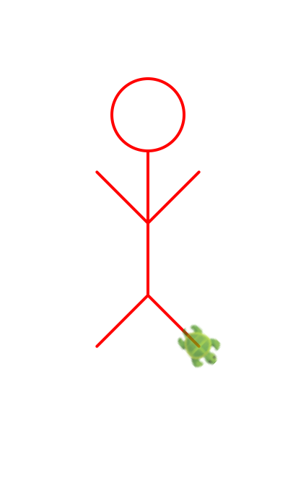
First Challenge Draw a stick-man!

