Slide 1


“Employee Web Service”
Submitted by: Bharath Kumar Palasa
Submission type : Individual
Name: Bharath Kumar Palasa
Batch : HDFC API Developer Batch
LMS Id : bharathpalasa@gmail.com
Program : HDFC API Developer Program
Date: 27/04/2023

Slide 2

Table of contents
Introduction
Project Overview
Architecture Design
Back-end Development
Testing
Deployment
Conclusion
Future Work
References
Appendices

Slide 3
Introduction
Employee web service project is designed to demonstrate the development and deployment of a secure web service that queries employee data from a database. The primary goal is to develop a web service that can retrieve employee data based on the employee ID, while also ensuring the security of the data through encryption and HTTPS.
In the organizations often need to retrieve employee data from a database, but doing so securely can be challenging. Accessing employee data through a web service is a common solution, but it requires careful consideration of security measures to prevent unauthorized access to sensitive information.
In this project we have developed a secure web service for retrieving employee data that ensures confidentiality and integrity of the data while maintaining availability to authorized users.

Slide 4
Introduction
The objectives of the project are to:
Develop a web service that queries employee data from a database
Securely transmit the data using HTTPS
Encrypt sensitive data to prevent unauthorized access
Implement logging functionality for tracking web service usage
Containerize the web service and deploy it on Kubernetes for scalability and availability
In this project we have learned how to resolve issues while demonstrating the use of popular software development tools such as Spring Boot, Jenkins, docker and Kubernetes.

Slide 5
Project Overview
The project involves the development and deployment of a secure web service that retrieves employee data from a database. The web service is implemented using Java and Spring Boot, and can be accessed through an HTTP request that takes an Employee ID as a parameter and returns the corresponding EmployeeName and DateOfBirth.
The key features of the web service:
Secure access to employee data through HTTPS
Encryption of sensitive data using AES-256
Logging of web service usage to track access to employee data
Containerization of the web service for scalability and availability
Deployment on Kubernetes for automated scaling and management

Slide 6
Project Overview
Functionalities of the web Service
One of the key functionality of the web service is its secure access to employee data through HTTPS. This ensures that sensitive employee data is encrypted during transmission over the network, preventing unauthorized access to the data. In addition to HTTPS, the project also uses self-signed certificates for testing purposes.
Another important functionality of the web service is the encryption of sensitive data using AES-256. This ensures that even if an attacker gains access to the data, they will not be able to read it without the encryption key. This provides an additional layer of security for the employee data being retrieved.
The project also includes logging functionality for tracking web service usage. Each time the web service is called, a log entry is created that includes a date-timestamp. If the log file exceeds 1 MB in size, the existing file is backed up and a new log file is utilized. This ensures that the usage of the web service can be tracked and monitored for security purposes.

Slide 7
Project Overview
The web service is containerized using Docker, which allows it to be easily deployed and managed on any platform that supports Docker. The use of containers also provides scalability, allowing multiple instances of the web service to be deployed and managed on a single machine or across multiple machines.
The deployment of the web service is managed using Kubernetes, a popular container orchestration platform. Kubernetes will create 3 instances of web service Kubernetes allows the web service to be automatically scaled up or down based on demand, ensuring that the web service remains available and responsive to user requests.
In addition to the web service, the project includes a Java client program that can be used to call the web service and retrieve employee data. The client program is also responsible for decrypting the encrypted DateOfBirth field, which is encrypted using the AES-256 encryption algorithm.

Slide 8
Project Overview
The project is implemented using a technology stack that includes :
Java for programming the web service and client program
MySQL for storing data in database
Spring Boot for creating a RESTful web service
Git for version control and source code management
Jenkins for continuous integration and deployment
AES-256 encryption for securing sensitive data
HTTPS for secure transmission of data over the network
Self-signed certificates for testing purposes
Postman for API testing
Docker for containerization of the web service
Kubernetes for container orchestration and management

Slide 9
Project Overview
Overall, the project provides a comprehensive solution for securely retrieving employee data through a web service. By using a combination of technologies such as Java, Spring Boot, Git, Jenkins, Docker, and Kubernetes, the project demonstrates a modern and scalable approach to secure web service development and deployment.

Slide 10
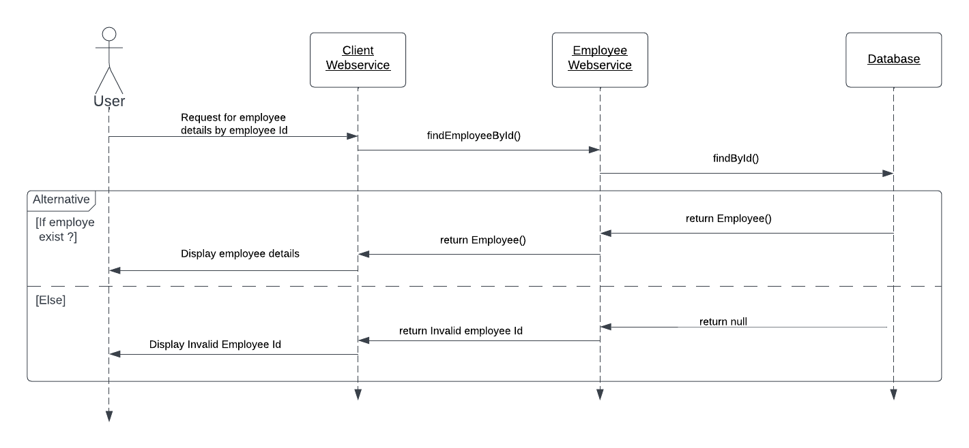
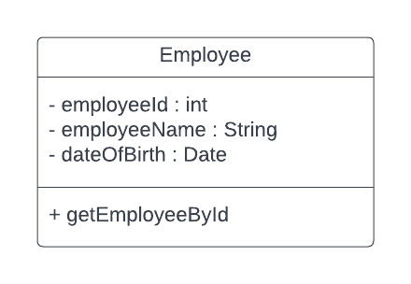
Architecture Design
UML Sequence and class diagrams

Slide 11
Architecture Design
The architecture design of project can be divided into four main components:
Database
Web Service
Client Program
Deployment

Slide 12
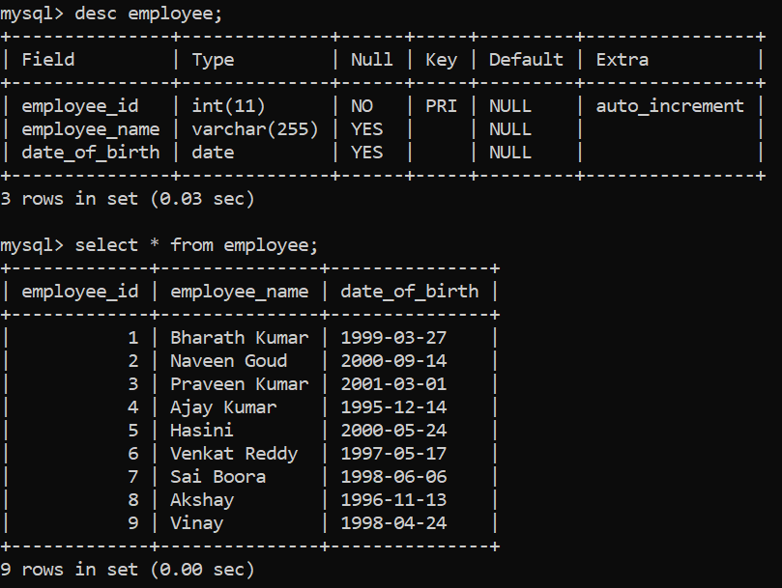
Architecture Design
1. Database
The project requires a database to store employee data. MySQL is used for this project and a database is created.
An Employee table is created in the database with 3 columns employee_id, employee_name and date_of_birth.

Slide 13
Architecture Design
2. Web Service
The web service is the primary component of the project, responsible for retrieving employee data from the database and returning it to the client program. The web service is implemented using Java and Spring Boot, and can be accessed through an HTTP request that takes an EmployeeID as a parameter and returns the corresponding EmployeeName and DateOfBirth.
The web service consists of several components:
Controller: The controller receives incoming HTTP requests, retrieves the requested data from the database, and returns the data to the client program.
Service: The service layer encapsulates the business logic of the application and interacts with the database through a DAO (Data Access Object) layer.
DAO: The DAO layer interacts directly with the database and performs CRUD (Create, Read, Update, Delete) operations on the Employee table.

Slide 14
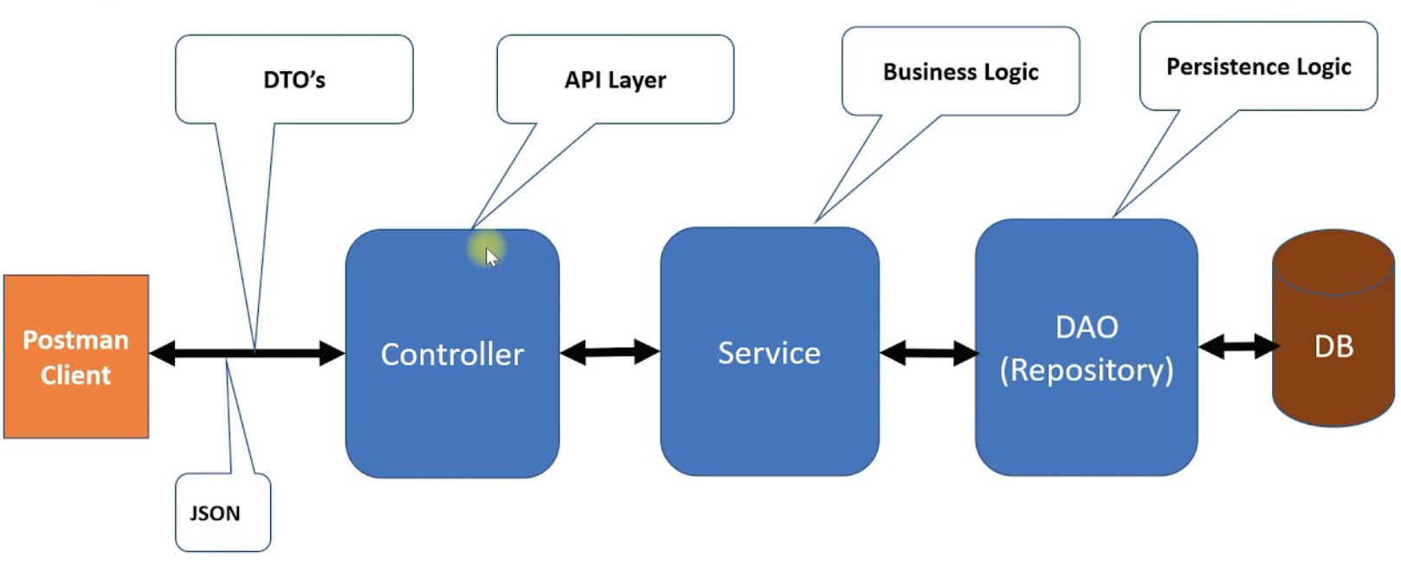
Architecture Design
Web service architecture

Slide 15
Architecture Design
3. Client Program
The client program is a separate Java application that calls the web service to retrieve employee data. The client program takes an EmployeeID as input and displays the corresponding EmployeeName and DateOfBirth to the user.
The client program consists of two components:
Controller: The controller sends an HTTP request to the web service, passing the EmployeeID as a parameter, and receives the response containing the requested data.
Service: The service layer encapsulates the business logic of the application and interacts with the web service through a REST (Representational State Transfer) client.
The client program also includes functionality for decrypting the encrypted DateOfBirth field returned by the web service.

Slide 16
Architecture Design
Client Program
Client Program
Employee Webservice
Database
USER
Decrypt DOB
Encrypt DOB

Slide 17
Architecture Design
4. Deployment
The project can be deployed using Docker and Kubernetes. The web service and database can be containerized using Docker and deployed on a Kubernetes cluster. Kubernetes provides features for scaling and managing containers, ensuring that the web service remains available and responsive to user requests.
Jenkins can be used for continuous integration and deployment, automating the process of building, testing, and deploying the web service and client program to the Kubernetes cluster.
Overall, the architecture design for the project uses a layered approach, separating the business logic, data access, and presentation layers of the web service and client program. The use of Docker and Kubernetes provides scalability and manageability, while Jenkins automates the process of deployment and testing.

Slide 18
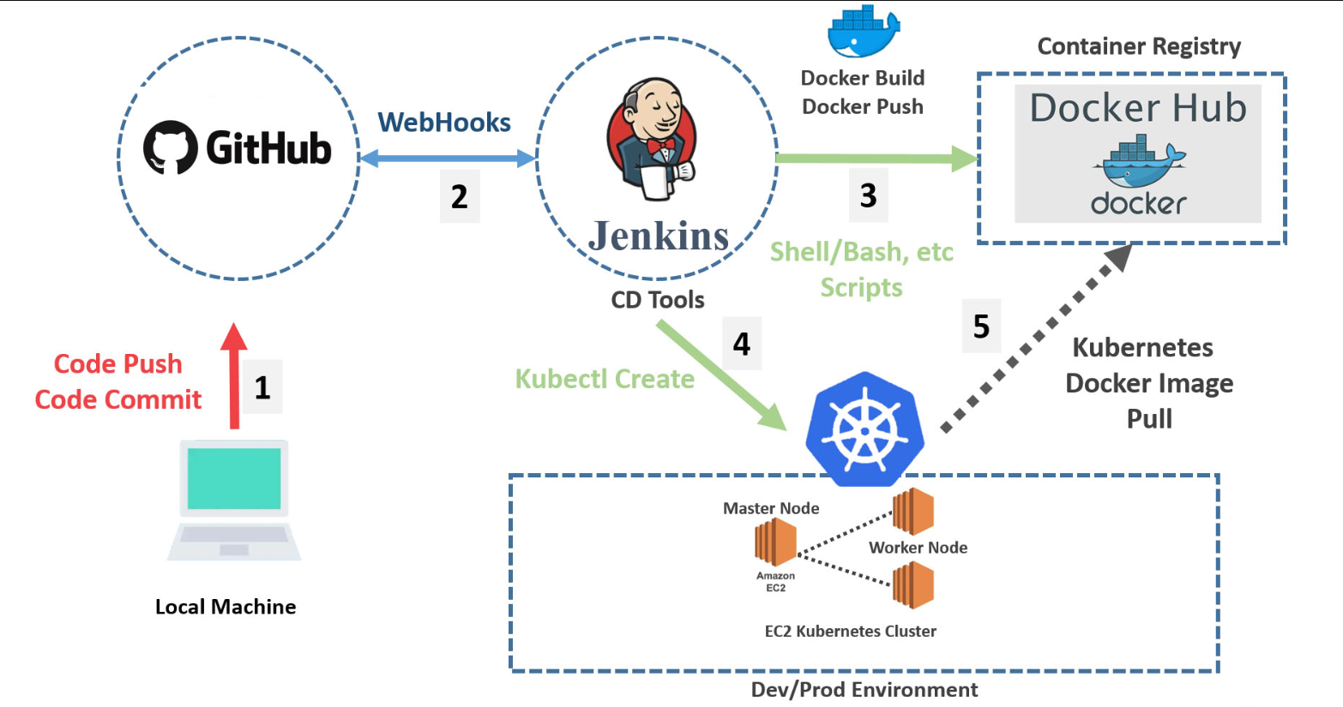
Architecture Design
Deployment architecture

Slide 19
Back-end Development
Backend development for the above project involves creating the web service and implementing the necessary functionality to retrieve employee data from the database and expose it through a REST API. The following steps provide an overview of the backend development process:
Set up the development environment: Install and configure the necessary software and tools for development, including a Java Development Kit (JDK), an Integrated Development Environment (IDE) such as Eclipse, and a database management system.
Create the database schema: Define the structure of the Employee table, including the EmployeeID, EmployeeName, and DateOfBirth columns. Use a tool such as SQL Workbench or pgAdmin to create the table.
Create the Spring Boot project: Use the Spring Initializr to generate a new Spring Boot project with the necessary dependencies, including Spring Web, Spring Data JPA, and a database driver

Slide 20
Back-end Development
Implement the Employee entity: Create a Java class that represents the Employee table in the database, including the three columns as properties.
Implement the DAO layer: Create a Java interface that defines the CRUD operations for the Employee entity, using Spring Data JPA to interact with the database.
Implement the Service layer: Create a Java class that encapsulates the business logic of the application, retrieving data from the DAO layer and transforming it as necessary.
Implement the Controller layer: Create a Java class that handles incoming HTTP requests, calling the appropriate method in the Service layer to retrieve the requested employee data.
Add encryption and decryption functionality: Implement AES-256 encryption and decryption functionality for the DateOfBirth field using a library such as Bouncy Castle.
Add logging functionality: Use a logging library such as Log4j to log access to the web service, including the EmployeeID and timestamp.

Slide 21
Back-end Development
Secure the web service: Configure the web service to use HTTPS for secure transmission of data over the network, using a self-signed certificate.
Test the web service: Use a testing framework such as JUnit to test the functionality of the web service, including testing for invalid EmployeeID input and encrypted/decrypted DateOfBirth data.
Deploy the web service: Containerize the web service using Docker and deploy it on a Kubernetes cluster, using Jenkins for continuous integration and deployment.
Backend development for the project requires a strong understanding of Java programming, Spring Boot, and database management. It also requires knowledge of encryption, logging, and secure communication protocols.

Slide 22
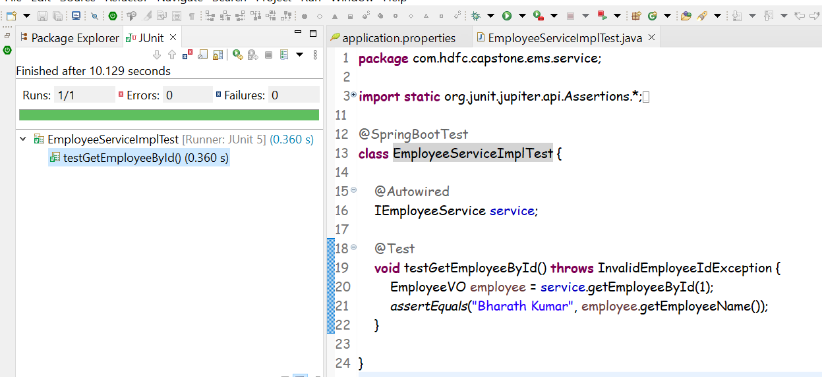
Testing
Unit testing

Slide 23
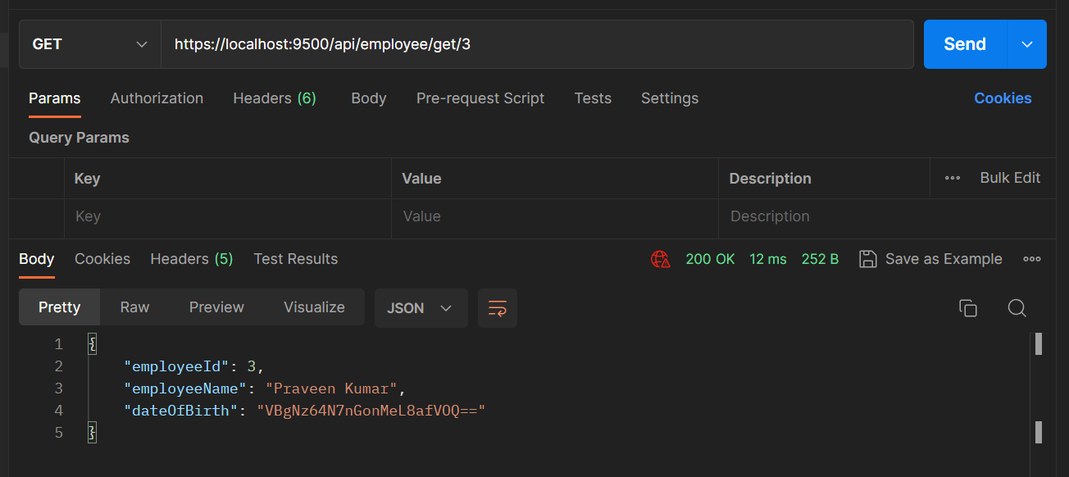
Testing
API Testing for employee web service

Slide 24
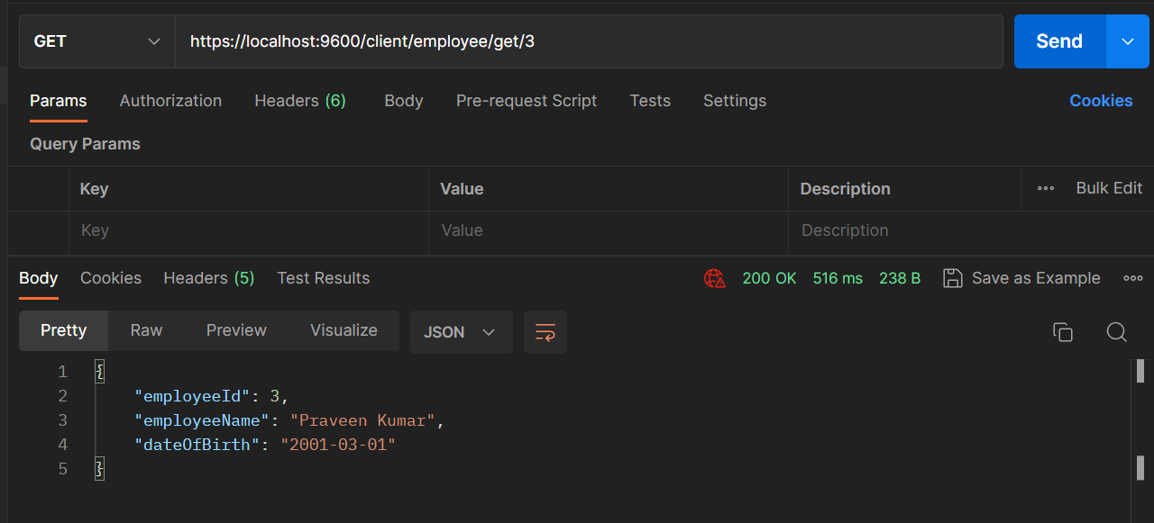
Testing
API Testing for client service

Slide 25
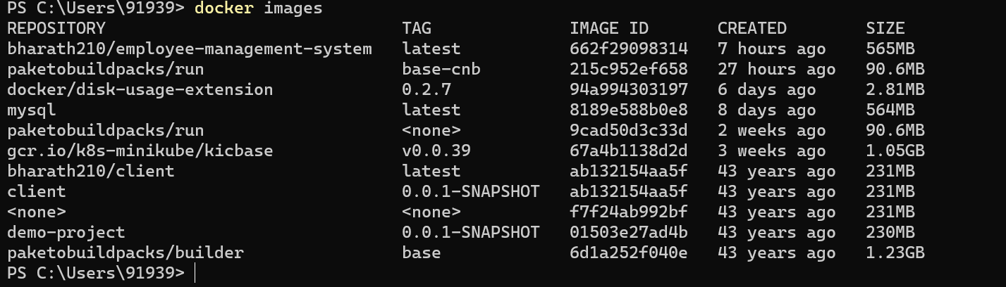
Deployment
Docker Image

Slide 26
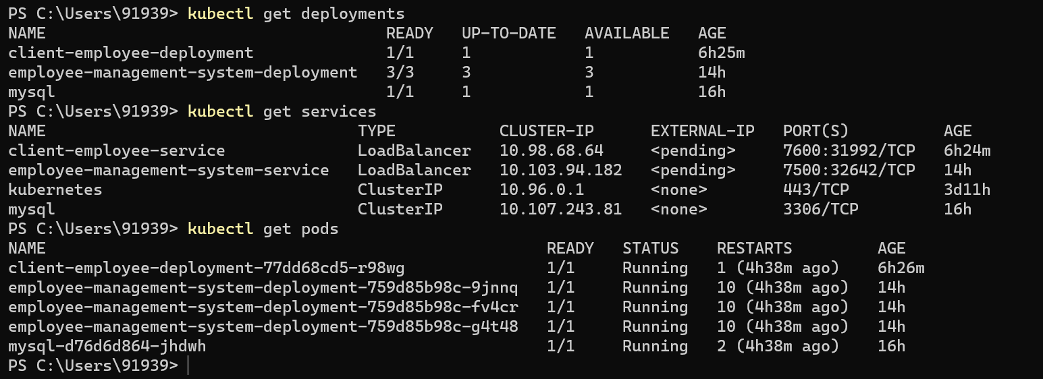
Deployment
Kubernetes Instances

Slide 27
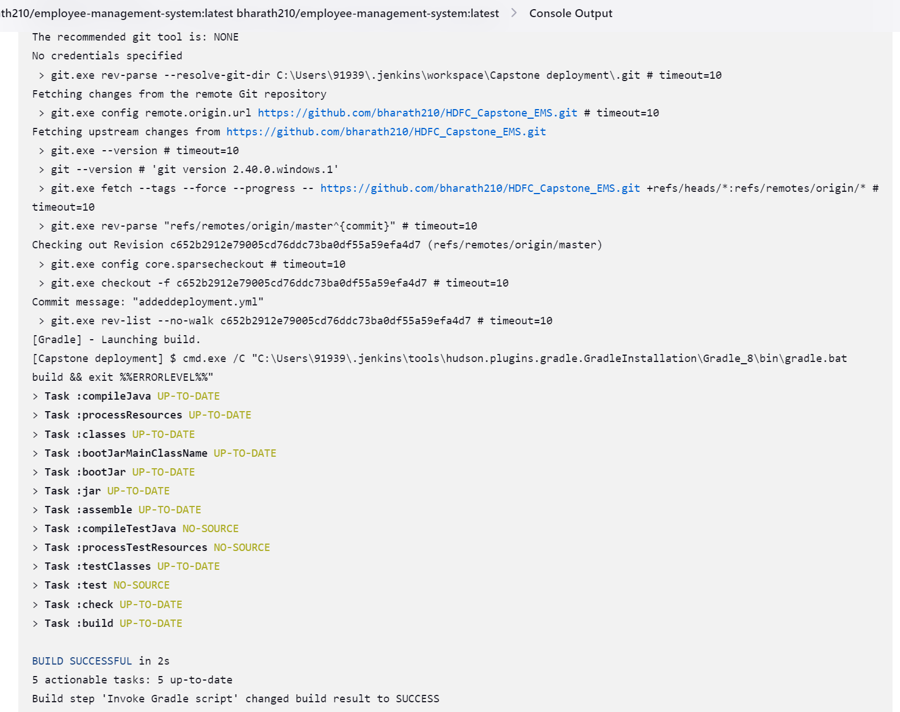
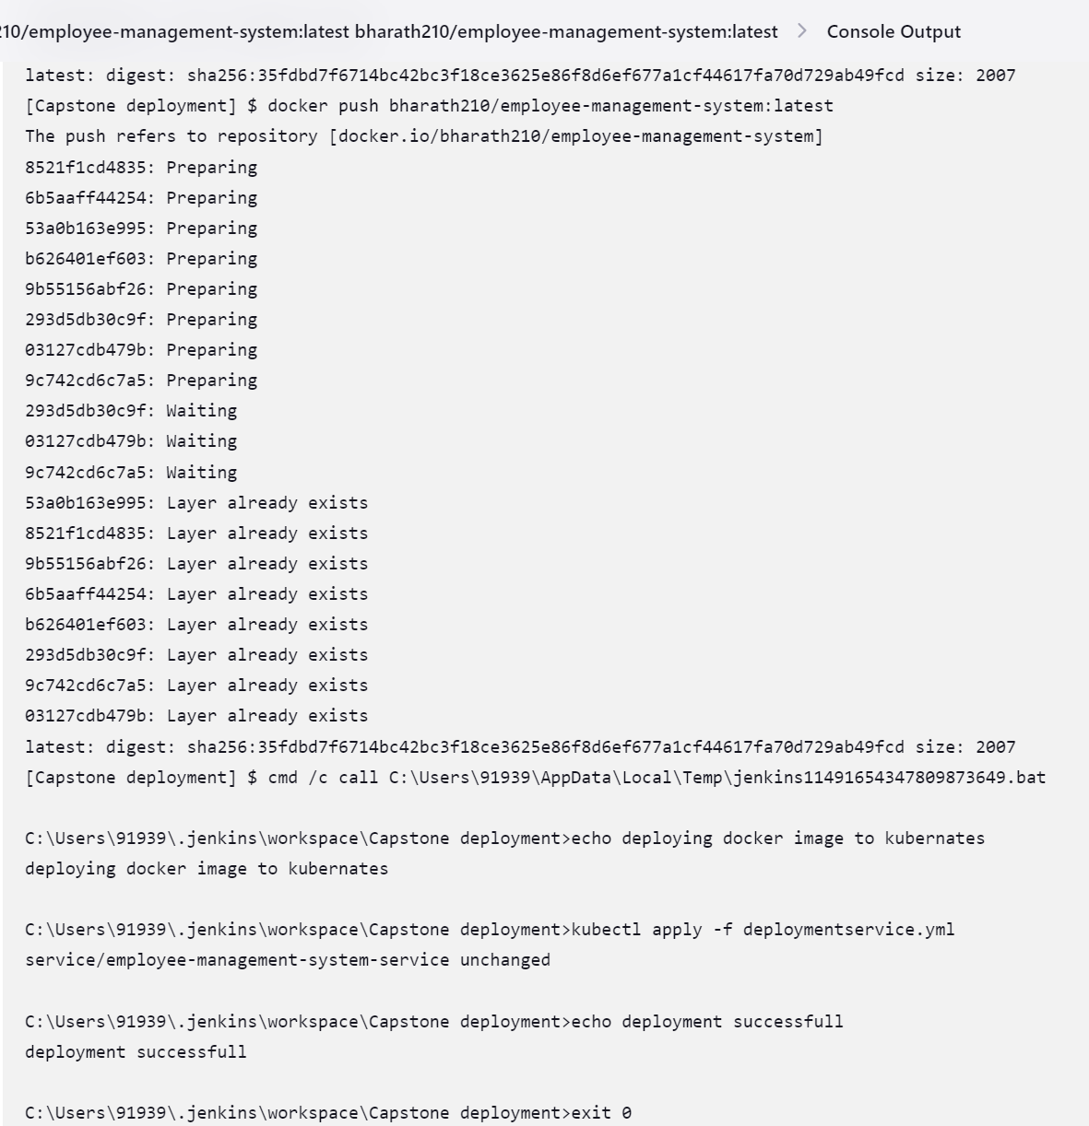
Deployment
Jenkins Integration

Slide 28
Conclusion
In conclusion, the Employee web service project is a comprehensive solution that allows users to query employee records by ID, expose the web service as an HTTPS endpoint with a self-signed certificate, encrypt sensitive data, and containerize the service for deployment on Kubernetes.
This project demonstrates the development of a full-stack solution using modern technologies such as Spring Boot, Java, Kubernetes, and Jenkins. It also showcases the importance of testing in the development process, including unit testing and API testing.
Overall, this project provides a practical example of building a robust and secure web service that can be utilized in various industries, including human resources, payroll management, and employee performance evaluation

Slide 29
Future Work
While the Employee web service project is a comprehensive solution, there are several areas where it can be further improved and enhanced. Some of the future work that can be done on this project includes:
Authorization and Authentication: Currently, the web service does not have any authorization or authentication mechanisms in place. Implementing authentication and authorization would improve the security of the service by ensuring that only authorized users can access sensitive employee data.
Caching: Caching can be added to the web service to improve the performance by reducing the number of database queries. This would help to reduce the response time and improve the scalability of the service.
UI Development: A user interface can be developed to provide a better user experience for querying employee data. This would allow users to interact with the web service more easily and efficiently.
More Advanced Encryption Techniques: Currently, the web service encrypts sensitive data using AES-256. However, more advanced encryption techniques can be explored to improve the security of the service even further.

Slide 30
Future Work
API Documentation: Providing comprehensive documentation for the web service API can make it easier for developers to understand and utilize the service. This can improve
Public key infrastructure (PKI) and digital certificates: An alternative for SSL which can provide more robust and scalable security mechanisms. PKI can enable secure authentication and encryption of data in transit, and it can also provide a mechanism for verifying the identity of the server and clients.
Overall, these future work areas can enhance the functionality, usability, and scalability of the Employee web service, making it a more valuable tool for businesses and organizations.

Slide 31
References
Spring Boot Documentation: https://spring.io/projects/spring-boot
Kubernetes Documentation: https://kubernetes.io/docs/home/
Docker Documentation: https://docs.docker.com/
OpenSSL Documentation: https://www.openssl.org/docs/
Jenkins Documentation: https://www.jenkins.io/doc/
Git Documentation: https://git-scm.com/doc
MySQL Documentation: https://dev.mysql.com/doc/
Postman Documentation: https://learning.postman.com/docs/getting-started/introduction/
cURL Documentation: https://curl.se/docs/
Apache Tomcat Documentation: https://tomcat.apache.org/tomcat-9.0-doc/index.html

Slide 32
Appendices
Employee Table Creation SQL Query :
create table Employee ( employee_id int PRIMARY KEY AUTO_INCREMENT,
employee_name VARCHAR(255),
date_of_birth DATE );
Employee Table Insertion SQL Query:
insert into employee ( employee_name, date_of_birth) values ('Bharath Kumar', '1999-03-27’),
('Naveen Goud', '2000-09-14’),
('Praveen Kumar', '2001-03-01’),
('Ajay Kumar', '1995-12-14’),
('Hasini', '2000-05-24’), ('Venkat Reddy', '1997-05-17’),
('Sai Boora', '1998-06-06);

Slide 33
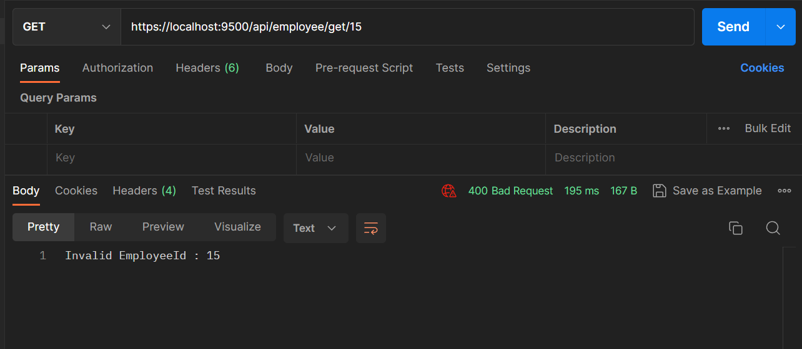
Appendices
Displaying Invalid Employee Error Message :

Slide 34
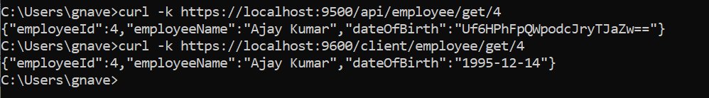
Appendices
cURL command for calling web services :
Dockerfile for Containerizing the Web Service:
FROM openjdk:8
EXPOSE 9500
ADD build/libs/employee-management-system-0.0.1-SNAPSHOT.jar employee-management-system-0.0.1-SNAPSHOT.jar
ENTRYPOINT [ "java","-jar","/employee-management-system-0.0.1-SNAPSHOT.jar" ]

Slide 35
Appendices
Kubernetes sample Commands for Deploying the Container on Kubernetes:
kubectl create deployment mydeployment --image=bharath210/demo-project:latest
kubectl expose deployment mydeployment --type=NodePort --port=8334

Slide 36
Thank You

