Slide 1
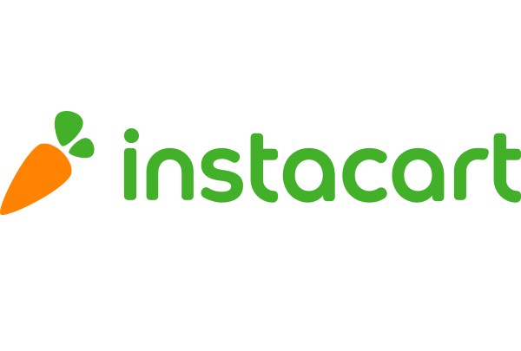


Recommendation and Market Basket Analysis

Slide 2
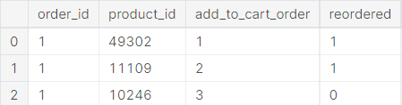
11
Data Description
Data is divided across 6 files:
order_products [2 files]
One for the basket of previously orders. [~33M rows]
Another for the basket of the future orders.

Slide 3
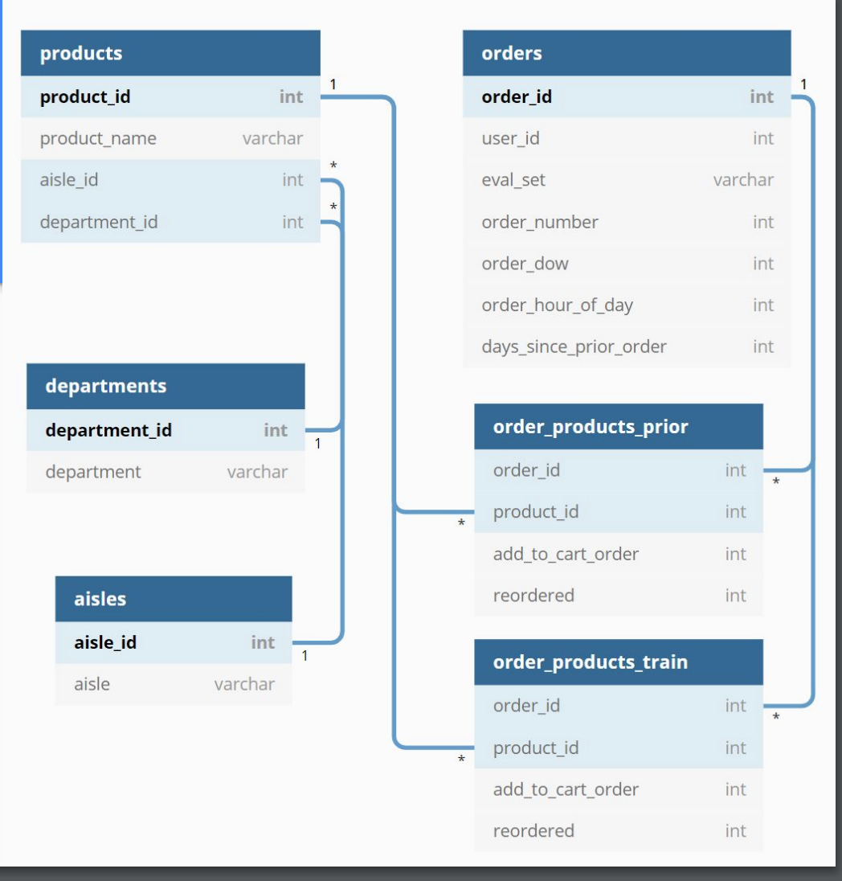
Data Description
10
Aisles [~134 sub-department]
21 Departments
134 Aisles
49,688 Products
206,209 Users
3,421,083 Orders...

Slide 4
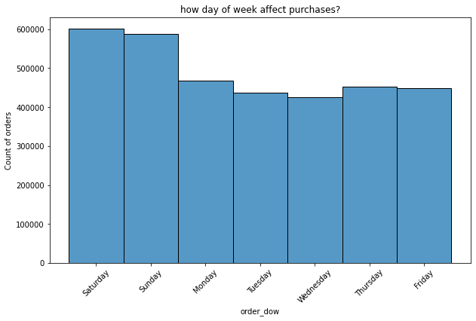
13
Data
Preprocessing
Days of week column only have numbers from 0-6
It didn't hold, which number correspond to which day of week
From the days of week histogram, Most orders were purchased on Day 0 and Day 1.
Thus we inferred that these 2 days seems to be the weekend.

Slide 5
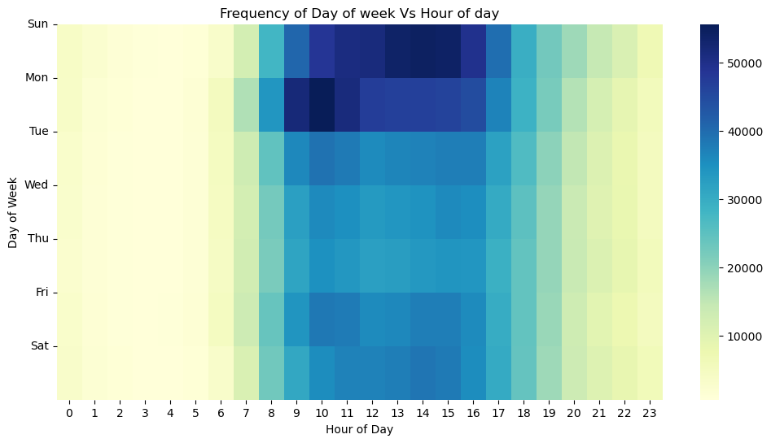
14
EDA
Peak ordering times are midday across all days, with evenings being the next busiest.
The least active hours are early morning (1-5 AM).
Sundays and Mondays show the highest overall ordering activity, indicating the start of the week as prime grocery shopping time.

Slide 6
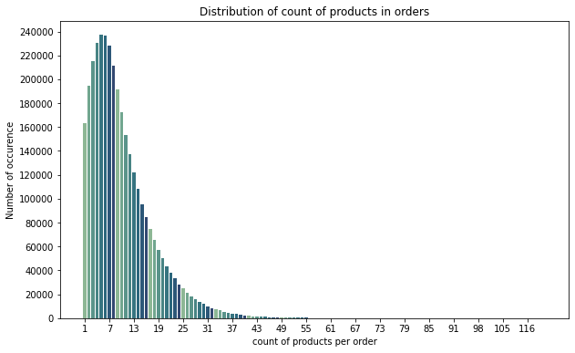
15
EDA
Most baskets contain from 5-8 products.

Slide 7
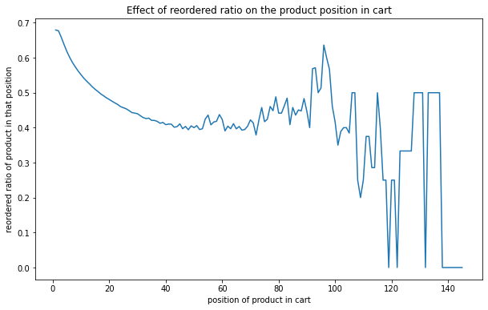
16
EDA
Intuitively, products placed first in cart are the products mostly reordered.
People tend to put first the products they already know.

Slide 8
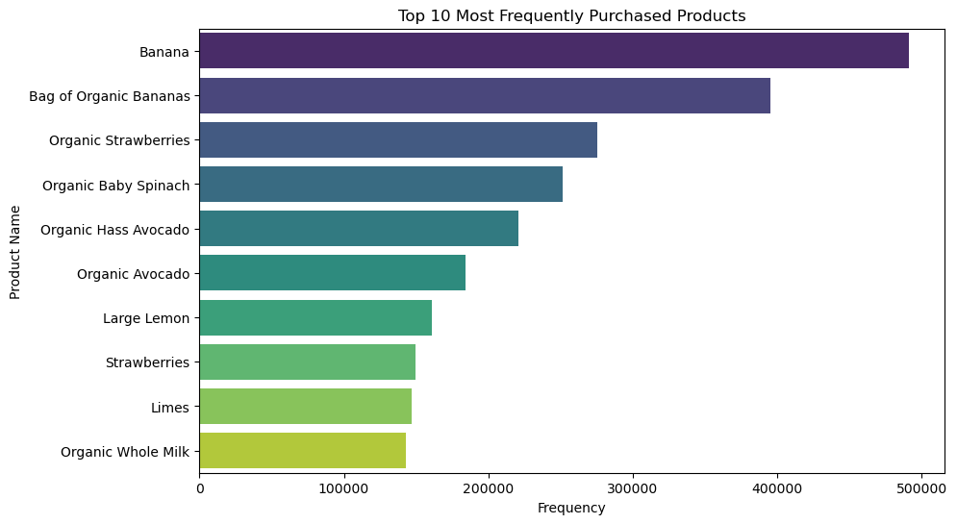
17
EDA
Analyzing products
5 Most Ordered Products
Banana
Bag of Organic Bananas
Organic Strawberries
Organic Baby Spinach
Organic Hass Avocado
14% of all purchases are bananas.
Organic products are frequently ordered.

Slide 9
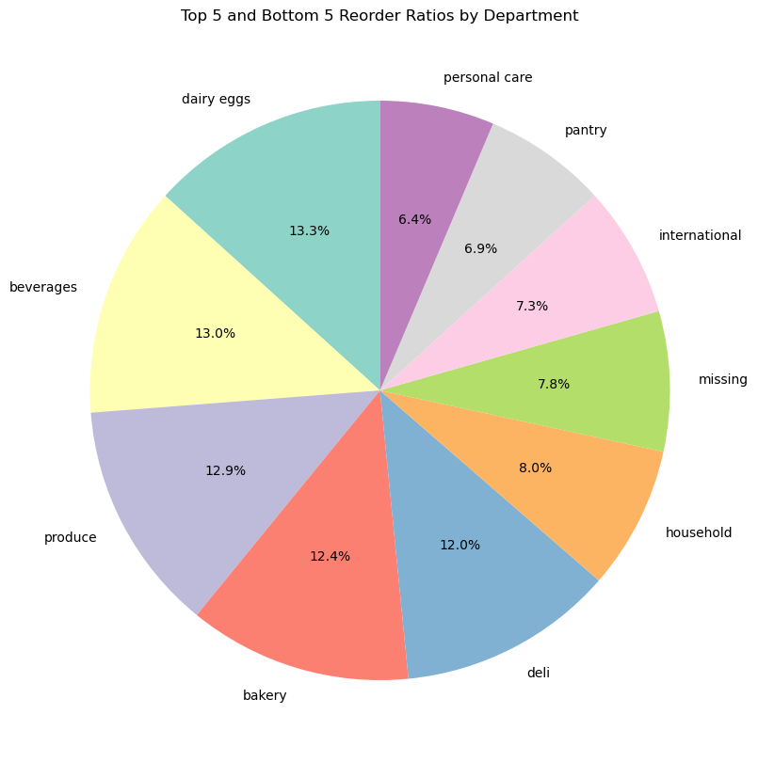
22
EDA
Departmental Reorder Ratios Analysis
It seems that personal contains very few reorder products ( 6.4% of the products).
Lowest Reorder Ratios: Departments such as international, pantry, and personal care have lower reorder ratios, which may point to less frequent needs or higher competition.
Dairy eggs and beverages departments have the highest reorder ratios, each constituting over 13% of reorders, indicating strong customer retention.

Slide 10
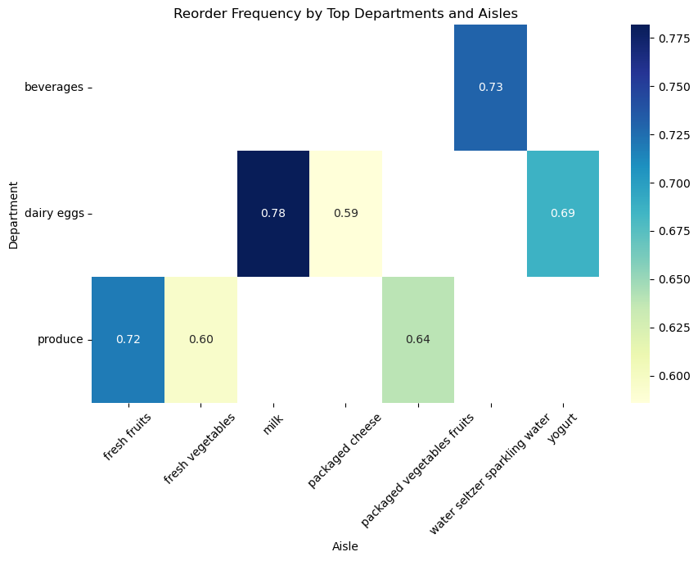
23
EDA
Reorder Frequency Heatmap
Beverages and dairy products, particularly yogurt, show strong customer repurchase patterns.
Produce items like fresh fruits and vegetables have varied reorder frequencies, indicating a mix of staple and occasional purchases.
Prioritize stock replenishment for high-frequency items to maintain supply with demand.

Slide 11
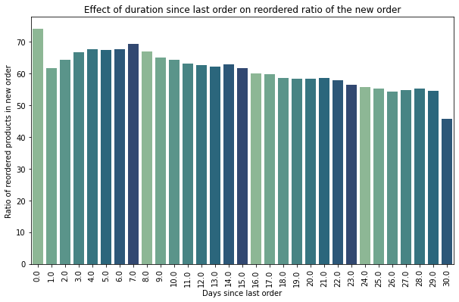
30
Business Questions
When to avoid recommending new products?
When it's most safe to recommend the user products they already know?
74 % of products bought at the same day of prev order, are reorders.
69% of products bought after one week from the previous order are reorders.
These are good timings to recommend products that user already knows.

Slide 12
31
Business Questions
When to avoid recommending new products?
By more than 65%, People usually buy previously ordered products from 6:00AM to 8:00AM
Recommend previously ordered products at these hours, while avoiding recommending new products at these hours.

Slide 13
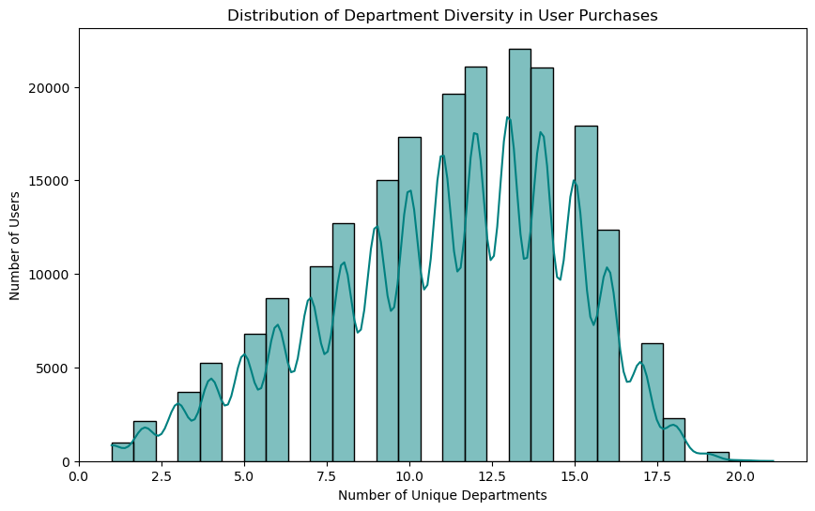
31
Business Questions
Analyzing Customer Purchase Diversity Across Departments
Most users purchase from a range of 10 to 15 unique departments, indicate a moderate to high level of diversity.
Fewer users shop at either a very low (0-5) or very high (15-20) number of unique departments.
Targeting users who shop from fewer departments could be a strategy to increase the breadth of their purchases by introducing them to a wider array of products.

Slide 14
32
Business Questions
Who should we avoid recommending new products?
We found that 685 users always buy previously ordered products. starting from their 2nd order they never buy something new.
Users with strong behavior!
E.g. user_id 197064

Slide 15
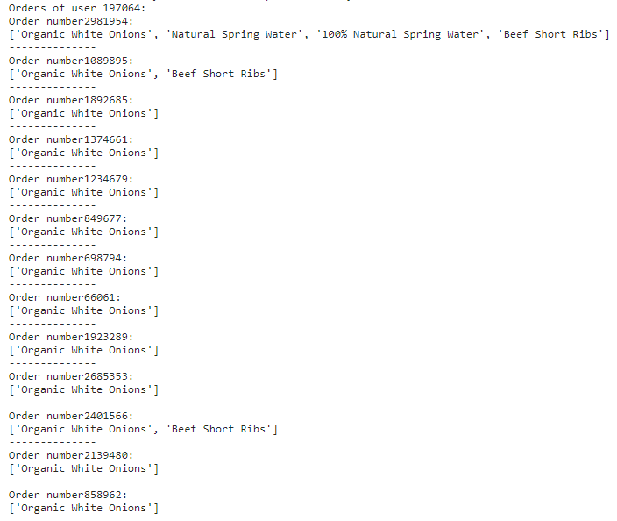
Purchases of user_id 197064
33

Slide 16
36
Analysis Model
Problem formulation
What do we want? We want to predict the products that will be in user's next future order.
Forming the data: We take each user with his/her previously ordered products, and form each record to be a user-product pair.
Then using cluster and relation rules, we can see whether this user will order or not this product in his/her future order.
Let's extract features that relate to this user-product pair.

Slide 17
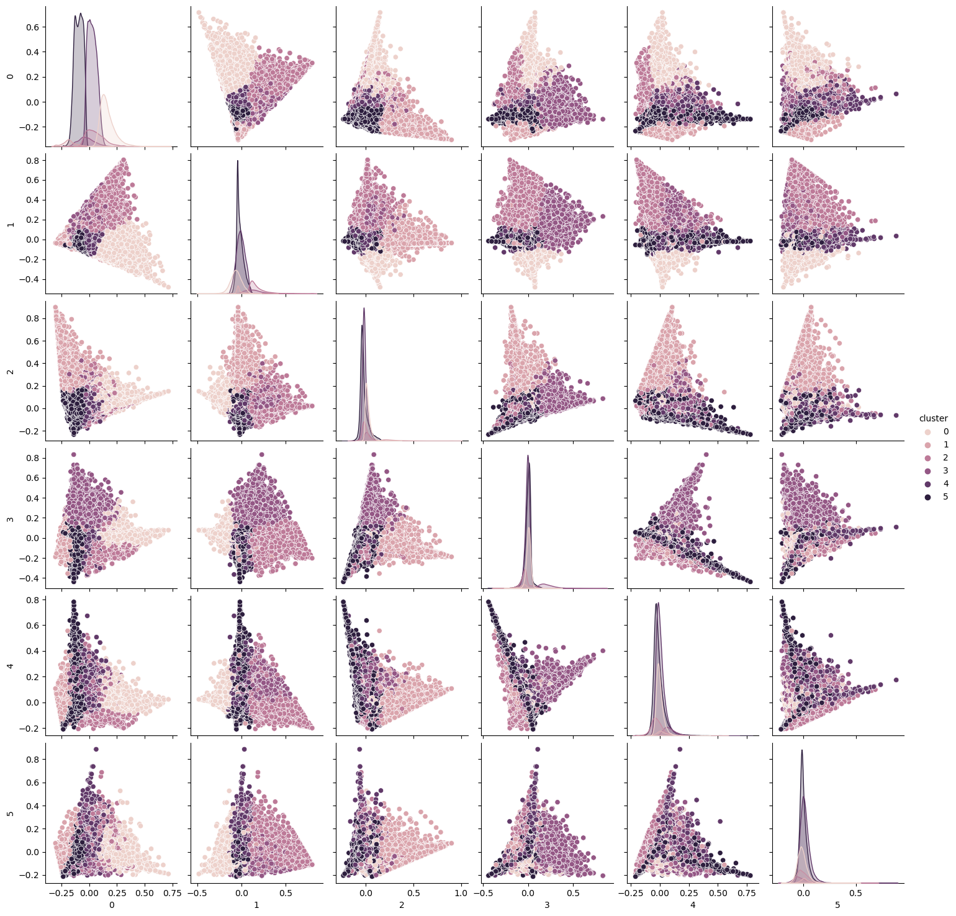
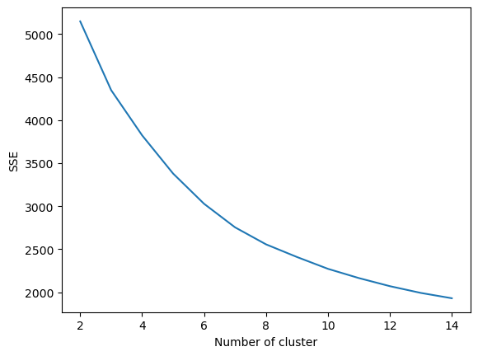
36
K-means Clustering

Slide 18
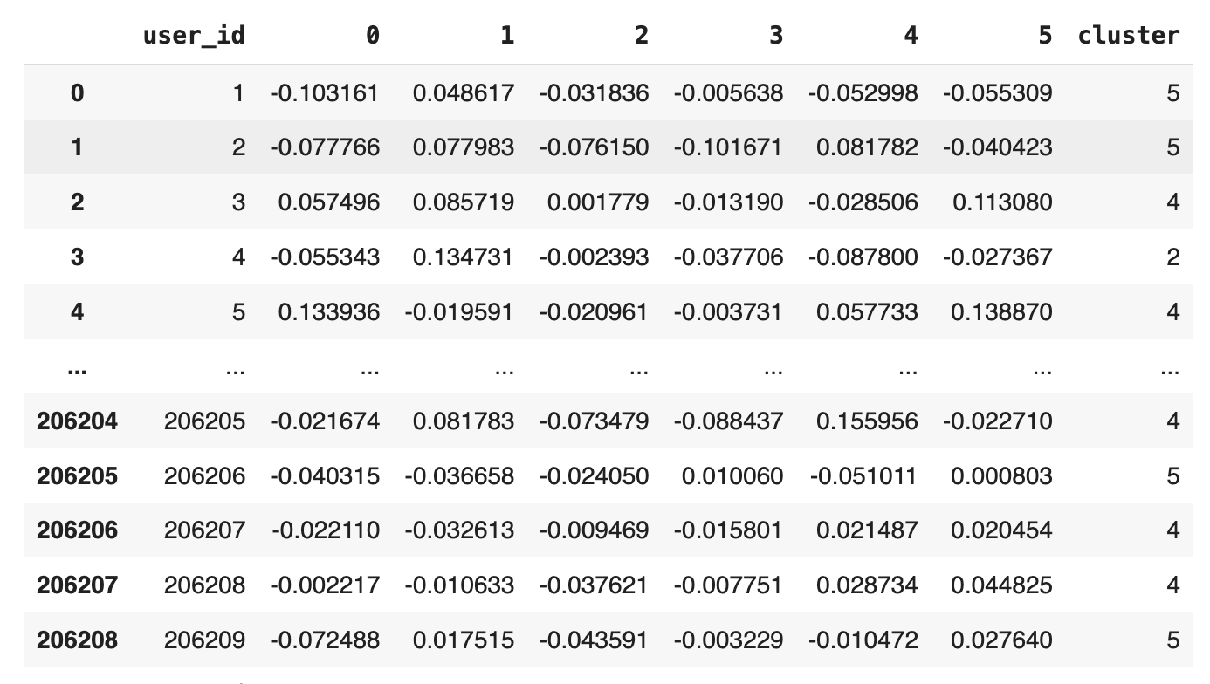
36
K-means Clustering
Clustering users based on purchase behavior using K-means.
PCA components are used to define user segments.
Each user is assigned a cluster number reflecting their purchasing pattern.

Slide 19
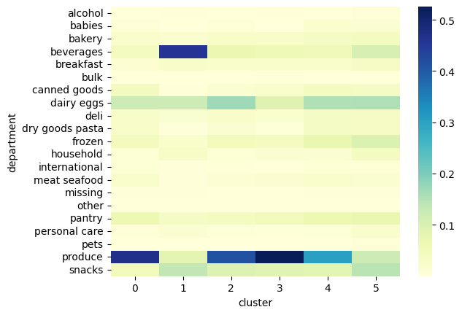
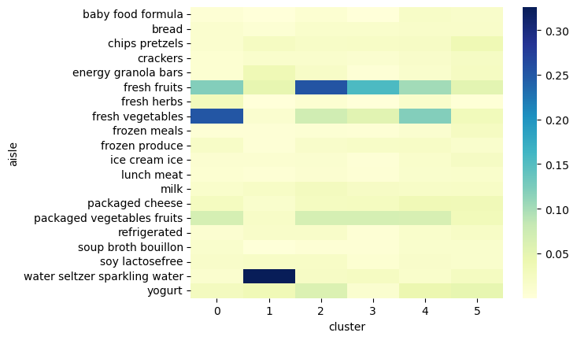
36
K-means Clustering
Department Preferences by Customer Cluster
Aisle Preferences by Customer Cluster

Slide 20
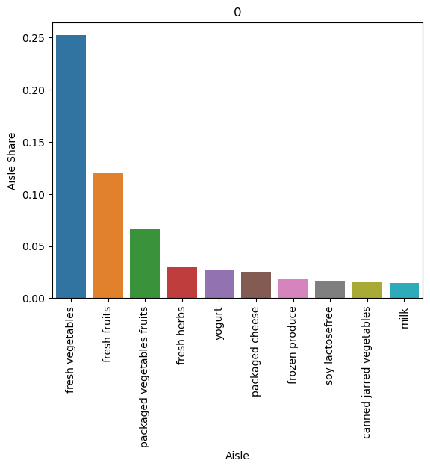
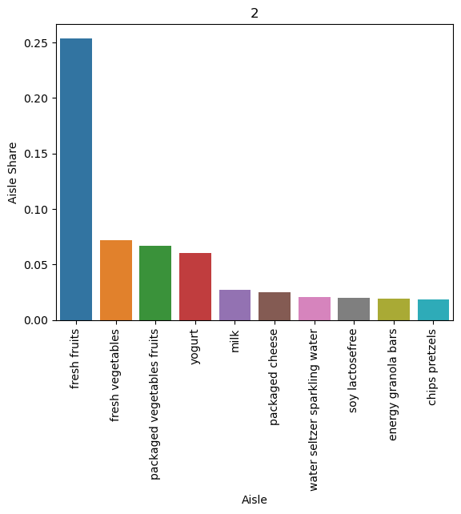
36
K-means Clustering
Top aisle purchases visualized for individual clusters.
Identifies cluster-specific product affinities.
Helps tailor recommendations to cluster-specific popular products.
Bar Chart of Aisle Shares per Cluster 0
Bar Chart of Aisle Shares per Cluster 2

Slide 21
50
Association Rules
Association rule finds interesting association or correlation relationships among set of data items ( products )
which is used for decision-making processes.

Slide 22
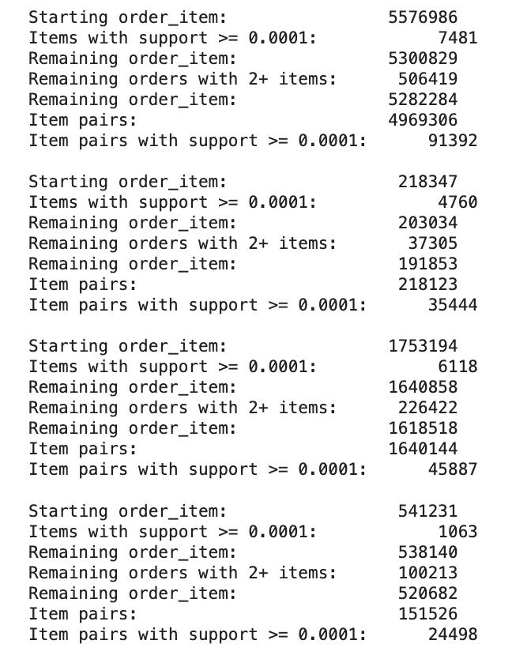
50
Association Rules
Cluster-Specific Product Pairing
This step forms relationships between items within large datasets of transactions.
The get_item_pairs function iterates through each order to generate all possible item combinations, which are then used to find frequent itemsets.
merge_item_stats function merges item frequency with the item pairs to calculate the support

Slide 23
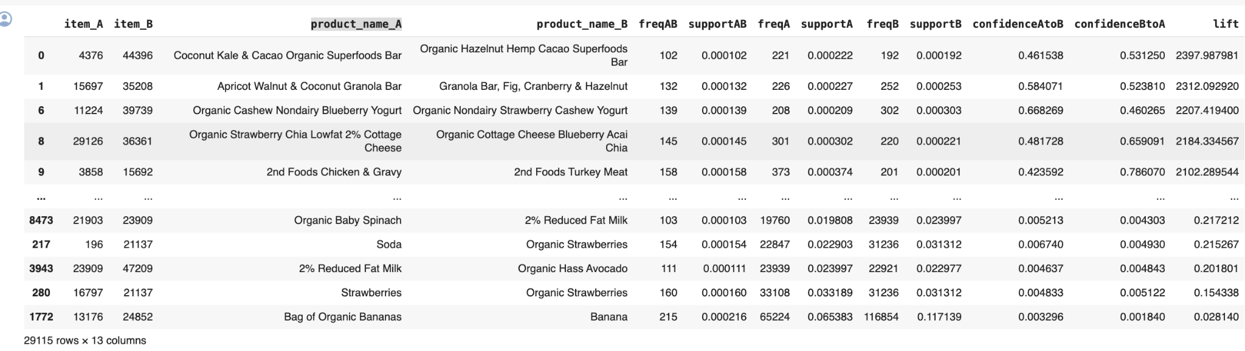
50
Association Rules
Cluster-Specific Product Pairing

Slide 24
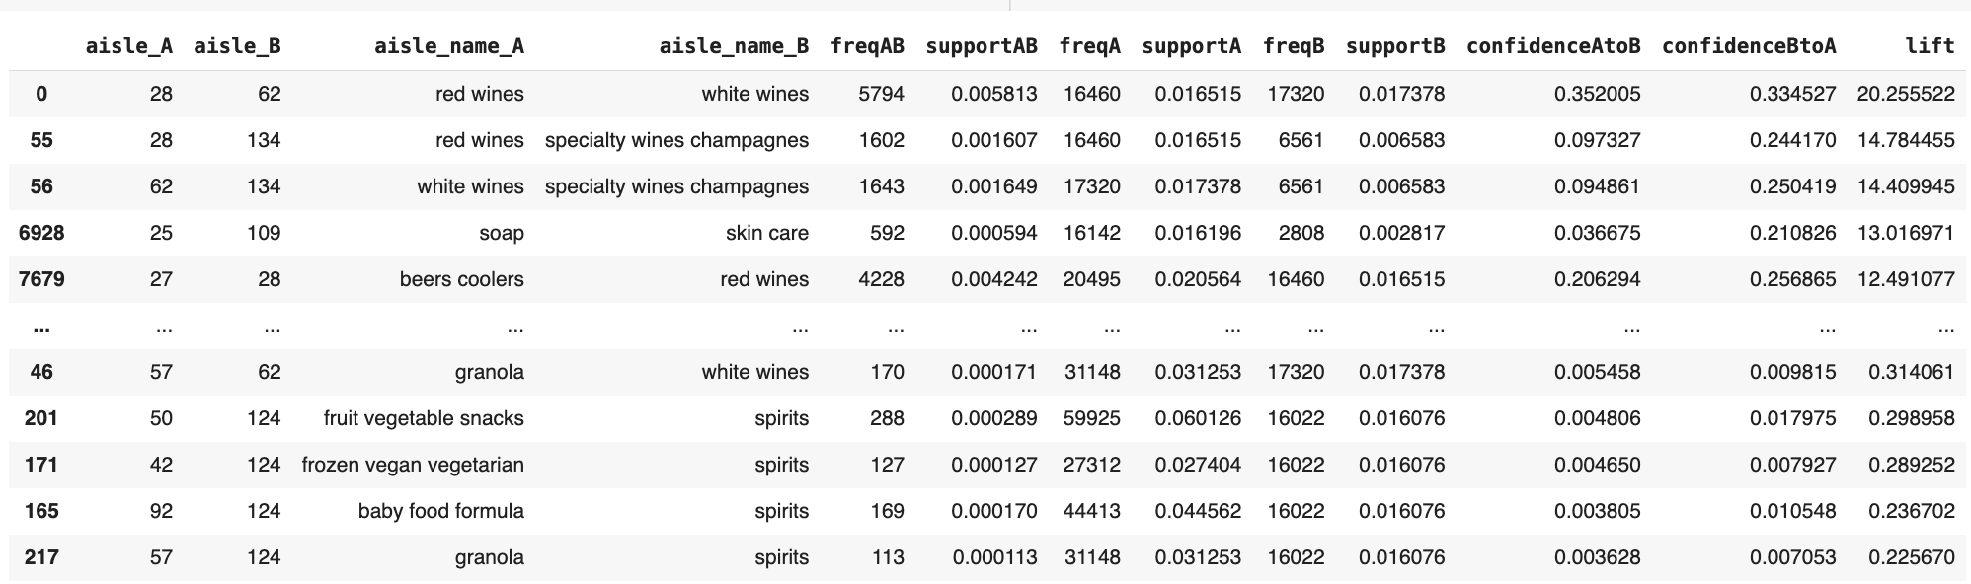
50
Association Rules
Cluster-Specific Aisle Pairing

Slide 25
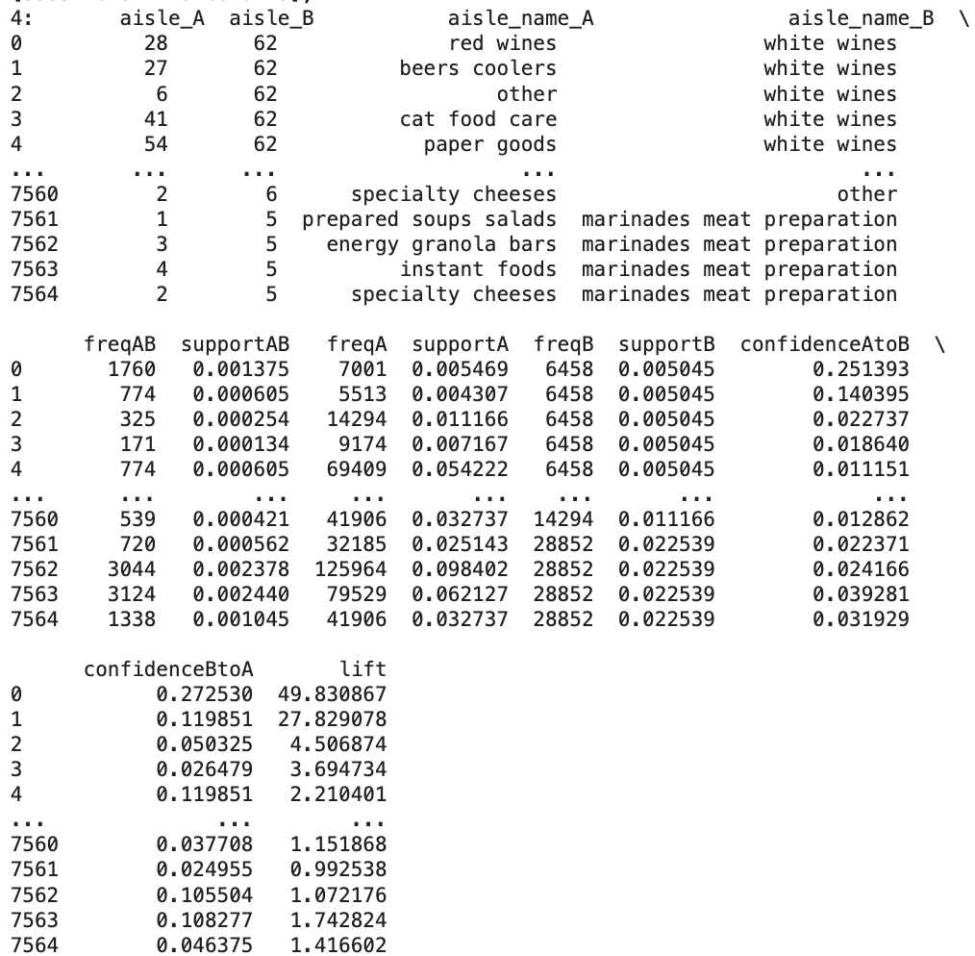
50
Association Rules
Cluster-Specific Aisle Pairing

Slide 26
Recommendation
Clustering Users: Segment users into clusters based on purchase behavior using K-means on PCA-reduced features.
Mining Association Rules: Identify frequent itemsets and calculate support, confidence, and lift for each cluster.
Building Rule Sets: Construct actionable rules from itemsets, filtering by confidence and lift thresholds.
Developing Recommendation Engine: Create functions to match users to clusters and retrieve cluster-specific rules.
Generating Recommendations: Recommend items with strong association rules to the input product for the user's cluster.
Delivering Recommendations: Present a sorted list of recommended products, excluding the input item.

Slide 27
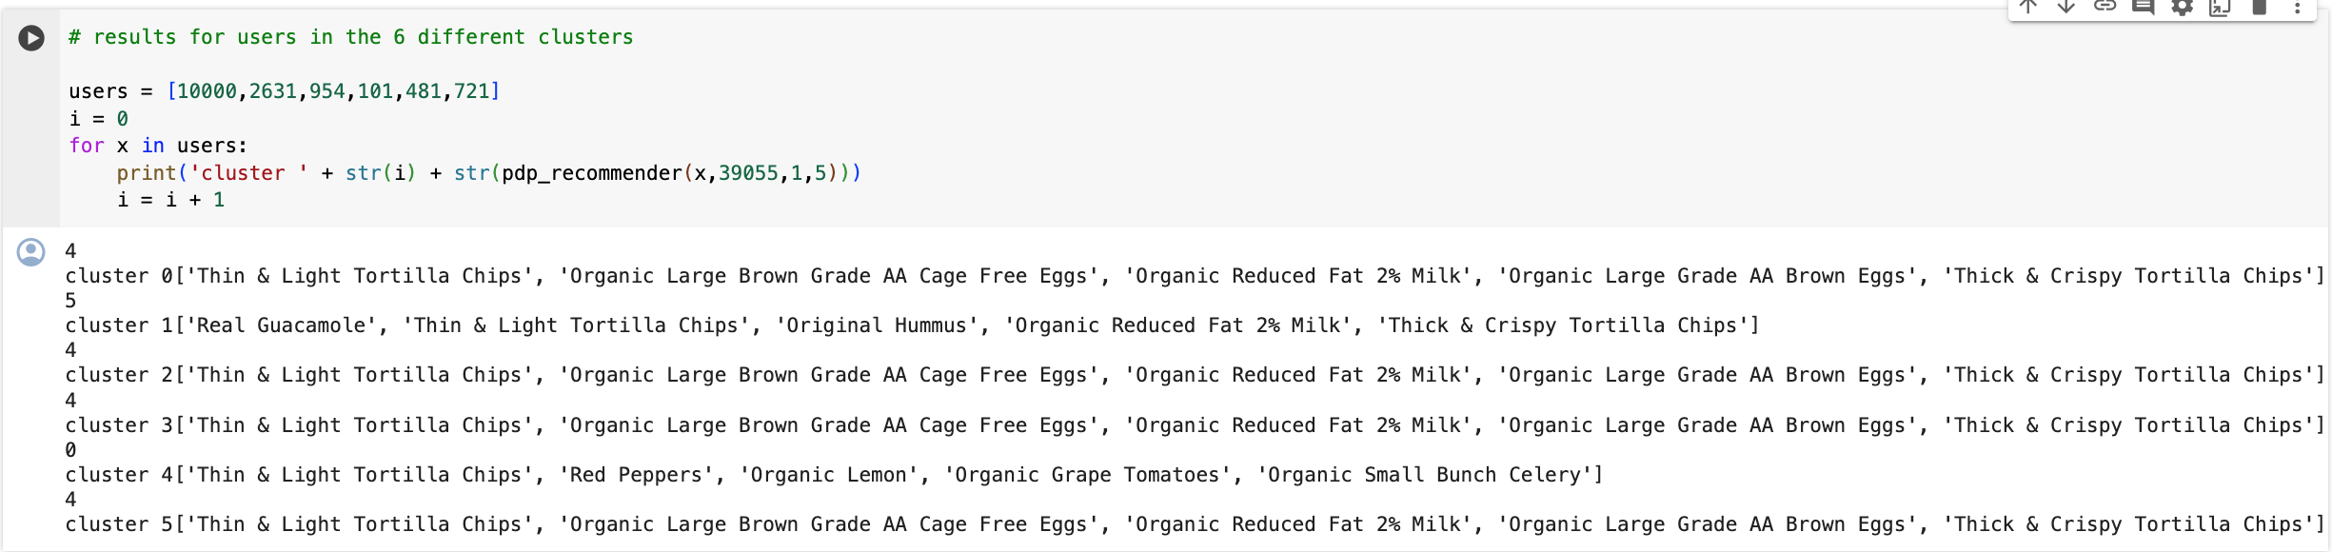
Recommendation

Slide 28
58
Conclusion
User shopping experience can be much enhanced if considered applying user-centric recommenders and associations.
From analysis, recommendation can differ according to time.

