Slide 1

Instacart Analysis for Personalized Recommendations
An in-depth exploration of customer purchasing patterns.
Team Members: Harish Narava, Bharath Gajula, Ram Malkari

Slide 2

Overview
Data source: Instacart online grocery orders.
Goal: Our central analysis objectives are to comprehensively understand Instacart customer purchasing behaviors and uncover actionable insights to inform business strategy and enhance customer experiences. By rigorously analyzing order patterns, product preferences, reordering habits and associations, we aim to paint a nuanced picture of customer segments and shopping dynamics
Approach: Initial descriptive statistics on monthly/weekly order rates, peak hours, and popular product categories will outline macro-level directional indicators of customer activity. Building on this, advanced algorithms will group customers into distinct segments based on their unique order characteristics. These tailored profiles allow for precision targeting through customized engagement strategies and recommendations.

Slide 3
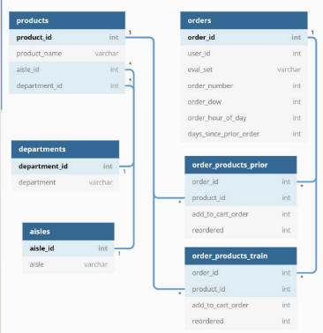
Data Overview
205,000 users contributing to the data.
Over 3 million orders analyzed.
49,685 products examined.

Slide 4
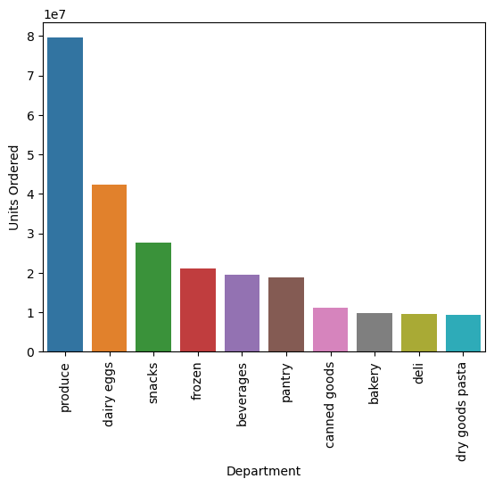
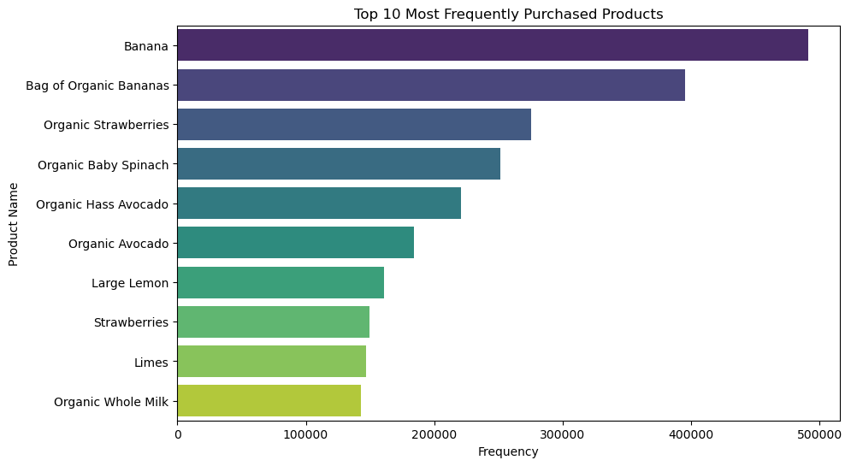
Top Departments
Produce is most purchased in terms of the number of units.
Followed closely by dairy eggs and snacks.
Most frequent
Most of the items belong to the fruits and vegetables department
Banana is the most purchased item.

Slide 5
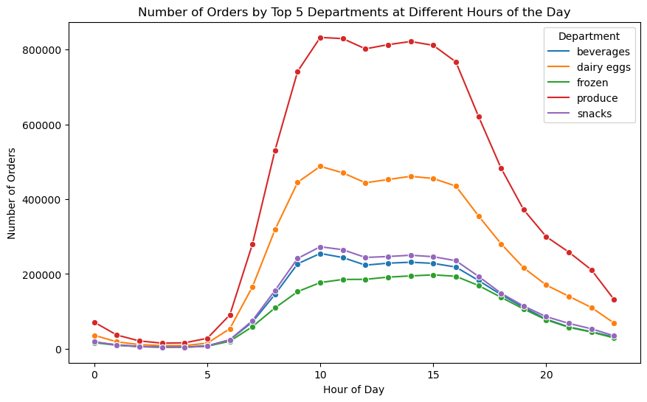
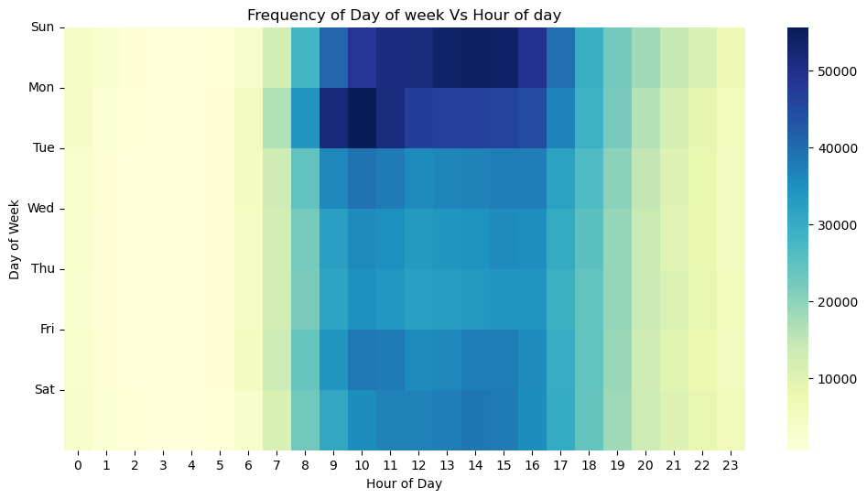
Peak Order Times
Afternoons and evenings are most popular for orders.
Produce department peaks in purchases mid-day.
Sunday and Monday are the busiest days of the week.

Slide 6
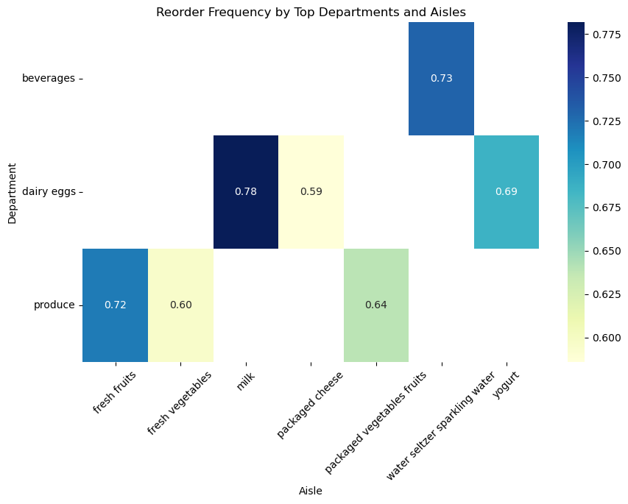
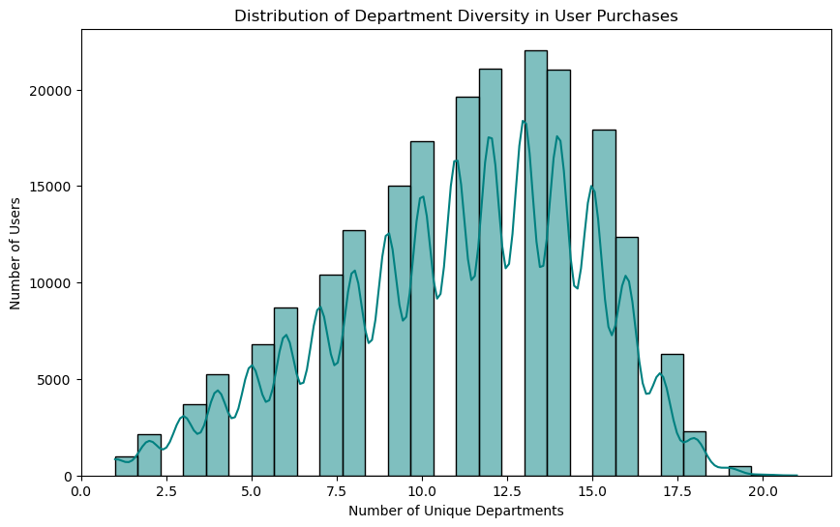
.
Reorder Frequency Heatmap
Beverages and dairy products, particularly yogurt, show strong customer repurchase patterns.
.
Department VS User Purchases
Most users purchase from a range of 10 to 15 unique departments, indicate a moderate to high level of diversity.

Slide 7
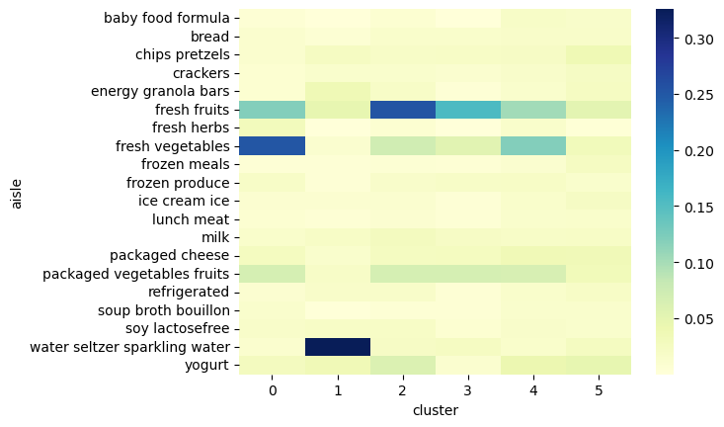
User Segmentation
Clustering applied on aisle purchase behaviors.
6 distinct user segments were identified.

Slide 8

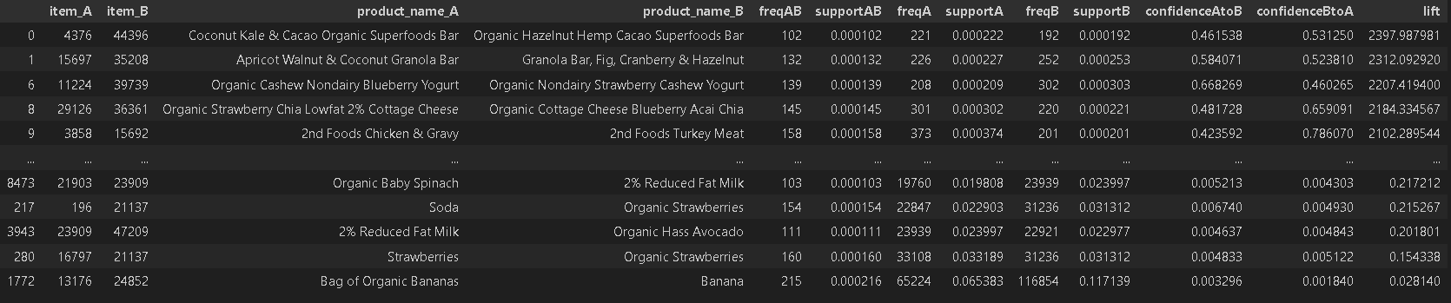
Association Rules
Applied separately to each user segment.
Reveals unique relationships tailored to each cluster.
Rules Support Confidence
{Chips} -> {Guacamole} 0.1% 46%
{Strawberries} -> {Yogurt} 0.1% 65%
Key patterns:
- Strong associations for complementary perishable foods
- Lower support for specialized products like alcohols

Slide 9
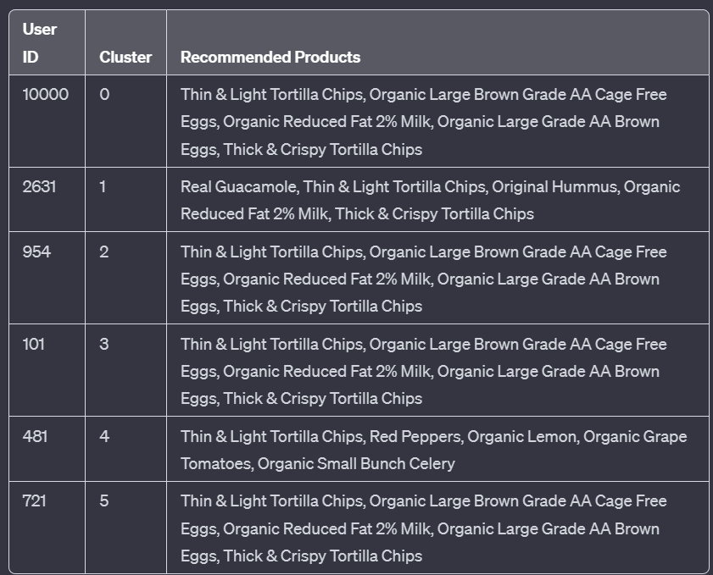
Recommendation Engine
Users mapped to their respective segments.
Next product suggestions based on cluster-specific rules.
Cluster 1 seems to represent customers that commonly buy dairy and chips, but also pair them with dips/appetizers like hummus and guacamole. Recommendations are tailored to those behaviors. The other clusters show very similar recommendations dominated by produce, eggs, milk, and chips. This suggests significant overlap in top purchases across those user segments.
However, cluster 4 stands out as having uniquely different tastes geared towards fresh vegetables and fruits rather than staple dairy and snacks. The recommendations like lemons, celery and grape tomatoes reflect produce affinity.

Slide 10

Conclusion
Key insights:
- Identified 5 customer segments with distinct purchase habits based on clustering
- Top departments by share of units ordered: produce, snacks, dairy
- Associated products likely to be ordered together like chips and hummus
Main recommendations:
- Target department-specific promotions to customer segments
- Provide personalized product recommendations based on associations
- Adjust inventory for high demand produce and snacks

