Slide 1

AMCAT Data Analysis
Team:
A.Bharath Kumar
Batch-186

Slide 2
Packages used
Pandas
NumPy
Matplotlib
Warnings
SciPy
Seaborn
Ipywidgets
Plotly

Slide 3
Table of content
Univariate Analysis
Bivariate Analysis
Multivariate Analysis

Slide 4

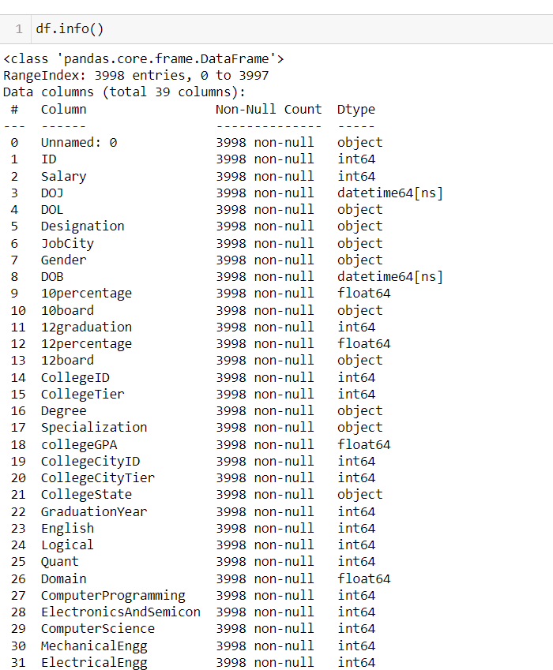
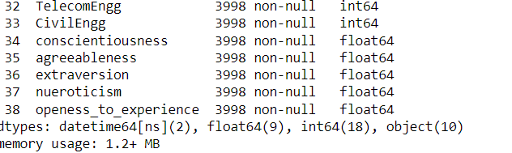
Shape and Info of data

Slide 5
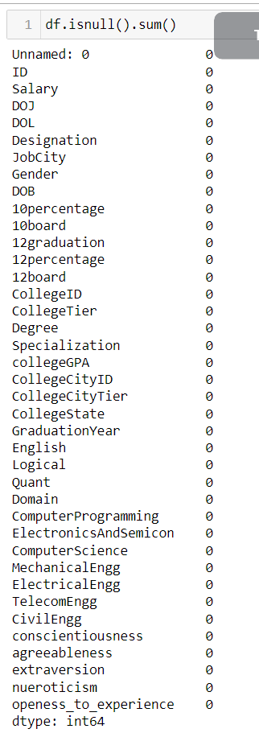
Checking Null values
There are no null values

Slide 6
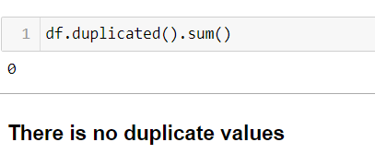
Duplicate values

Slide 7
Univariate Analysis insights on Numerical
Minimum salary is 35000 and Maximum salary is 4000000
From the above plot as we can see that it's having a long tail at the right side , looks like log normal distribution¶
Lowest percentage in 10th is 43.0 and Highest percentage in 10th is 97.76
From the above plot as we can see that it's having a thick tail towards the left side looks like a negatively skewed distribution
Lowest percentage in 12th is 40.0 and Highest percentage in 12th is 98.7
From the above plot as we can see that it's having a tail towards left side looks like a negatively skewed distribution
In the year 1999 only 1 person completed his graduation and his id is 32034
Highest count of 12 graduation year is 2009 and the count is 1052
negative skewed distribition left tail and positive kurtosis
Lowest CollegeGPA is 6.45 and Highest CollegeGPA is 99.93¶
From the above plot we can see that it's having a long tail towards the left looks like highly negativly skwed

Slide 8
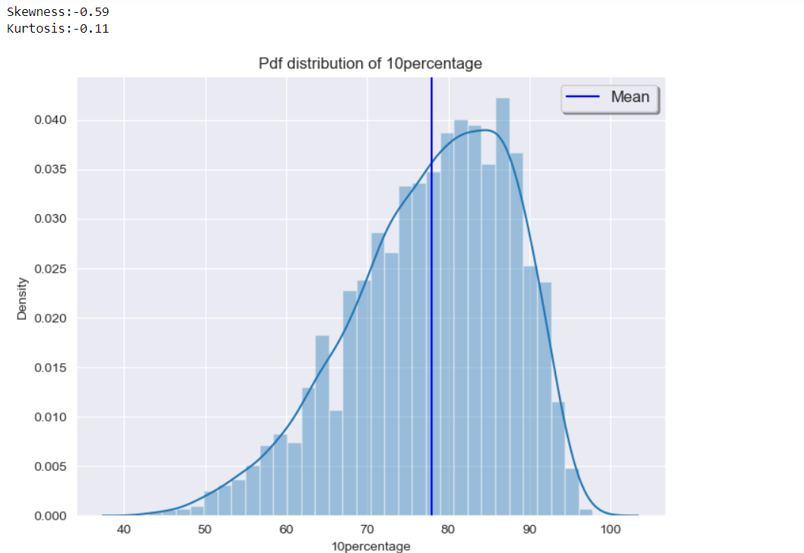
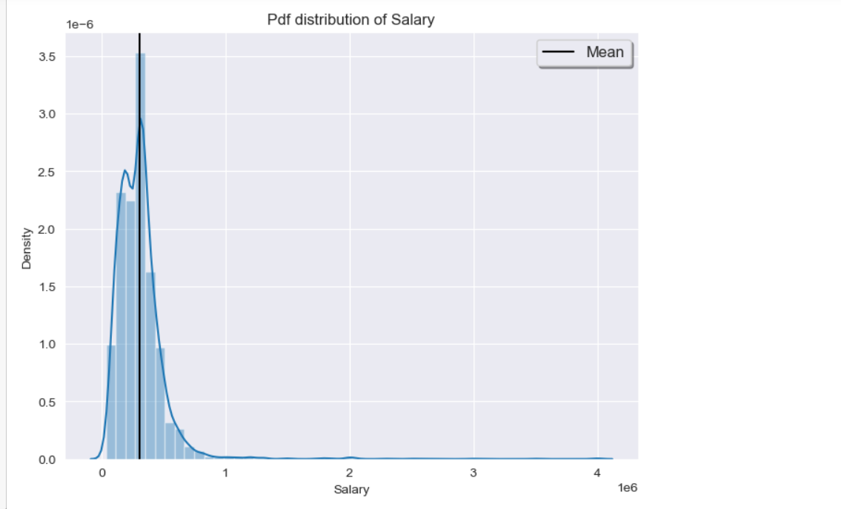
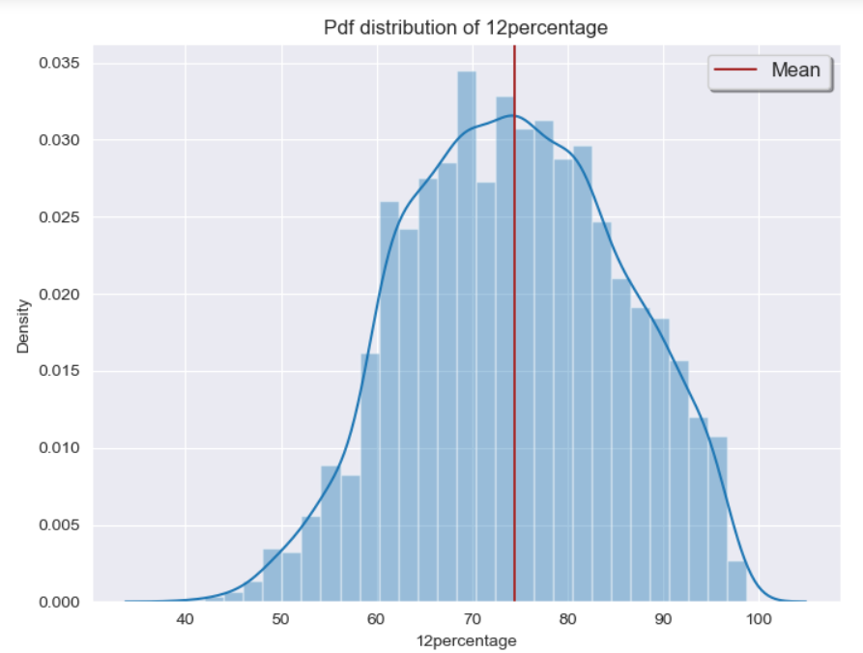
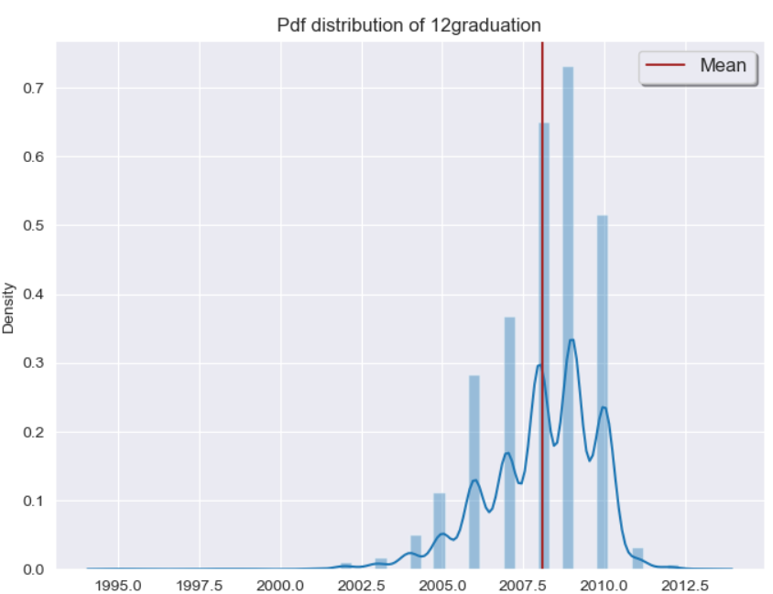

Slide 9
Univariate Analysis insights on Categorical
From the above plot we can say that there are more male candidates than female
From the above plot we can analyse that most of the candidate choose software engineering
More people are choosed to work in banglore
From the above plot we can say that most of the candidates are from B.Tech/B.E¶
From the above plot we can see that most choosed specialization is Electronics and communication engineering
From the above plot we can see that Uttar Pradesh is having most of the preferrence colleges¶

Slide 10
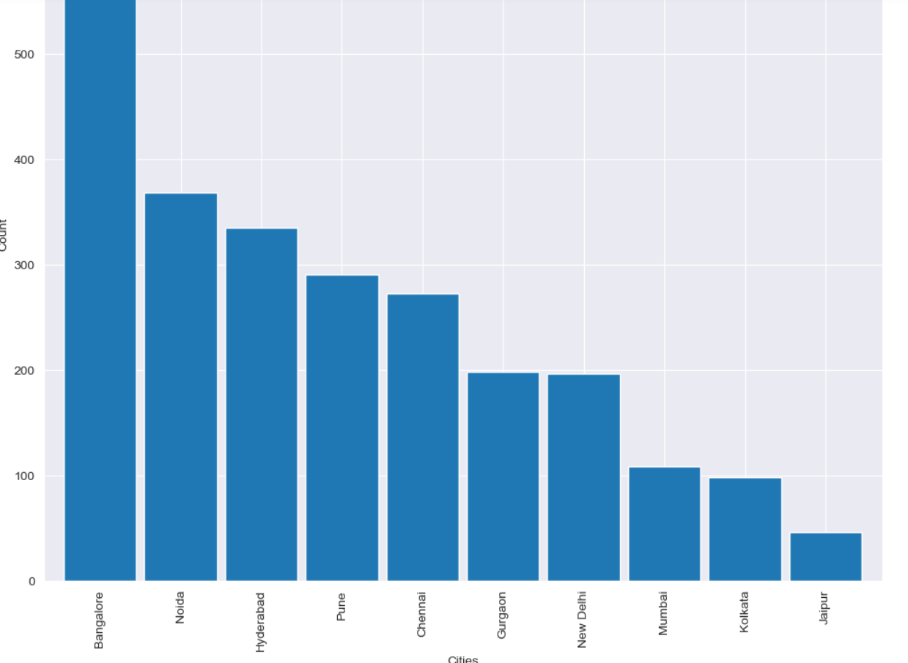
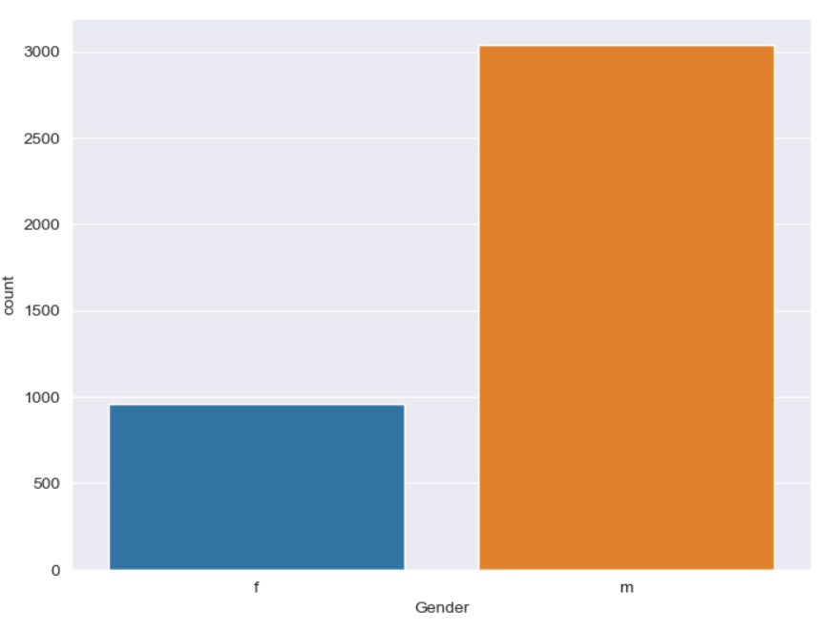
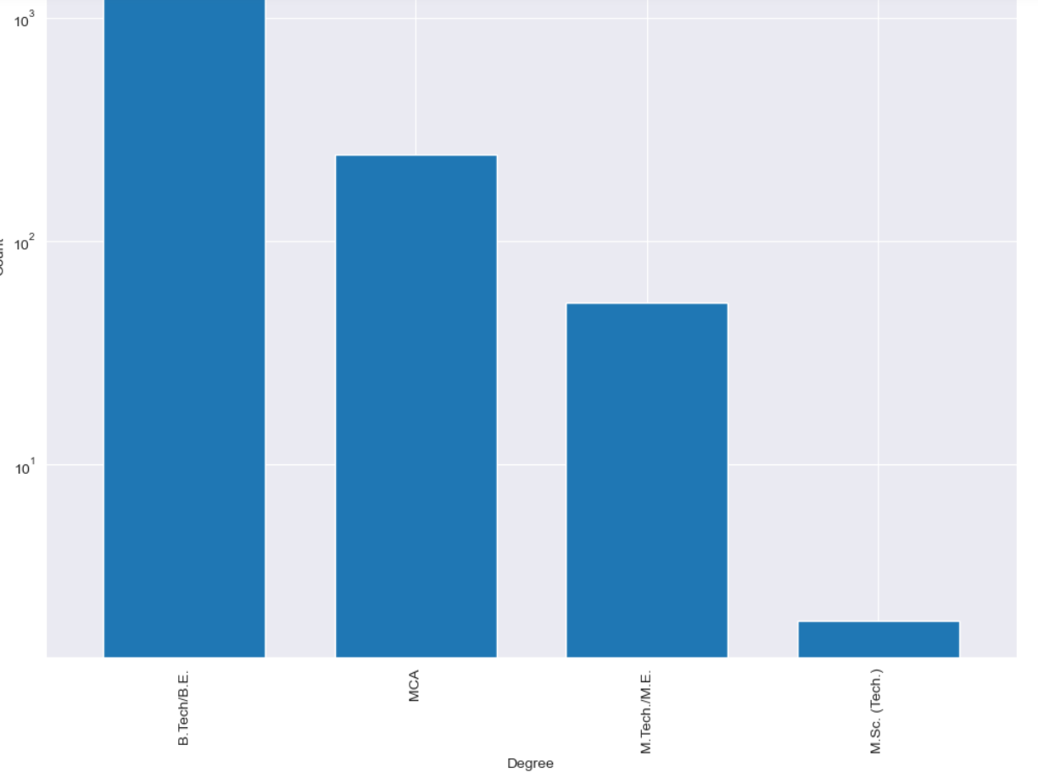
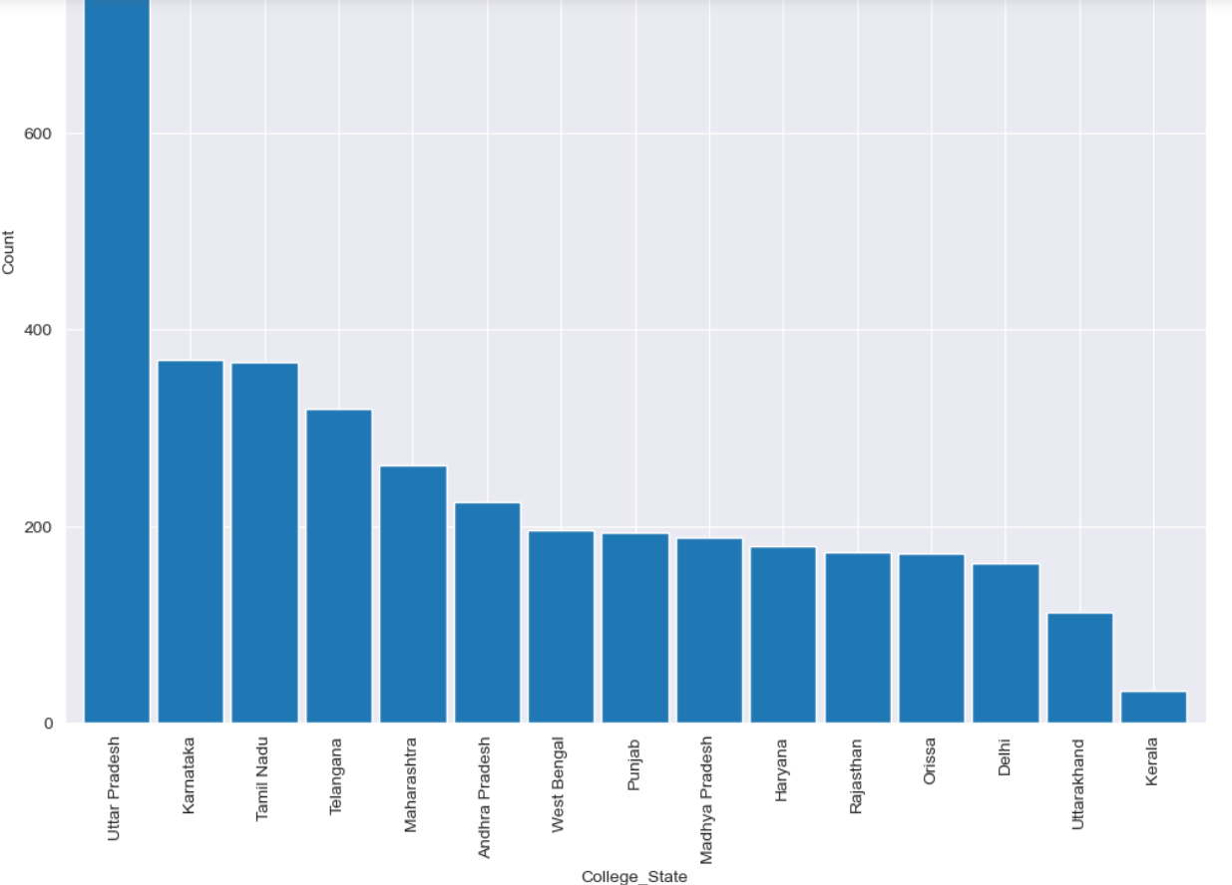

Slide 11
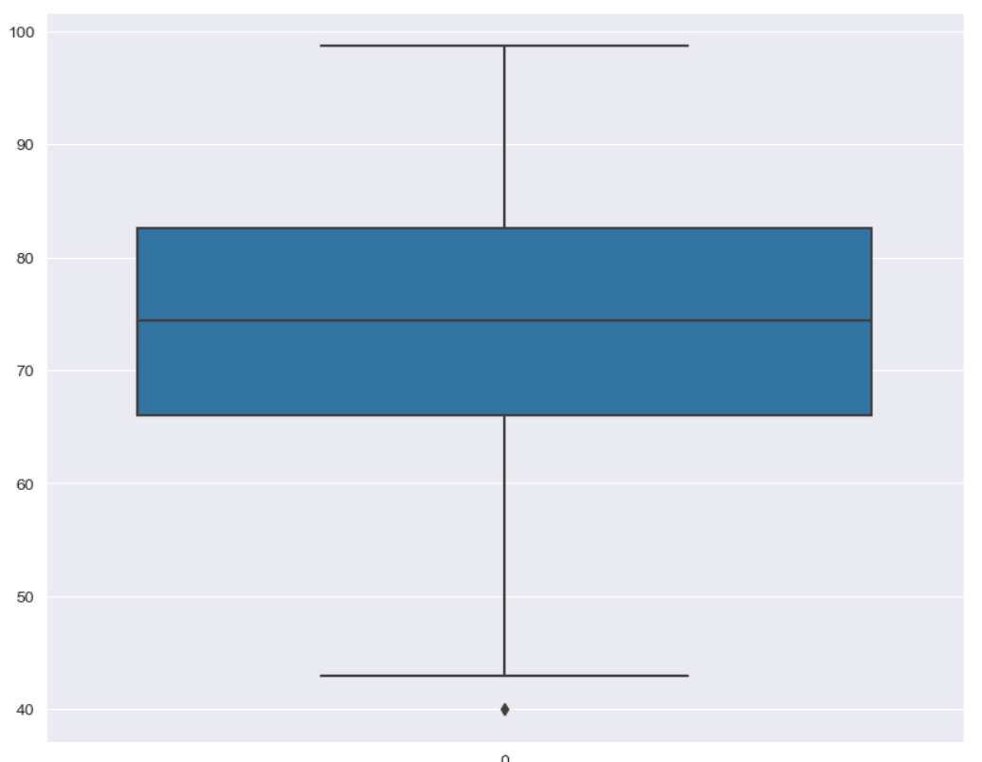
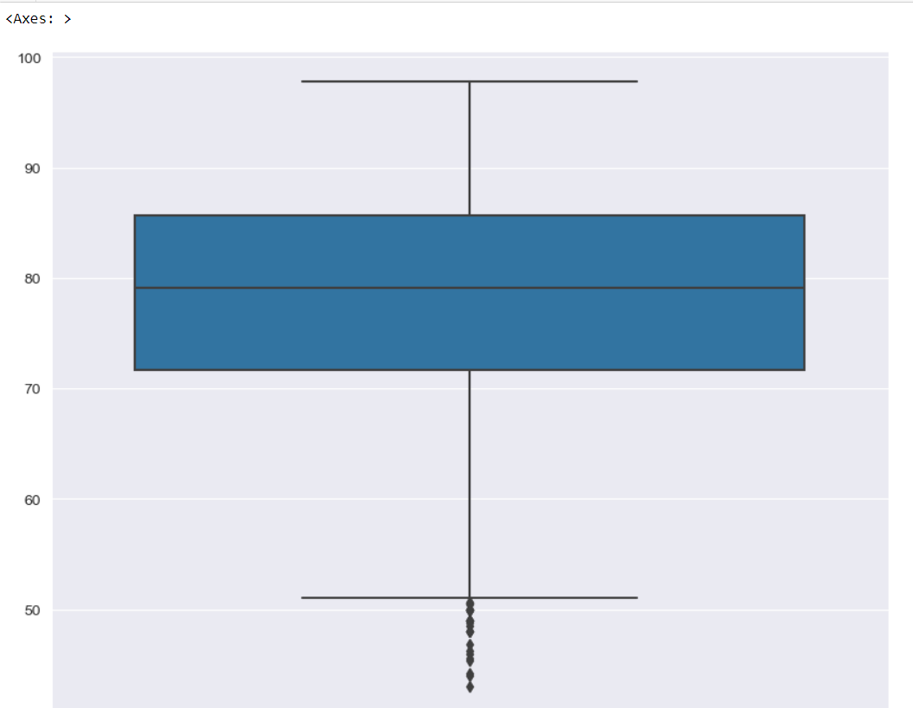
Finding the outliers
10 percentage
12 percentage

Slide 12
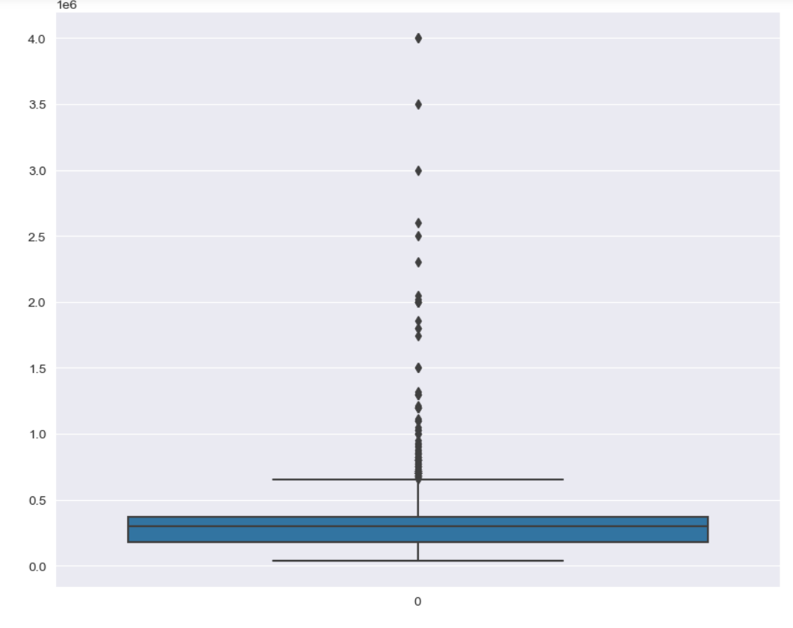
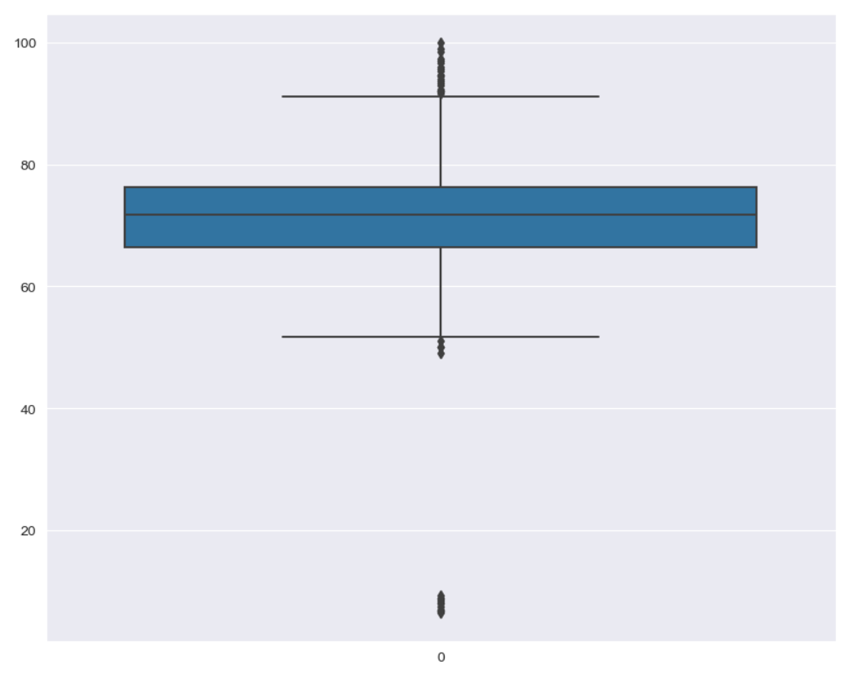
salary
collegeGPA

Slide 13
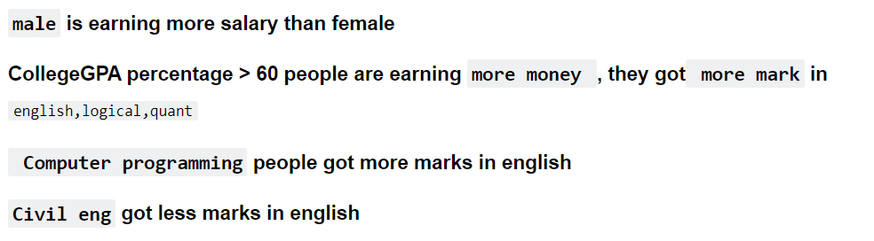
Bivariate Analysis insights

Slide 14
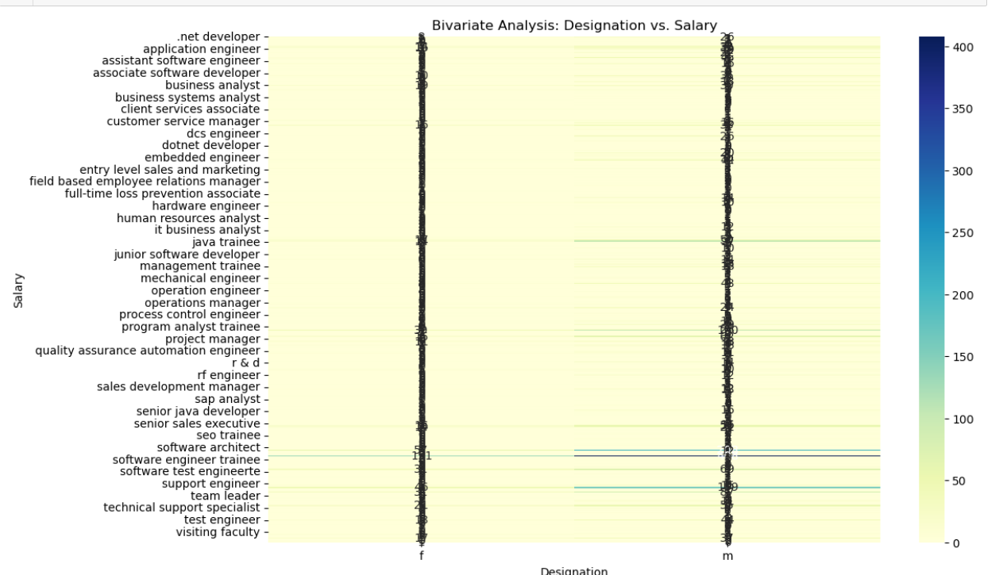

Slide 15
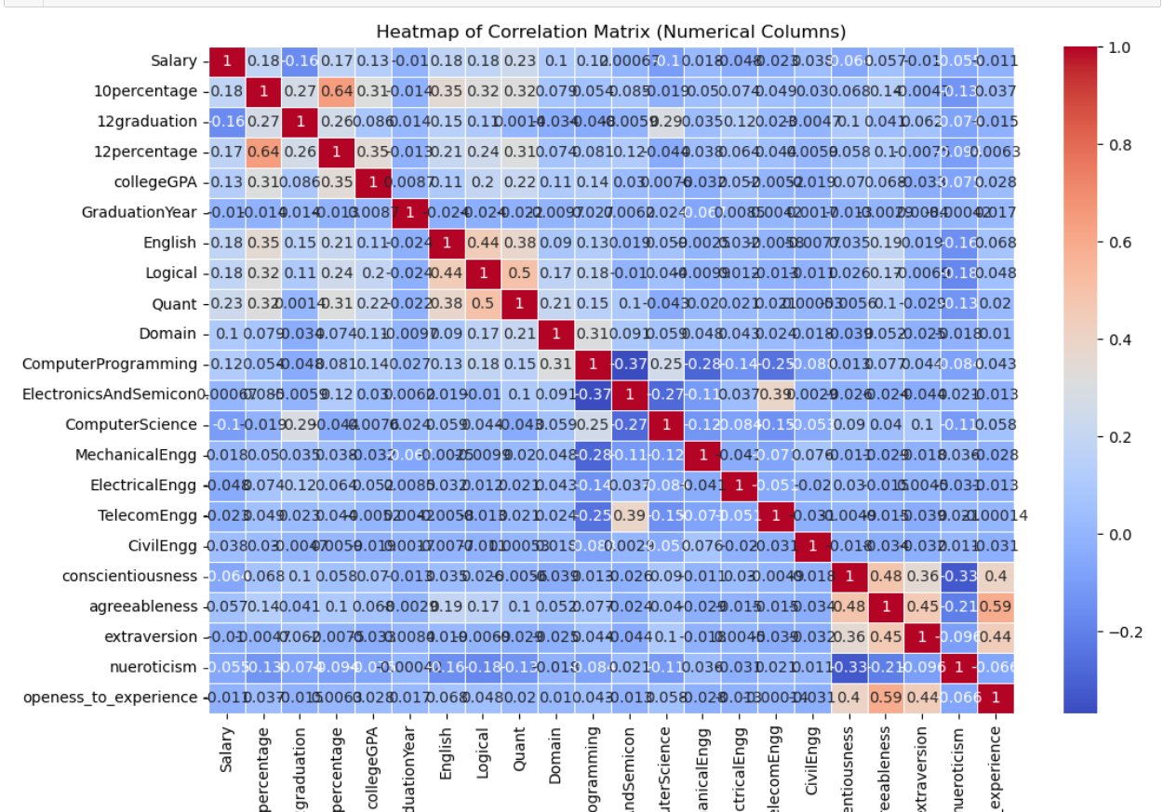
Multivariate Analysis insights

Slide 16
Thank you

