Slide 1
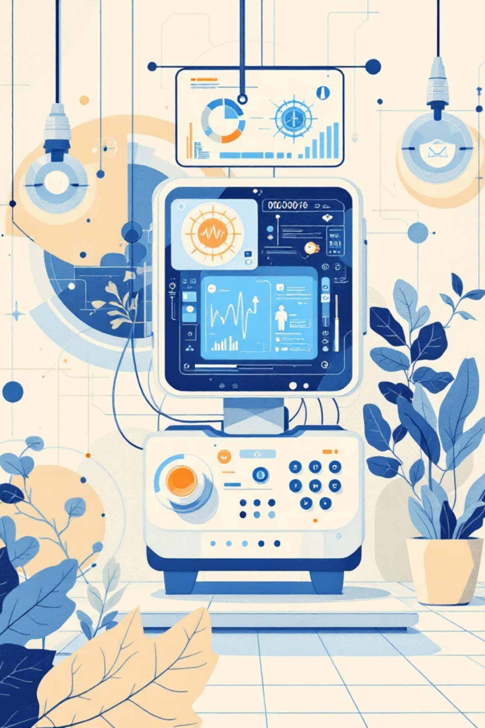
AI-Based Disease Prediction System

Slide 2

1. Introduction
Artificial Intelligence (AI) is widely used in healthcare to predict diseases using patient data. The AI-Based Disease Prediction System helps to identify possible diseases based on symptoms entered by the user. This system uses machine learning algorithms to analyze patient symptoms and predict the most likely disease. It helps doctors and patients to get an early idea about health conditions.

Slide 3

2. Objective
To develop a system that predicts diseases using AI.
To reduce the time required for disease diagnosis.
To provide early health suggestions to users.

Slide 4

3. Problem Statement
Many people do not know which disease they may have based on their symptoms. Visiting hospitals for every small symptom is difficult. Therefore, an intelligent system is needed to analyze symptoms and predict possible diseases quickly.

Slide 5
4. Methodology
The system collects symptoms from users and compares them with a medical dataset. Machine learning algorithms analyze the data and predict the possible disease.
Steps:
01
02
03
Collect dataset of diseases and symptoms.
Clean and preprocess the data.
Train the machine learning model.
04
05
Input symptoms from the user.
Predict the disease using the trained model.

Slide 6

5. Tools and Technologies
Python
Pandas
NumPy
Scikit-learn

Slide 7


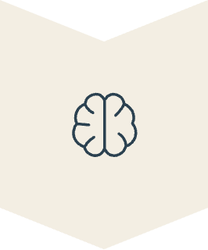


6. System Architecture
User enters symptoms
Data processing
Machine Learning model
Disease prediction
Result display

Slide 8
7. Advantages
Fast disease prediction
Helps in early diagnosis
Easy to use system
Supports healthcare decision making

Slide 9

8. Future Scope
In the future, this system can be improved by integrating real hospital data, adding more diseases, and connecting with mobile applications for better healthcare support.

Slide 10

9. Conclusion
The AI-Based Disease Prediction System helps to predict diseases using machine learning techniques. It improves healthcare services by providing quick and accurate disease predictions.

