Slide 1

cv
Traffic Signal Control System for Tackling Congestion in Urban Areas
Team members
K K Bharath
K Revanth Krishna
K Jawanth Reddy
M. Sri Bhuvan
Under the guidance of
Dr. Ramya R S,
Associate Professor,
Dept of Computer Science and Engineering
Department of Computer Science & Engineering, DSCE

Slide 2
cv
TABLE OF CONTENTS
Abstract 03
Modules Identified 04
CNN-DQN Model 05
ResNet18-DQN Model 07
Contour Approximation-DQN Model 09
YoloV7 Model 11
Simulator-Traffic3D 13
Comparison of graphs 15
Co-guide Interactions 16
Team Contributions 17
Tech Frameworks Used 18
Project Management Tool 19
Department of Computer Science & Engineering, DSCE

Slide 3
cv
ABSTRACT
The number of vehicles is rising daily and so is traffic. In metropolitan places, traffic congestion has been a significant issue, moreover this is majorly observed at road intersections.
Most existing traffic signal systems are pre-timed and don’t act with real time. This is also affecting the emergency service vehicles.
To tackle this several traffic signal control systems have been used to reduce wait time near intersection areas which works based on real time traffic on sufficient training
This paper discusses different traffic signal control models and algorithms to investigate further in this field.
Department of Computer Science & Engineering, DSCE

Slide 4
MODULES IDENTIFIED
Reinforcement Learning model
This includes a reinforcement learning model that can take in an image of the junction as input and output a Q-value distribution for each action.
YoloV7 model
This is a pre-trained object detection model that is trained to recognize emergency vehicles such as ambulances and police vehicles.
Traffic Simulator
This is a simulator built in Unity that is able to mimic an actual junction with different types of vehicles. It also has a camera installed which can transmit images to the RL model

Slide 5
Reinforcement learning model - CNN-DQN
It includes a model that is able to learn the correlation between the image of the junction and the best action that is taken.
Three models have been tried and compared - CNN-DQN, ResNet-DQN and CA-DQN.
CNN-DQN involves a small neural network with lesser number of hidden layers.
The only pre-processing applied to the input image is the removal of background and reducing the dimensions of the image.
It is observed that it takes a long time to train and converge on the optimal actions.

Slide 6
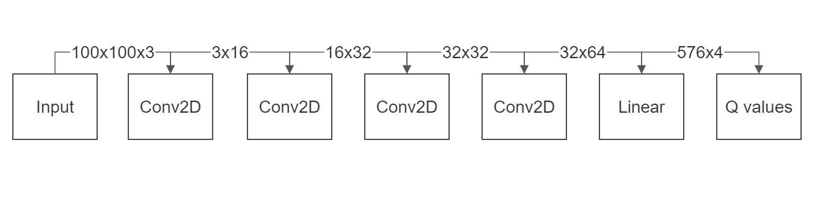
Architecture of the CNN-DQN Deep Learning model

Slide 7
Reinforcement learning model - RESNET18-DQN
The second model that we tried is ResNet18-DQN.
The 18 indicates 18 hidden layers.
It helps solve the problem of exploding gradients in the CNN-DQN by skipping over a few layers during training.
This, in turn, also helps us train deeper neural networks which are proved to learn much more compared to shallower networks.

Slide 8
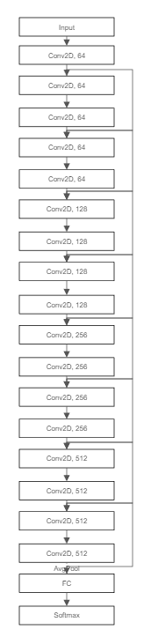
Architecture of the ResNet18-DQN Deep Learning model

Slide 9
Reinforcement learning model - CA-DQN
The third model was our innovation over the first two.
It uses a Computer Vision approach of pre-processing called Contour Approximation.
Contour Approximation helps us identify the number of vehicles in each lane which acts as the state.
The main advantage of having such a small state is that more data can be stored and training can happen much more faster.
We observed that this model was able to give the best results in the given scenario.

Slide 10
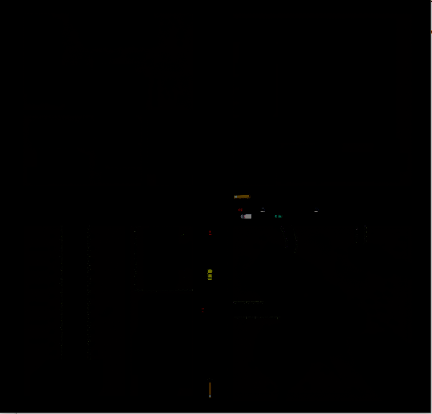
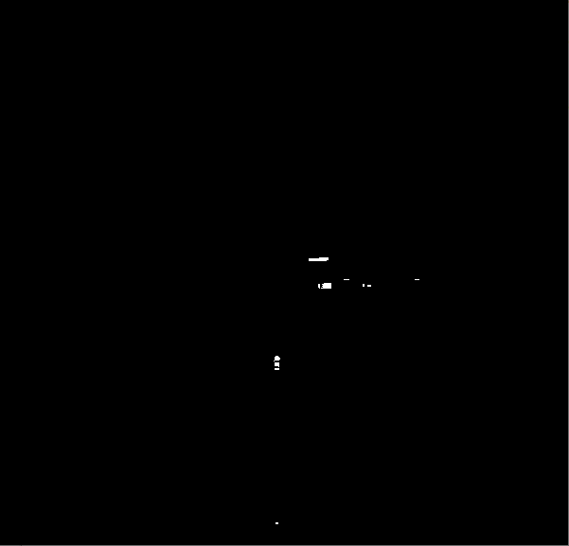
Working of Contour Approximation
Image before Contour Approximation
Image after Contour Approximation

Slide 11
YOLOV7 object detection model
Our system is also designed to automate the process of handling emergency vehicles.
The way this works is by running an object detection algorithm that is trained to recognize ambulances and police vehicles on any image of the junction.
If an emergency vehicle is detected, the lane corresponding to it is noted down.
This lane is given the highest priority and the lane is freed, ignoring the lane given by the Reinforcement Learning Algorithm.

Slide 12
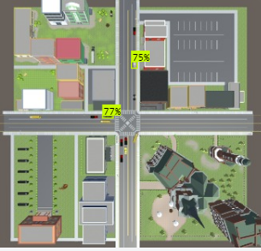
YOLOV7 emergency vehicle detection sample
The trained model detecting an ambulance and a police vehicle

Slide 13
Simulator - Traffic3D
We used traffic3D as our simulator.
traffic3D provides an easy to use interface to create realistic traffic in junctions.
It comes with pre-modeled vehicles that are able to move just like real-time vehicles and follow traffic rules.
traffic3D also allows the addition of vehicles such as ambulances to make the junction resemble real-life.
It also comes with a TCP connection interface which allows connecting to an external Python Script which can communicate with the simulator and send and receive data.

Slide 14
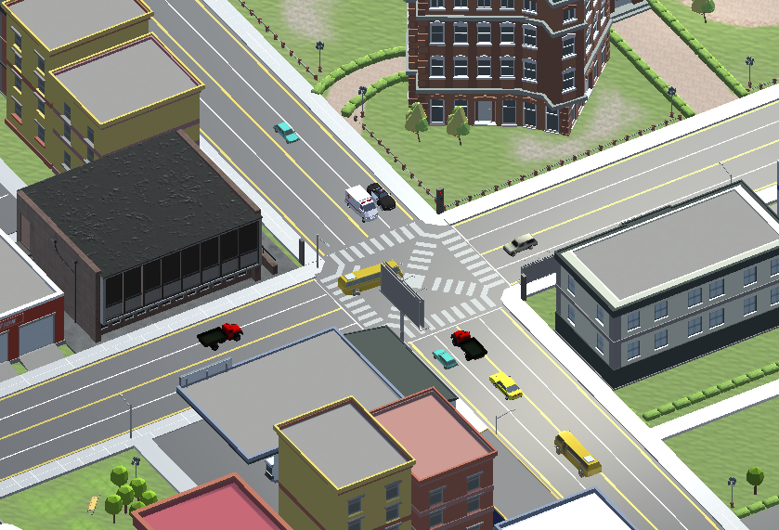
Simulator - Traffic3D

Slide 15
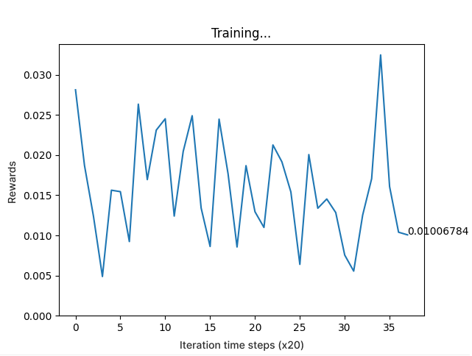
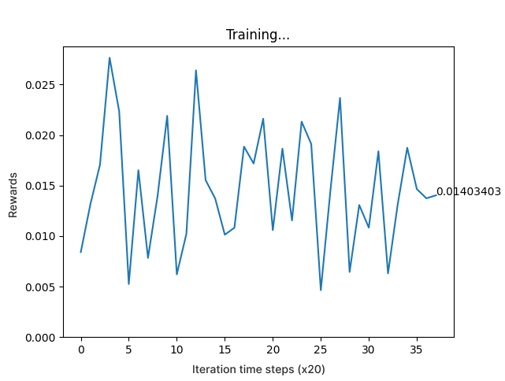
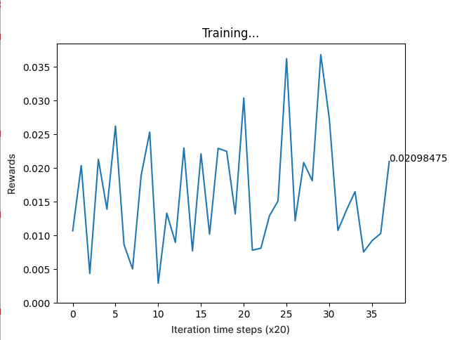
Comparison of results of different models
CNN-DQN
ResNet18-DQN
CA-DQN

Slide 16
CO-GUIDE INTERACTIONS
DATE | PARTICULARS
14th January 2023 | We discussed the problem statement from selected paper We put forth our understanding in the base paper
30th January 2023 | We presented our literature survey work. Some implementations ideas were discussed Suggestion given : Handling multiple emergency vehicles
9th April 2023 | We presented our fully functioning project. The given suggestion is implemented in our project The guide has cleared our project.

Slide 17
TEAM CONTRIBUTIONS
Members | Contribution
K K Bharath 1DS19CS062 | Building the different models, working on graphs.
K Revanth Krishna 1DS19CS064 | Working on the simulator, setting up traffic3D.
K Jaswanth Reddy 1SD19CS066 | Labelling dataset for Yolo-training, changing Unity code to meet requirements.
M Sri Bhuvan 1DS19CS082 | Training YOLO object detection, integrating with Python code.

Slide 18
TECH FRAMEWORKS USED
Hardware:
GPU - Nvidia GeForce GTX 1660 for training different models
Ryzen 5 3500 CPU for image processing and capturing
Software:
Unity3D for simulation, experimentation
Pytorch for building Deep Learning models
MatPlotLib for visualization
Roboflow for building dataset and YOLOv7 model training

Slide 19
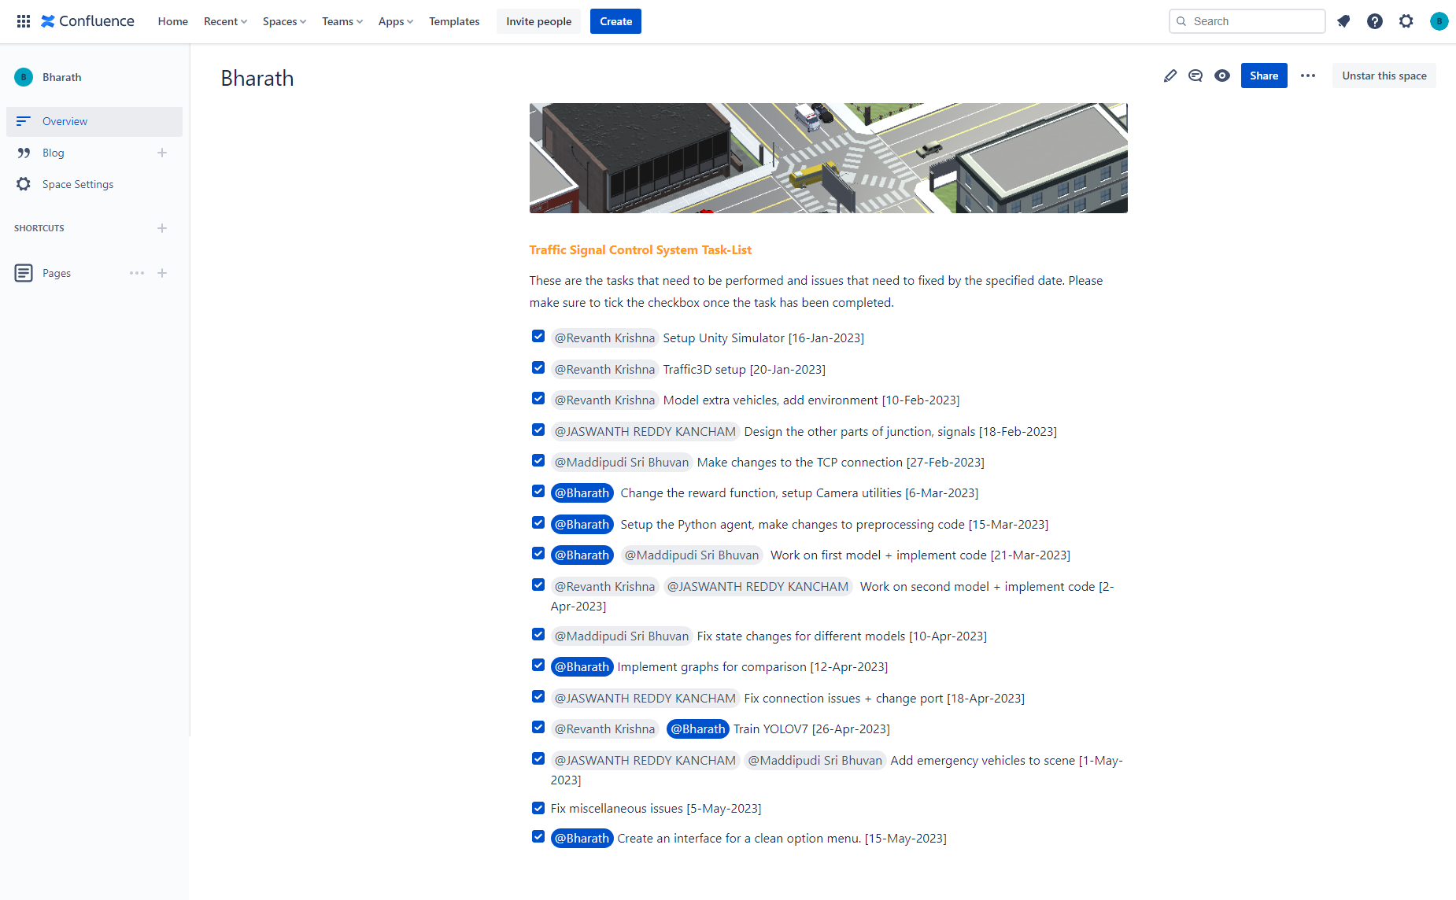
Project Management Tool
Atlassian Confluence

Slide 20
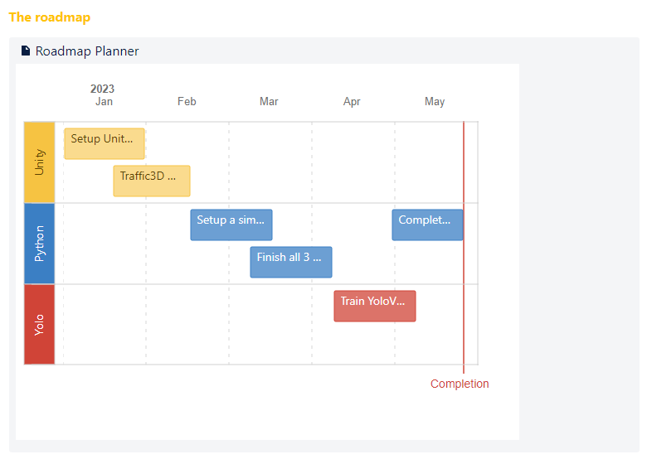
Project Management Tool
Atlassian Confluence

